Slide 1
Longfin Smelt entrainment relations
LFS Synthesis Team meeting
December 9, 2016
Source for Graphics and text: California Department of Fish and Game (CDFG). 2009. Effects Analysis -- State Water Project Effects on longfin smelt. California Department of Fish and Game. 58 pages plus appendices
Kimmerer, W. J., and M. L. Nobriga. 2008. Investigating particle transport and fate in the Sacramento-San Joaquin Delta using particle tracking model. San Francisco Estuary and Watershed Science 6(1, Article 4):26 pp.

Slide 2
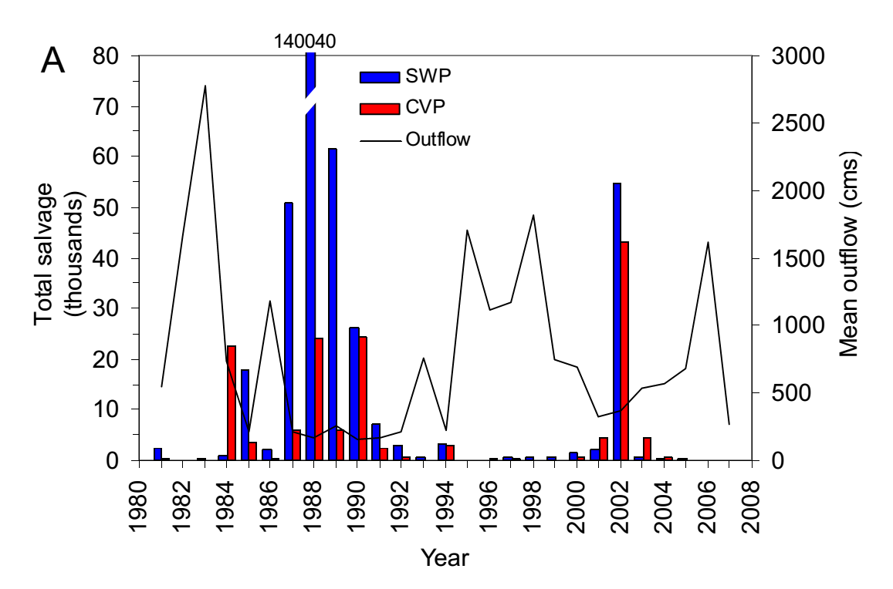
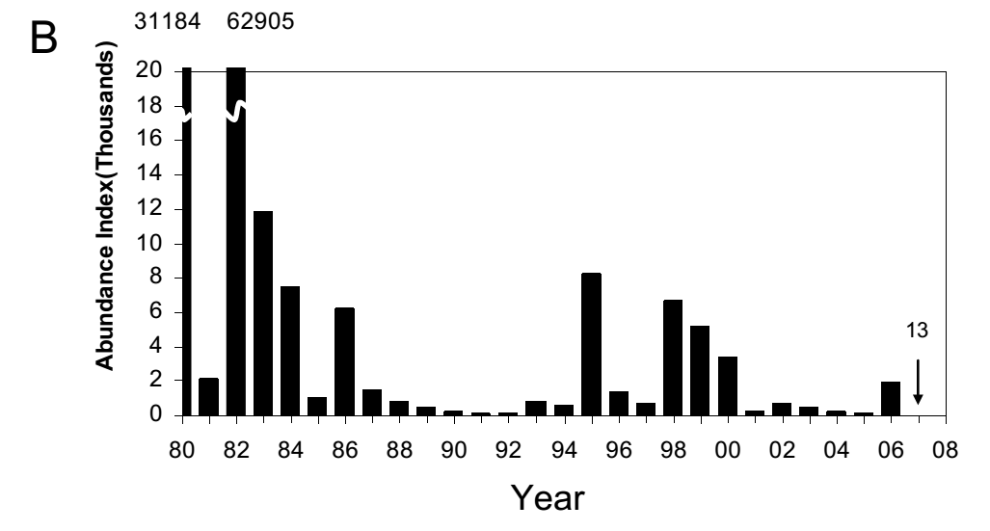
Longfin Smelt Salvage inversely related to outflow

Slide 3
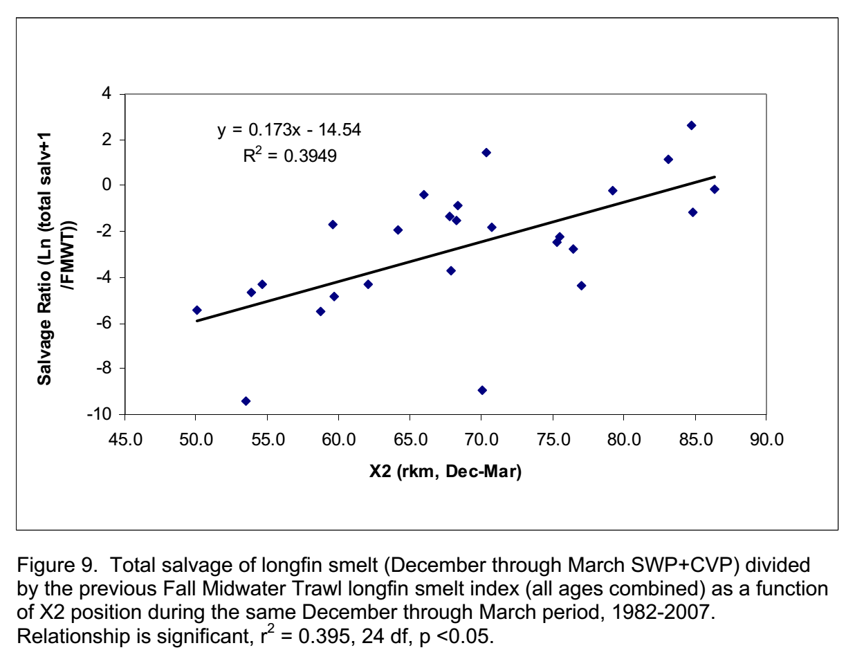
Longfin Smelt Salvage inversely related to outflow …
And influenced by current abundance

Slide 4
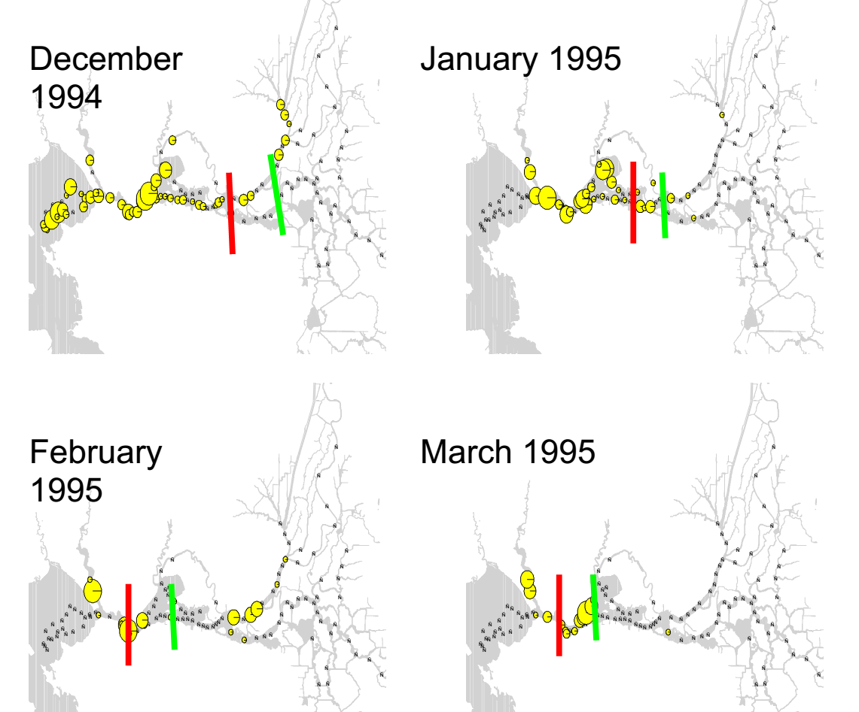
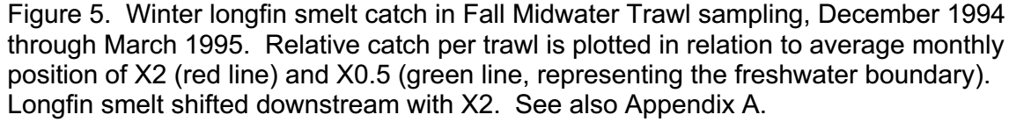
Outflow (X2) influences Longfin Smelt distribution

Slide 5
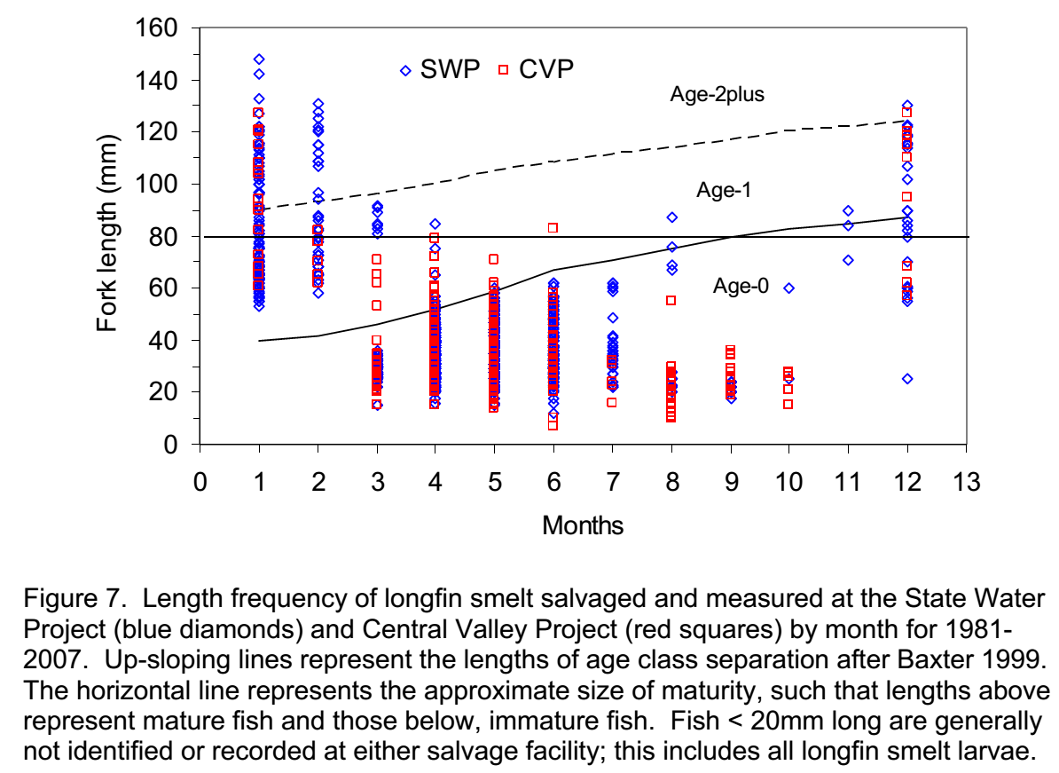
Most adult salvage Dec-Feb; juvenile salvage begins Mar, most Apr-Jun; larvae are not counted (or salvaged well; they are entrained)

Slide 6
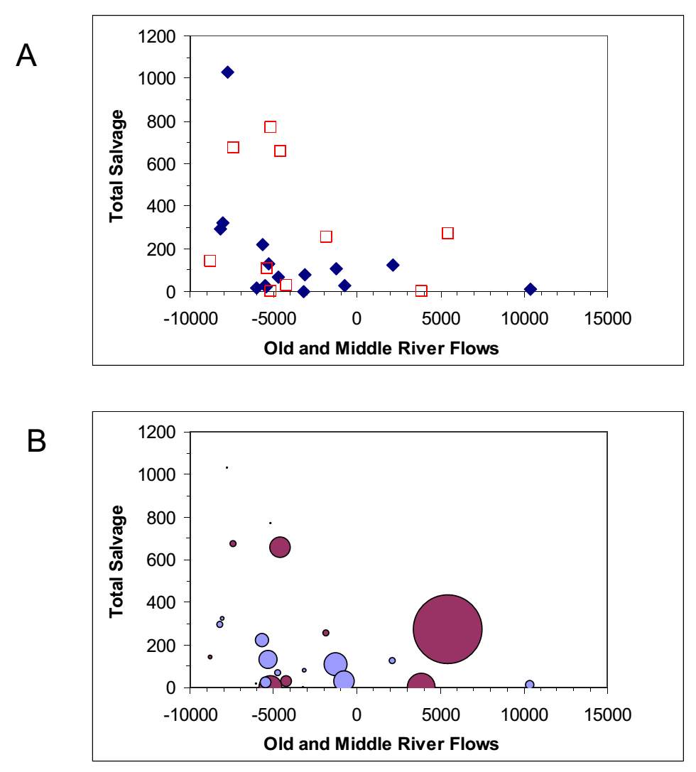
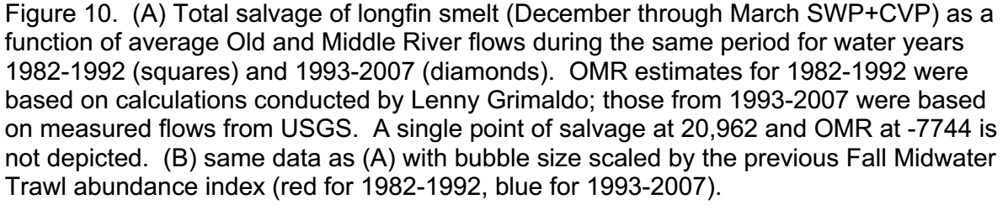
Relation between Old & Middle River flow and LFS Salvage
Same data as above, with circles scaled to FMWT LFS abundance

Slide 7
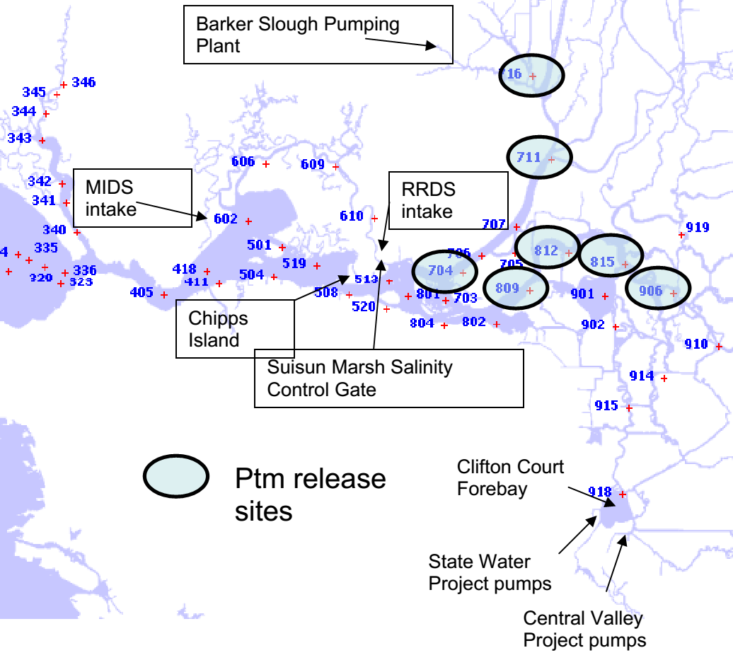
Tracking of surface oriented and neutrally buoyant particles (DSM2) used to assess entrainment of larvae
Notes:
PTM - seven injection sites , seven injection dates per year (Jan 1, 15, Feb 1, 15, Mar 1, 15, Apr 1), three water years used (1992, 2002, 2008). At each injection location, date, 5,000 particles injected continuously over 24 hrs and tracked for 90 days. Experiments were done twice injecting first neutrally buoyant and then surface oriented particles; the latter might better represent depth distribution of early larvae. We tallied final fates at 90th day: entered SWP or CVP, in agricultural diversions, passed Chipps Island, in Montezuma Slough, in North Bay Aquaduct.

Slide 8
Injection farther east = more chances for entrainment south
Inflow
Channel to
export pumps

Slide 9
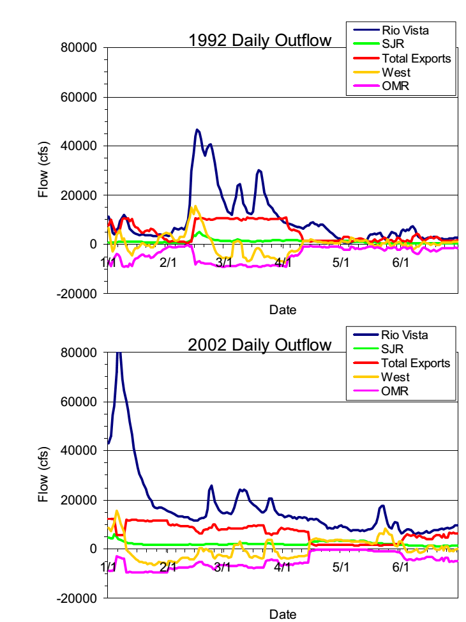
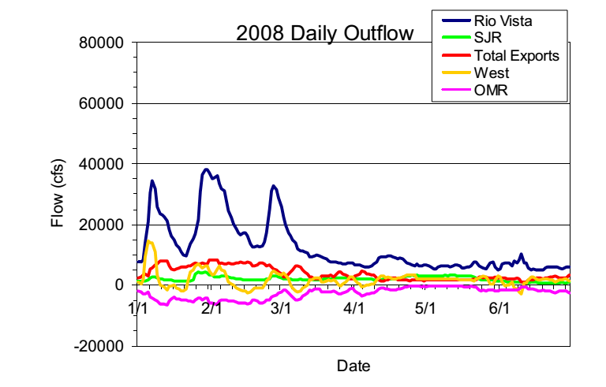
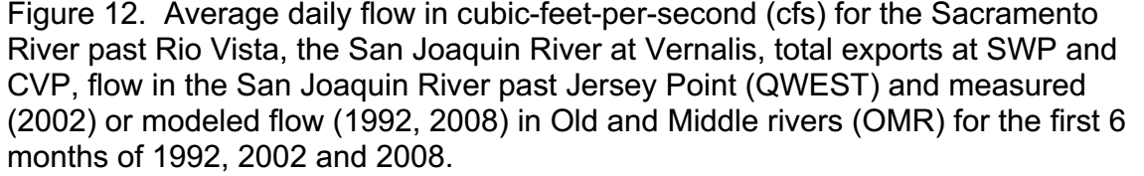
Flow years selected for PTM: 2 high salvage years, 2008 first year of BO regulated flows

Slide 10
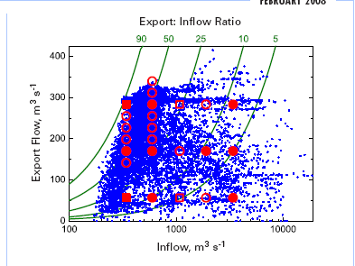
Historically, much of the time inflow was low-ish and exports relatively high
Source: Kimmerer and Nobriga 2008
Notes:
Big cloud around the 50 E:I line!

Slide 11
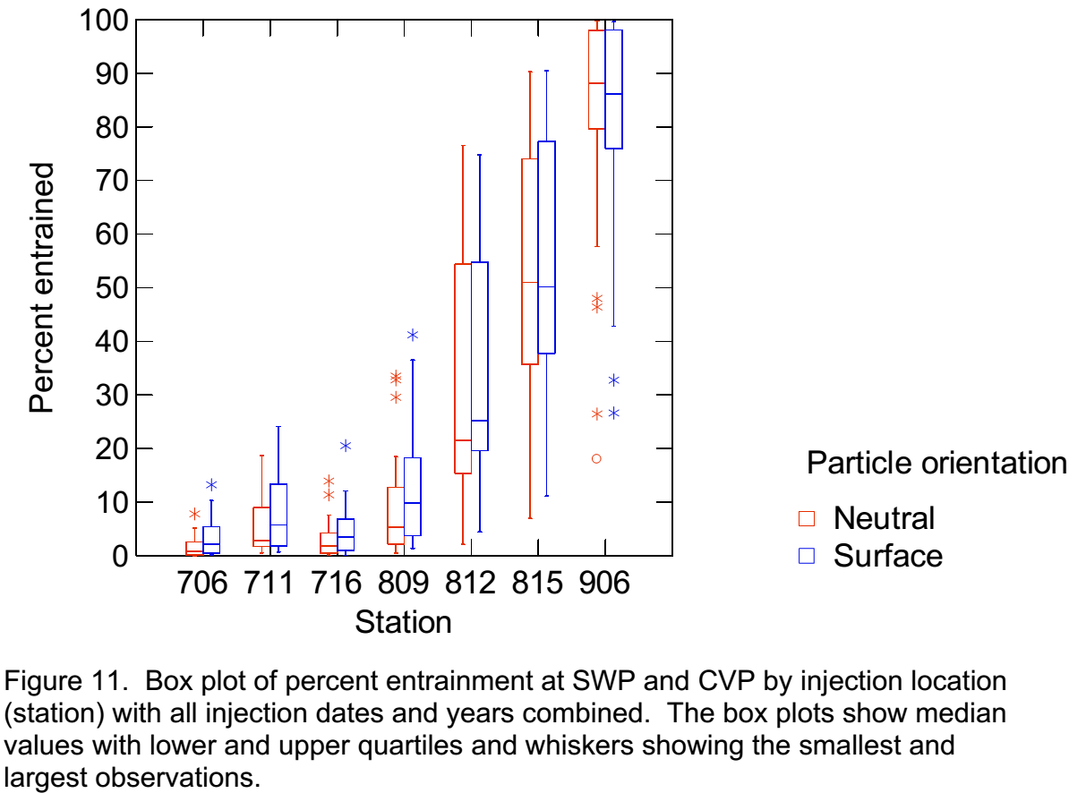
Particle (larva) entrainment in water exports influenced by injection (hatch) location

Slide 12
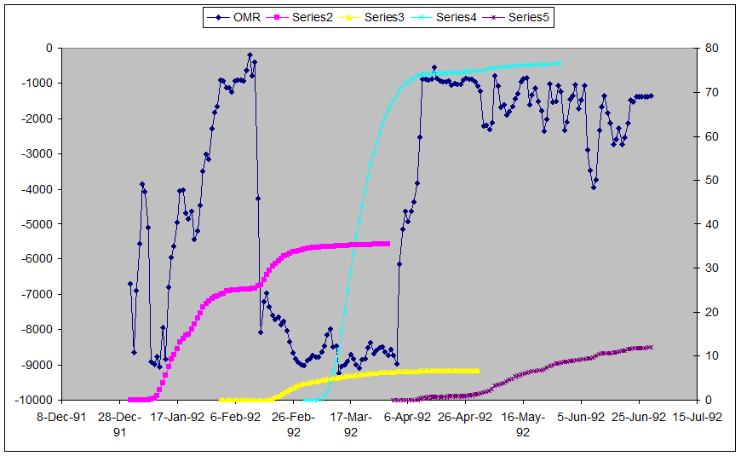
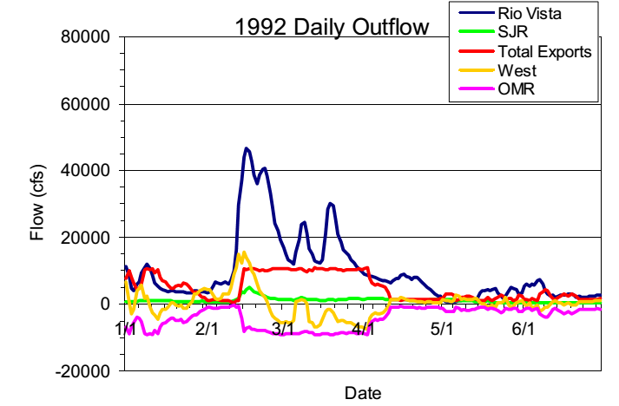
Particle fate highly dependent on conditions during and soon after injection
Arrow color at right matches colors for injected particles above
Notes:
Jan 1 (pink) – inject in brief period of strongly negative OMR, but shortly a more positive period and brief positive Qwest = downstream transport out of entrainment risk
Feb 1 (yellow) – injected in a couple weeks of low exports, but little net flow, but Qwest becomes strongly positive for a week+ before OMR
Mar 1 (turquois) – injected when OMR AND Qwest strongly negative. Even though Qwest becomes less negative almost all particles entrained
Apr 1 – initial situation the same as Mar 1, but quickly changed so majority of particles were not entrained in south Delta, and low exports and weakly positive Qwest allowed many to move past Chipps Island; some remained in Delta after 90 days (see CDFG 2009 fig 13).

Slide 13
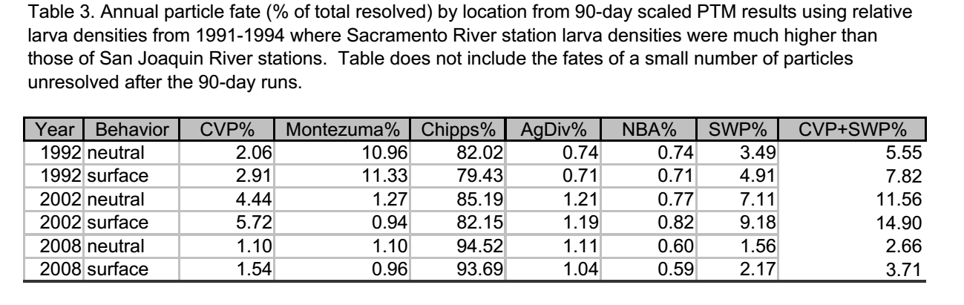
Estimated population-level entrainment effects on larvae were relatively low
Notes:
To assess population-level effects, particles were weighted to account for geographic and season patterns in hatch timing. Particles for each of the injection dates were weighted following the hatching pattern (CPUE of yolk sac larvae) determined from historical Bay Study data. Geographic weighting was based on 1991-1994 larva densities in the lower San Joaquin and Sacramento rivers

Slide 14
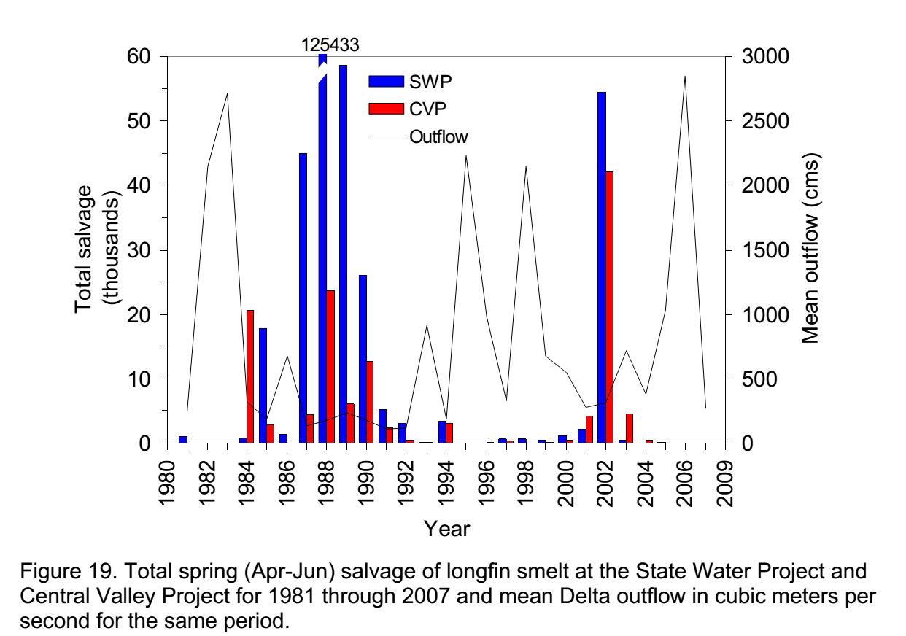
Pattern of entrainment for juveniles (>20 mm FL) similar to that of adults

Slide 15
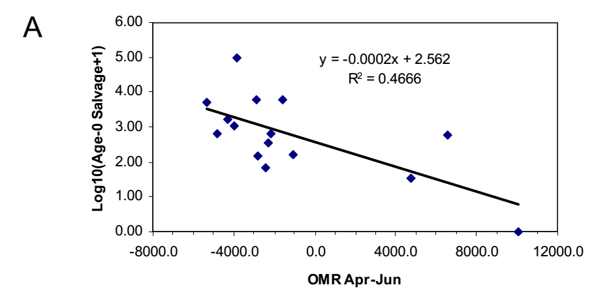
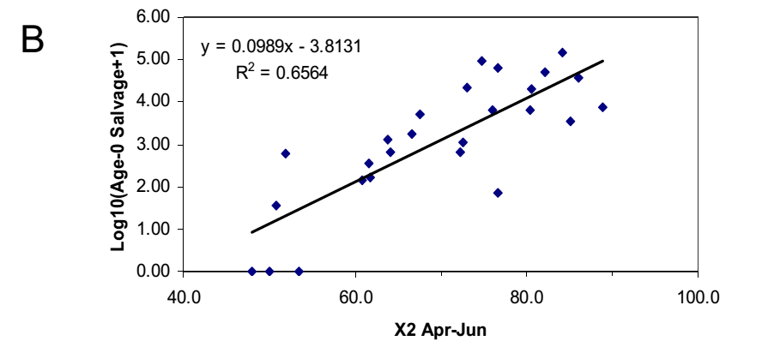
Juvenile salvage is a function of OMR flows and X2 like adults

Slide 16
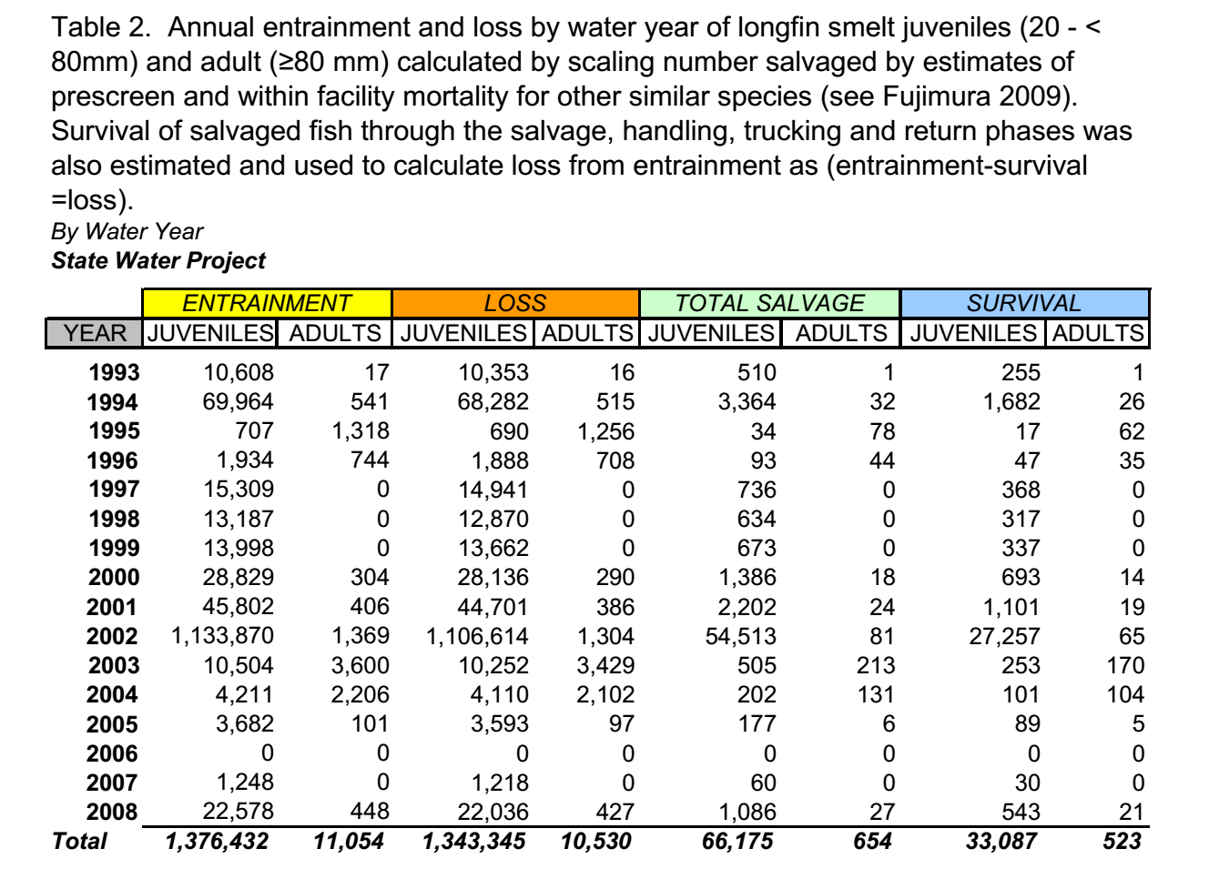
Years selected

