Slide 1
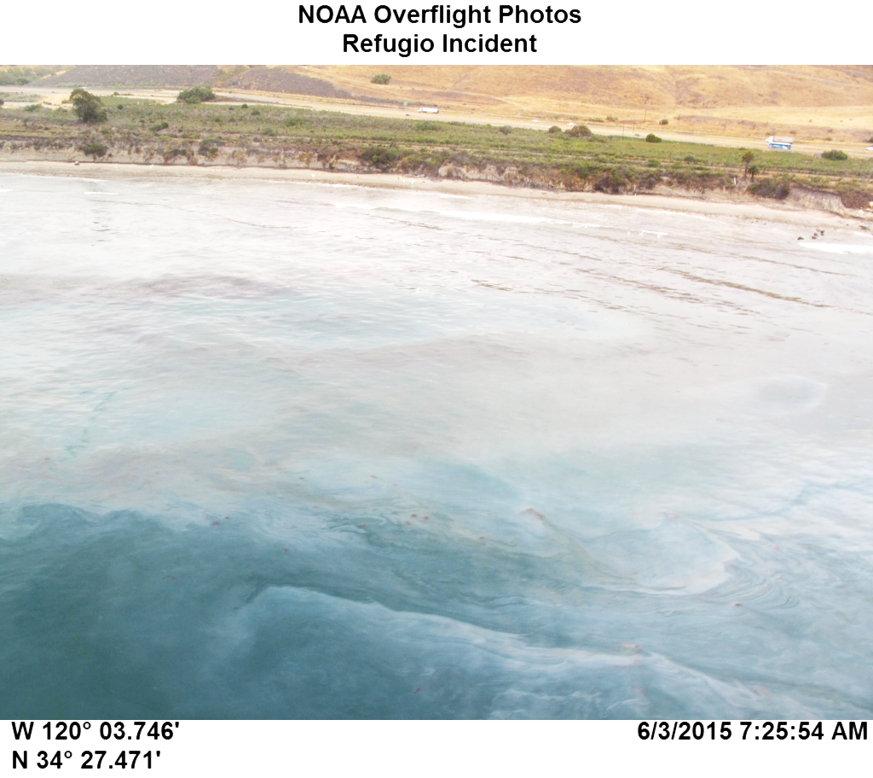
Refugio Oil Spill Response & Recovery
California Coastal Commission
June 10, 2015

Slide 2
Incident Summary
On 19 May 2015 at 1243, a Hazardous Materials Spill Report was submitted to the Governor’s Office of Emergency Services
The report indicated a 24-inch pipeline rupture that occurred near Refugio State Beach in Santa Barbara County, CA
The responsible party (Plains All American Pipeline) estimated the total release at 500 barrels (21,000 gallons) of crude oil on the shoreside of Hwy 101 which then flowed into the Pacific Ocean
Initial reports estimated a sheen to be 3.5 NM along the beach and 50-100 yards into the water

Slide 3
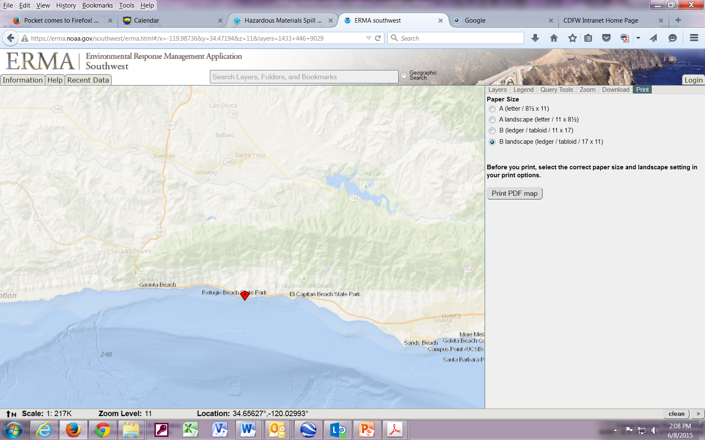
Location of Incident
(Approximately 25 miles west of Santa Barbara)

Slide 4
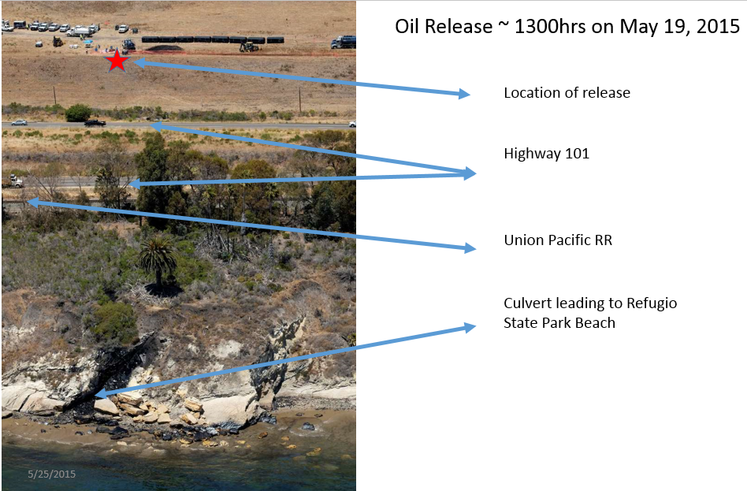

Slide 5
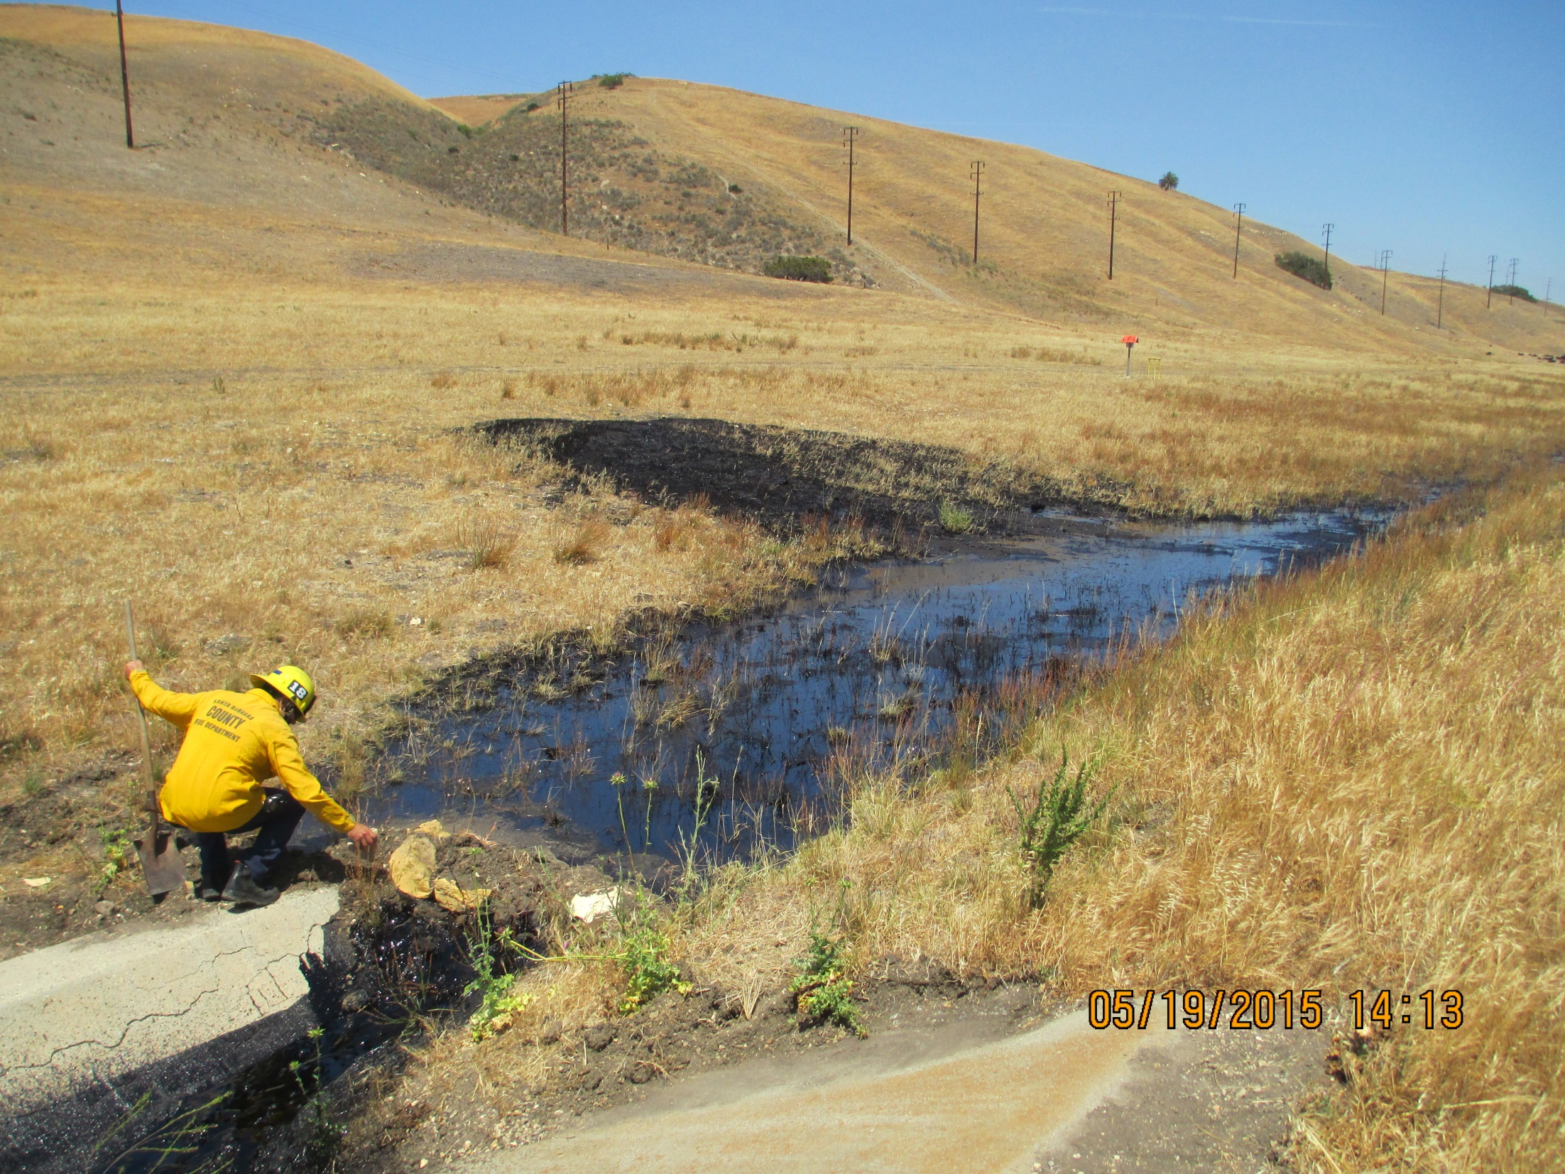
Release Site
(Replaced pipeline above Hwy 1 / 101)
Photo Courtesy of NOAA

Slide 6
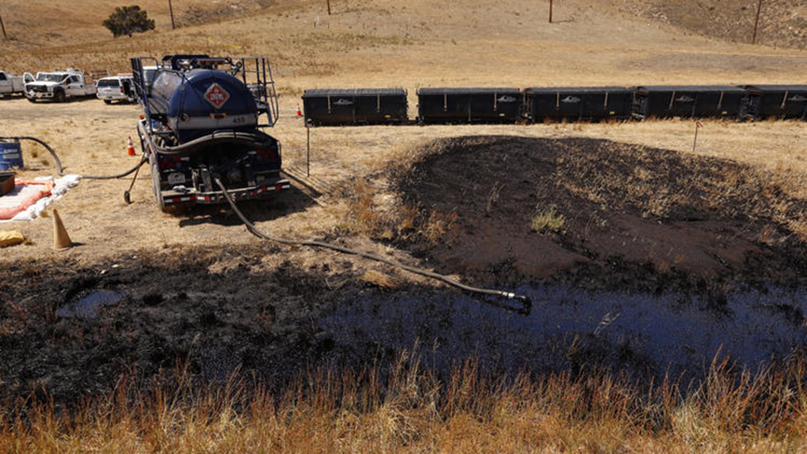

Slide 7
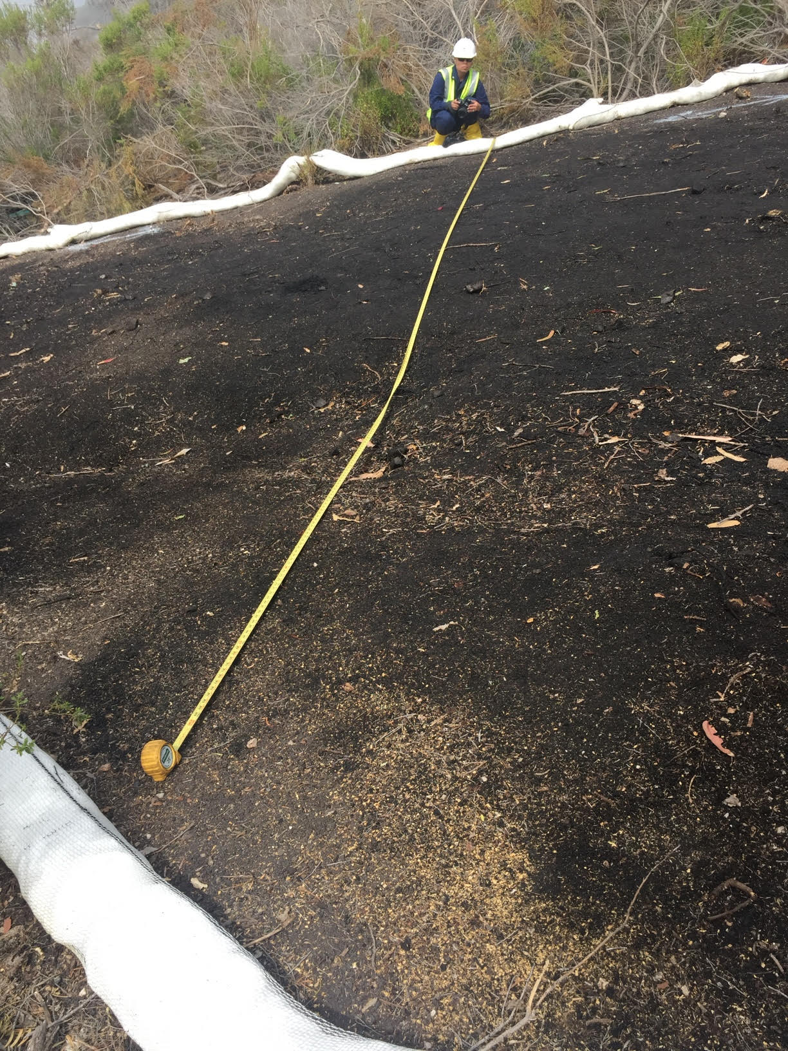
Photo Courtesy of NOAA

Slide 8
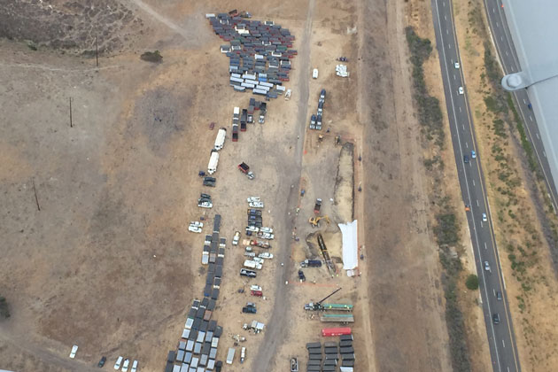
Photo Courtesy of noozhawk

Slide 9
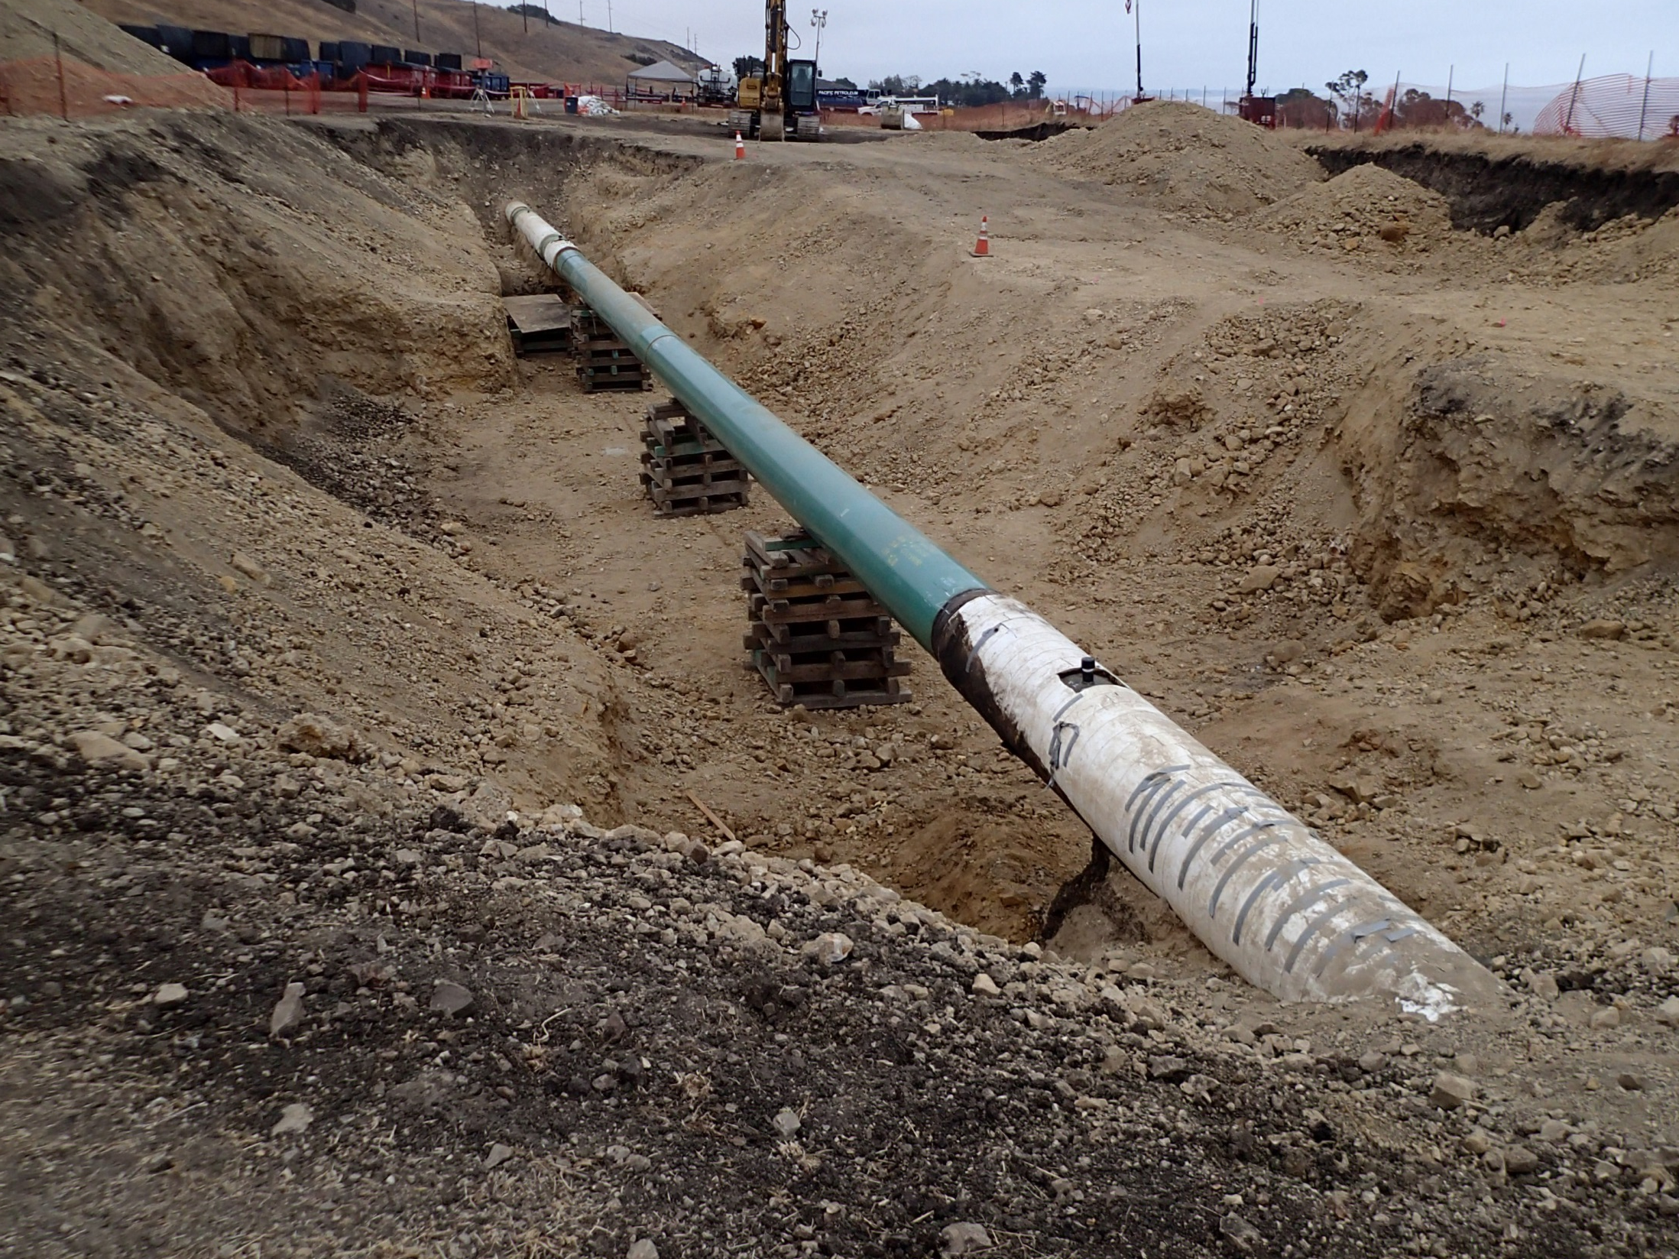
Pipeline Replacement
Photo Courtesy of CDFW-OSPR

Slide 10
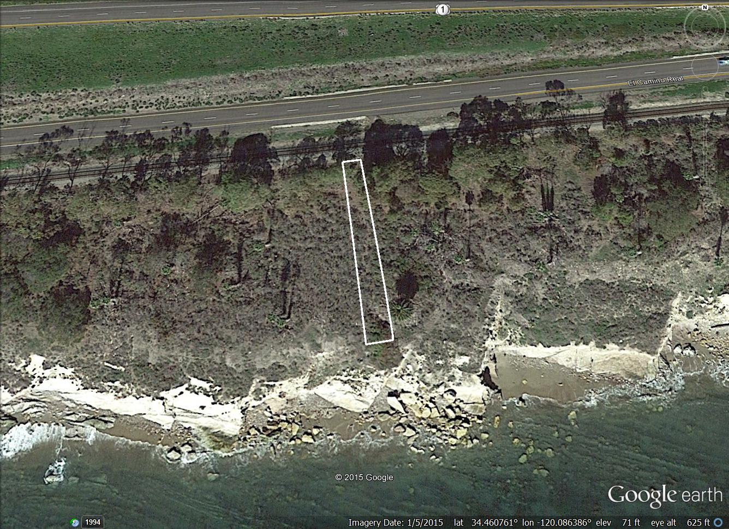
Contaminated Soil Removal
(Estimated dimensions: 250’ x 10’-50’ x 2’)

Slide 11
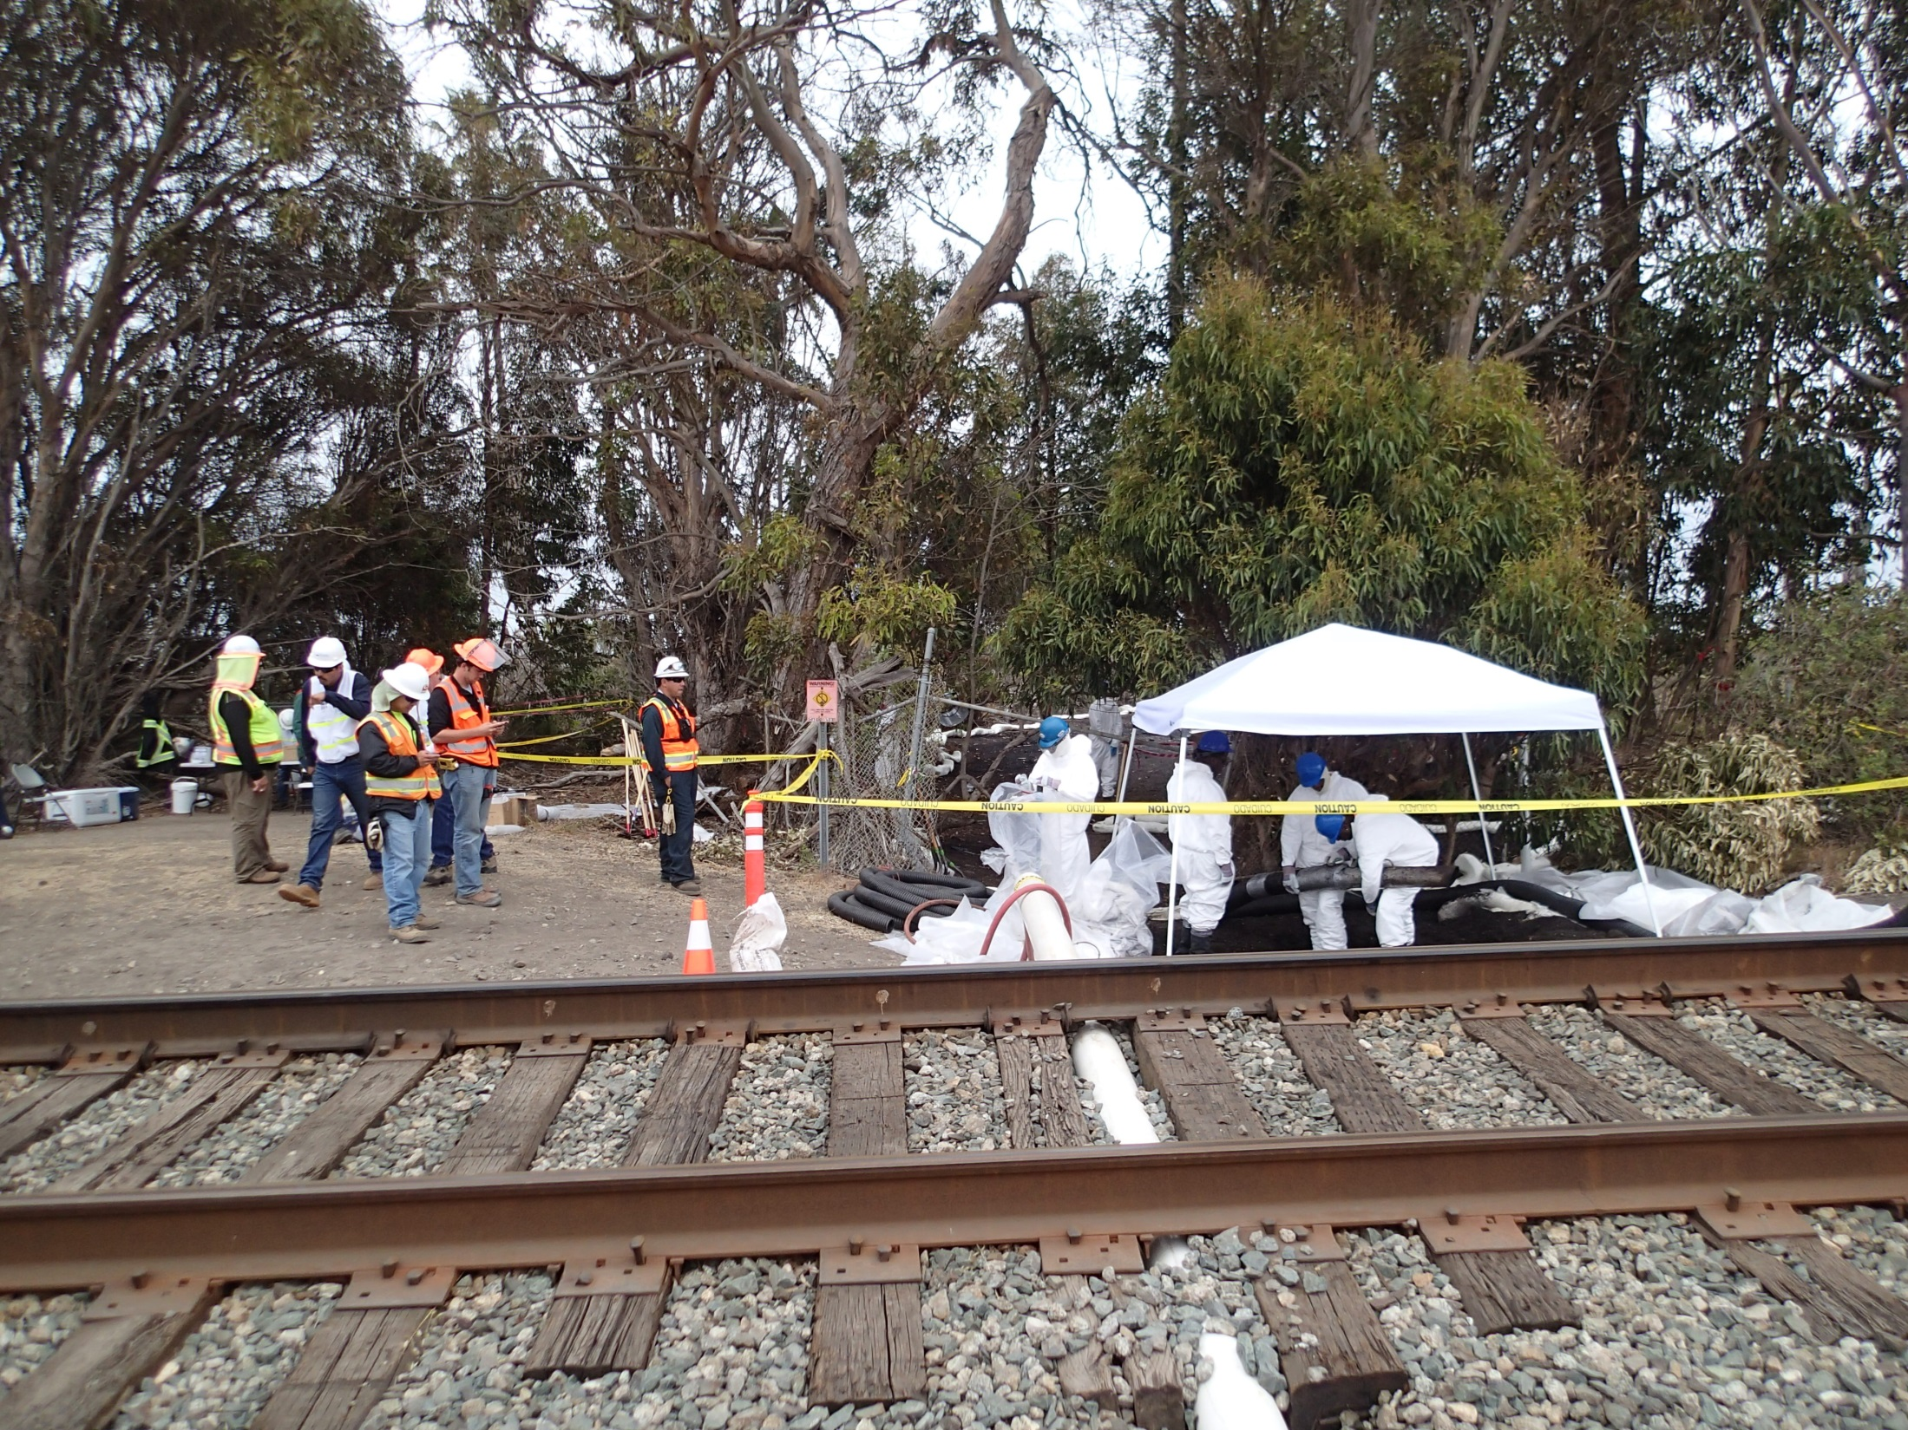
Location of Release
(below RxR line)
Photo Courtesy of CDFW-OSPR

Slide 12
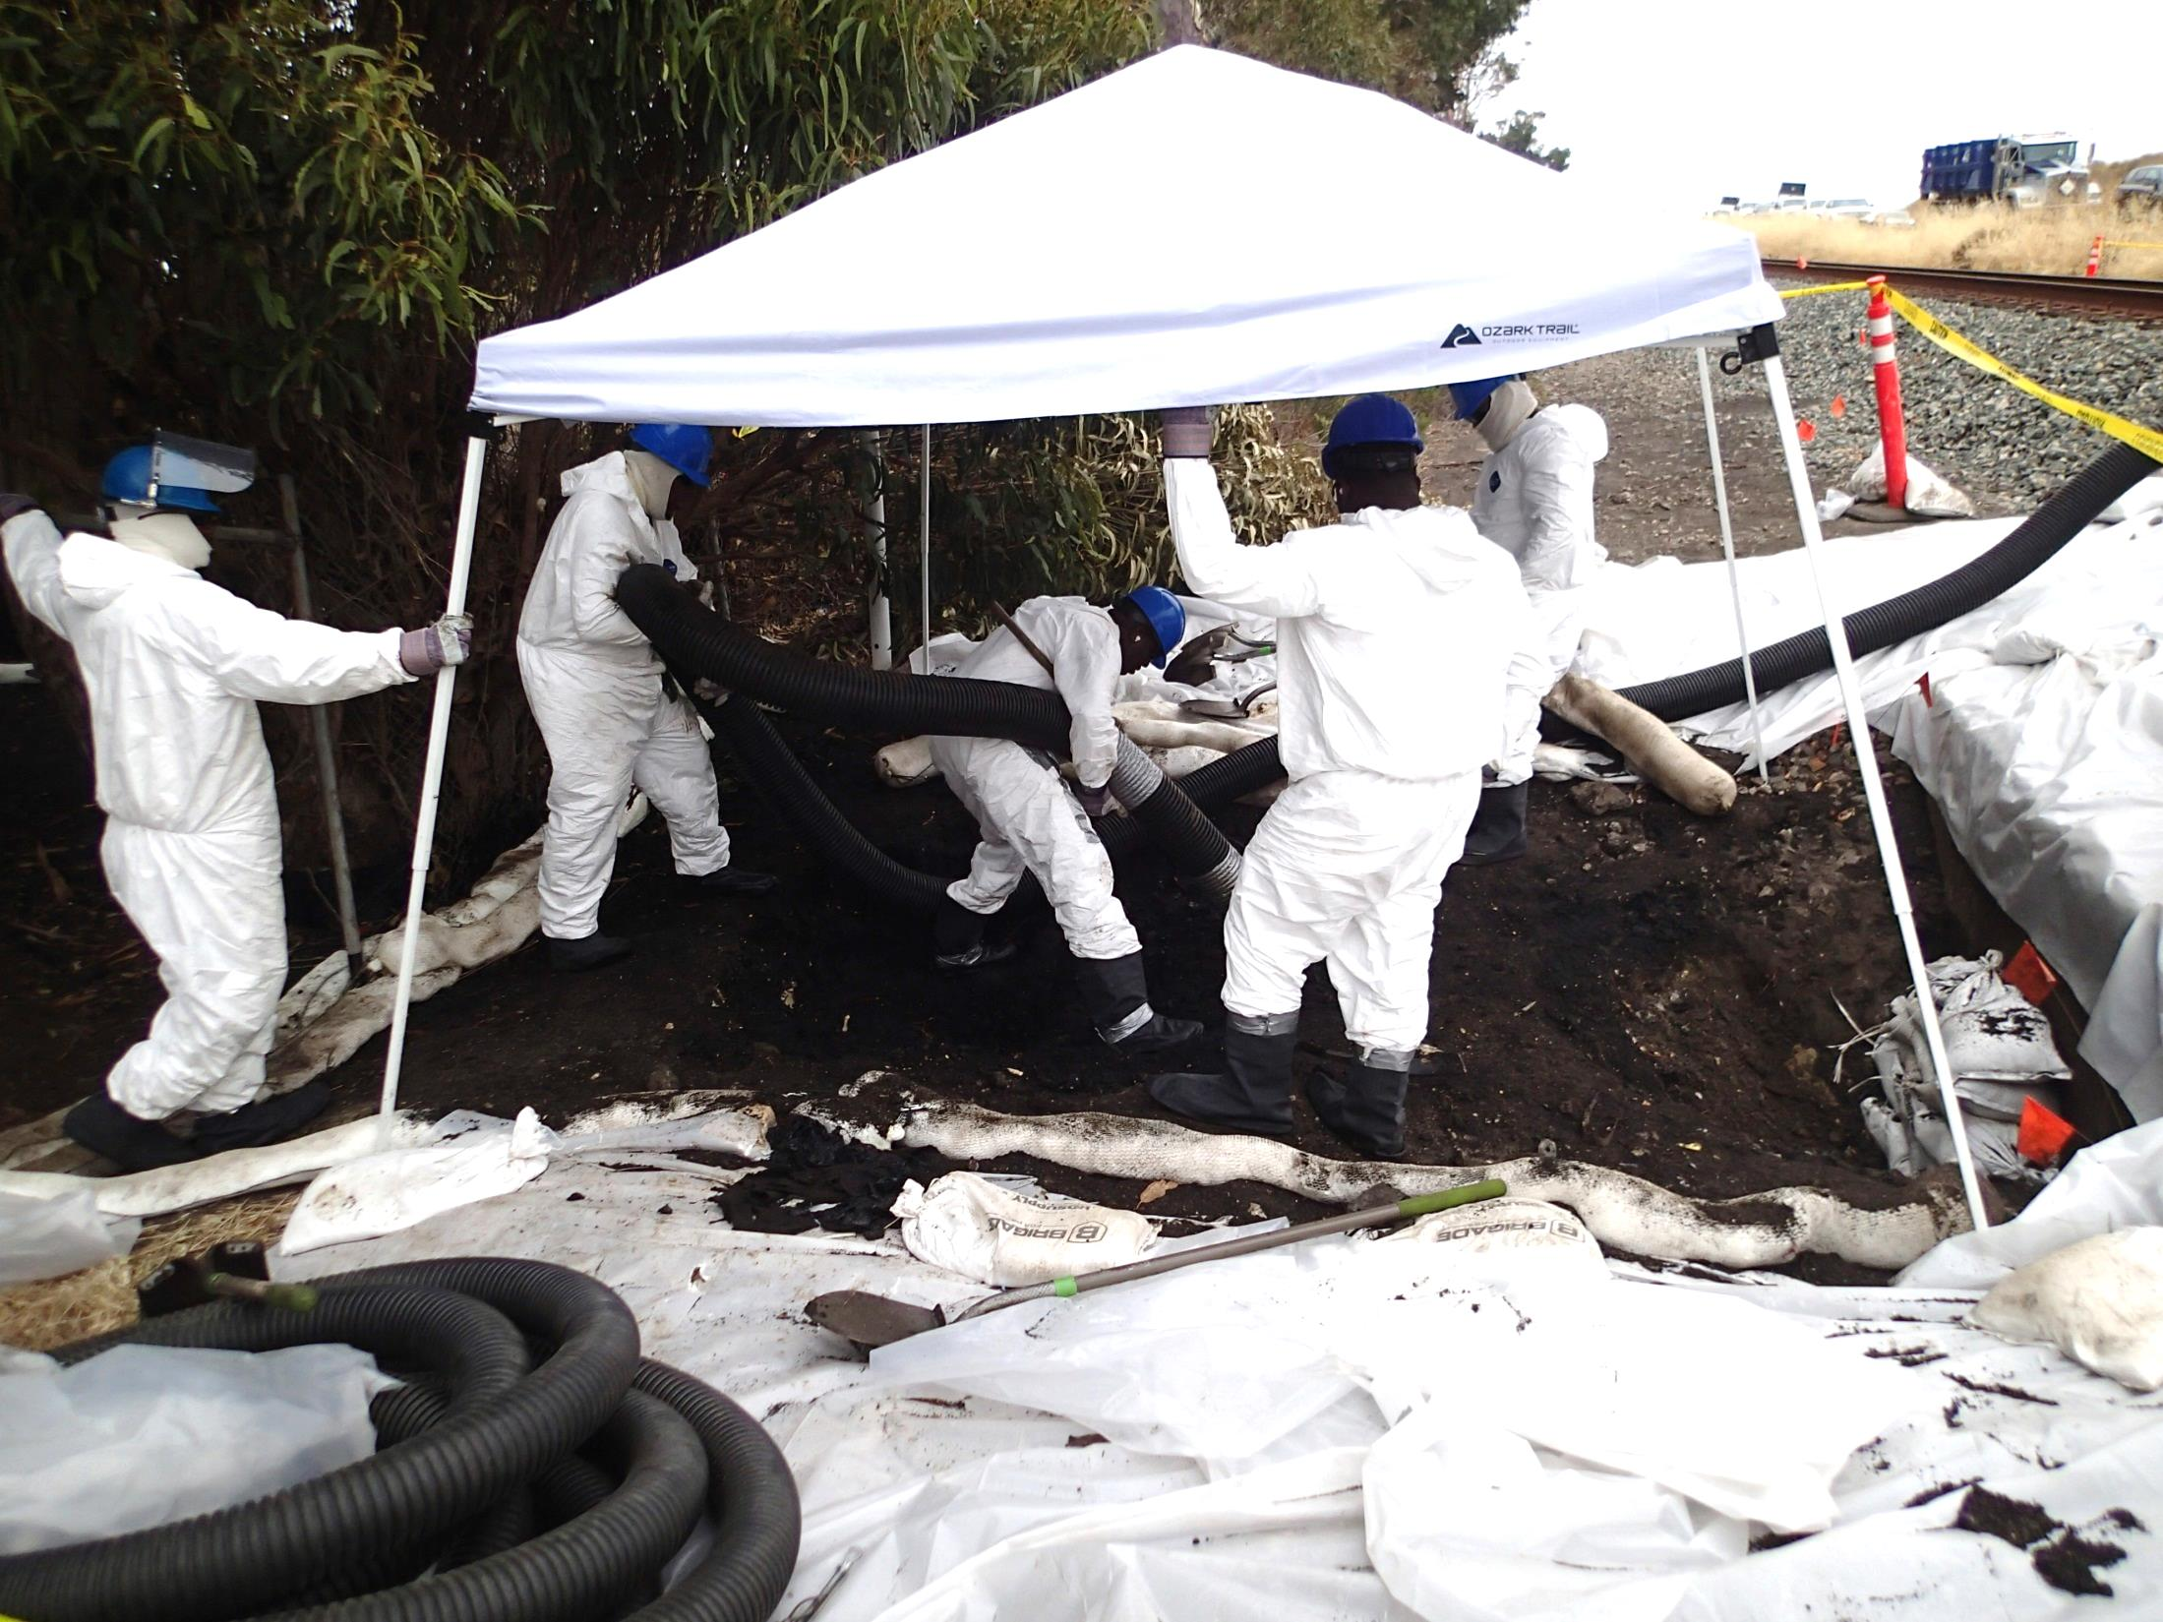
Contaminated
Soil Removal
Photo Courtesy of CDFW-OSPR

Slide 13
Current Operations:
Crane by the Hwy 1 / 101 will to lift dirt bins from excavation area to a staging area so they can be trucked away.
On the bluff, in addition to hand crews, a mini excavator and skid steer are being used to excavate about 2 feet of contaminated soil (area is 260x10-50 ft in dimension and about 500 cubic yards)
The operations are being monitored by US EPA, State Parks, Central Coast RWQCB, Santa Barbara County and cultural/tribal monitors

Slide 14
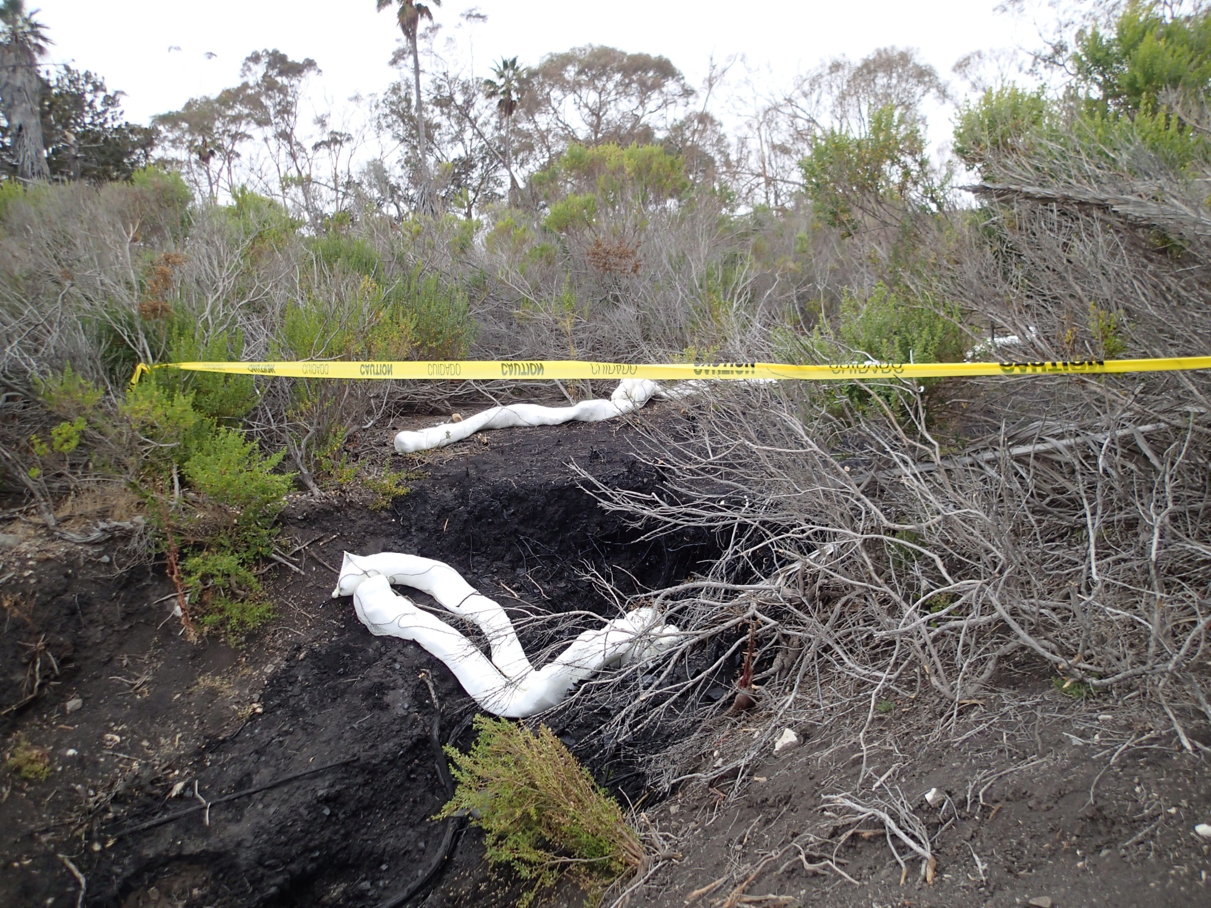
Slough area below the terrace
Photo Courtesy of CDFW-OSPR

Slide 15
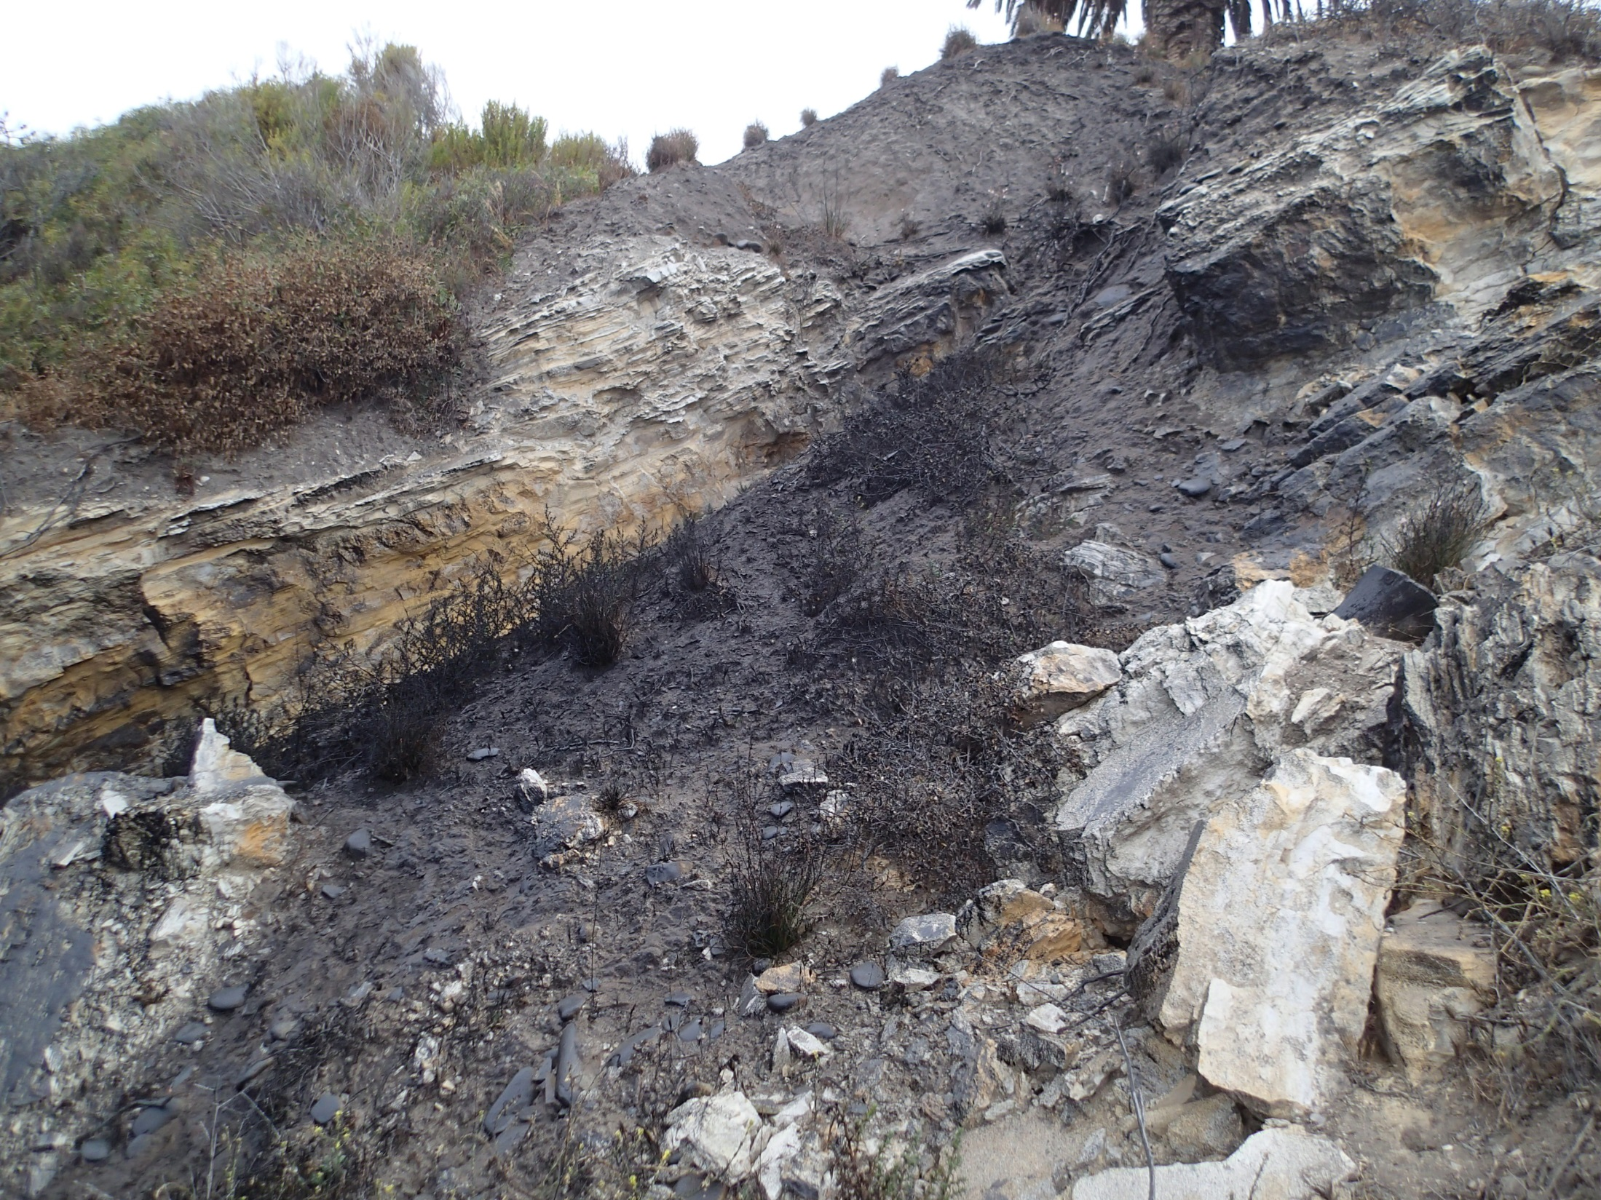
Cliff area below the terrace
Photo Courtesy of CDFW-OSPR

Slide 16
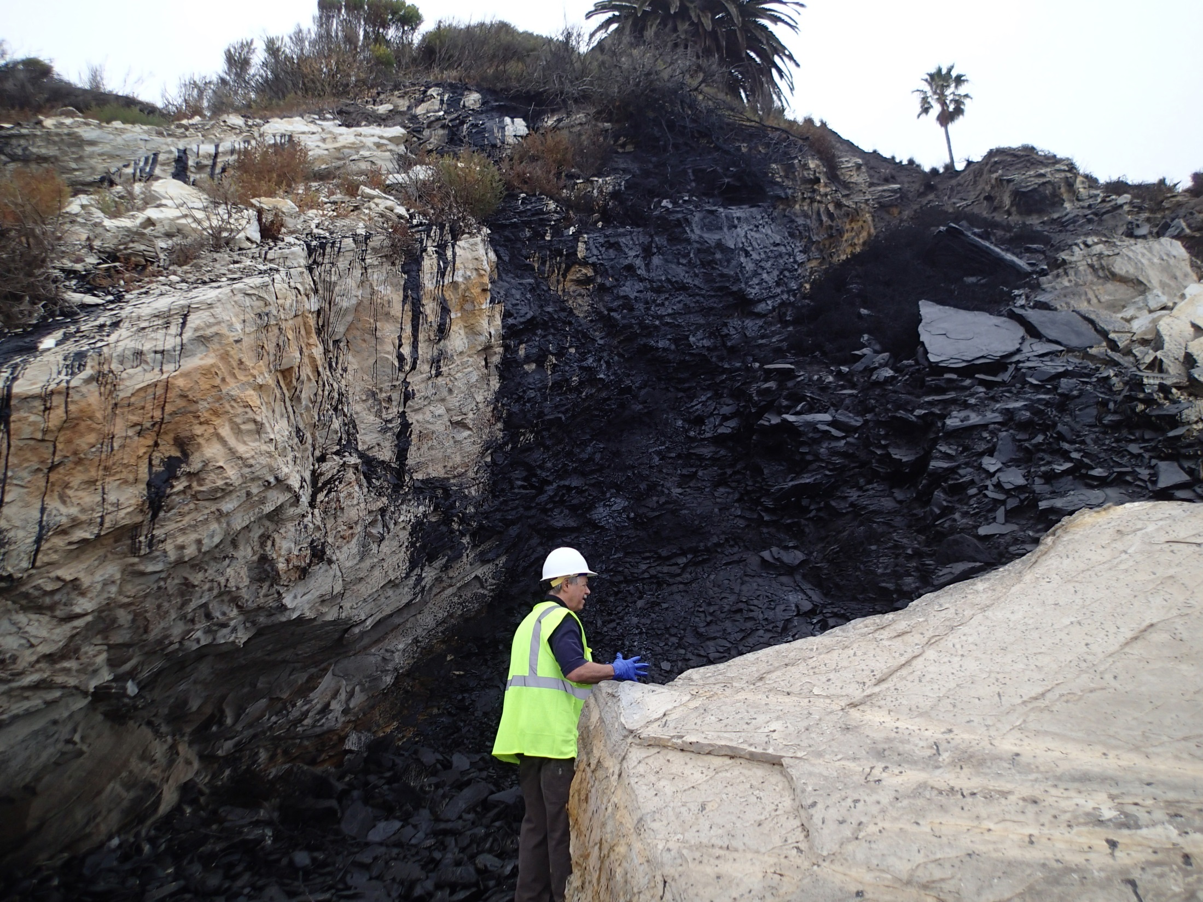
Cliff face and
upper intertidal area
Photo Courtesy of CDFW-OSPR

Slide 17
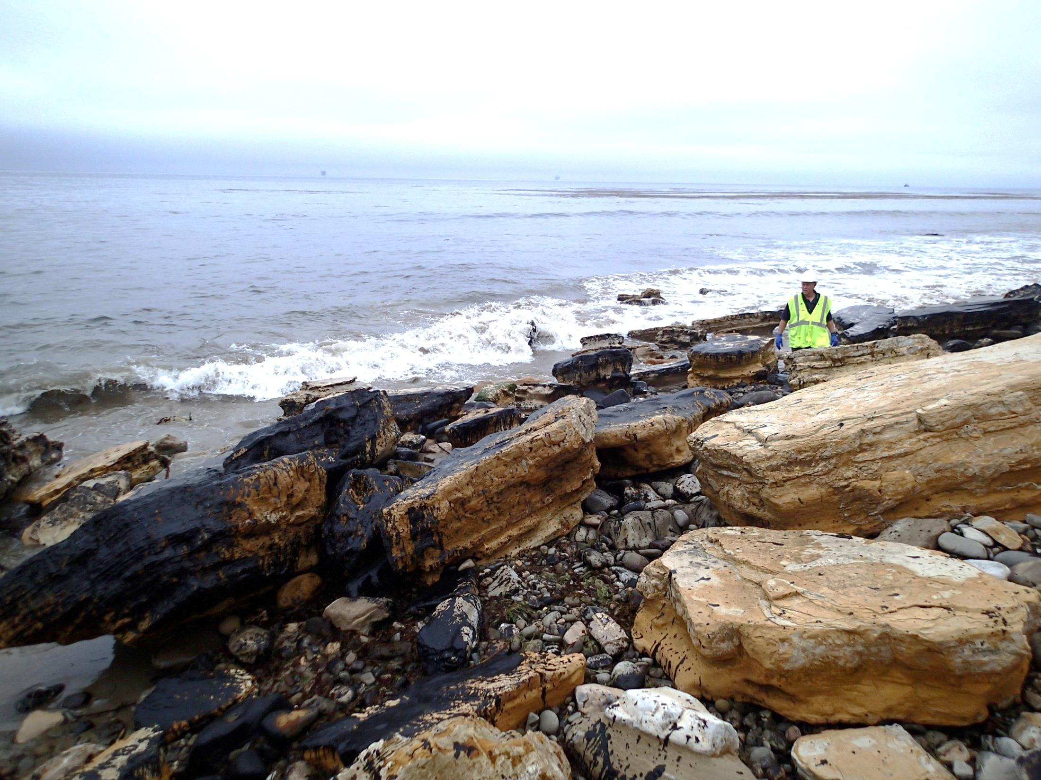
Shoreline below the cliff
Photo Courtesy of CDFW-OSPR

Slide 18
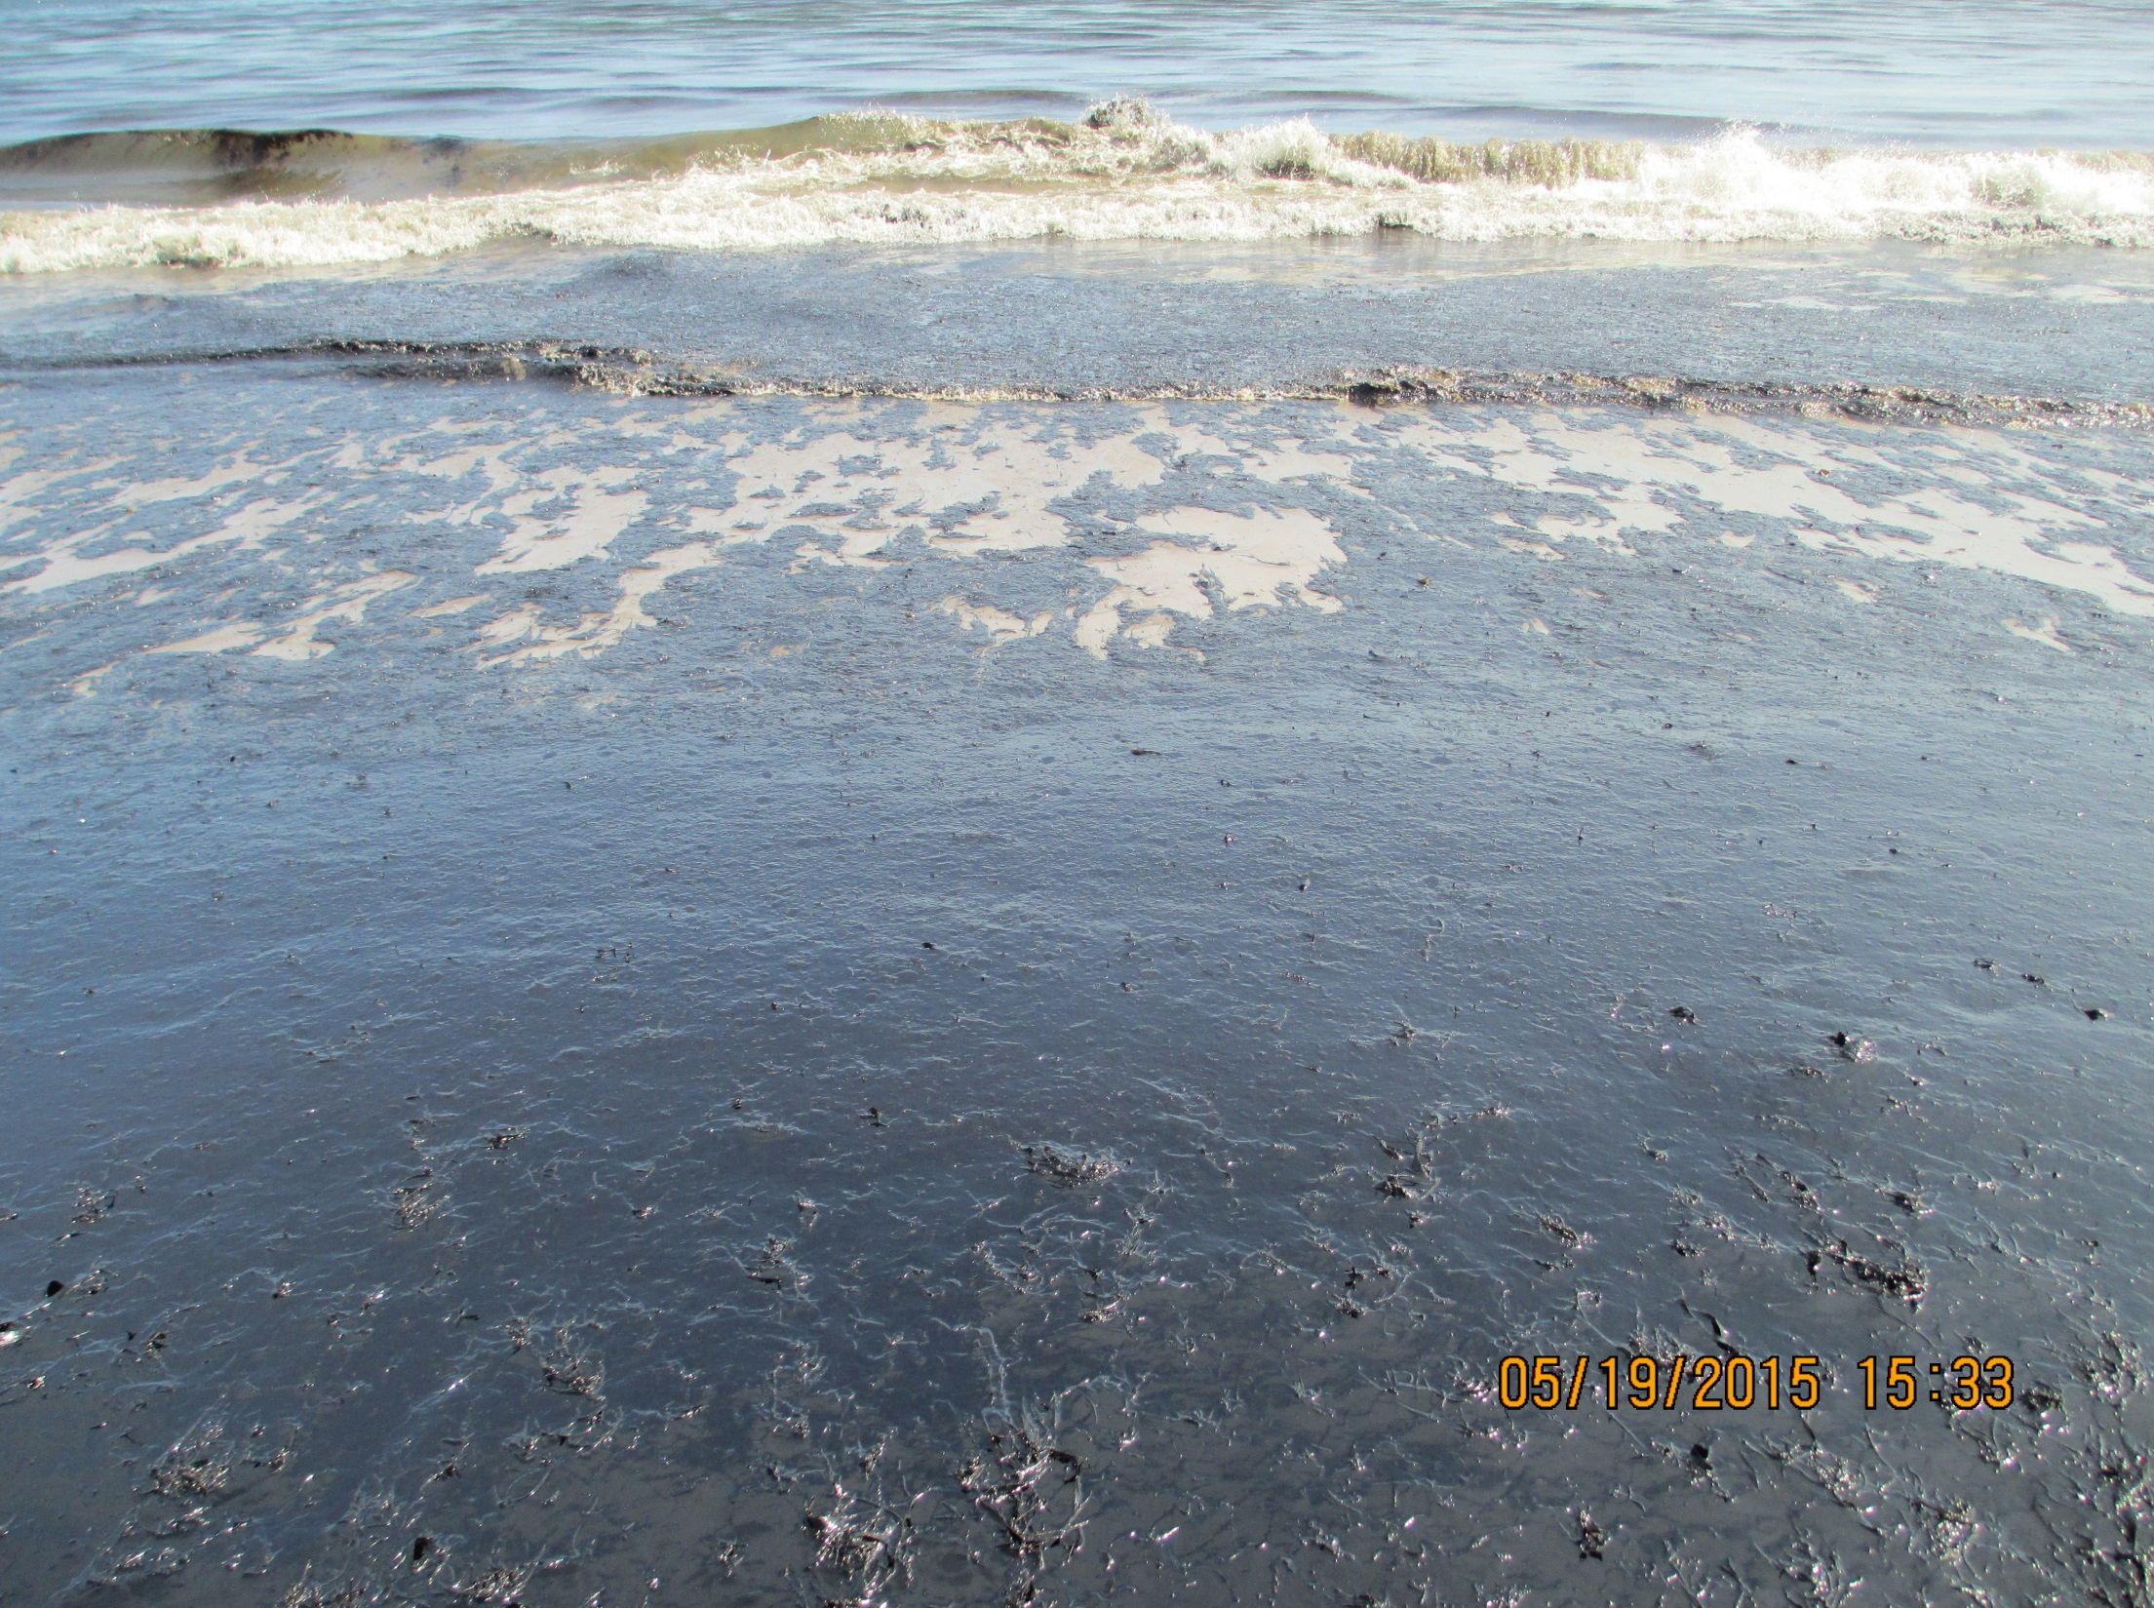
Other Shoreline Impacts
Photo Courtesy of NOAA

Slide 19
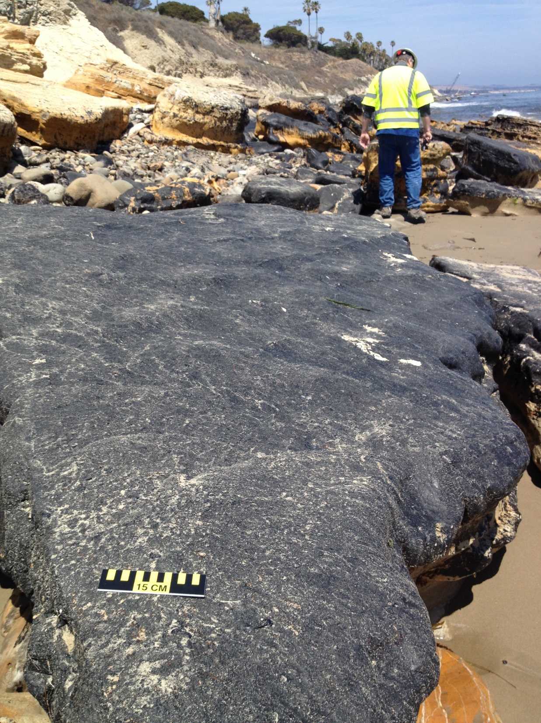
Photo Courtesy of NOAA

Slide 20
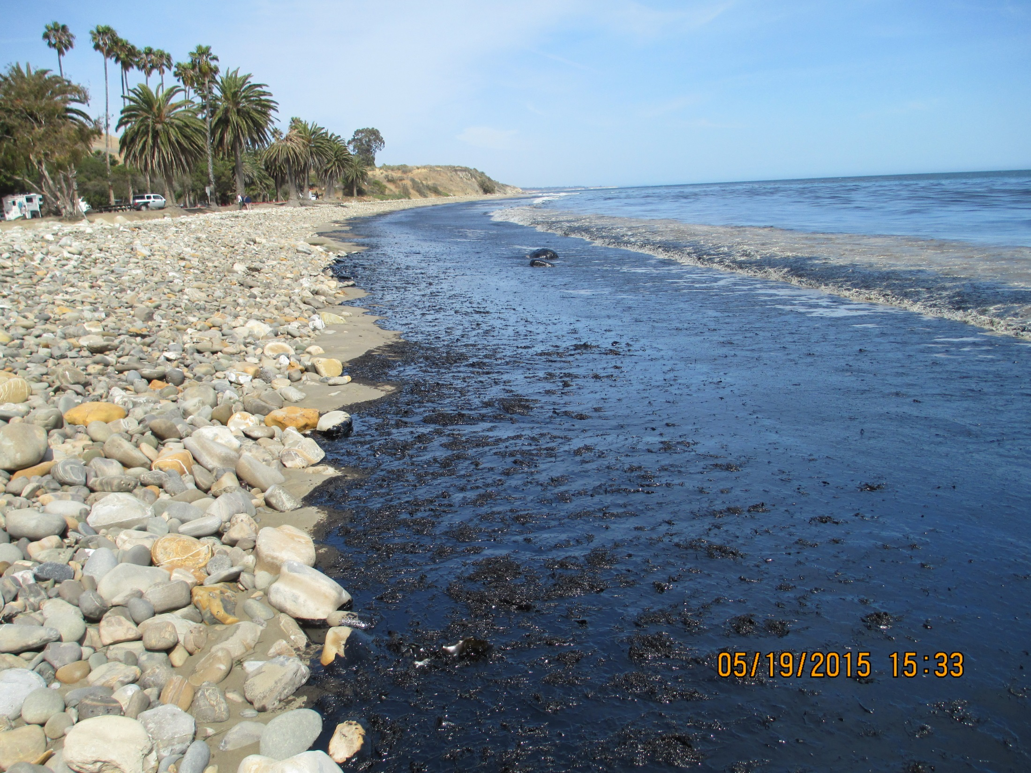
Refugio State Beach
Photo Courtesy of NOAA

Slide 21
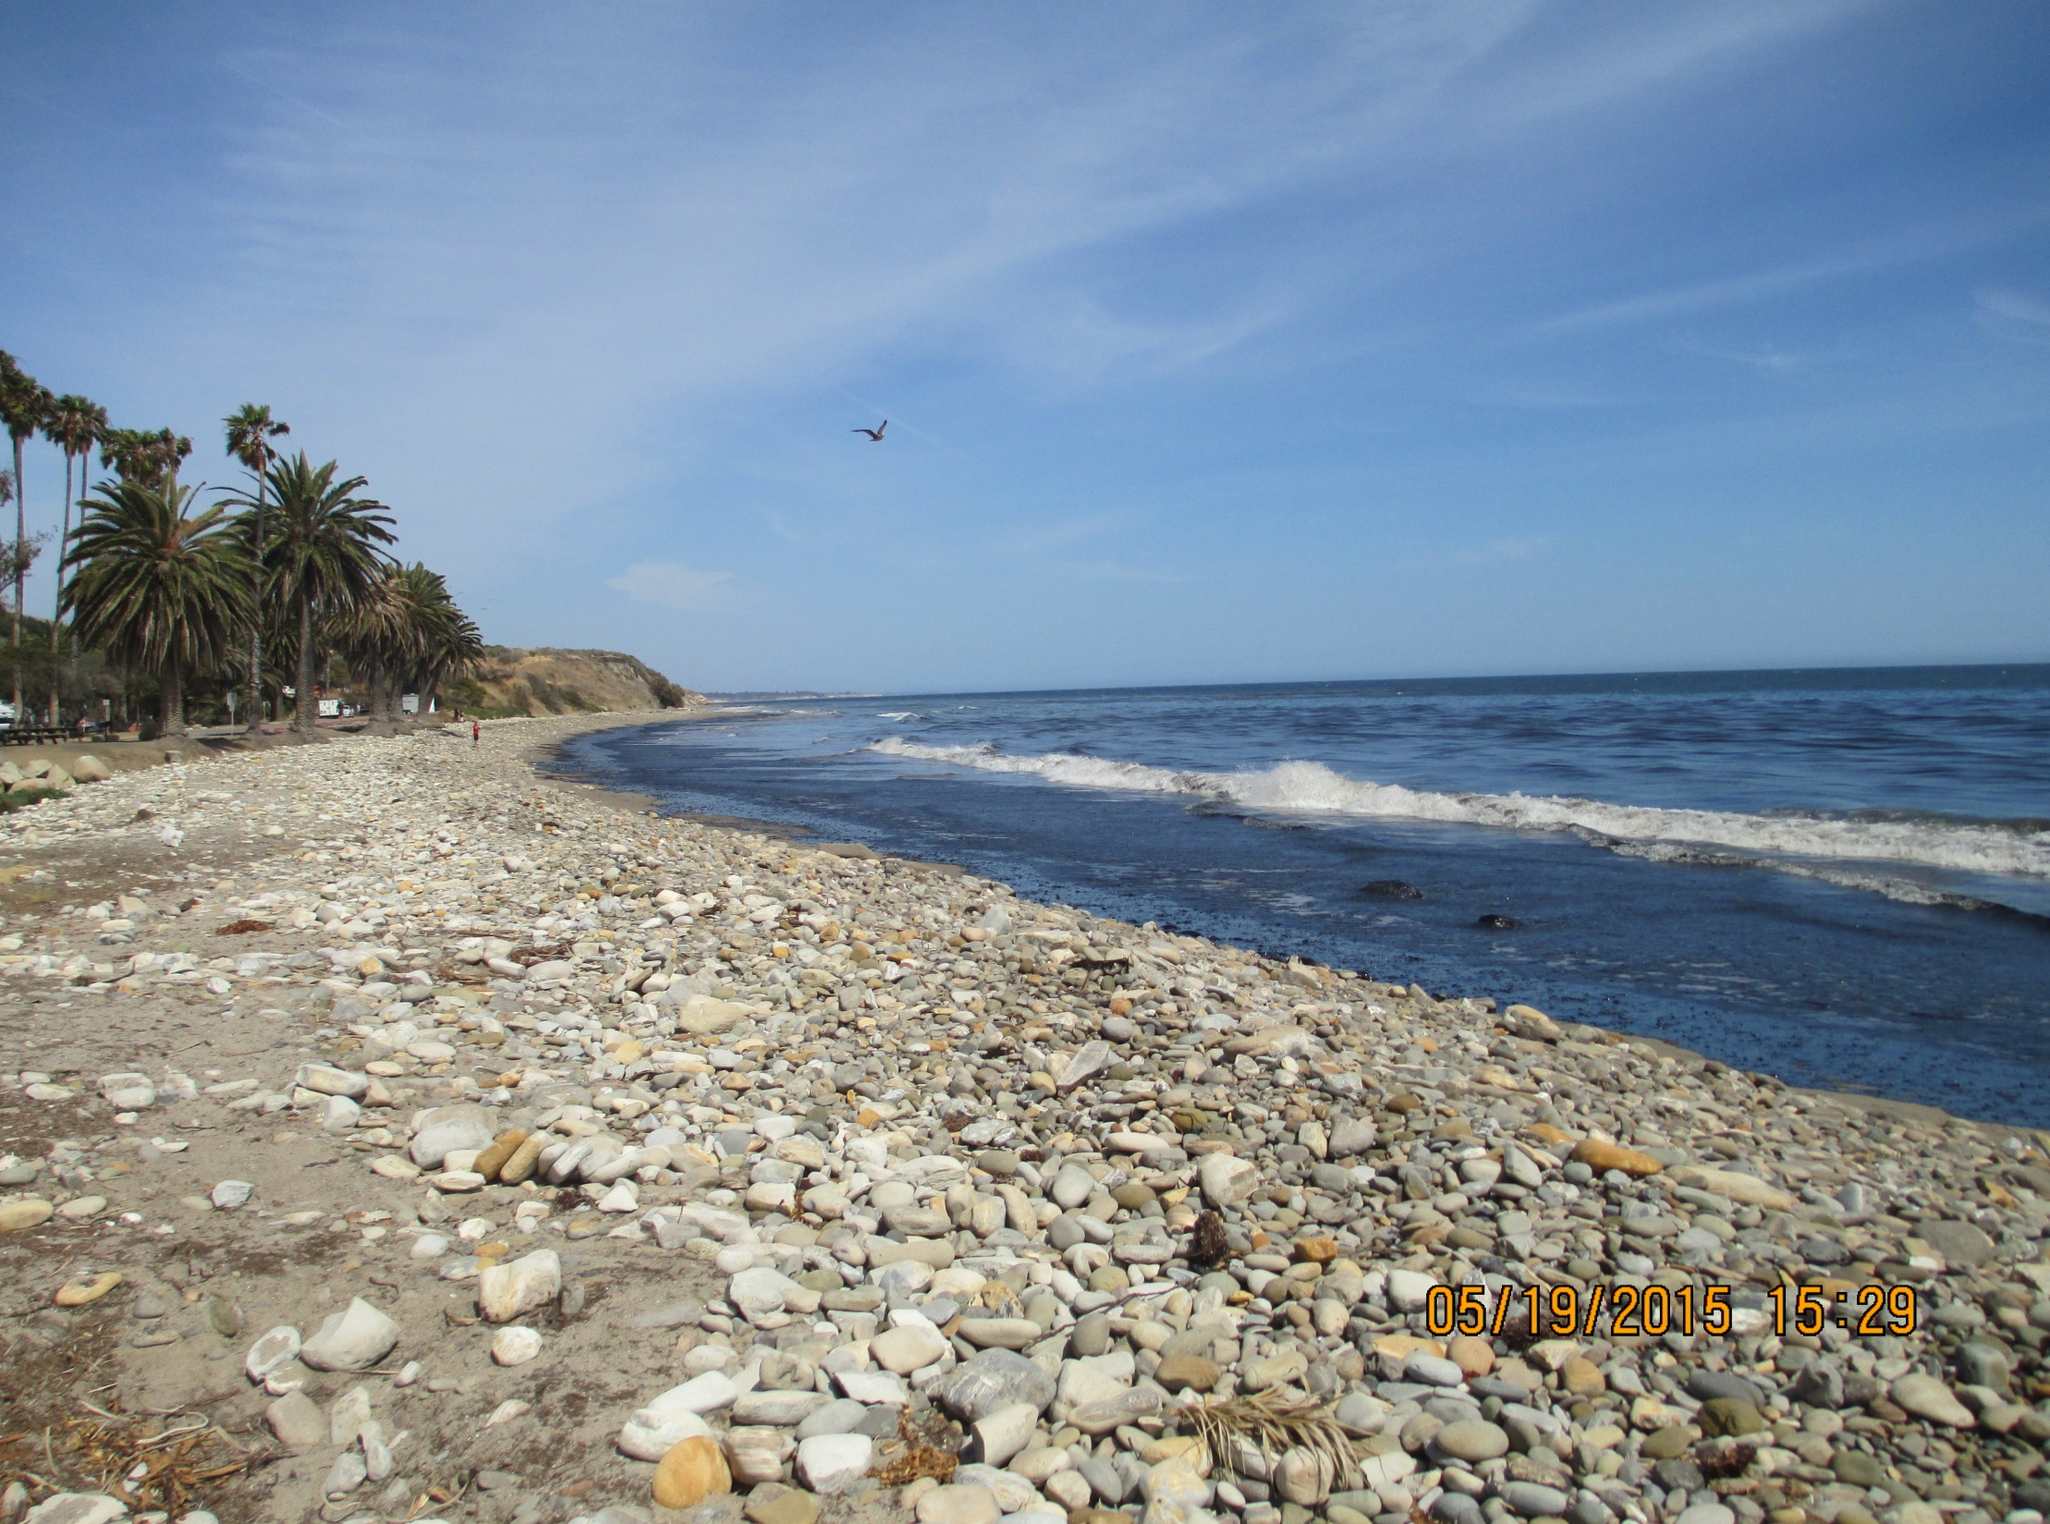
Refugio State Beach
Photo Courtesy of NOAA

Slide 22
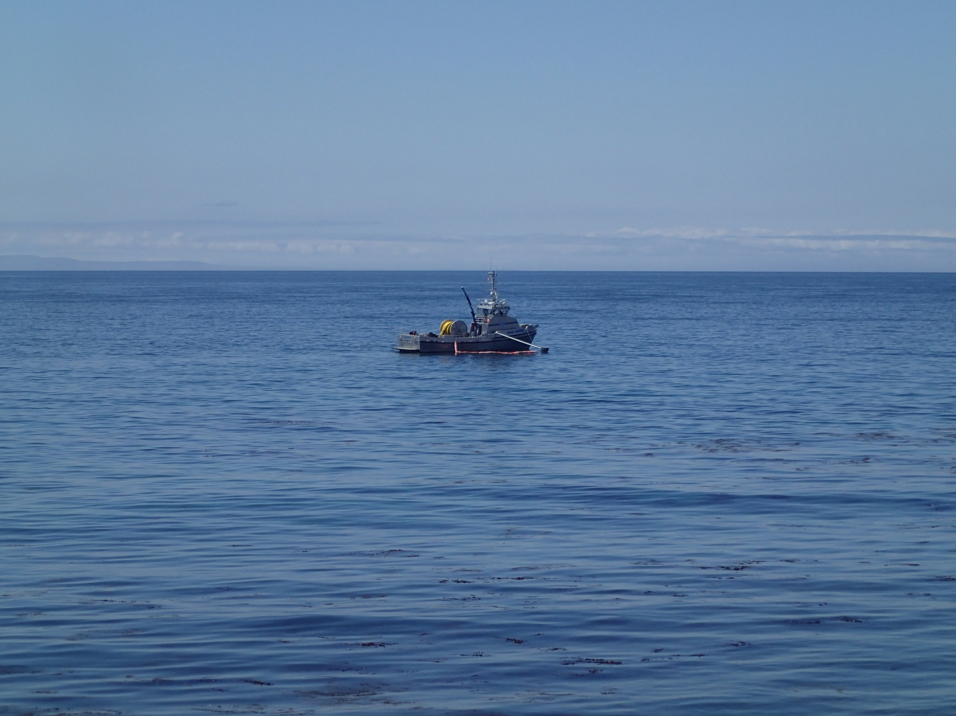
On-Water Operations
Photo Courtesy of CDFW-OSPR

Slide 23
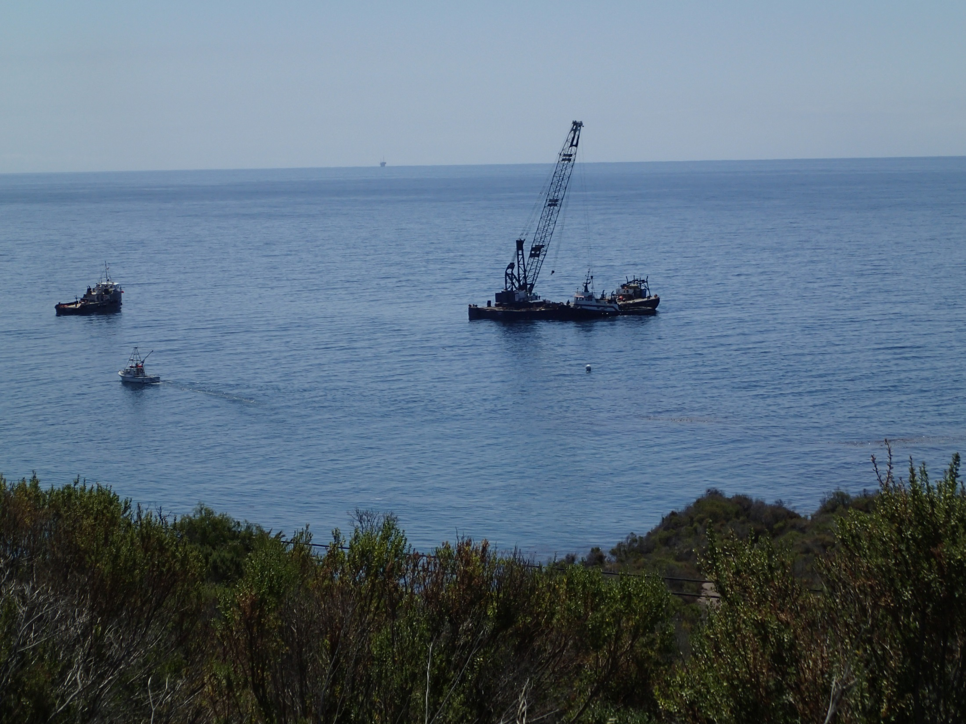
Photo Courtesy of CDFW-OSPR

Slide 24
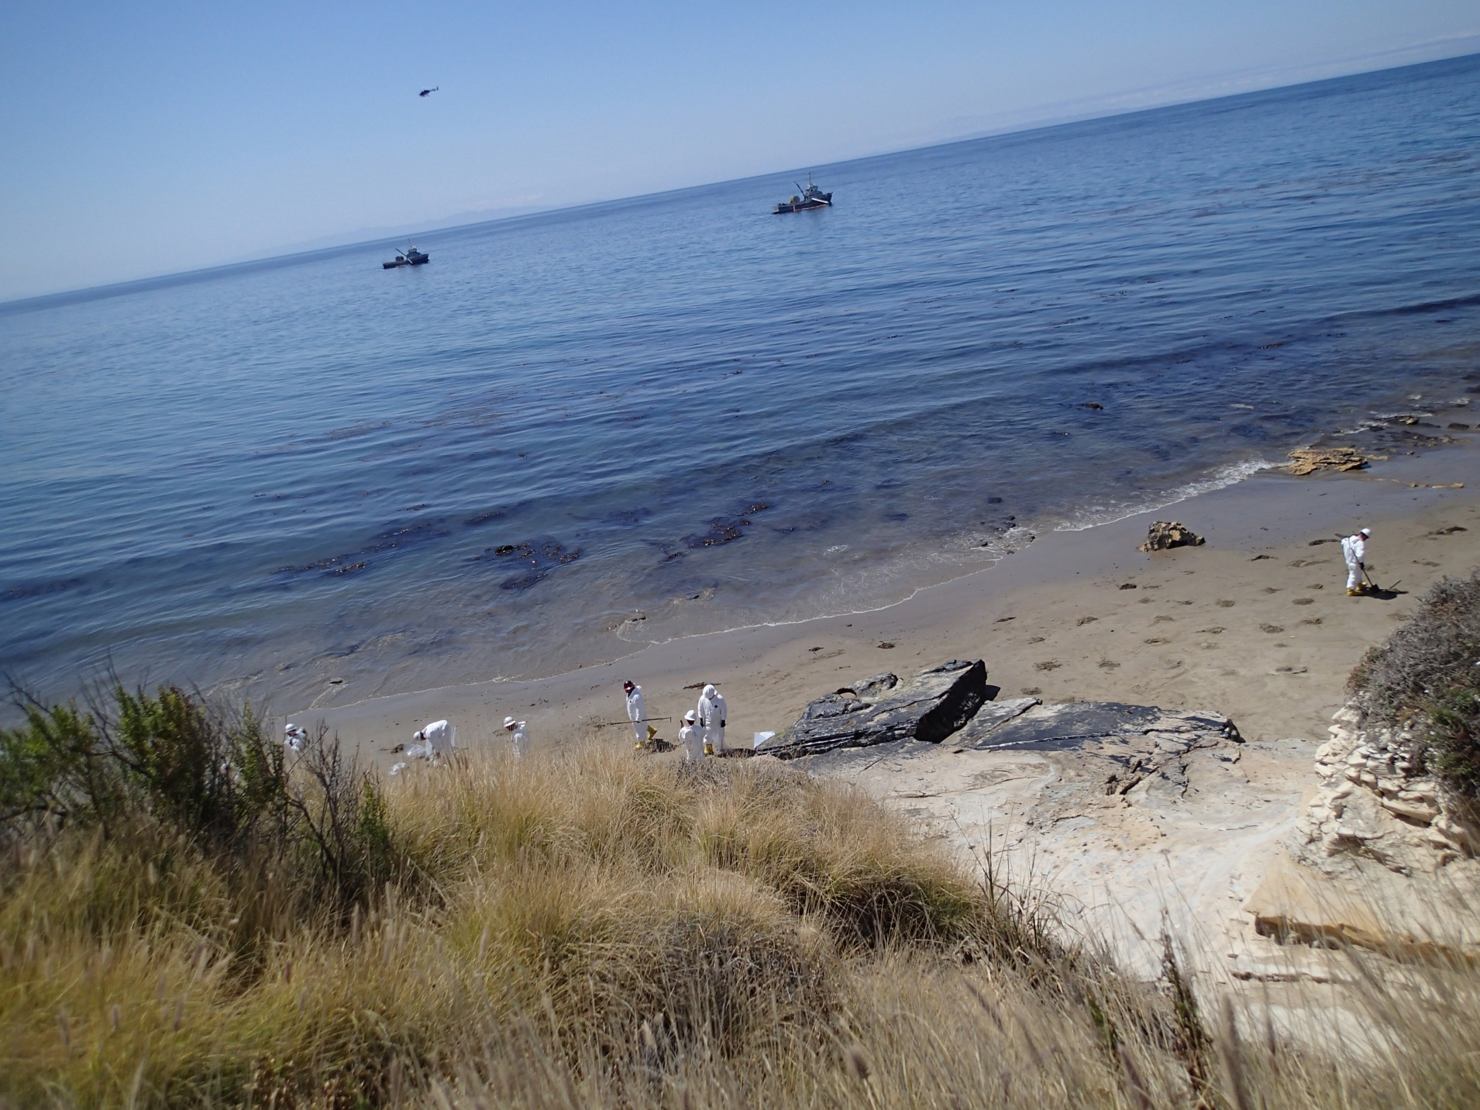
Photo Courtesy of CDFW-OSPR

Slide 25
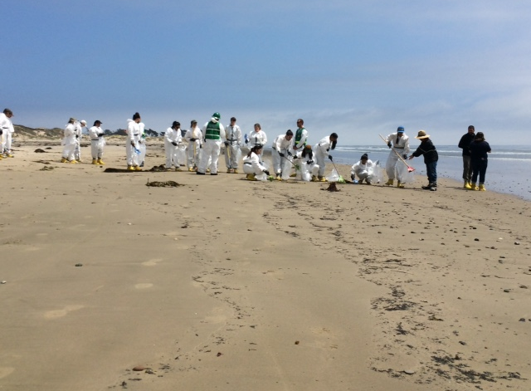
Volunteers
Over 400 volunteers registered and trained

Slide 26
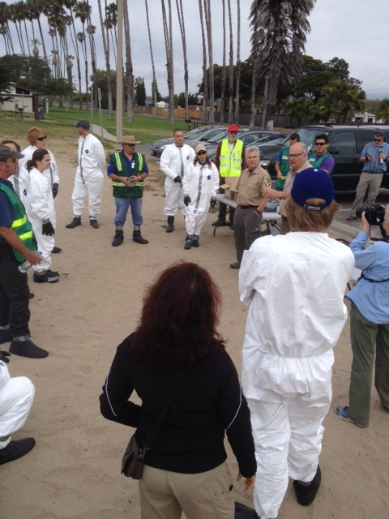
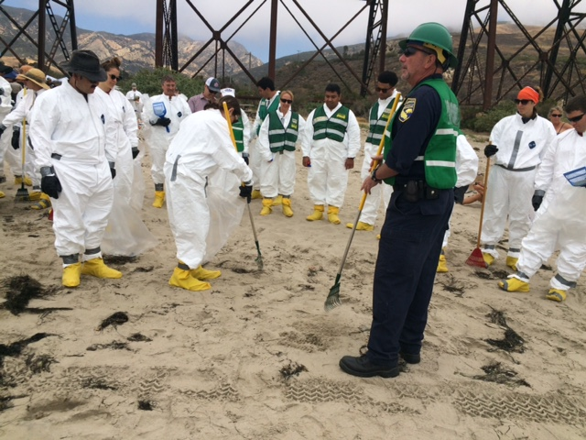
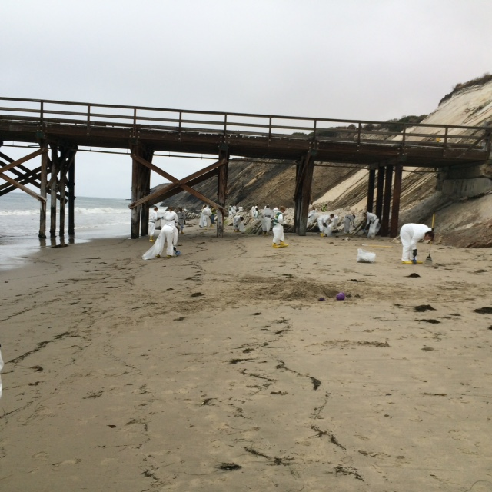
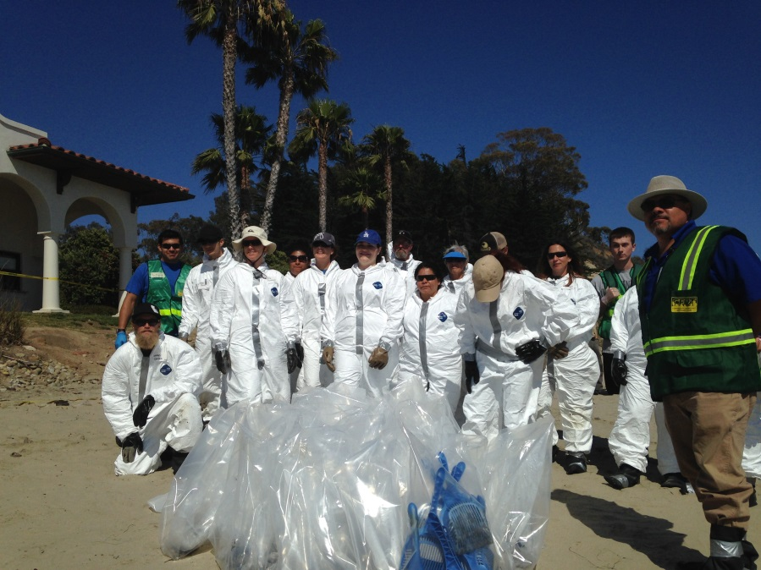
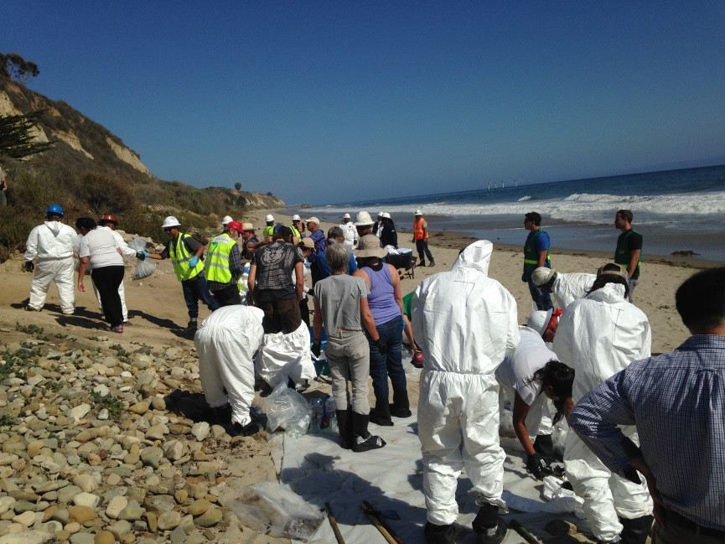

Slide 27
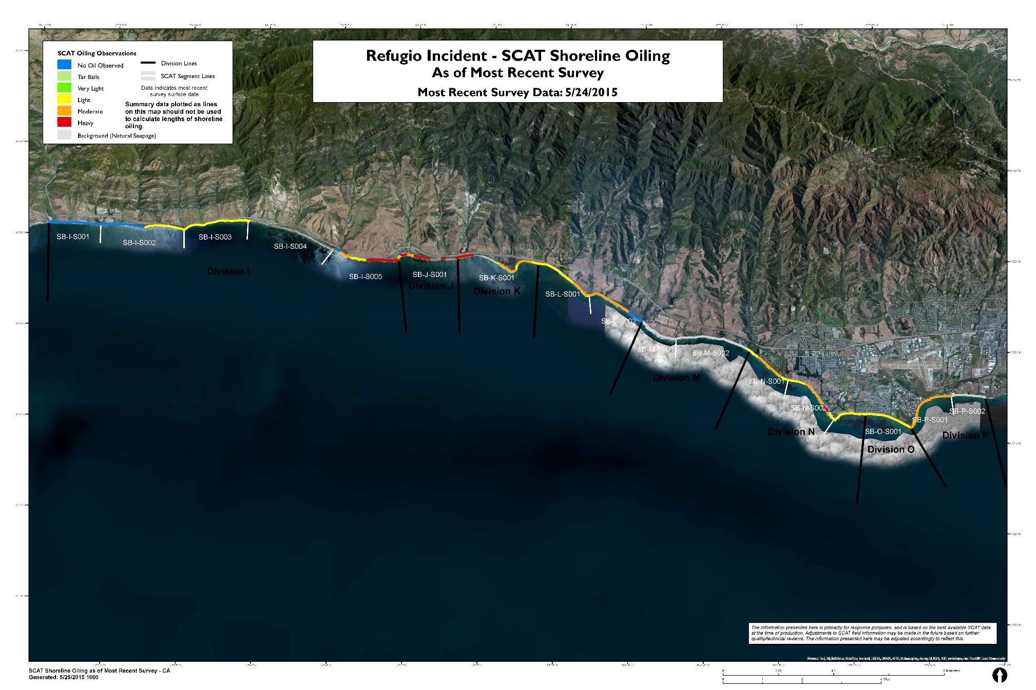
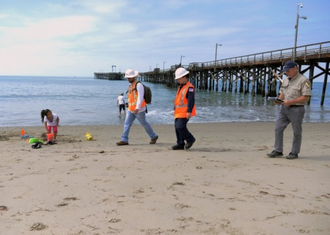
Shoreline Cleanup Assessment Techniques (SCAT) Team
Scat Teams are responsible for documenting the extent and degree of oiling

Slide 28
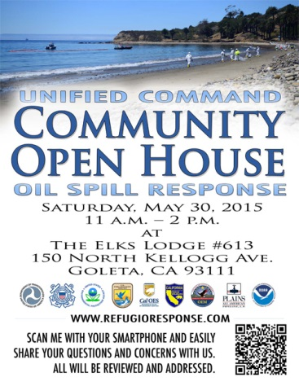
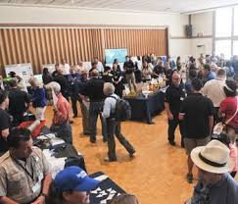

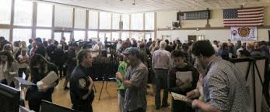

Slide 29
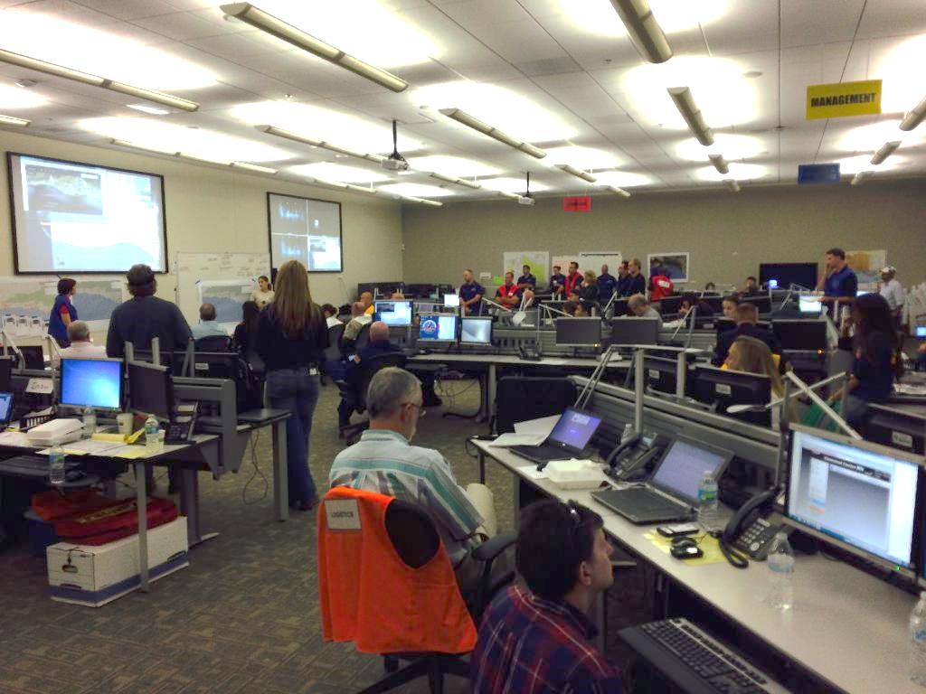
Incident Command Post (ICP)
Notes:
Initial ICP was located at the Santa Barbara County Fire Department Emergency Response Center. The ICP was later moved to a leased building by the Santa Barbara Airport

Slide 30
Other Activities:
  41 separate response plans have been approved by the Unified Command for the Refugio Incident
Submerged oil surveys in geographic areas with the highest probability of encountering Refugio Incident oil were conducted using multi-beam sonar, side scan sonar, ROV deployment and finally ground-truthing by divers. For all the surveys, no sunken or suspended oil was observed with the exception of the possibility of pea-sized tarballs rolling in the surf 4-6’ of water offshore of El Capitan

Slide 31
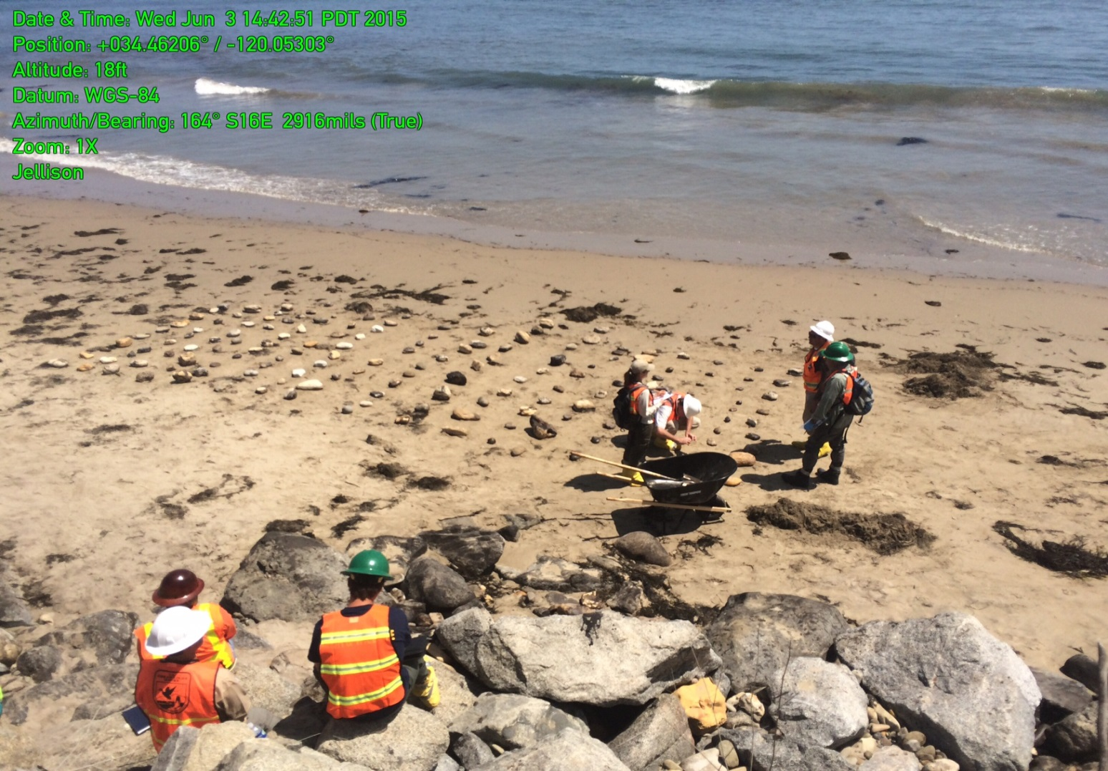
Other Activities (continued):
  Cobble relocation treatment test – Cobbles of varying sizes were placed in the surf zone to test for mobility and natural cleaning (results pending)

Slide 32
Other Activities (continued):
  Sediment washing using a cement mixer - Oiled cobble from Refugio Beach State Park was tumbled in a small electric cement mixer with course sand in a test to see if this was a viable option. Approximately 15-20 cobbles from 3 to 6 inches in diameter with up to 30% oil coat were tumbled in the mixer with sand and examined at 5 minute intervals for a 30 minute treatment period. After the first 5 minutes, the soft oil coat was much reduced to oil stain with some small patches of oil coat remaining, however there was little further improvement after the 30 minute treatment. The consensus was that the cobble tumbling test did not produce an acceptable level of oil removal from the cobble and use of this technique to treat the oiled cobble at Refugio Beach State Park was rejected.

Slide 33
Other Activities (continued):
  Wire brushing test - Boulders and bedrock surfaces were first scraped with a shovel to remove as much of the thick oil coat as possible. This was followed by the use of a wire brush to remove remaining oil from these solid surfaces. The observer reported that wire brush treatment scattered bits of removed oil over a wide area making containment and collection difficult. Furthermore, wire brushing actually spread the oil onto un-oiled areas of the rock surface making a small patch of oil into a much larger stain. For these reasons, use of wire brushes to remove oil from the surfaces of bedrock and boulders was rejected.

Slide 34
Thank you. Questions?

