Slide 1
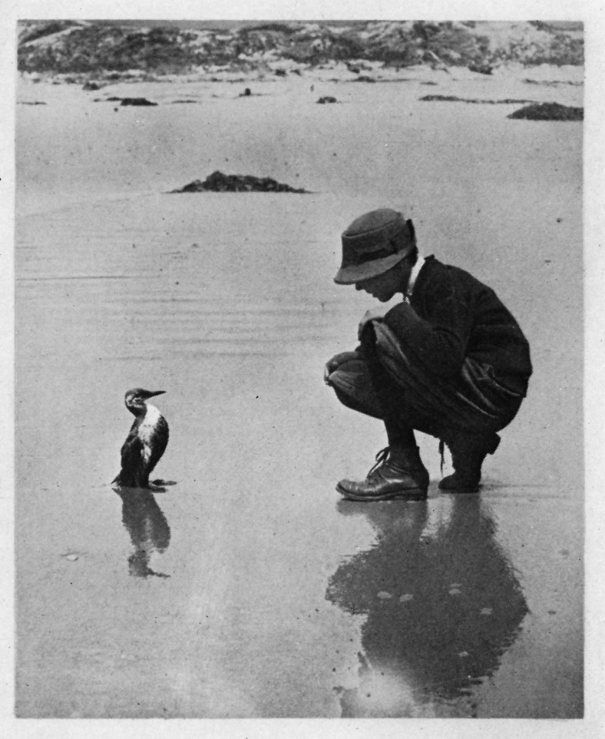
Oiled Wildlife Care Network
An Overview
Kyra Mills-Parker
kyparker@ucdavis.edu

Slide 2
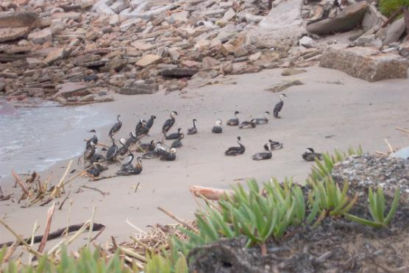
Outline of Presentation
Effects of Oil on Wildlife
OWCN Structure
How OWCN Works Within a Spill
Wildlife Care Procedures

Slide 3
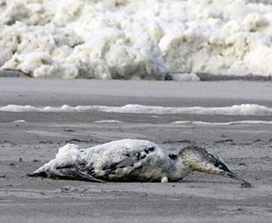
Types of Contaminants
Petroleum Oils
Hydrogenated Oils
Fish oils
Vegetable oils
Other compounds
“Cheetos” cheese
Algae
Courtesy P. Chilton, COASST

Slide 4
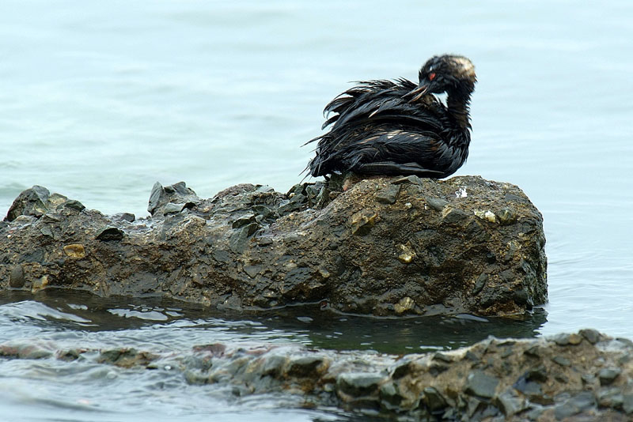
Primary Effects: Initial Impact is External

Slide 5
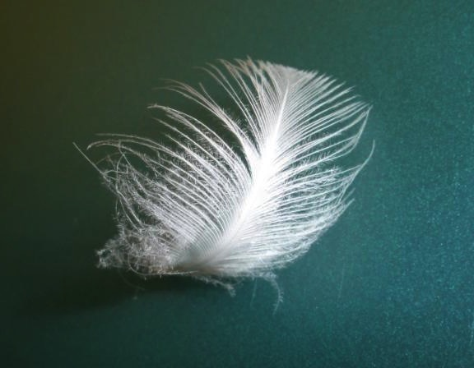
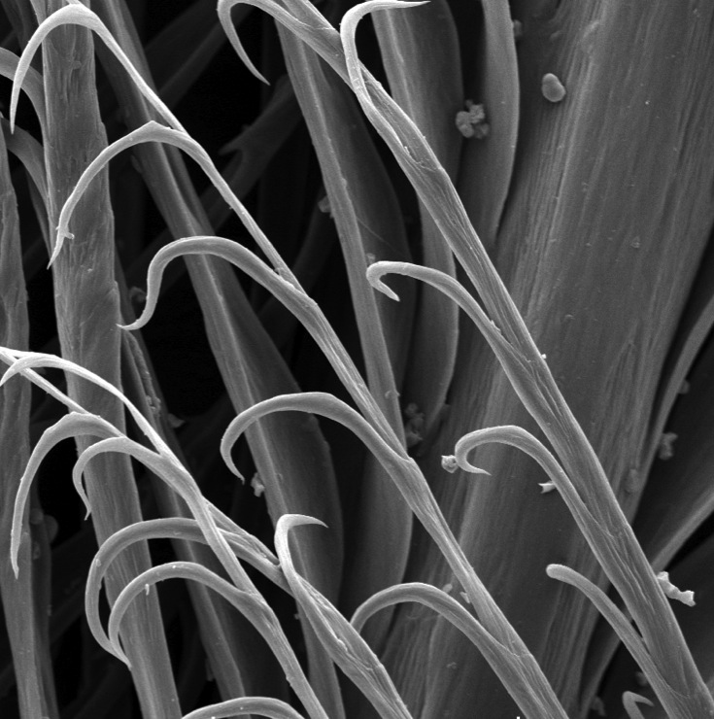
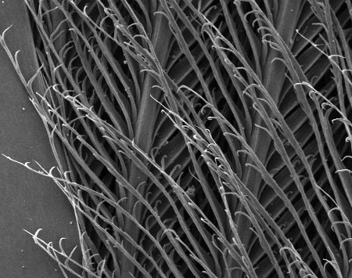
Feather anatomy
Shaft (rachis)
Barbules
Barbs
Hooklets
Oil physically interferes with the normal architecture of feathers
Slide courtesy R. Duerr
Common murre ventral contour feathers

Slide 6
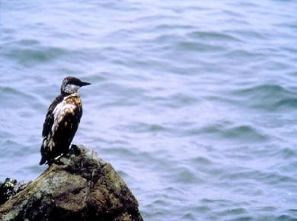
External Oiling Affects Behavior
Loss of buoyancy
Interferes with feather’s ability to trap/hold air
Loss of insulation
Causes hypothermia
Consequences
Decreased foraging
Dehydration
Increased metabolism
Starvation
Notes:
Talking points: Buoyancy created by air trapped by hair is sea otters and feathers in birds. Picture demonstrates air being released from hair coat when diving animals coat is compressed due to pressure of water at depth.

Slide 7
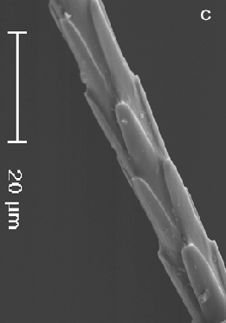
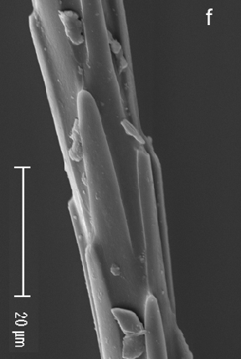
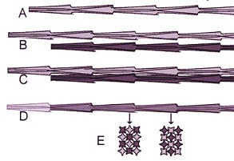
Oil also physically disrupts the normal architecture of fur
Clean fur Oiled fur

Slide 8
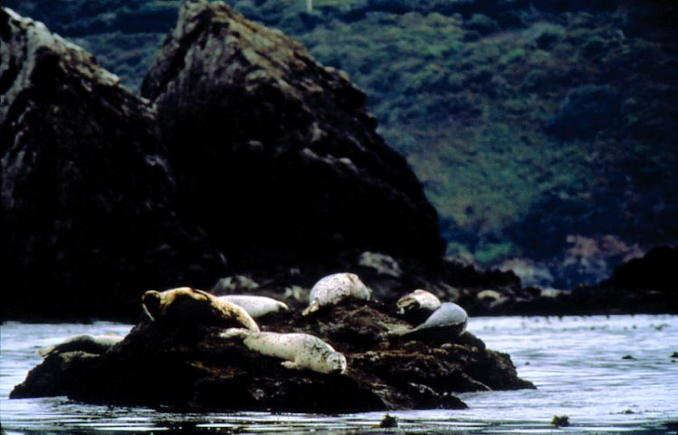
Seals, Sea Lions, Walrus
Blubber Insulation: Less reliant on fur
Effects
Locomotion inhibition
Dermal and internal effects
Notes:
Neonatal harbor seals rely on their pelts to keep dry, although their parents are less affected by external oiling due to an abundant blubber layer.

Slide 9
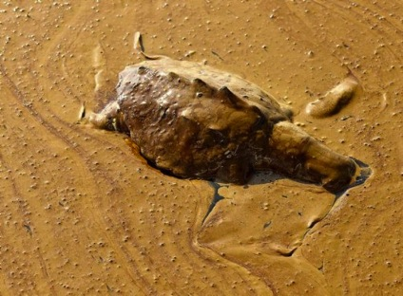
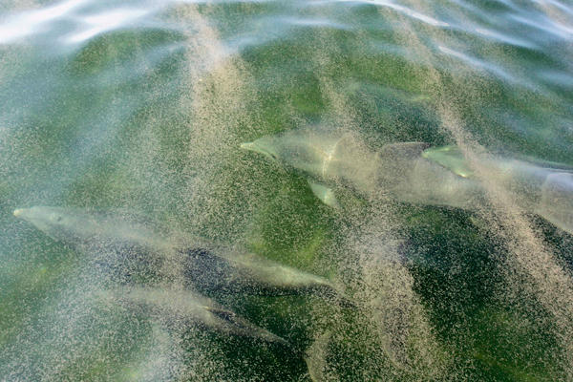
Cetacea & Sea Turtles
Sparse data (until recently)
Primary impact thought to be internal
Cetacea appear less susceptible to oiling
Epidermis impenetrable to petroleum compounds
Exposure
Dolphins avoid oil in captive setting
Cetacea observed swimming and foraging in oil during spills

Slide 10
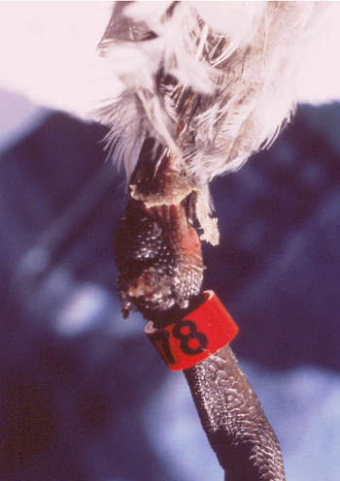
Other Primary External Effects
Mucosal irritation
Skin irritation
Corneal ulcers
Affected tissues predisposed to bacterial infection
Notes:
Talking points: mucosal irritation secondary to preening/grooming; skin irritation secondary to direct contact – esp. with more refined products; corneal ulcers secondary to direct contact or volatile fumes.

Slide 11
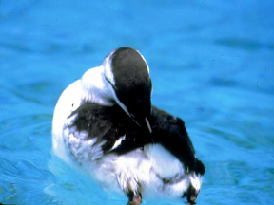
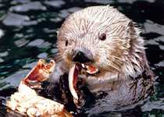
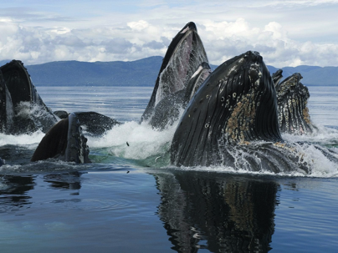
Internal Exposure
Routes of Entry
Ingestion
Inhalation
Absorption
Sources
Preening & grooming
Contaminated water
Contaminated prey

Slide 12
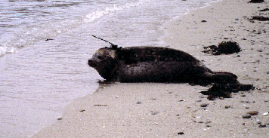
Primary CNS Effects
Narcotic effects of BTEX/ PAHs
Harbor seals in EVOS
No oil avoidance, “tameness”, lethargy, dullness
Histopathological findings: Neuronal damage

Slide 13
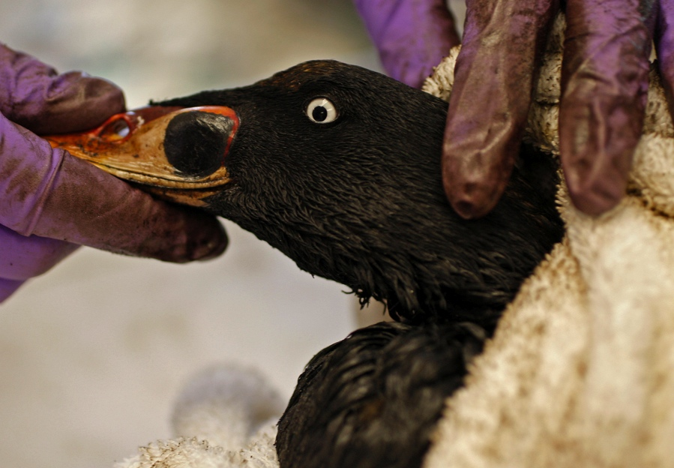
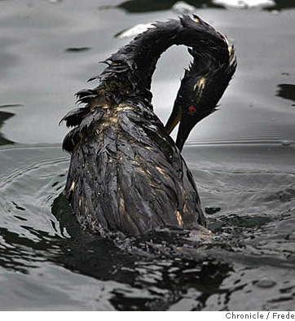
Malnutrition
Contributing factors:
Inability to find food
Higher energy needs
Poor digestion
Damage to intestines
Feather oiling
Preening increases oil ingestion

Slide 14
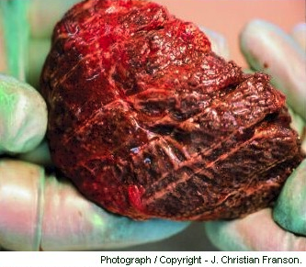
Primary Respiratory Effects
Fume inhalation pneumonia
Aspiration pneumonia
Subcutaneous emphysema (sea otters)
Lung discolored by aspirated oil

Slide 15
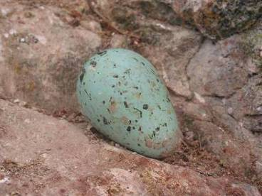
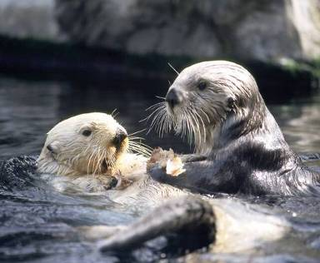
Primary Reproductive Effects
Altered reproductive behavior
Early embryonic death
Decreased chick/pup survival
Increased abandonment
Can lead to population level effects

Slide 16
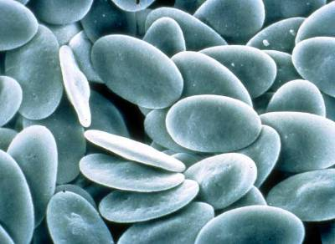
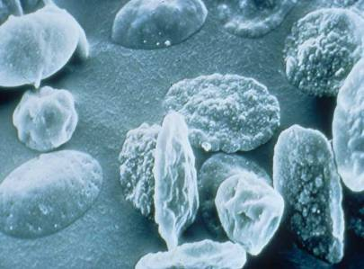
Primary Effects on Blood
Anemia
Destruction: Hemolysis
Loss: Hemorrhage
Immunotoxicosis
Proportion of lymphocytes decreased
Healthy avian red blood cells
Unhealthy avian red blood cells
Courtesy T. Leighton

Slide 17
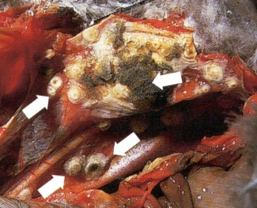
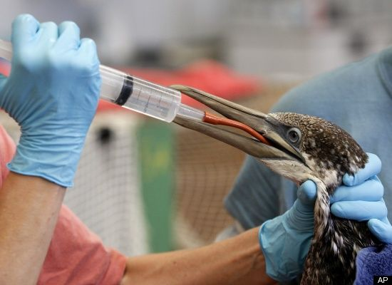
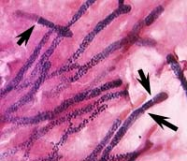
Fungal infections - Aspergillosis
Exacerbated by
Poor ventilation
Warm, humid environment
Stress!
Once established, curing the infection is extremely difficult

Slide 18
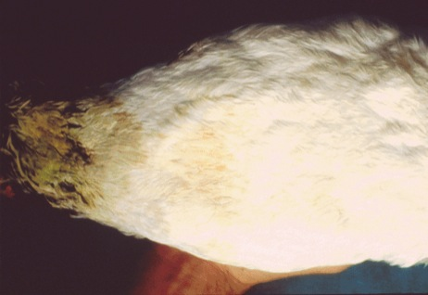
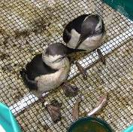
Secondary Effects: Husbandry
Anemia
Aspergillosis
Feather/fur damage
Soiled tail feathers

Slide 19
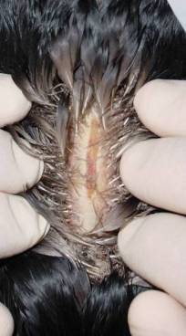
Secondary Effects: Husbandry
Anemia
Aspergillosis
Feather/fur damage
Keel lesions

Slide 20
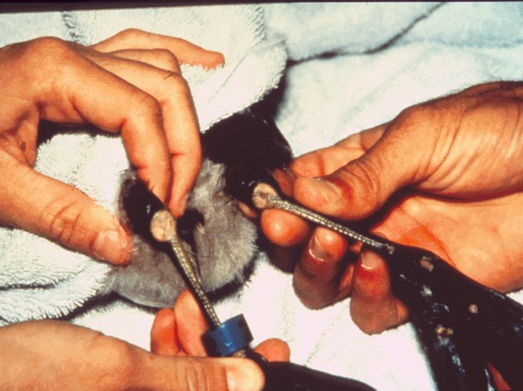
Secondary Effects: Husbandry
Anemia
Aspergillosis
Feather/fur damage
Keel lesions
Foot and hock lesions

Slide 21
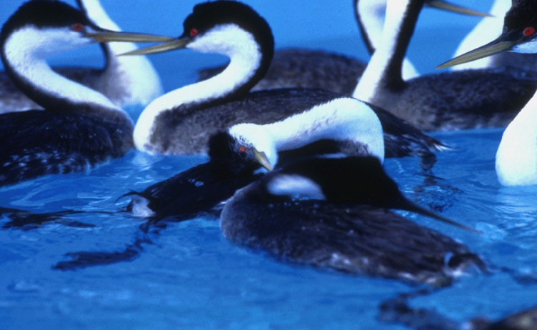
Secondary Effects: Husbandry
Anemia
Aspergillosis
Feather/fur damage
Keel lesions
Bumblefoot
Feather impaction
Notes:
Large grebes
Preened feather material lodges in the ventriculus (gizzard)

Slide 22
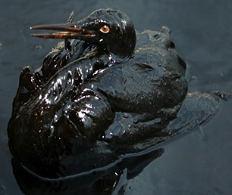
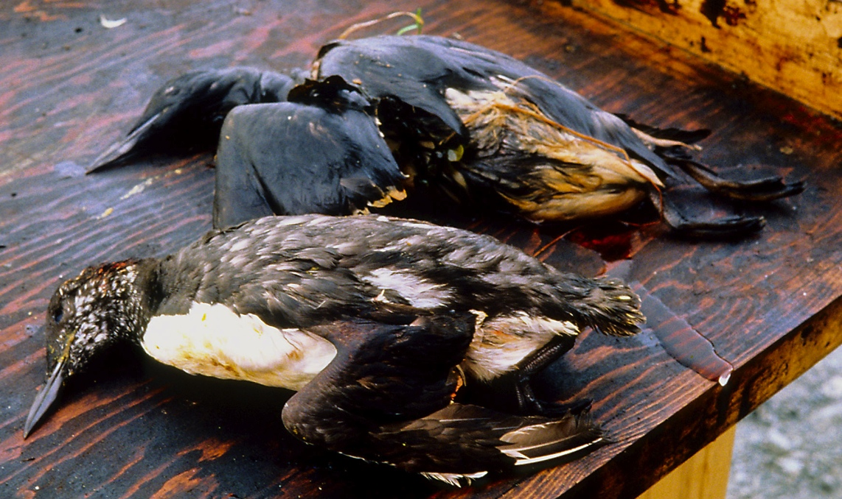
Ultimate result
Debilitation and death

Slide 23
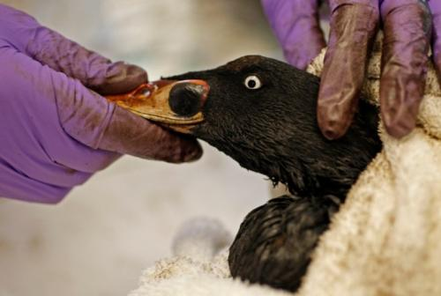
What Impacts Survival?
Product spilled
Species affected
Weather
Animal condition/season
Speed of capture
Facility availability
Trained personnel and preparation

Slide 24
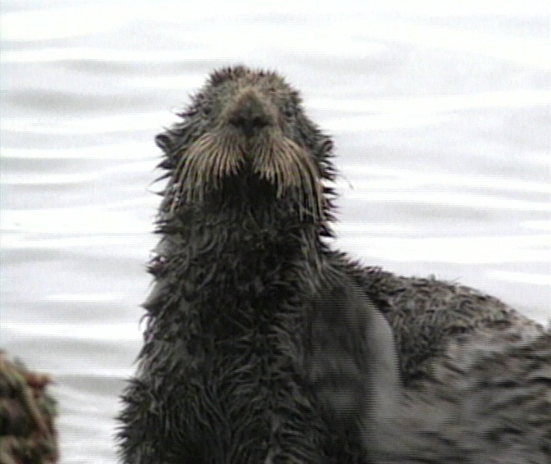
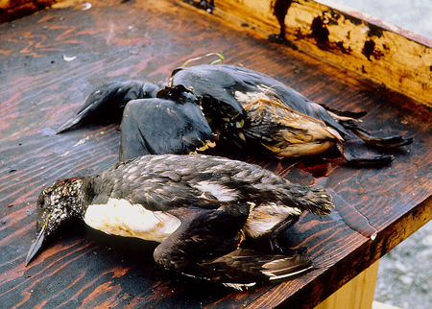
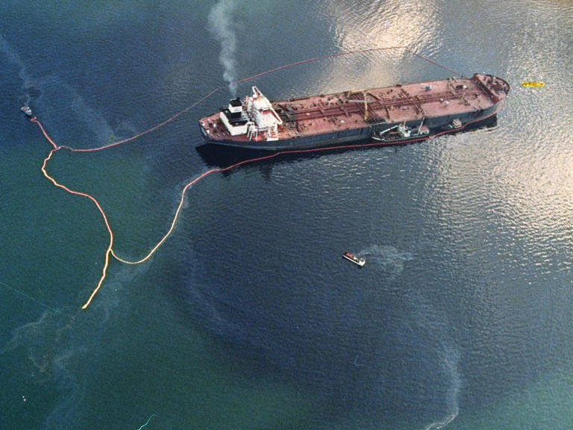
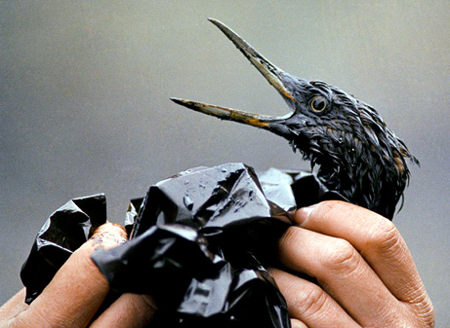
Exxon Valdez Oil Spill (EVOS)

Slide 25
EVOS Salient Points
Lack of adequate resources
Remote location
Diversity and quantity of wildlife

Slide 26
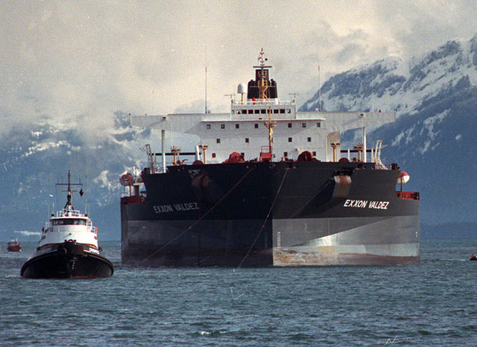
EVOS Wildlife Impacts
Estimated impacts:
250,000 seabirds
2,800 sea otters
300 harbor seals
22 killer whales

Slide 27
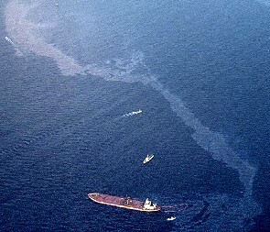
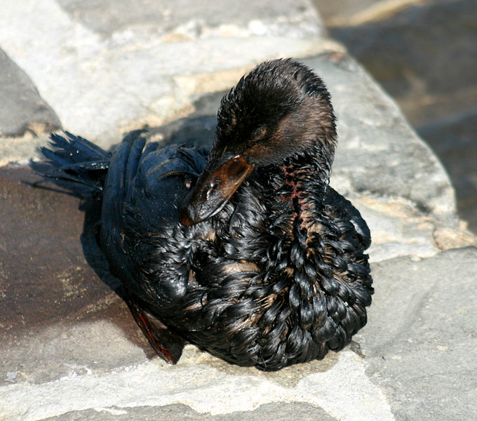
American Trader Oil Spill

Slide 28
American Trader Oil Spill
Feb. 7, 1990
400,000 gal crude oil
600 rescued, rehabilitated, released
3,000-4,000 birds killed

Slide 29
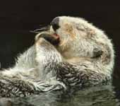
Wildlife Legislation - Federal
Oil Pollution Act of 1990 (OPA90):
“… Provide for a specific…wildlife response plan…to minimize disruptions to…wildlife and their habitat.”
Notes:
11
Amendment to the CWA
Addressed range of issues assoc with preventing, responding to, and paying for oil pollution incidents in navigable waters of the US.
Greatly increased federal oversight of maritime oil transportation while providing greater environmental safeguards.

Slide 30
Wildlife Legislation - California
Lempert-Keene-Seastrand Oil Spill and Prevention Act:
Created DFW-OSPR
Required rehabilitation stations
Established research program
Notes:
CA insisted on better legislation
Created 7 ACP in CA which dictate how a response would be carried out.
The products from this legislation made CA the most proactive response region in the US/world for oil spills and wildlife care.

Slide 31
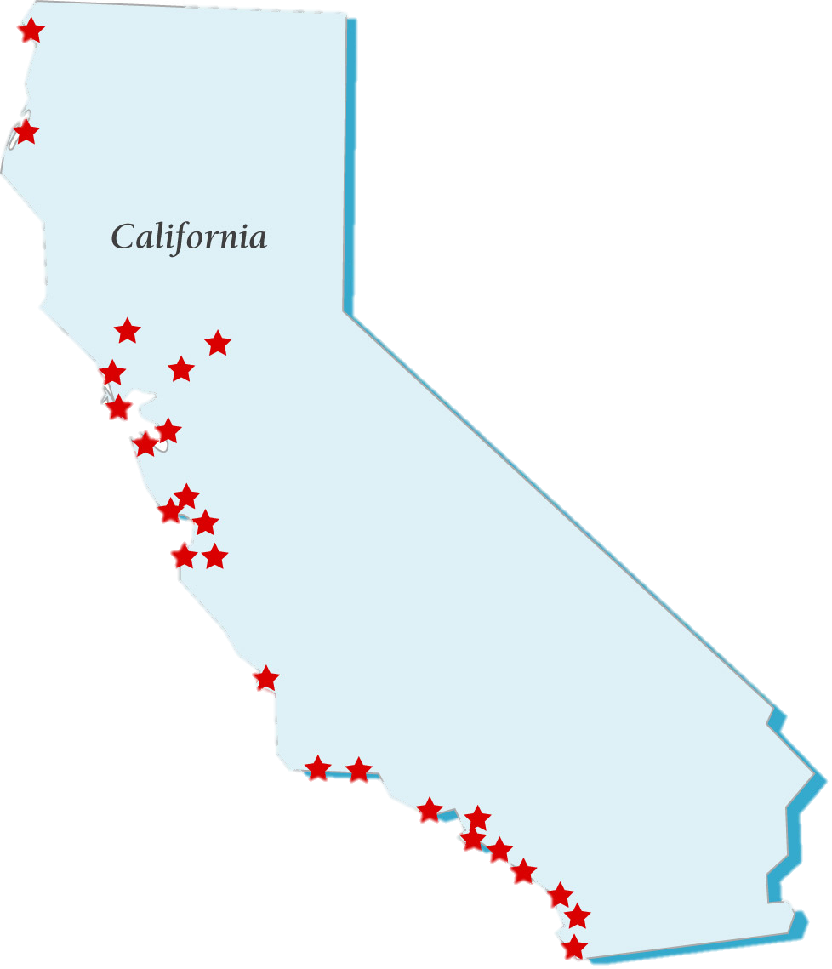
Oiled Wildlife Care Network
Administration
1994–1997: OSPR
1997– now: Wildlife Health Center, UC Davis
Mission
Provide best achievable capture & care to oiled wildlife
Funding
Interest from Oil Spill Response Trust Fund
Oversight
Advisory Board
Sci. Adv. Comm.
Structure
> 30 Member Organizations
Programs
Readiness
Response
Reaching Out
Research
Notes:
13

Slide 32
Readiness: Partners
Participants
31 organizations represented
Rehab orgs, universities, NGOs
Types: Primary Care, Stabilization, Personnel
Agreements
MOUs between OSPR and organizations
Agree to provide rapid cooperative response
OSPR/OWCN agrees to equip, supply & train
$$ to develop/maintain multi-use facilities
Notes:
5

Slide 33
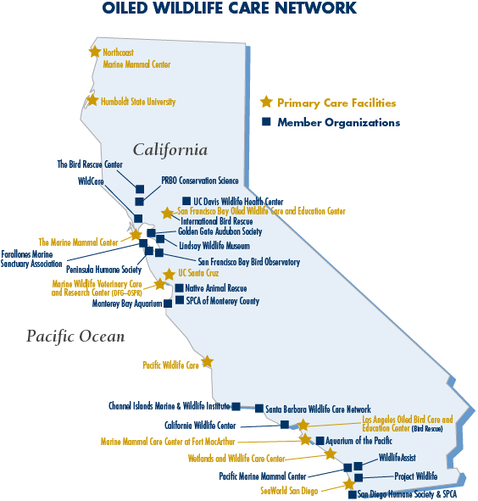
Notes:
5

Slide 34
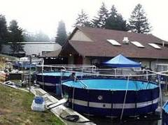
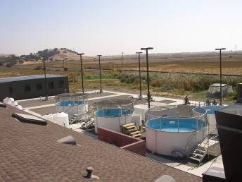
Readiness: Facilities
Types
Primary care (12)
Stabilization (11)
Personnel (7)
Multi-Use
Reduces spill startup time
Cost-effective maintenance
Non-spill use
Rehabilitation
Education
Research

Slide 35
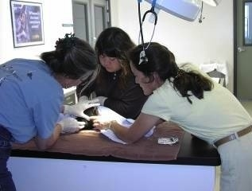

Readiness: Training
Convergent Volunteers
Basic info/safety
Pre-Trained Volunteers
Basic
“Webinar”, animal care overviews
Conference/Labs
Staff
HAZWOPER
More advanced techniques

Slide 36


Response
>75 spills in CA, nationally, and internationally, and almost 8,000 oiled birds and mammal
Cosco Busan 2007
Dubai Star 2009
Deepwater Horizon 2010
Rena 2011
Notes:
Of course, this all leads up to our fourth “R”, which is response. The OWCN has responded to over 75 spills in California alone, as well as national and international spills, and has cared for almost 8,000 oiled birds and mammals here in California. Some notable spills of recent years that the OWCN has responded to include the Cosco Busan and the Dubai Star in California, Deepwater Horizon in the Gulf, and the Rena spill in New Zealand.

Slide 37



Reaching Out
Seminars, presentation
Public Outreach
Website, newsletters, blog
National/International Assistance
Response planning, spill assistance, facility development
Notes:
As part of our reaching out program, we provide outreach seminars to colleges and public groups, and present at conferences. The OWCN strives to provide a strong public outreach by keeping a current website and up to date blog, and providing an annual update of OWCN activity. We also provide national and international assistance in the form of facility development, response planning, and spill assistance.

Slide 38

Research
Purpose
Better understand effects
How best to care for wildlife
Post-release survival
Success
Over 140 projects funded since 1996
Three post-release projects since 1997

Slide 39

Research: In house
Soft sided pens
Nutrition & fluids
Effects of being housed in fresh water
Infrared cameras to monitor waterproofing
Testing satellite transmitters
Picture by Hannah Nevins
Notes:
The OWCN also participates in it’s own research aimed at advancing the field of oiled wildlife response. Some examples of recent studies include the use of soft sided pens to reduce animal injuries during a spill, various nutrition and fluid studies, the effects of sea birds being housed in fresh water, the use of infrared cameras to monitor waterproofing, and the testing of satellite transmitters for future use in post-release studies.

Slide 40

OIL SPILL!

Slide 41

Equipment
Facilities
Personnel

Slide 42



Wildlife Response
Primary Response
Oil recovery/countermeasures
Planning and reconnaissance
Carcass collection
Disturbance minimization
Secondary Response
Deterrence
Pre-emptive capture
Tertiary Response
Recovery & rehabilitation

Slide 43


Slide 44


Slide 45

Reconnaissance Group
Evaluates numbers, species, and locations of wildlife that could be/are impacted by oil

Slide 46


Hazing Group
Deters wildlife from entering contaminated areas
Notes:
.

Slide 47


Wildlife Recovery Group
Collection of dead and capture of live oiled animals

Slide 48


Field Stabilization Group
Linked to increased survival
Provides “first aid” to animals near to spill area

Slide 49

Care & Processing Group
Collects evidence from all live & dead animals
Provides medical care to affected animals
Notes:
This is the fourth group….

Slide 50

OIL SPILL
NOTIFICATION
STAND BY
ACTIVATION
RESPONSE
DEMOBILIZATION

Slide 51

Notification
Call/text from OSPR
From RP
Public, OWCN members
Hotline: 877-UCD-OWCN

Slide 52
OIL SPILL
NOTIFICATION
STAND BY
ACTIVATION
RESPONSE
DEMOBILIZATION

Slide 53

Activation
Based on presence or likelihood of wildlife
Recon, field reports, knowledge of area
Mechanism
Usually through Wildlife Branch Director
RPs can activate, but must have OSPR approval

Slide 54
OIL SPILL
NOTIFICATION
STAND BY
ACTIVATION
RESPONSE
DEMOBILIZATION

Slide 55






Steps to a Response
Field Stabilization
Recovery & Transport
Pre-Wash Care
Processing & Intake
Release
Conditioning
Cleaning

Slide 56

Recovery/Transport Procedures
Follow defined search areas
Collect key field data
Complete WSEL
Transfer animals to Field Stabilization or Primary Care
Correct field ops effective in:
Reducing impacts by hazing unoiled wildlife
Capturing individuals that would otherwise perish
Maximize the survival rate
Increase safety of unoiled predators/scavengers

Slide 57
Processing Procedures
Legal Documentation
Log info collection
Photographic record
Feather collection
Leg banding
Both live and dead animals are catalogued

Slide 58

Intake Procedures
Intake Exam
Record generation
Animal examination
All systems
Oiling
Temperature, weight
Blood Sample Collection
Goal of 5-7 min exam

Slide 59
Pre-Wash Care
Temperature control
Fluid therapy
Blood testing & weight checks every 2 d.

Slide 60

Cleaning Procedures
Washing
Rinsing: High pressure, “dry by washing”
Drying

Slide 61

Pre-Release Conditioning
Regaining waterproofing
Pools
Time/nutrition
Pre-Release
Waterproofing
Behavior
PE normal
Hematology
Federal banding
Post-release studies/tracking

Slide 62

Release

Slide 63

OWCN Responses Overall
Responses: >90
Training
Full-time volunteers: >4,000
Convergent volunteers: >5,000
Live animals: >10,000
Average 50 - 75% release percentage

Slide 64


What Makes it Successful?
Safely conducted
Rapid, efficient and collaborative initiation
Return “normal” wildlife to a clean environment
Provide best achievable care to animals
Learn how to better respond in the future
Better understand the impact of oil spills on wildlife

Slide 65

Thanks! Questions?

