Slide 1
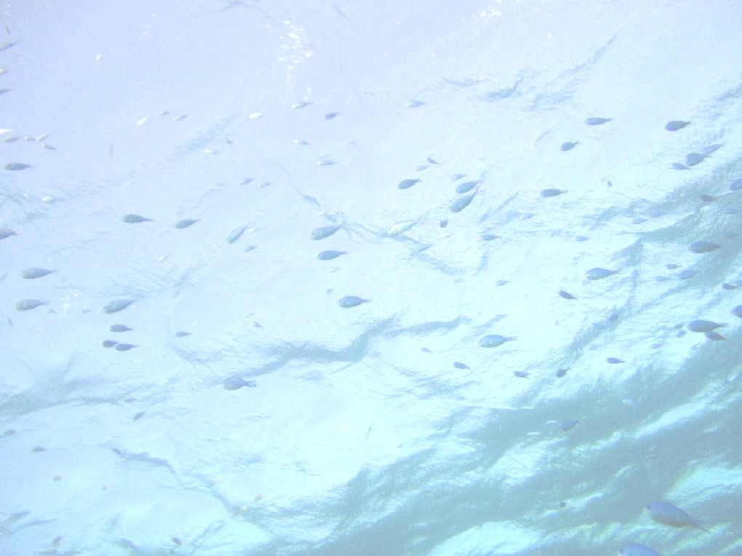
The Effects of Oil Spills on Ecosystems
Regina Donohoe, Ph.D.
Bruce Joab, M.S.
Beckye Stanton, Ph.D.
California Dept. of Fish and Wildlife
Office of Spill Prevention and Response

Slide 2
ECOTOXICOLOGY OVERVIEW

Slide 3
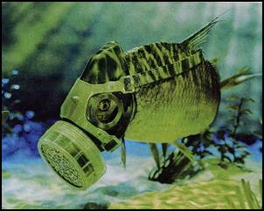
Ecotoxicology
Toxicology
  Study of adverse effects of chemicals
  Based on relationship between exposure and effects
Eco(toxicology)
  Focus on non-human organisms, populations and communities (Suter, 1993)

Slide 4
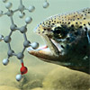
Exposure
External Concentration
Internal Concentration
Target Tissues
Effects
Excretion
Acute vs Chronic Exposures

Slide 5
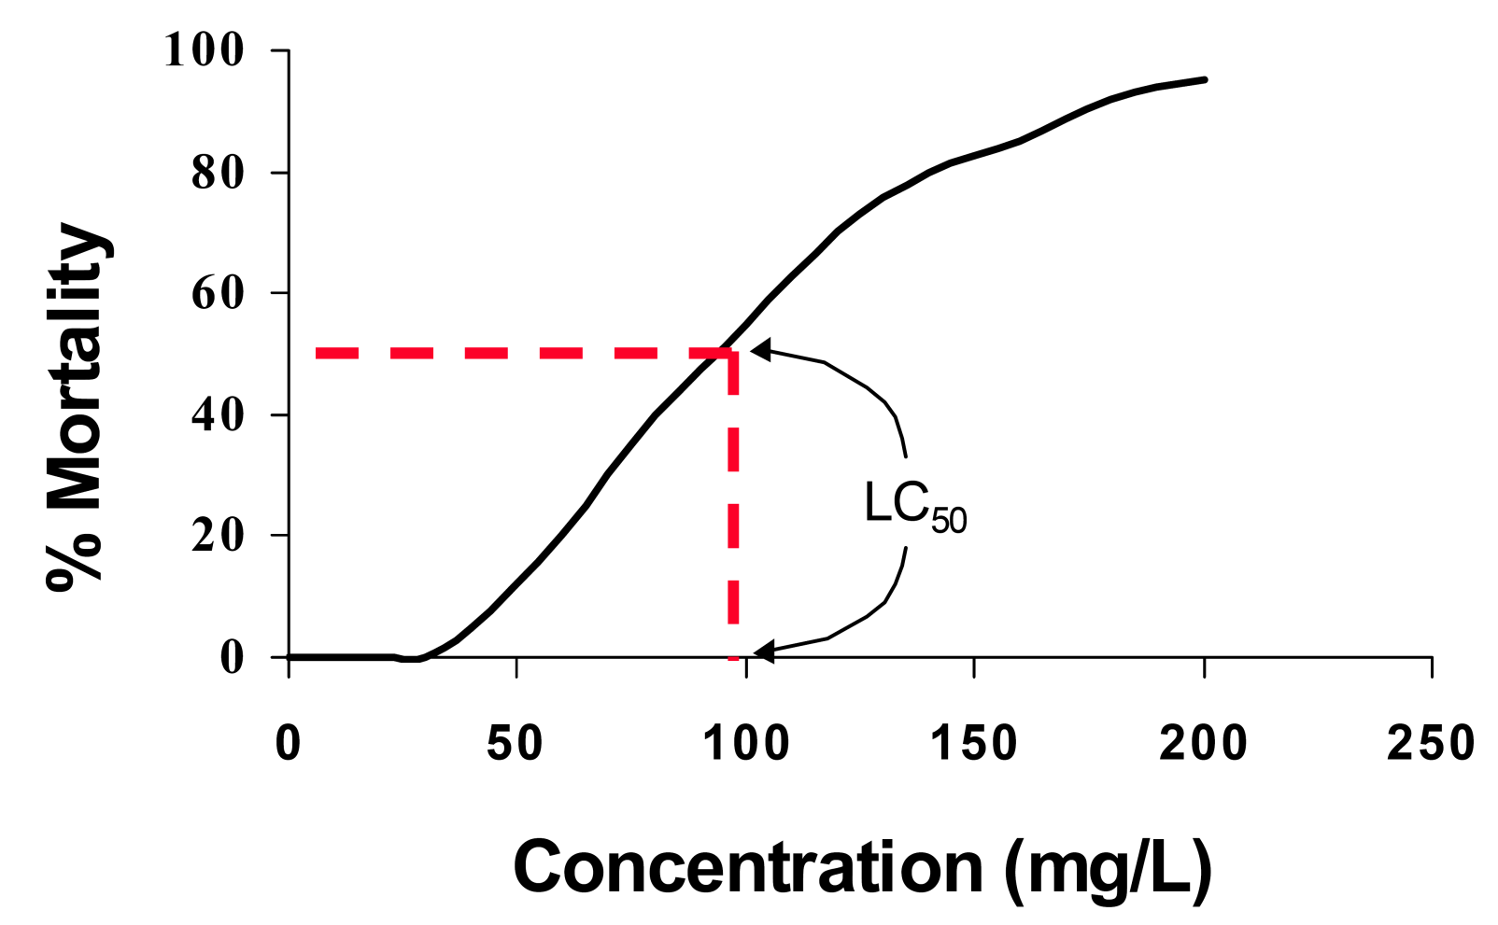
Exposure-Effects Relationship
As the LC₅₀ decreases, toxicity increases
U.S. Navy, 2003

Slide 6
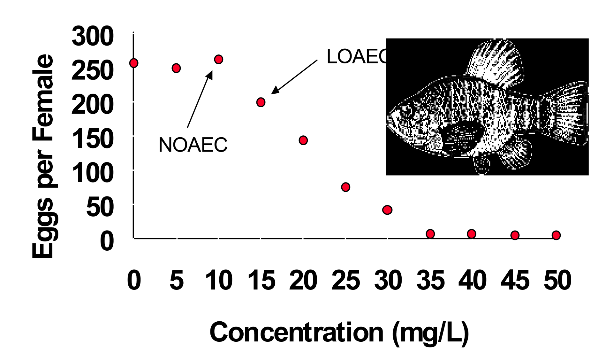
Example of
Exposure-Effects Relationship
U.S. Navy, 2003

Slide 7
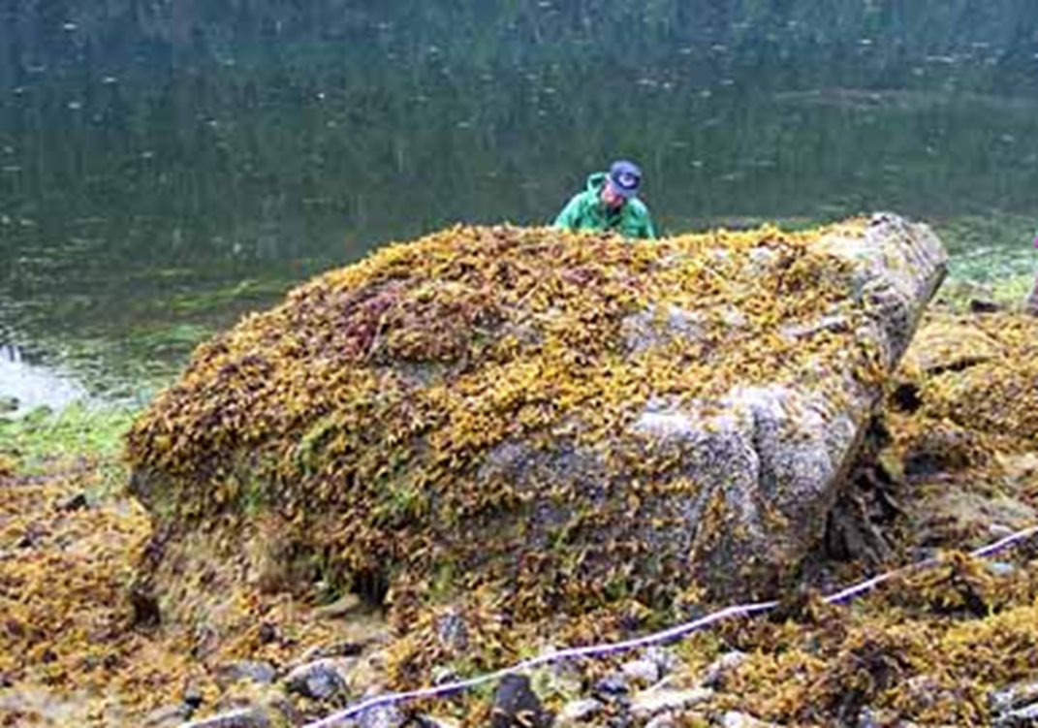
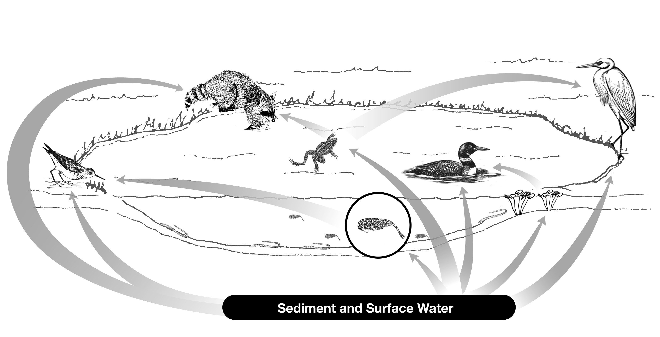
Direct and Indirect Effects
Direct effects on individuals/populations
Indirect effects
  Change in habitat
  Change in prey or predator abundance

Slide 8
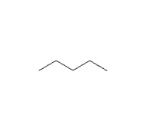
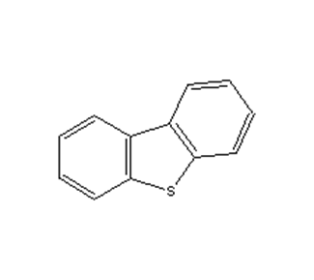
Methods to Evaluate Petroleum Toxicity
Petroleum Product Mixture
  TPH
Indicator Compounds
  BTEX, B(a)P
Individual Fractions
  Aliphatic: pentane, hexane
  Monoaromatic: benzene
  Polyaromatic: high MW PAHs
  Polar: dibenzothiophene
  Asphaltene: high MW compounds

Slide 9
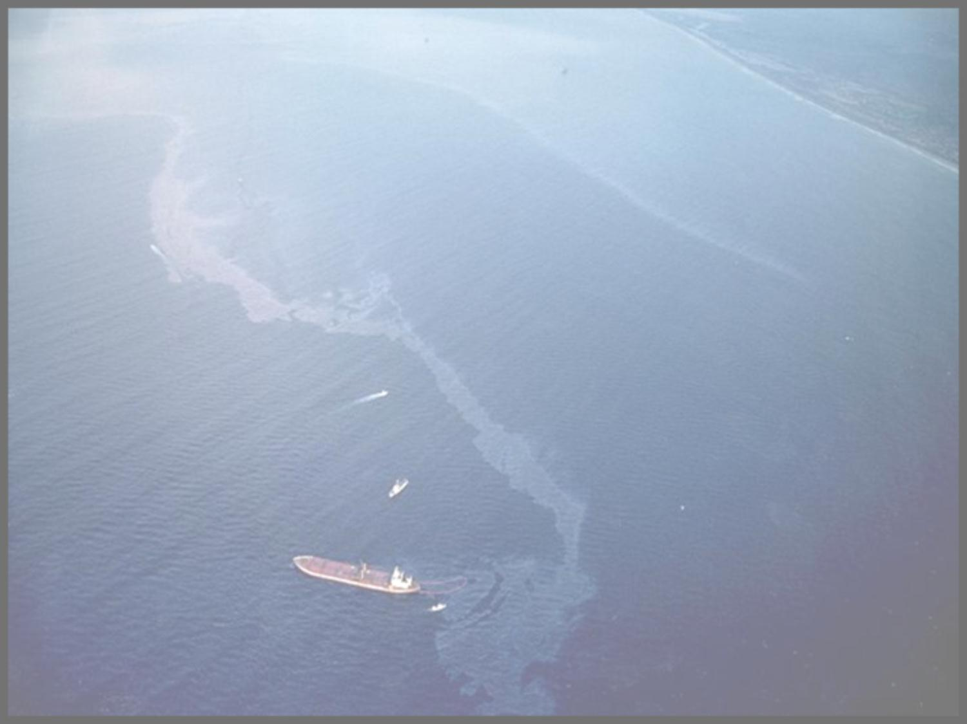
EFFECTS ON FISH, INVERTEBRATES, AND AQUATIC PLANTS

Slide 10
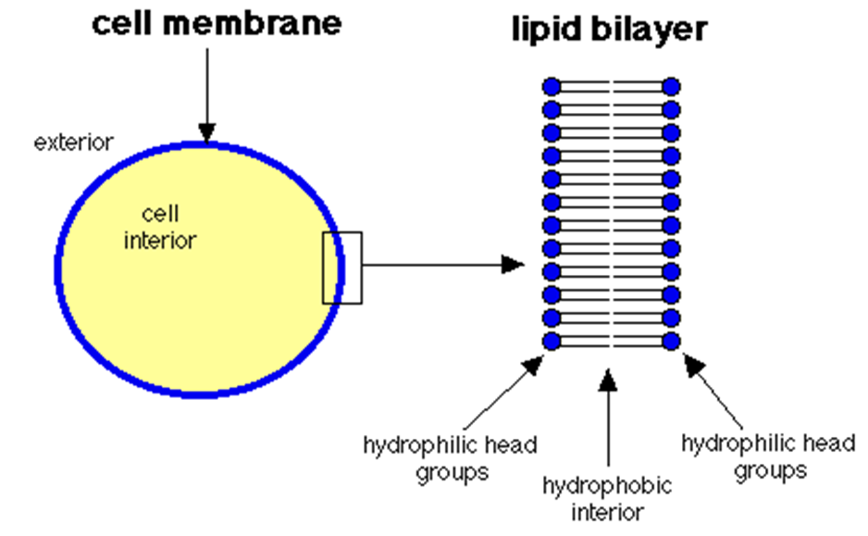
Acute Effects of Petroleum Mixtures
Mortality
Physical solvation & membrane penetration
Nonpolar narcosis

Slide 11
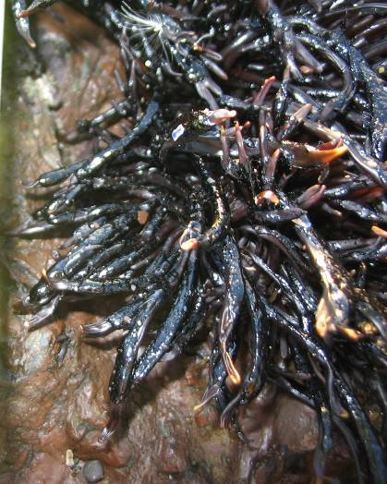
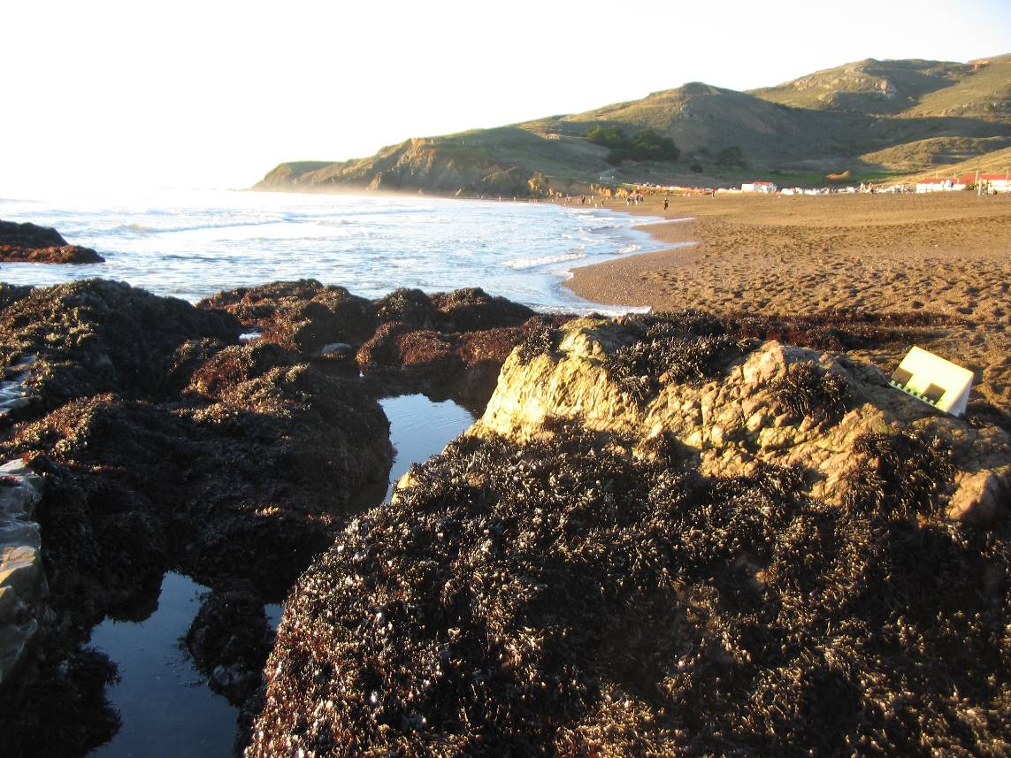
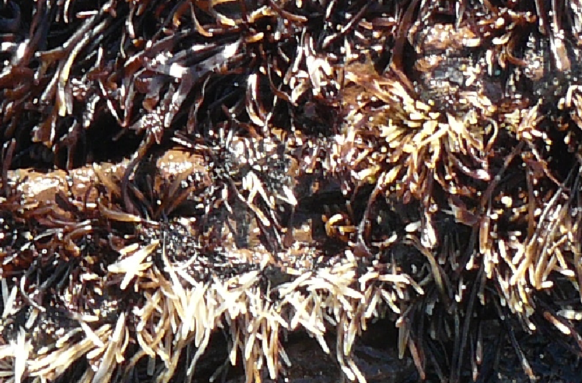
Effects from Fouling/Smothering
Cosco Busan Spill - Rodeo Beach
23 Nov 2007 - two weeks post-spill
Un-Oiled
Oiled
January 8, 2008
Photo Courtesy of Darren Fong, National Park Service and Pete Raimondi, U.C. Santa Cruz (Cosco Busan Oil Spill Trustees, 2011)

Slide 12
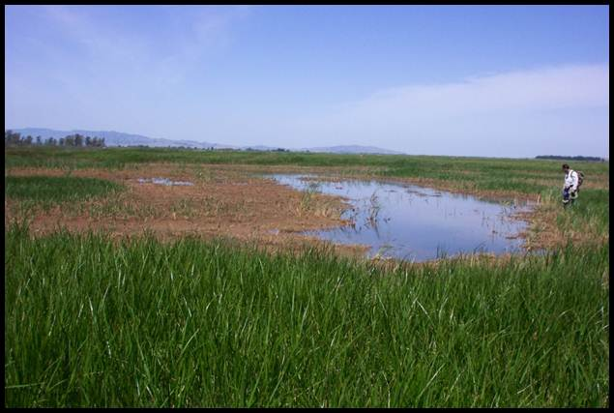
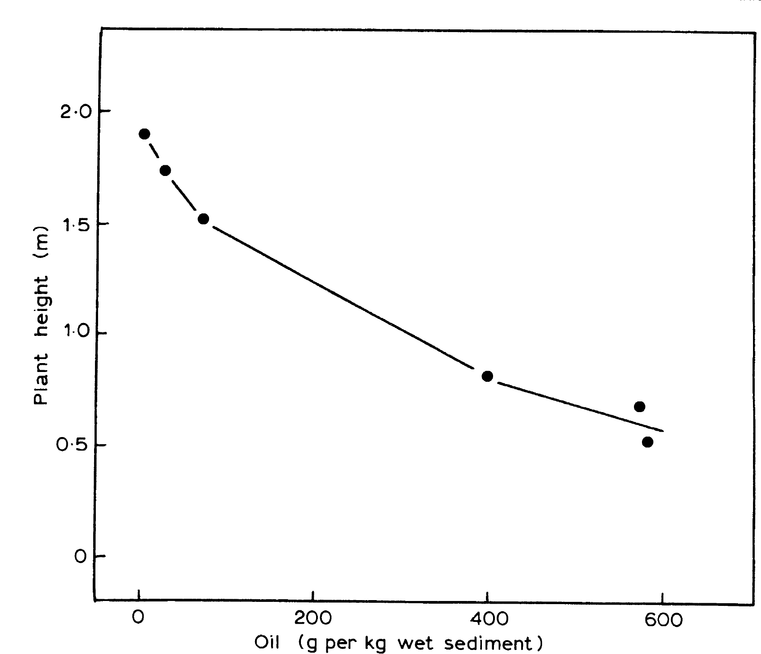
Chronic Effects on Plant Growth
Green and Trett (eds.), 1989
Notes:
Besides mortality, there are other chronic effects from petroleum mixtures.
Reduced growth is commonly encountered in animals and plants – shown here. Reduced growth can be measured by plant height – or an overall reduction in percent cover.

Slide 13
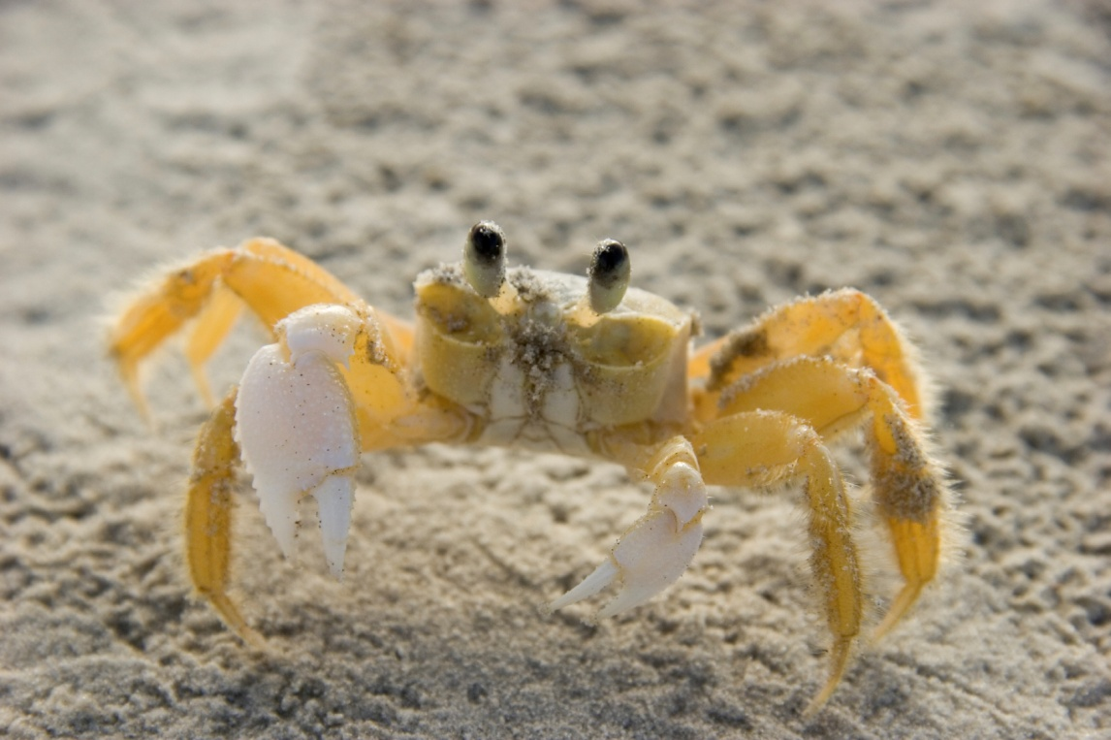
Chronic Effects – Mixtures
Animal Behavior

Slide 14
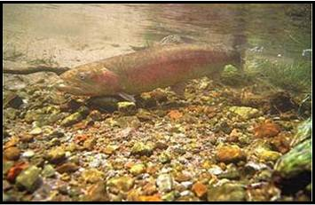
Chronic Effects of Constituents
PAHs
  Effects on early life stages of fish
  Cancer in fish
  Other sublethal effects
Polars

Slide 15
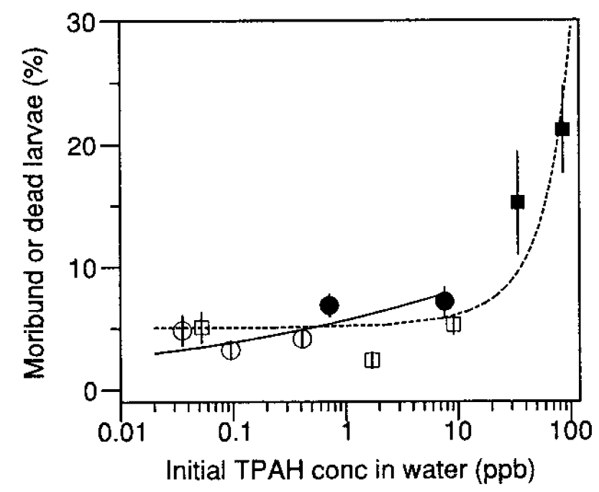
PAHs & Early Life Stage Fish
Mortality
Carls et al., 1999

Slide 16
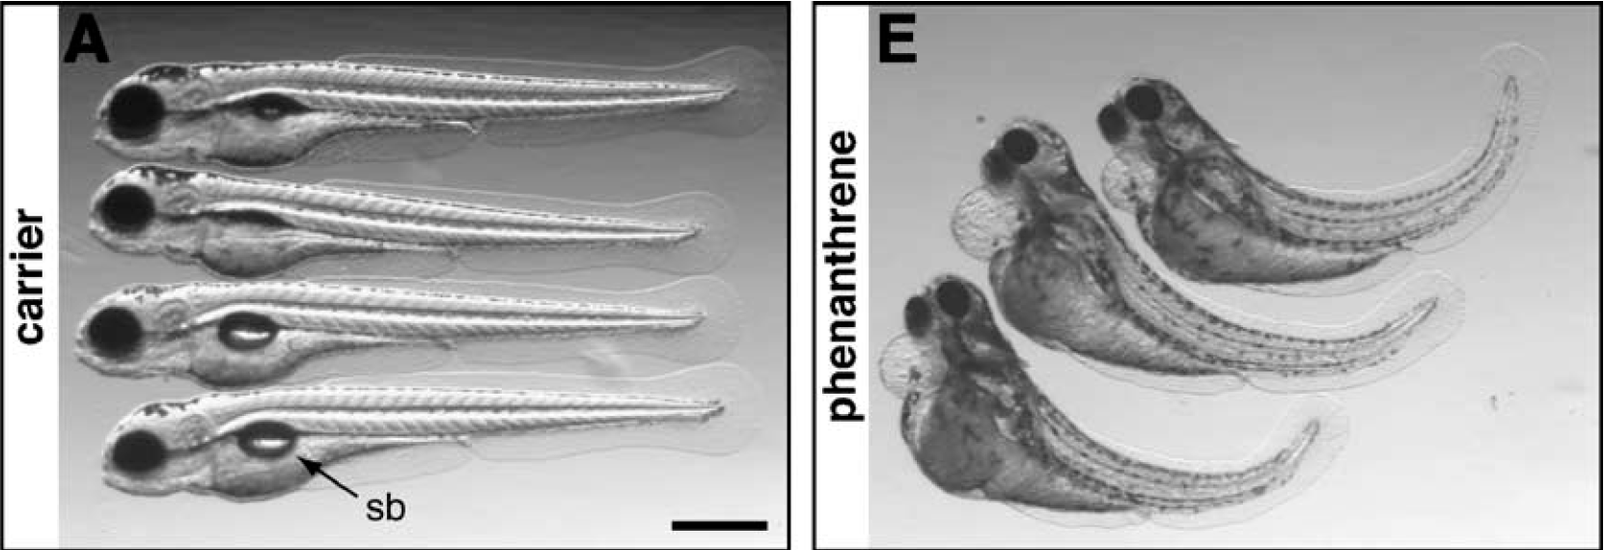
PAHs & Early Life Stage Fish
Embryo Abnormalities
56 μM
Incardona et al. 2004

Slide 17
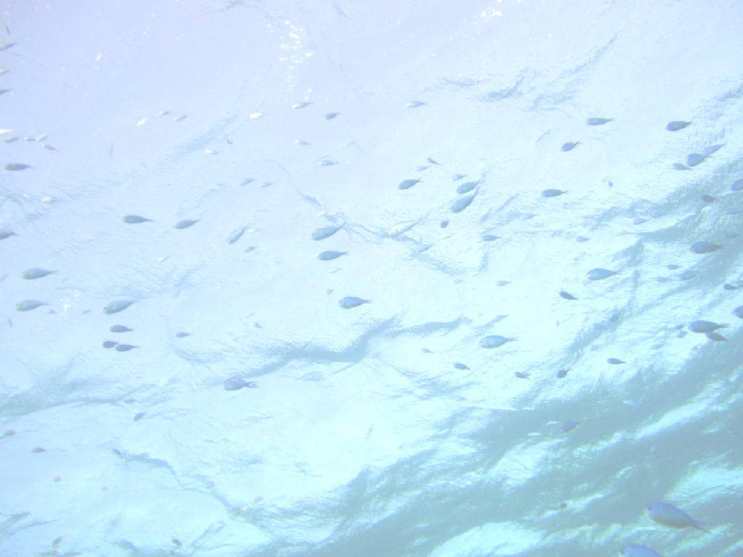
PAHs & Early Life Stage Fish
Herring following Cosco Busan Spill

Slide 18
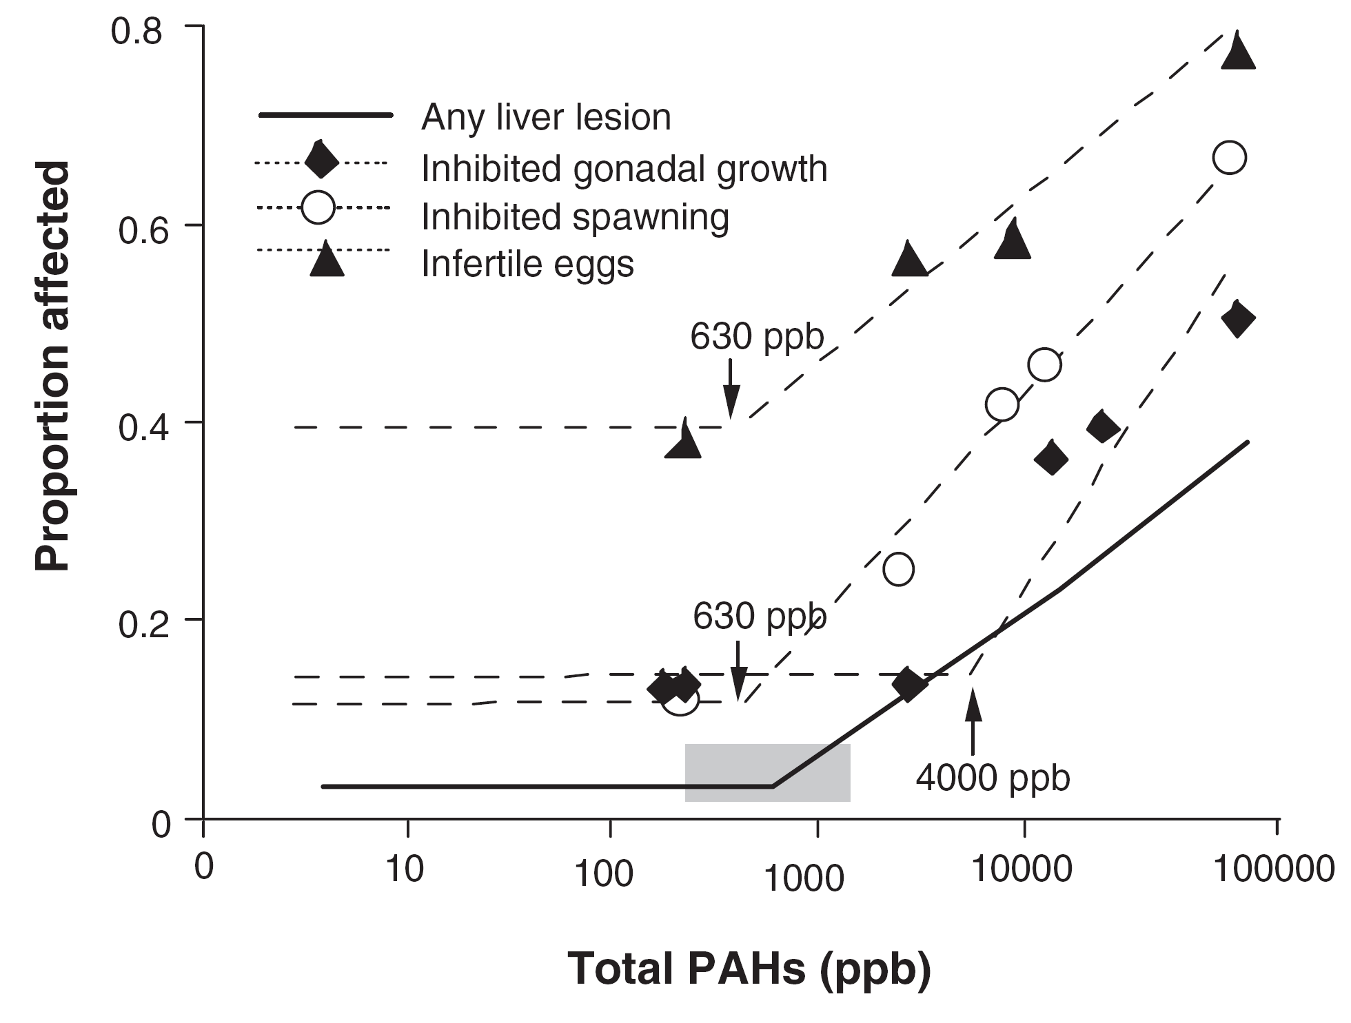
PAHs & Fish
Reproductive Toxicity
Female English sole
in sediment
Johnson, 2002

Slide 19
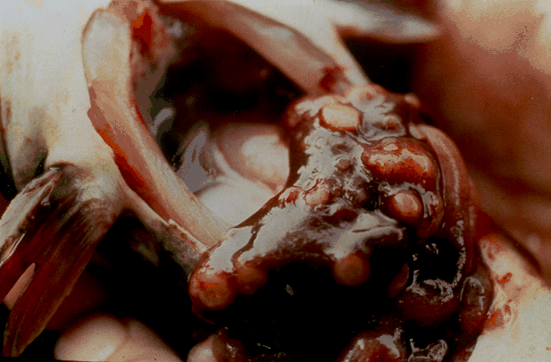
PAHs & Fish
Cancer
Liver carcinomas in brown bullhead
(Courtesy of P. Baumann)

Slide 20
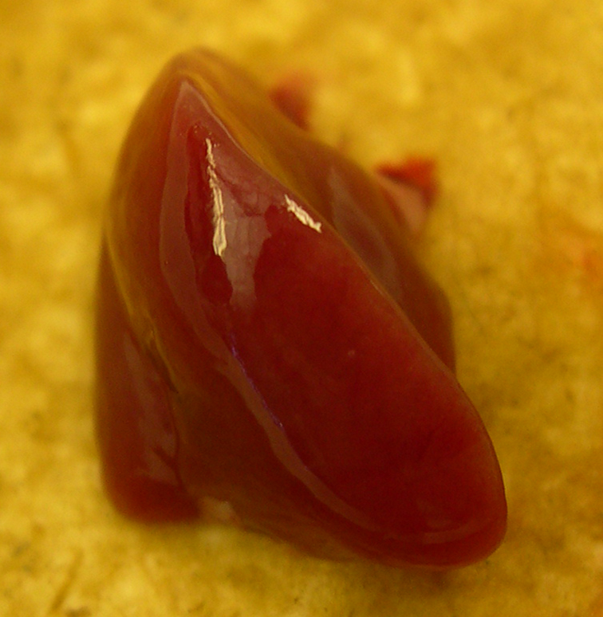
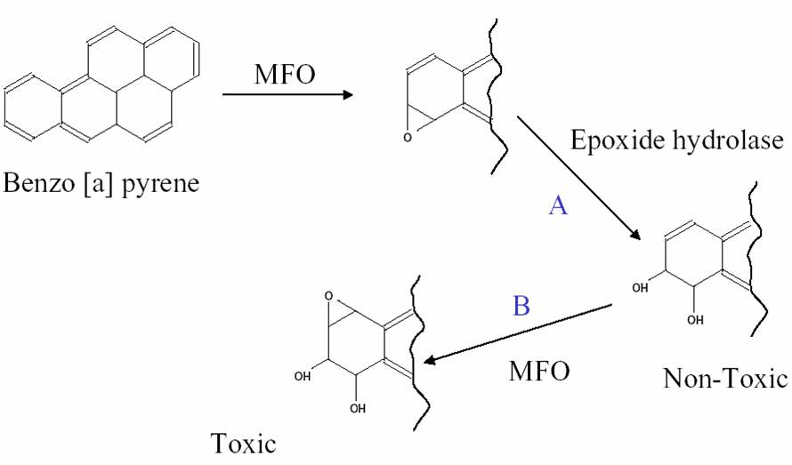
PAHs & Fish
Other Sub-lethal Effects
  Immunotoxicity
  Enzyme Induction
P-450
P-450

Slide 21
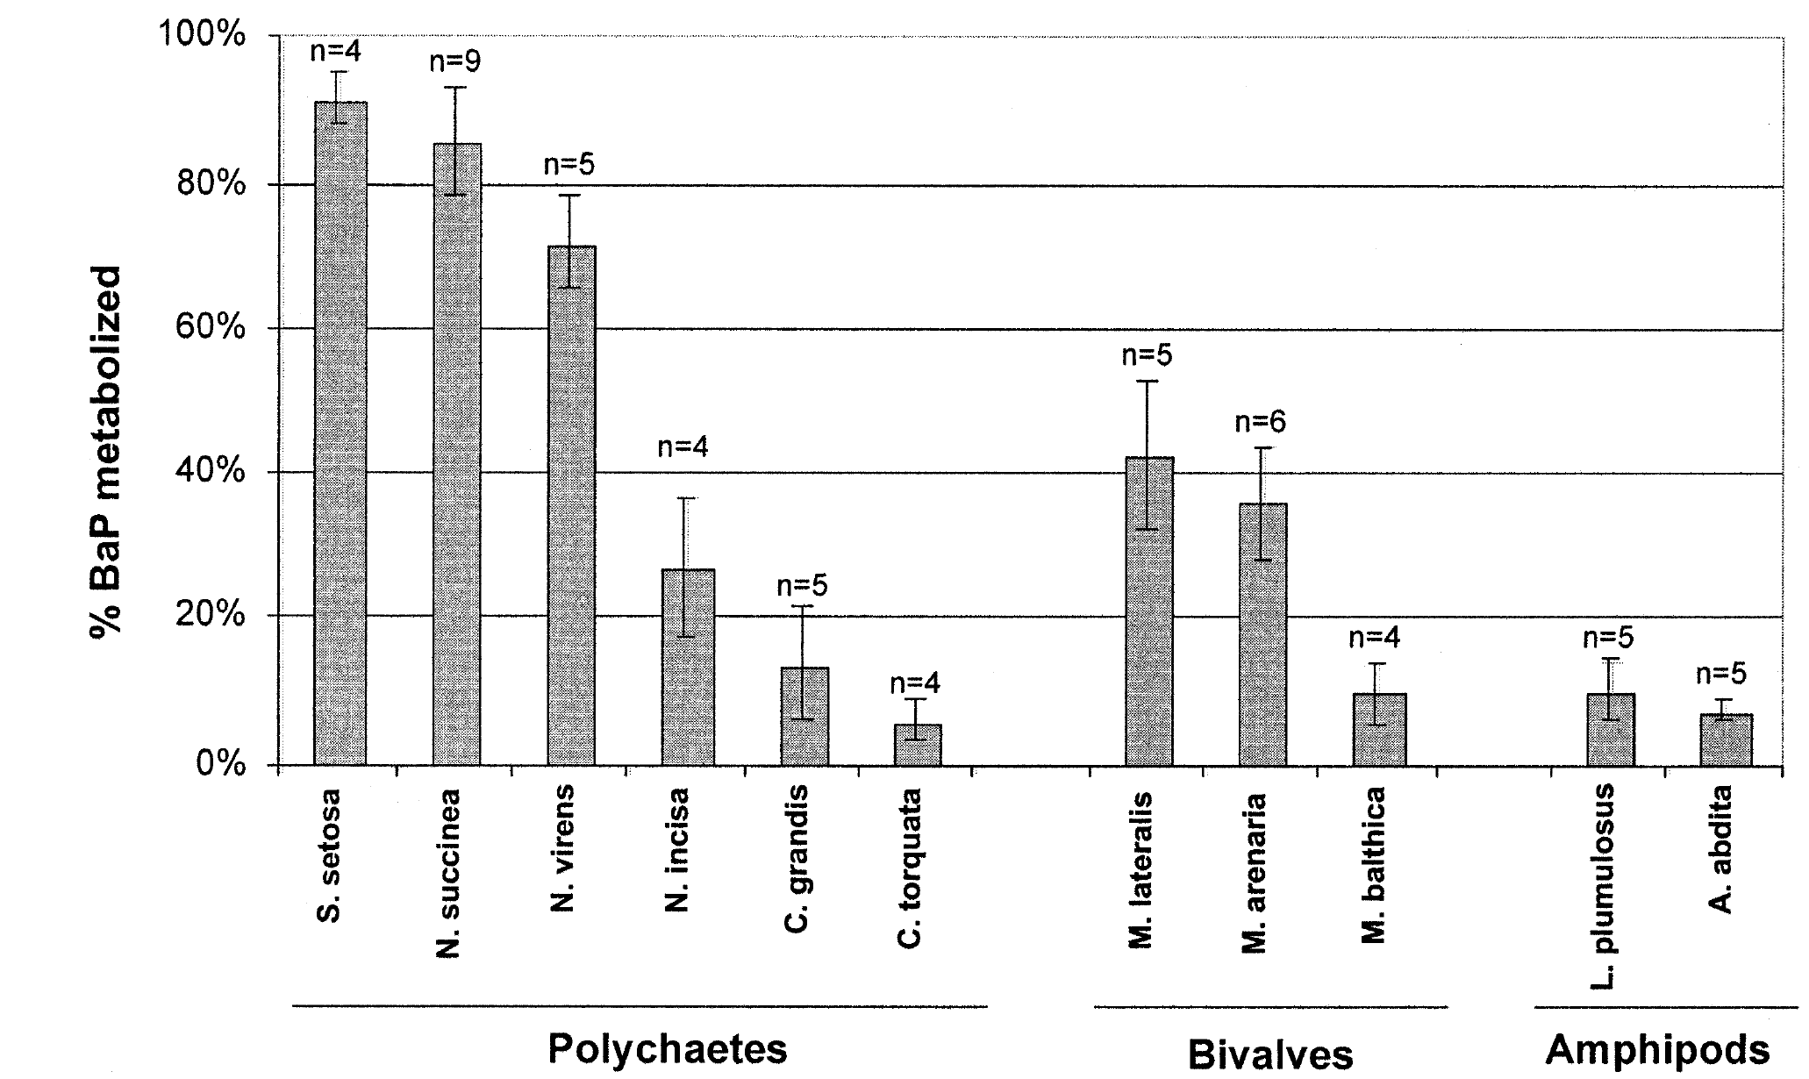
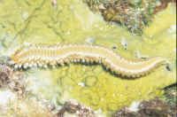

PAH Metabolism in Invertebrates
Rust et al., 2004
Elimination Rates: T_{1/2} for PAHs
  Trout 6 - 9 d vs Invertebrates 0.8 – 30 d
  Meador et al. 1995

Slide 22
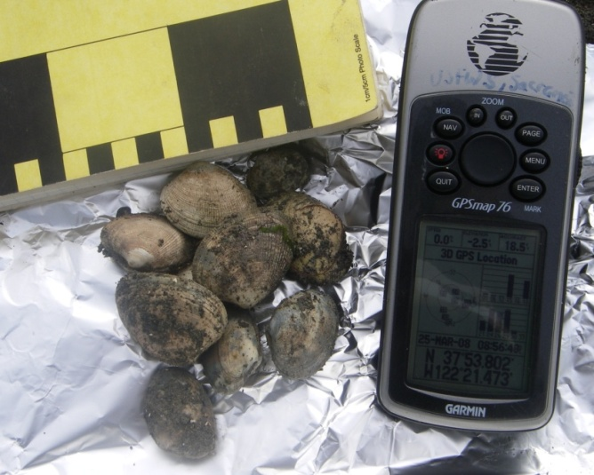
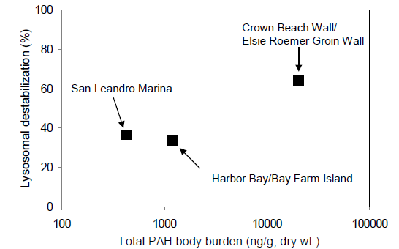
PAHs & Bivalves
“Clam up”
Tissue accumulation
Reduced growth
  Widdows et. al, 1993
Lysosomal destabilization
  Reduced number of lysosomes with intact membranes
Mortality
  Gaping shells
Hwang, 2010

Slide 23
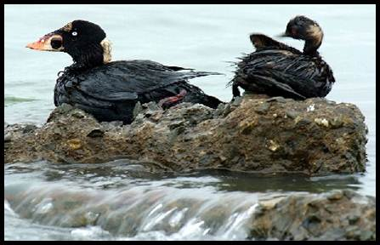
EFFECTS ON AQUATIC BIRDS AND MAMMALS

Slide 24
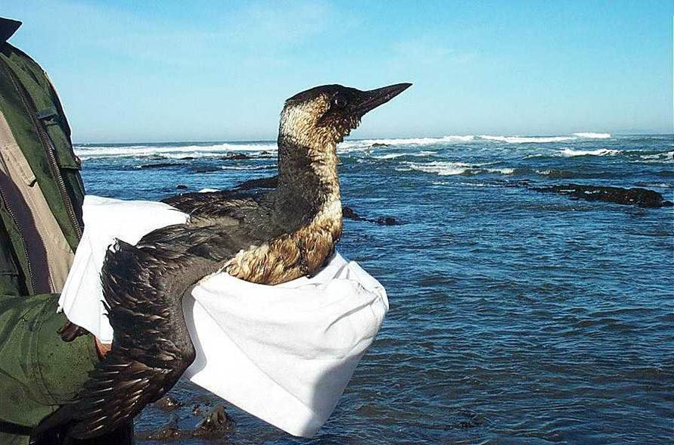
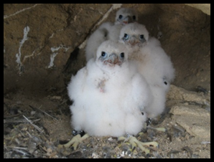
Effects of Oil Contact in Birds
Direct oiling
Indirect oiling of eggs
  Embryotoxicity and embryolethality
  Inhibition of gas exchange and chemical toxicity

Slide 25
Chronic Effects of TPH & PAHs in Birds & Mammals
Reproduction (Birds):
  ↓ Eggshell strength, egg production, hatchability, fertility (LOAELs; 250-3000 mg/kg/d TPH)
Growth:
  ↓ Body weight
Liver/Kidney Pathologies
  ↑ Liver hypertrophy and P450 enzyme induction
  ↑ Kidney degeneration
Immune Function
  ↓ Disease resistance

Slide 26
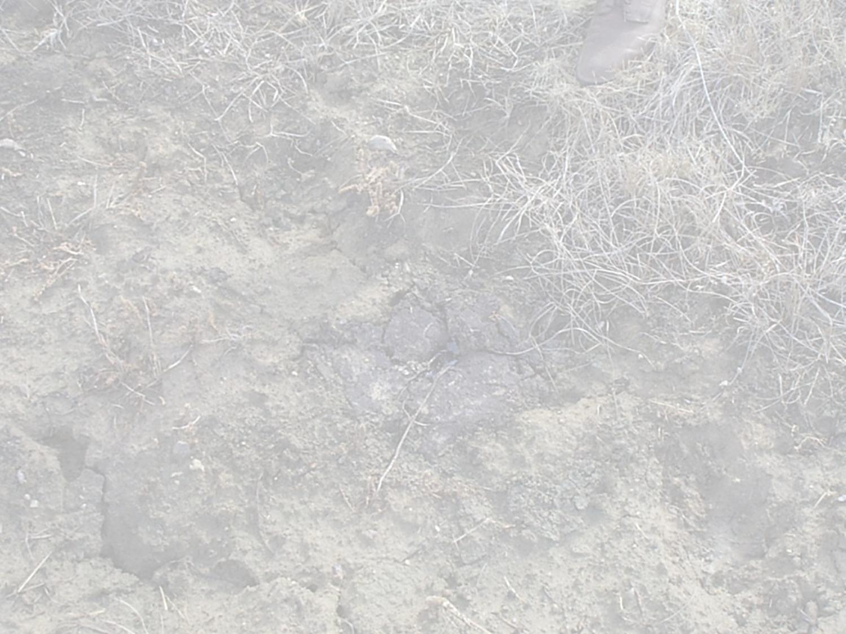
EFFECTS OF PETROLEUM ON TERRESTRIAL ECOSYSTEMS

Slide 27

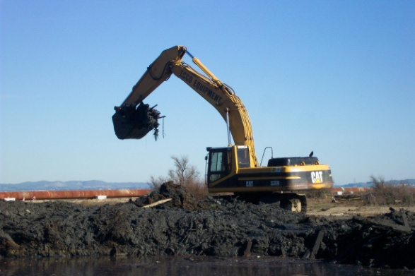
Product Mixtures: TPH
  Regulatory guidelines limited and variable
    100-10,000 mg TPH/kg
  Lighter mixtures more toxic than heavier crude
  Literature studies must match characteristics of spill
Efryomson et al., 2004

Slide 28
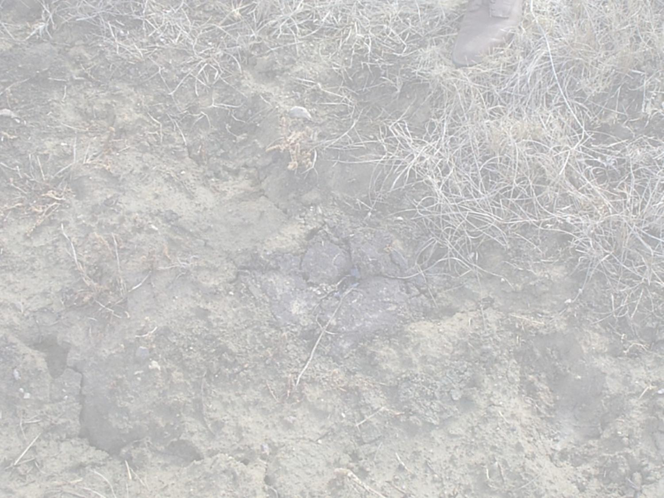
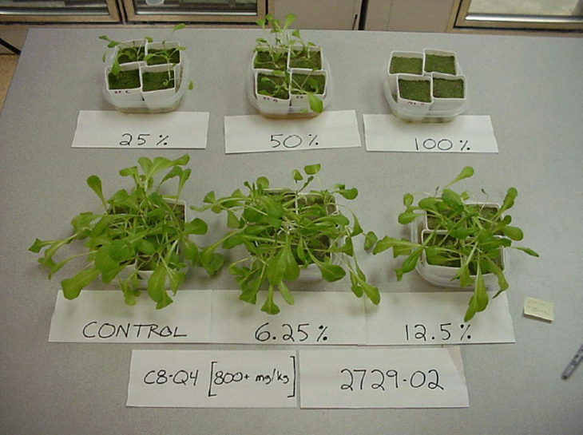
TPH & Plants
Effects on germination and growth
Soil TPH benchmarks for plants
  159 – 7540 mg TPH /kg for crude oils
Efryomson et al., 2004

Slide 29
TPH & Soil Invertebrates
Effects on survival and reproduction
Soil TPH benchmarks for soil invertebrates
  47-1057 mg TPH/kg for crude oils
Efryomson et al., 2004

Slide 30
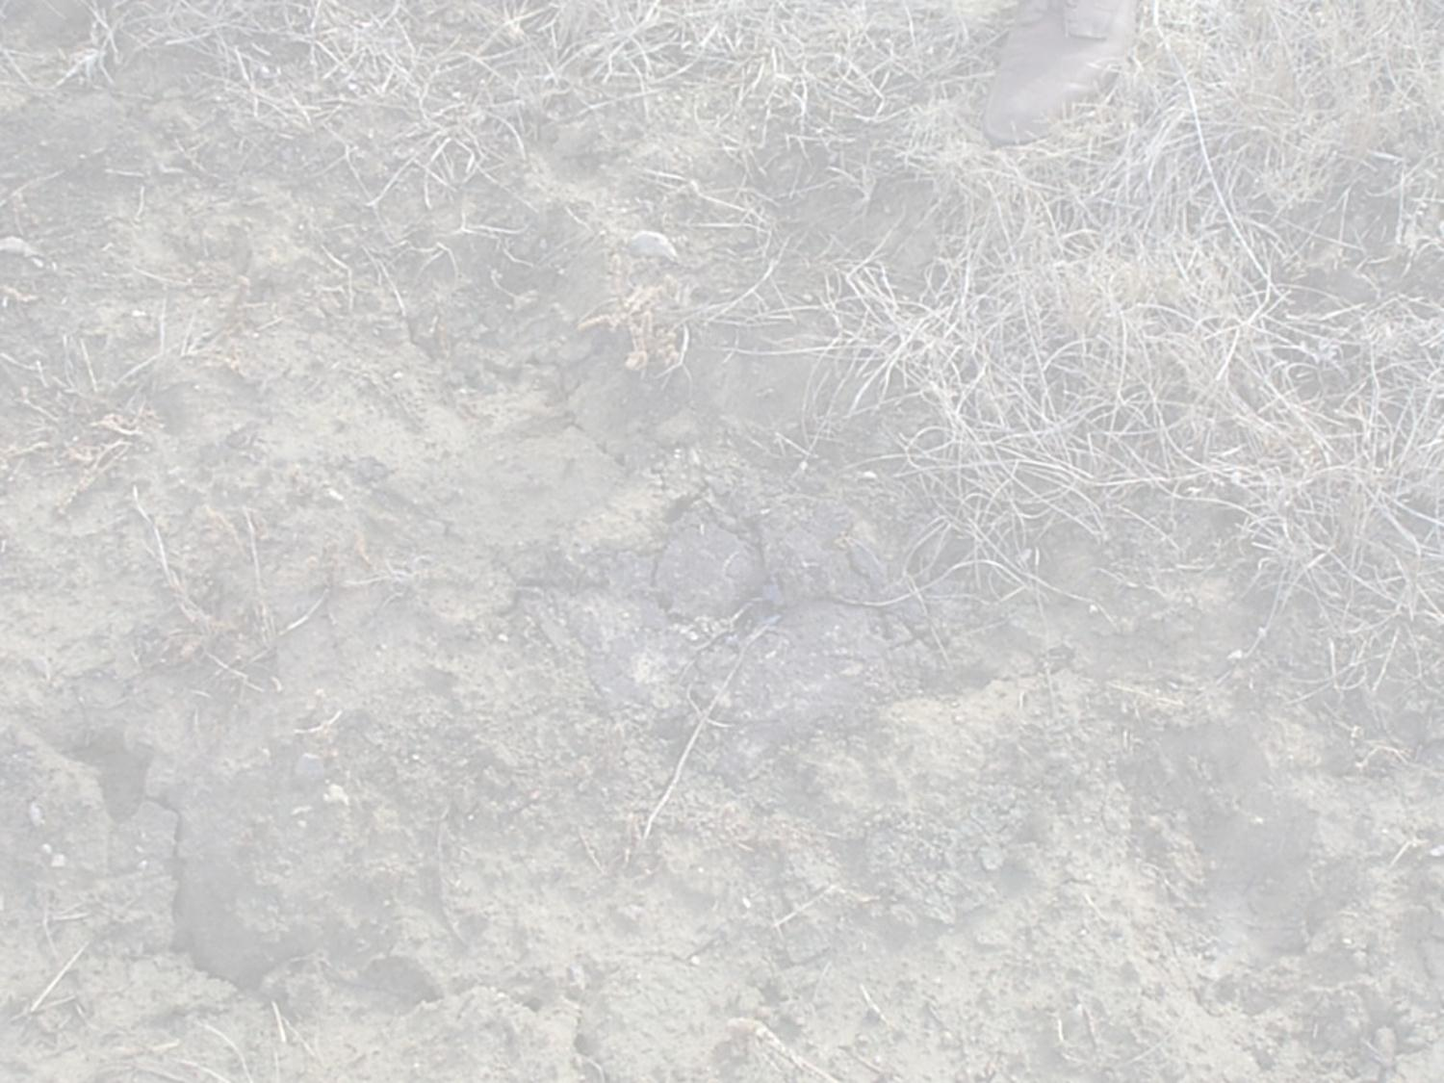
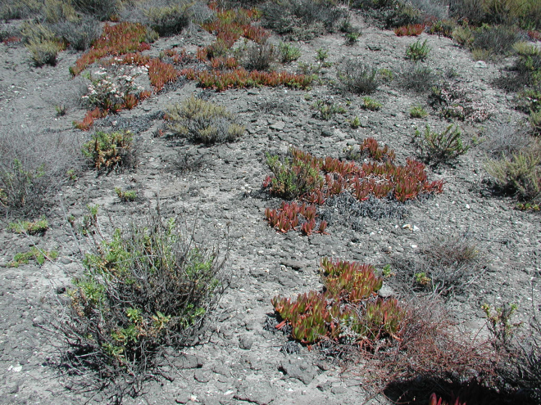
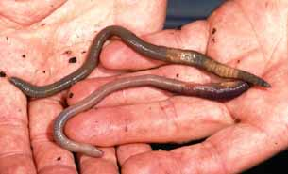
Soil Benchmarks for PAHs
Chemical | EC₂₀ for Plant Growth (mg/kg) | EC₁₀ for Invert Repro (mg/kg)
Fluoranthene | 140 | 37
Pyrene | 49 | 10
Phenanthrene | 37 | 23
Fluorene | 55 | 8
Sverdrup et al. 2001 and 2003

Slide 31
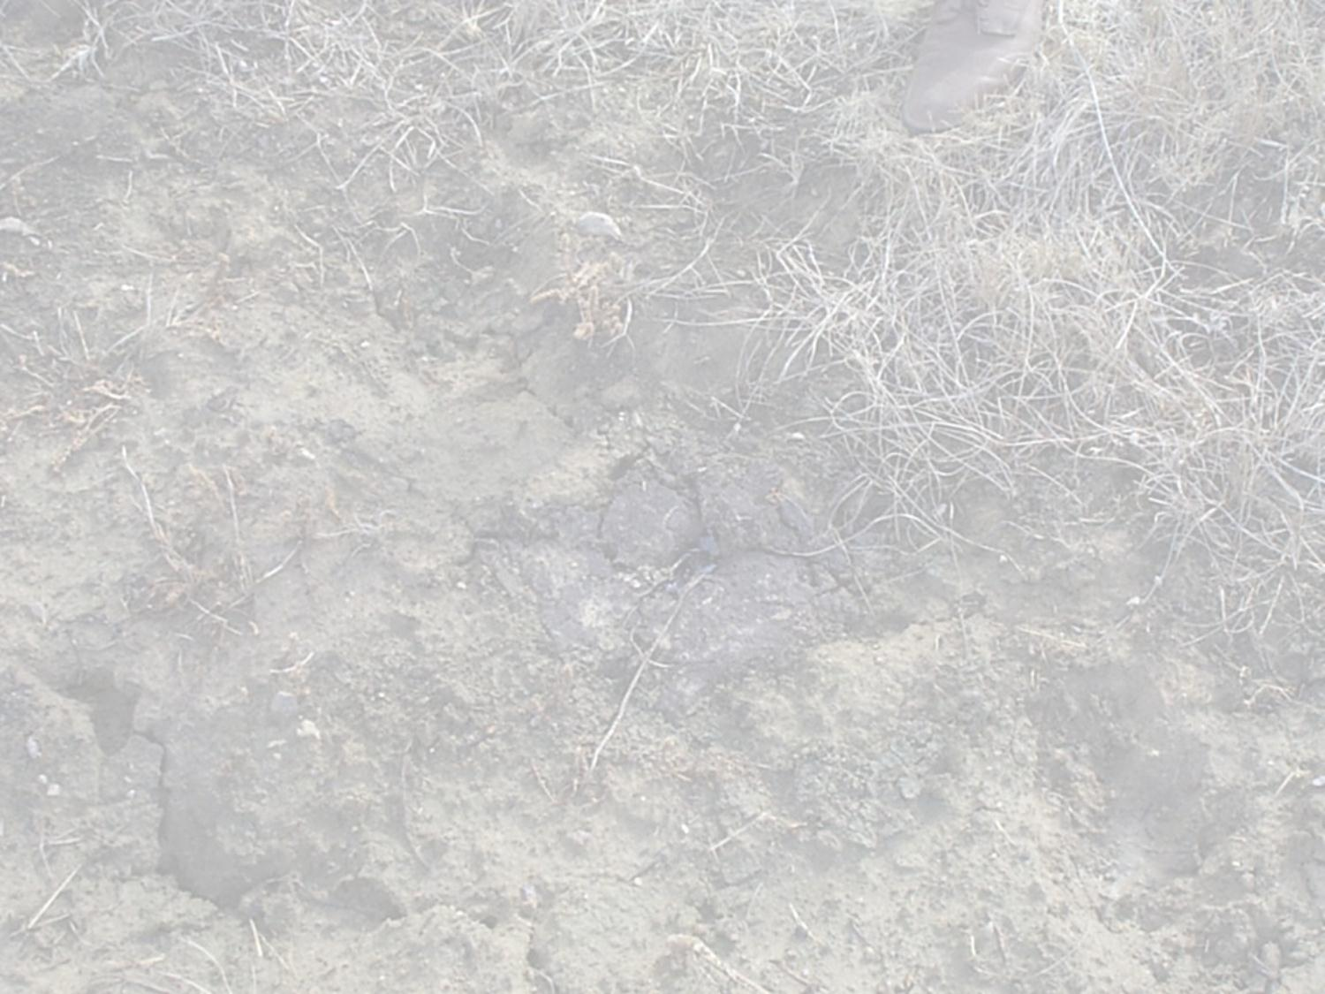
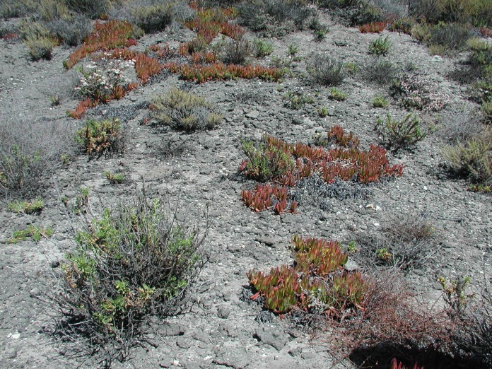
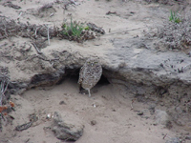
BTEX & Burrowing Animals
Volatiles in subsurface soil or groundwater
BTEX in soil gas
Potential exposure to burrowing animals by inhalation
Effects of benzene exposure on bone marrow
  hematological effects above 9.6 ppmv or 6.8 mg/m³ for a burrowing mammal
ATSDR, 1997

Slide 32
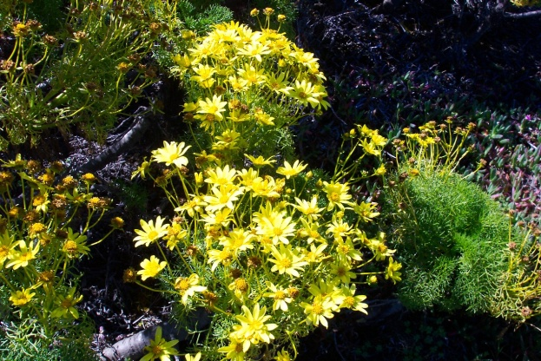
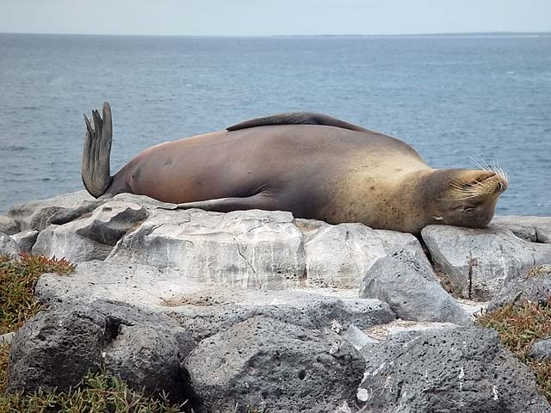
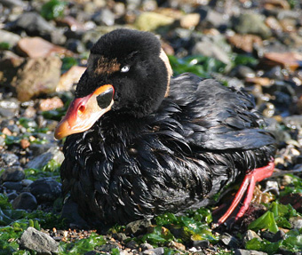
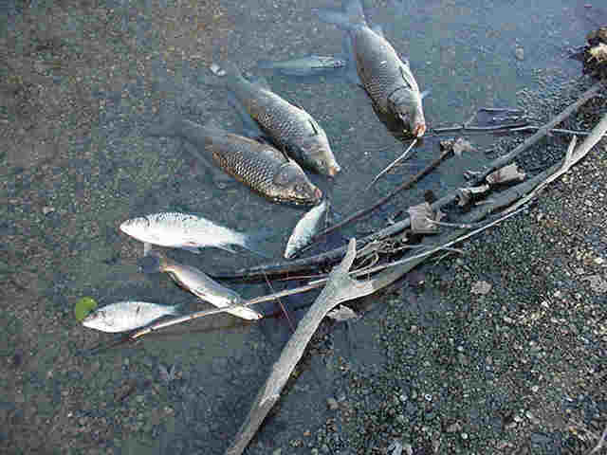
Petroleum products may be toxic to a wide variety of ecological receptors
Evaluation of the toxicity of petroleum mixtures is complex
Important to define the exposure-effects relationship to predict direct impacts
Short-term and long-term impacts may be assessed by a variety of methods

Slide 33
Questions?

