Slide 1
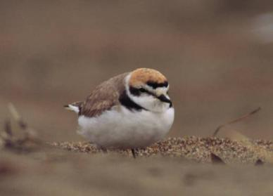
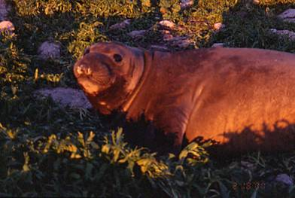
Environmental Response to Oil Spills (EROS) –
NOAA & OSPR’s Pollution Response Roles
March 25, 2014
Jordan Stout, NOAA
Josh Curtis, OSPR

Slide 2
Overview
Background & Context
  Some Oil Spill History
  NOAA & OSPR Organization
Evolution of EROS
Table Top Exercise
Exercise Review

Slide 3
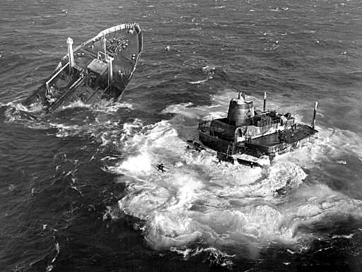
Background & Historic Perspective
T/V Argo Merchant
(December 15, 1976)
  Grounded on Middle Rip Shoal off Nantucket, MA
  Broke up after 6 days
  Spilled 7.7 million gallons of No. 6 Fuel Oil
  60x100 nautical mile slick
  Demonstrated need for Scientific Support
Notes:
Too rough to lighter or salvage
Spilled Oil Research (SOR) Team established
NCP established scientific support for EPA & USCG
Scientific Support focused on trajectories
1978 - SOR Team became distinct unit of NOAA (an official document exists somewhere)

Slide 4
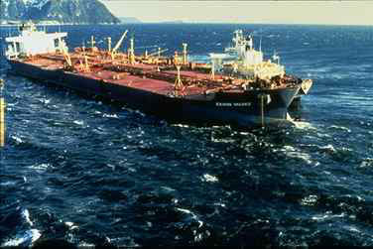
Background & Historic Perspective
T/V Exxon Valdez
(March 24, 1989)
  Ground on Bligh Reef, Prince William Sound, AK
  Spilled nearly 11 million gallons of Prudhoe Bay Crude Oil
  1,200+ miles of shoreline impacted
  35,000 seabirds killed
  1,000 marine mammals killed
  >10,000 responders
  Prompted Oil Pollution Act of 1990 (OPA 90)
Notes:
Scientific Support Coordinators (SSCs) as “Special Teams”
Scientific support included trajectories & biology

Slide 5
NOAA’s
Office of Response & Restoration
Office of Response
& Restoration (OR&R)
Emergency Response
Division (ERD)
Marine Debris
Division
Assessment & Restoration
Division (ARD)
Business Services
Group (BSG)
NW-Great Lakes Region
Budget & Financial
Management
SW Region
Regional Operations Branch
Technical & Scientific
Services Branch
Program , Policy &
Planning
NE Region
Cost Recovery
Response Support Team
SE-Gulf of Mexico Region
Information Technology
Development Team
Communications
Branch
Spatial Data
Branch
Notes:
On responses, you’re likely to see folks from ERD though some ARD folks might be involved periodically.
Most of ERD is housed in Seattle and considered the “Home Team”
Provide support to “Field” folks (myself & deployed responders)
Provide 24/7 response support (via SSCs)

Slide 6
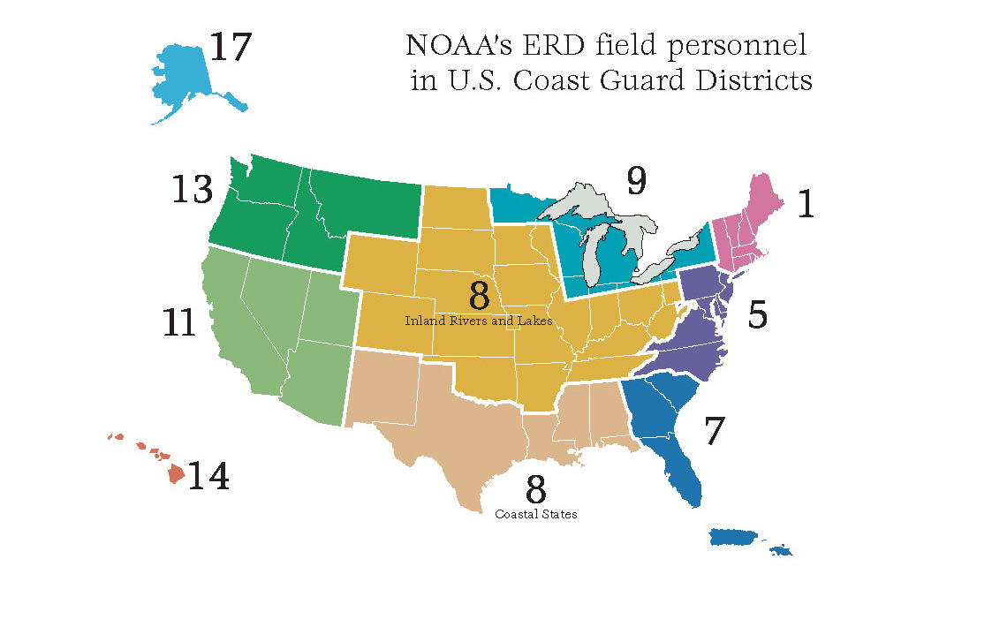
Notes:
Scientific Support Coordinators are staff advisors to Federal On-Scene Coordinators (FOSCs) responsible for planning the scientific aspects of spill response and are available to coordinate on-scene scientific operations if requested.
24/7 National Network
9 Regional Scientific Support Coordinators
“Me & my rolodex”
Scientific Support Team in Seattle
Home & Away Teams
Provided by Emergency Response Division (formerly “NOAA HazMat”)
Division has provided all sorts of response support for >30 years
Provide support for nearly 200 responses/year
Lots of varied, in-house institutional knowledge
When Sector calls me, I reach back to Seattle & form an incident-specific team of spill scientists…

Slide 7
NOAA ERD Support
During Incidents
24/7 availablility
Respond to oil & hazmat spills (domestic & international)
Incident-specific Scientific Support Team may include
  Oceanographers
  Modelers
  Biologists
  Chemists
  Physicists
  Weather Forecasters
  Information Management Specialists
Provide scientific support
  Chemical hazard analysis & interpretation
  Pollutant mapping & trajectory analysis
  Resources at Risk
  Provide recommendations for impact mitigation measures
  Facilitate and coordinate spill-specific research as appropriate
Notes:
Multi-disciplinary, incident-specific teams of spill scientists
Flexible & scalable

Slide 8
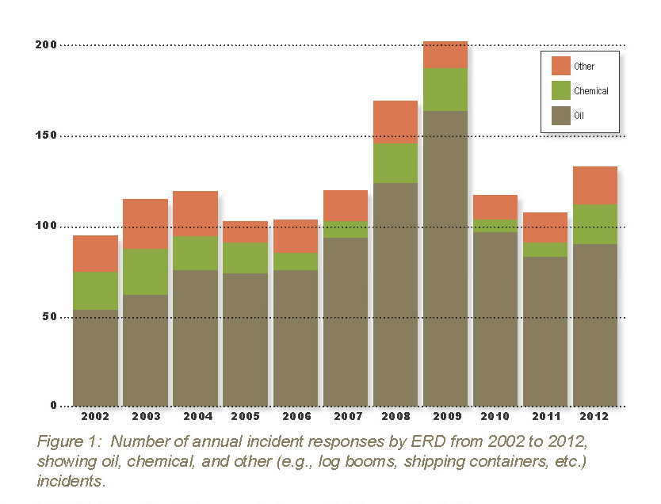

Slide 9
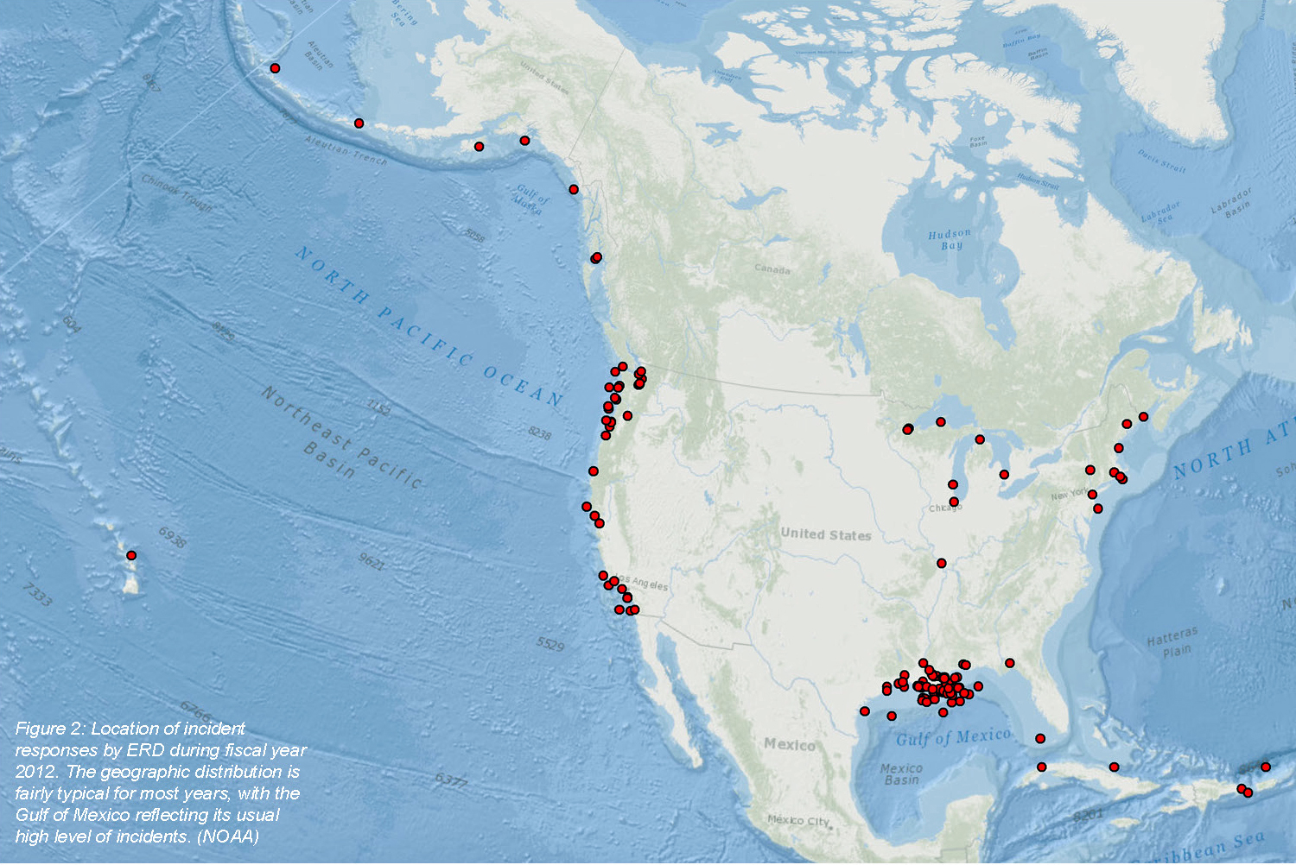

Slide 10
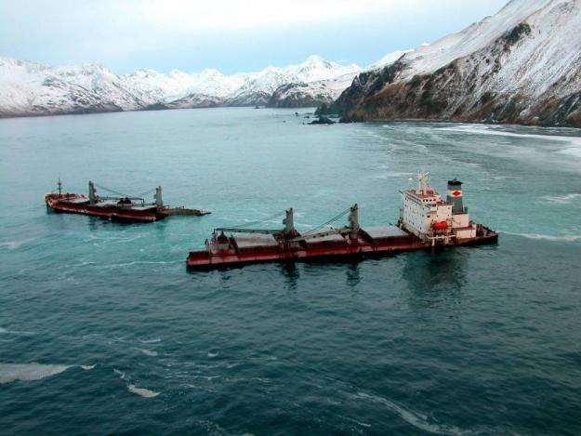
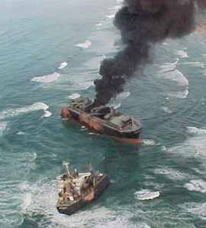
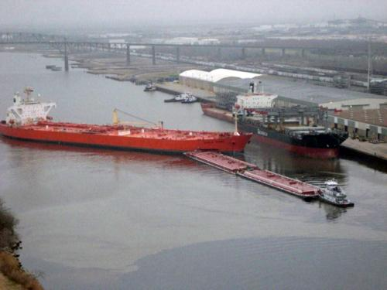
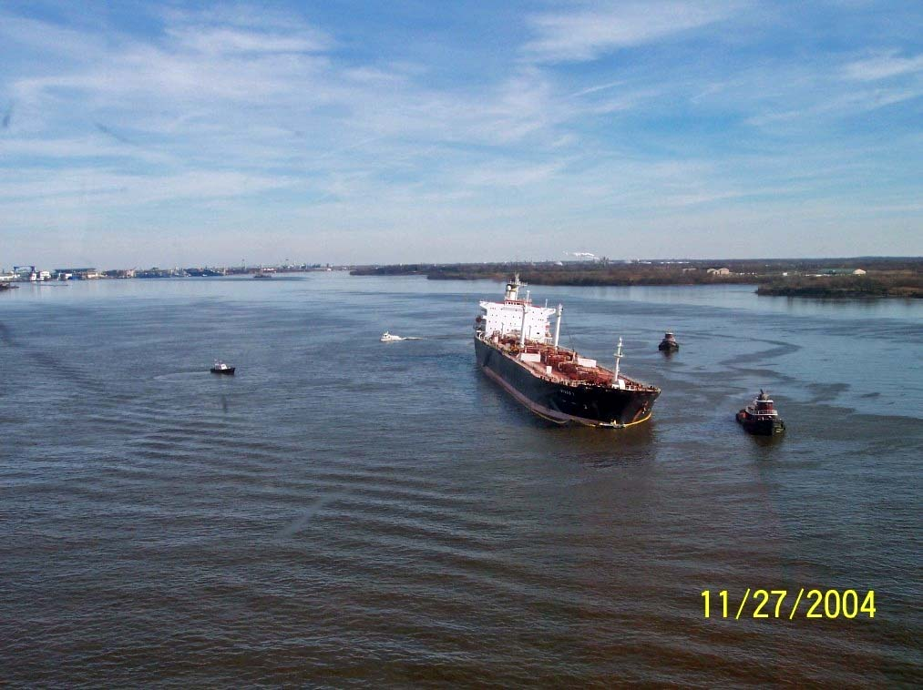
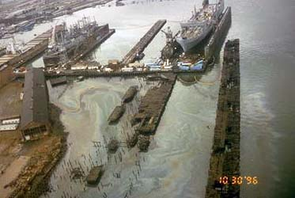
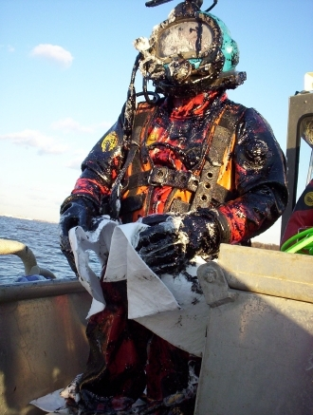
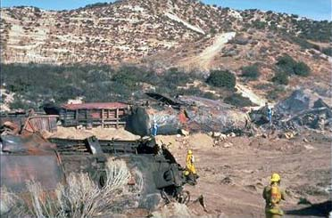
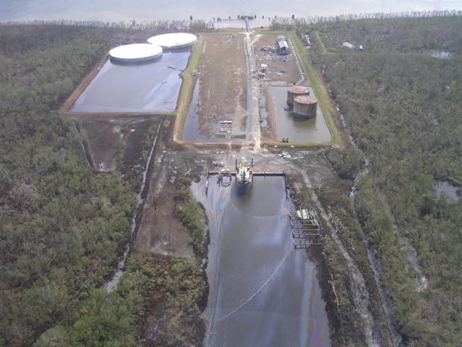
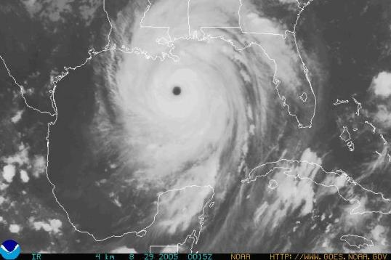
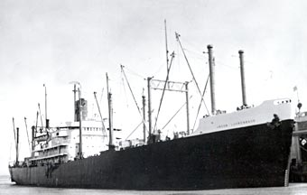
Domestic incidents
Jacob Lukenbach
Puerto Rican
New Carissa
Athos I
Selendang
DBL-152
Katrina spills
Katrina orphan HAZMAT containers
Notes:
Played a role in every moderate & major US spill in last 30yrs.
2003 – ____
2004 – Selendang
2004 – Athos I
2005 – Hurricane Katrina
2006 – _____
2007 – Tong Cheng
2007 – Cosco Busan
2008 – DM932
Hurricane Katrina (2005):
Fully staff two command posts and one forward operations base (ESF-10 Pollution Response Base in Baton Rouge)
Provide satellite maps of flooded areas for SAR
Provide weather support for operations
Provide navigation survey support to open waterways
Assess immediate HAZMAT threats to public (jointly with EPA and State of Louisiana)
Assess and respond to secondary pollution threats to public and natural resources (including oil spills)

Slide 11
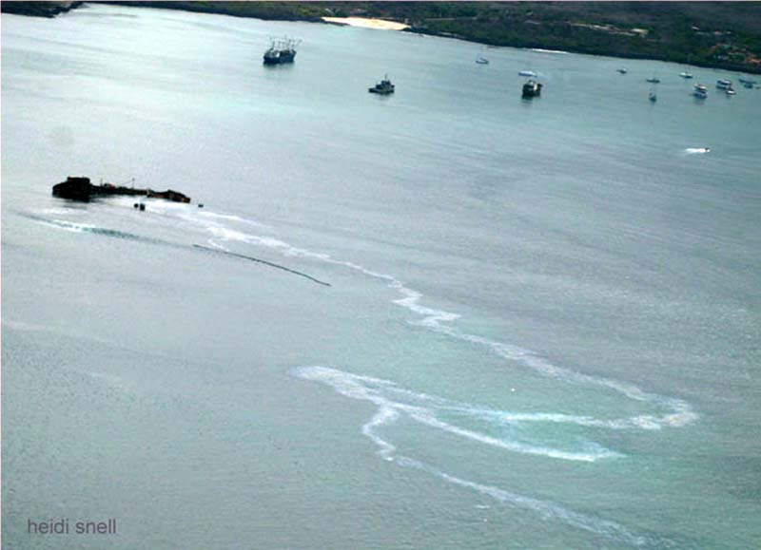
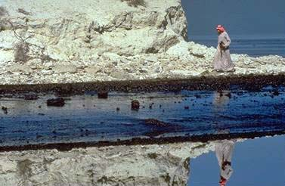
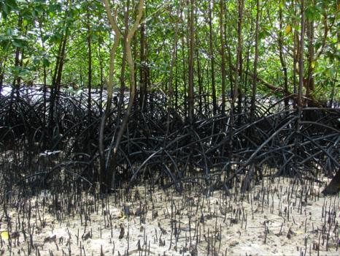
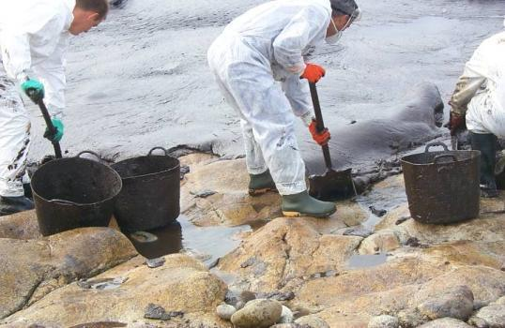
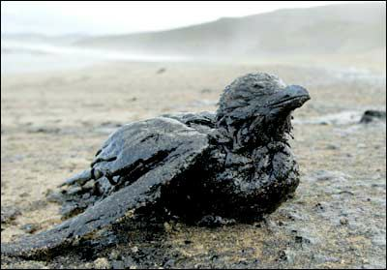
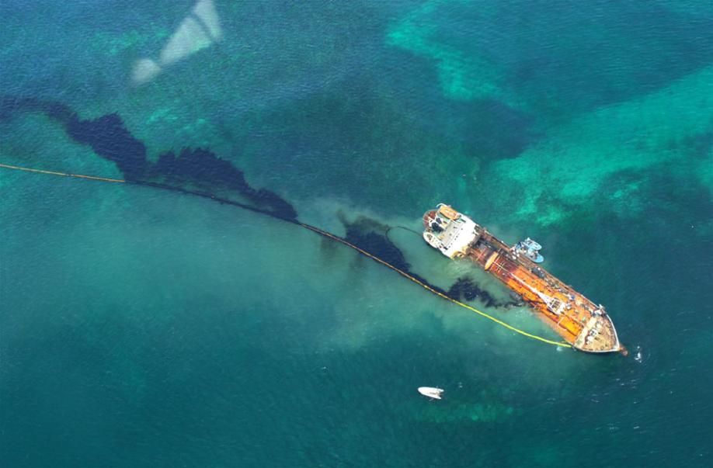
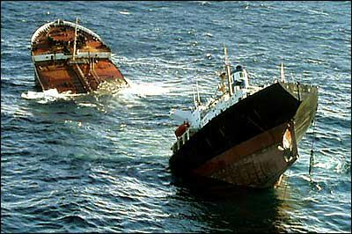
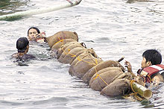
International incidents
Prestige (Spain)
Solar I (Phillipines)
M/V Jessica (Galapagos)
Desert Storm (Persian Gulf)
Notes:
1991 – Desert Storm (Persian Gulf)
2001 – T/V Jessica (Galapagos)
2002 – Prestige (Spain)
2003 – ____
2004 – ____
2005 – ____
2006 – Solar I (Phillipines)
2007 – T/V Hebei Spirit (Korea)
T/V Prestige spill in Spain (2002):
Requested by Spanish government
Forecast oil spill fate and trajectory
Shoreline clean up by environmentally protective means
Restoration options for natural resources
Long-term recovery monitoring of oiled coastline
Fisheries management and contaminant expertise
Managing seafood health issues
Environmental injury assessment
Assess economic damages and natural resource injuries

Slide 12
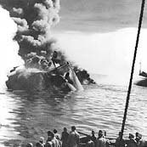
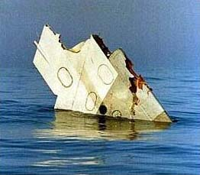
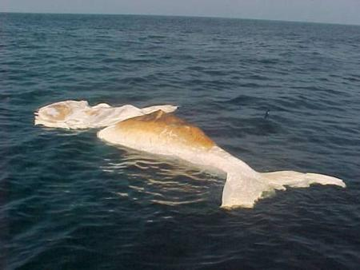
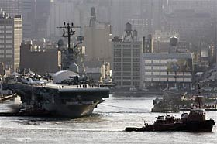
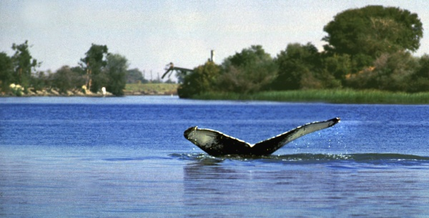
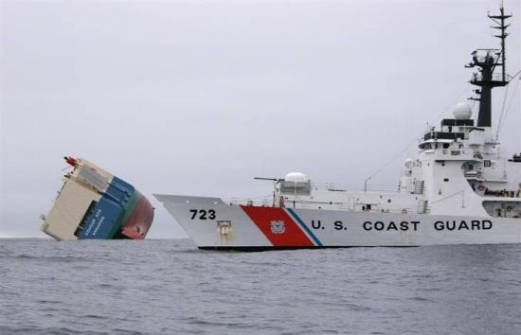
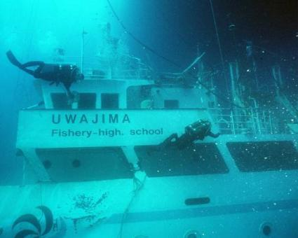
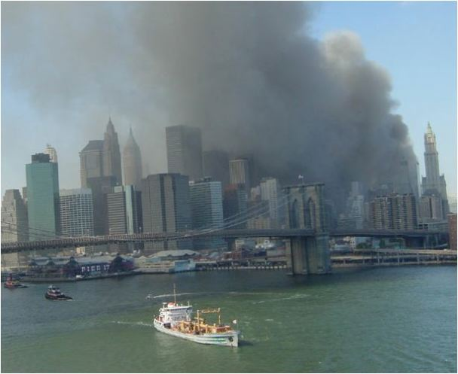
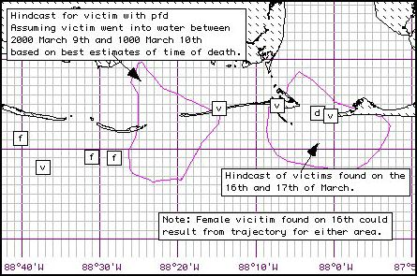
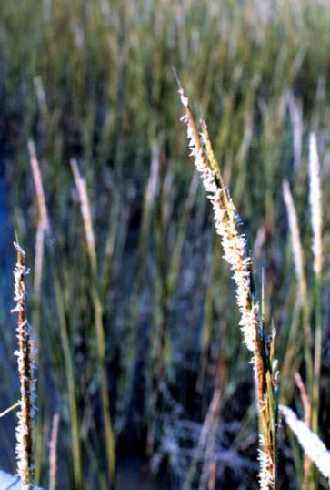
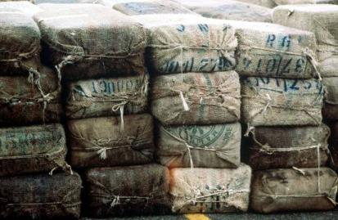
Non-traditional support
Ehime Maru
Alaska Airlines Flight 261
John F. Kennedy, Jr. airplane debris
USS Intrepid
9/11
Whale carcasses
Body recoveries
Humphrey the whale
Spartina seed dispersion in Puget Sound
Notes:
Species dispersion (Spartina seeds, Algae…)
Red tide distribution
Garbage & log spills
Potential ship scuttling locations
Drug bales
2003 – ____
2004 – ____
2005 – ____
2006 – Aircraft carrier in NY???
2007 – Sacramento Humpback Whales
2008 – US Satellite, Long Island fireworks & Great Lakes trash

Slide 13
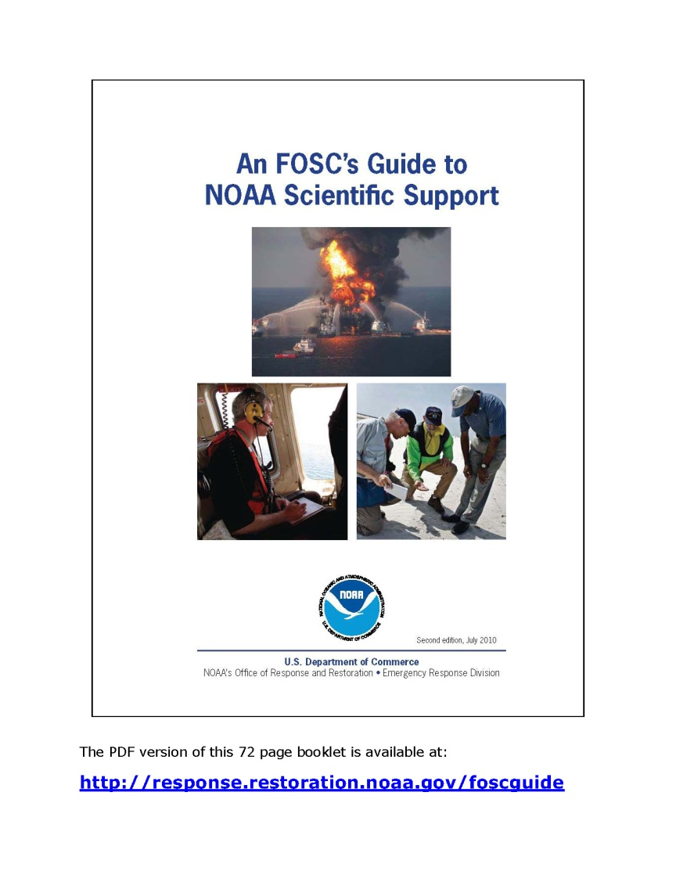
NOAA support between incidents
Planning
  ACPs, RRTs, NRT, JRTs
  ERAs & TAP
Drill support
Training
Outreach
POC for NOAA models
Support other USCG missions
And…
Notes:
Planning –
committee members
workshops
Exercises – 15-20 large (PREP-scale) exercises/year
Trainings – 700–900 students/year
Outreach – Schools, briefings, ___
NOAA model POC -

Slide 14
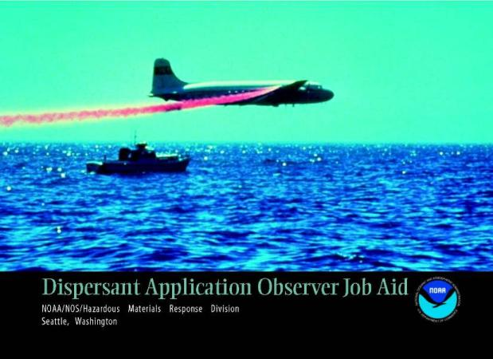
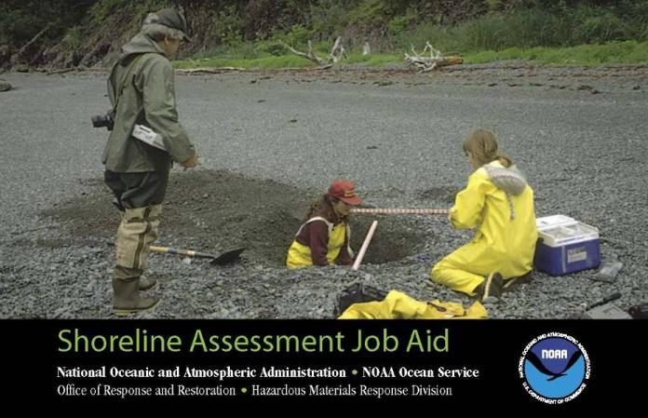
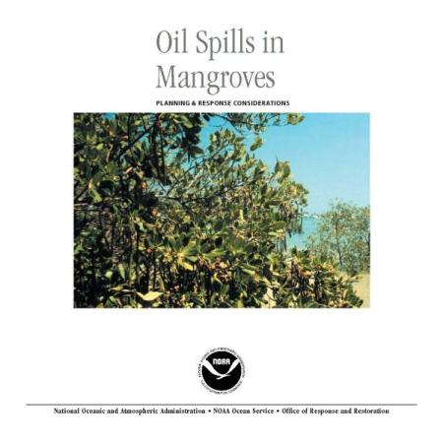
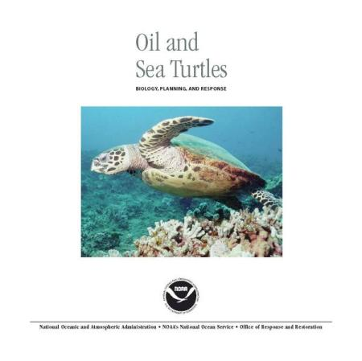
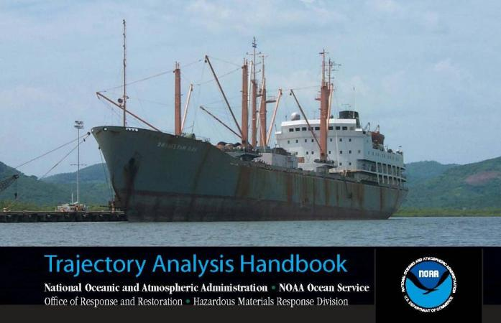
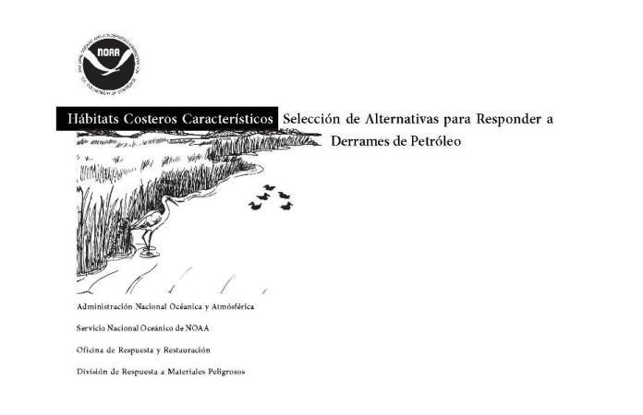
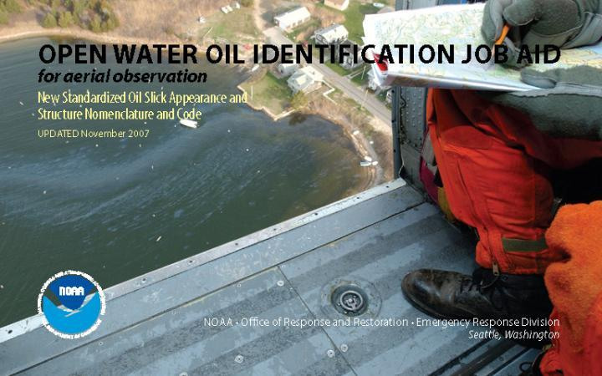
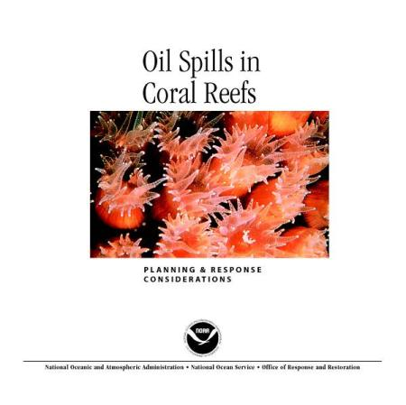
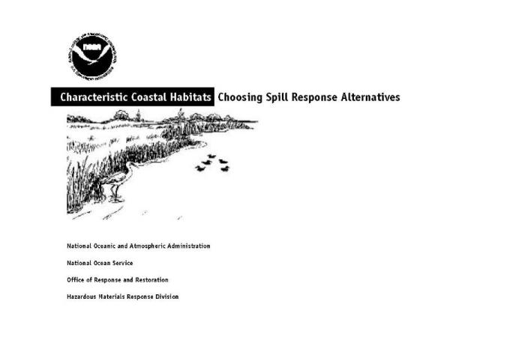
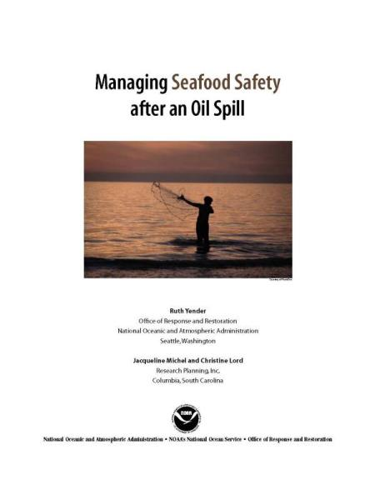
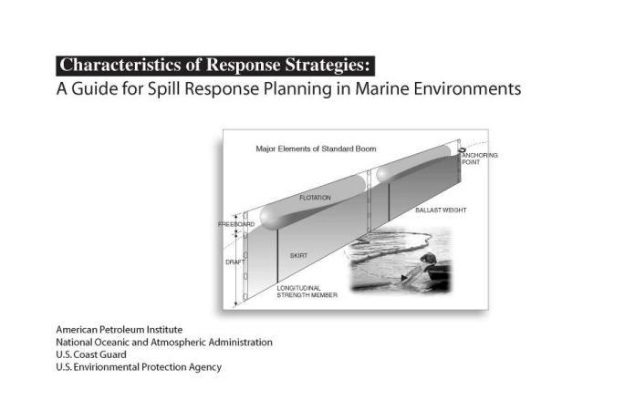
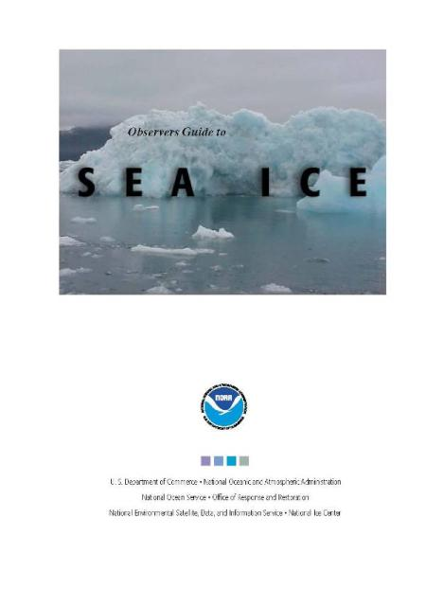
Factsheets, manuals & job aids
Shoreline Assessment Manual
SCAT
Oil Observation Job Aids
Response in Tropical Habitats
Spills & Seafood Safety
Notes:
Operationally-relevant job aids & reference materials
Shoreline Assessment Manual
SCAT
Oil Observation Job Aids
Response in Tropical Habitats
Spills & Seafood Safety

Slide 15
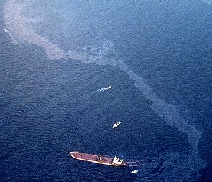
Background & Historic Perspective:
OSPR
Shell Martinez Oil Spill
(April 23, 1988)
  ~ 400,000 gal of crude oil
T/V American Trader
(February 7, 1990)
  Ran over its anchor off Huntington Beach, CA
  Spilled 416,500+ gallons of crude oil
  Beaches closed
  Fish impacted
  3,400 birds killed
  Prompted Lempert-Keene-Seastrand (OSPRA) 1990
Notes:
Platform A (January 1969; ~4million gallons) – set stage for modern Environmental Movement, Earth Day and (some say) EPA & NOAA.
Shell Martinez - a year prior to EVOS. AST release.
American Trader - a year after EVOS. Ran over her anchor.
Lempert-Keene also known as Oil Spill Prevention & Response Act (OSPRA)

Slide 16
Department of Fish & Wildlife
Office of Spill Prevention & Response
DFW Director
(Charlton Bonham)
Legal Branch
Technical Advisory
Committee
(10 members)
OSPR Administrator
DFW Chief Deputy Director
(Tom Cullen)
Deputy Administrator
(Yvonne Addassi)
Executive Support Staff
Scientific Branch
Financial & Administrative
Services Branch
Marine Safety, Enforcement
& Response Branch
Notes:
On a response, you’re likely to see folks from:
Marine Safety, Enforcement & Response Branch (DFG Wardens & Oil Spill Prevention Specialists)
Scientific branch

Slide 17
OSPR – Scientific Branch
Scientific Branch
Chief
(Julie Yamamoto)
Field Services & Veterinary
Science Program
(Mike Sowby)
Response Support Program
(Randy Imai)
Resource Assessment Program
(Mike Anderson)
Laboratories
(Dave Crane)
Scientific Field
Response
GIS
NRDA / Restoration
Petroleum Chemistry
Lab
Veterinary
Services
Health & Safety
BRAC
Water Pollution
Control Lab
ART
CERCLA
Pesticides Lab
Ballast Water
Marine Pollution
Studies Lab
Wildlife Ops
Notes:
Field Services & Veterinary Science Lab Progarm

Slide 18
Background & Historic Perspective
OPA 90 & OSPRA in CA set in motion many environmental planning & prevention activities…
  Area Contingency Planning
    ID sensitive sites
    Response strategies, GRP’s
  C-Plans for vessels & facilities
  Drill & Exercise programs
  Adoption of ICS for oil spill response
  SCAT
  ESI
  Wildlife response protocols (OWCN in CA)
  NRDA
Notes:
We’ll be touching on the last 4 items here in class this week

Slide 19

As an emergency unfolds...
What got spilled?
Where will it go?
Who/what will it hit?
What might happen?
What can be done?
Notes:
SST composition will be spill-specific to meet the needs & demands of the incident & the FOSC
Oceanographers
Modelers
Biologists
Chemists
Physicists
Weather Forecasters
Info. Management Specialists
Others
How we do it:
Incident-specific weather forecasts
Tides & currents
Modeling & trajectory forecasts
Pollutant chemistry, fate & environmental effects
Overflight observations
Natural resources at risk (RAR)
Information management
Shoreline Cleanup Assessment (SCAT)
Environmental issues & trade-offs
Cleanup recommendations & monitoring
Consultation
Other stuff… Navigation Response Team, for instance.

Slide 20
Evolution of EROS
1991-92 NOAA trained OSPR in (2) one week courses
Mid-1990’s NOAA developed Science of Oil Spills (SOS) course
2001 NOAA & OSPR co-teach SOS
2005 OSPR develops Environmental Response to Oil Spills (EROS)
Notes:
Remember that OSPR started in early 90’s with the passage of Lempert-Keene
NOAA’s SOS class provides training nationwide, with 8 sessions scheduled this year

Slide 21
Environmental Response to Oil Spills (EROS) – an Oil Spill Exercise
March 25, 2014
Jordan Stout, NOAA
Josh Curtis, OSPR

Slide 22
Table Top Exercise
A facilitated walk-through of a spill response
To enhance your environmental responder skills, and
Get you thinking about the type of information required to respond to a large spill
  Break into 6 equal teams
  Introduce yourself & experience
  Using materials provided, discuss questions & possible solutions
  Whole class review at end

Slide 23

Exercise and Spill Scenario
The T/V HARDLUCK is inbound to San Francisco Bay in the central traffic lane about 20 miles from the Golden Gate. The weather is calm but foggy. At approximately 0300 hrs she collides with an outbound barge rupturing her port side. Oil is in the water. The barge capsizes but remains afloat. The tug is unaffected.
Notes:
Hmmm, this scenario is not unlike the T/V Eagle Otome…

Slide 24


HARDLUCK

Slide 25
COASTAL WATERS FORECAST NATIONAL WEATHER SERVICE SAN FRANCISCO CA
POINT ARENA TO PIGEON POINT TO 20 NM –
POINT ARENA TO PIGEON POINT 20 TO 60 NM OFFSHORE –
747 AM PDT TUE APR 19 2011
...SMALL CRAFT ADVISORY TODAY AND TONIGHT... .
TODAY
W TO NW WINDS 15 TO 25 KT. DECREASING TO 10 TO 20 KT IN THE AFTERNOON. WIND WAVES 2 TO 5 FT. NW SWELL 5 TO 7 FT AT 9 SECONDS.
TONIGHT
NW WINDS 10 TO 20 KT. WIND WAVES 2 TO 4 FT. NW SWELL 5 TO 7 FT AT 9 SECONDS. RAIN LIKELY.
WED
NW WINDS 10 TO 20 KT. WIND WAVES 2 TO 4 FT. NW SWELL 5 TO 7 FT AT 8 SECONDS. SHOWERS LIKELY.
WED NIGHT
NW WINDS 10 TO 20 KT. WIND WAVES 2 TO 4 FT. NW SWELL 6 TO 8 FT. RAIN LIKELY.
THU
NW WINDS 10 TO 20 KT. WIND WAVES 2 TO 4 FT. NW SWELL 6 TO 8 FT. RAIN LIKELY.
FRI AND SAT
NW WINDS 5 TO 10 KT. WIND WAVES 1 TO 2 FT. NW SWELL 6 TO 8 FT.

Slide 26
Materials for Environmental Unit
Documentation:
Scenario
Chart
Weather
Ship’s particulars
MSDS
Oil properties sheet
Currents (HF radar output)
ESI Map
ACP site map
Maps of PRNS & GFNMS*
List of questions
Assignments (6 teams):
Oil Group (2 teams)
Trajectory Group (2 teams)
Resource at Risk (RAR) Group (2 teams)
Notes:
STOP HERE
Conduct Exercise
Next Slide is Exercise Review

Slide 27

Let’s
Get
Started!!!
R. LeValley
Notes:
1) Focus on the spill response “process,” the questions, and range of answers.
2) Highlight several topics as a lead-in to presentations that will occur later in the course.
3) Other considerations and “need to know” information that will not be covered in this training course.
4) Open discussion and perhaps a few slides to keep the talks focused and moving. This could also be done on the flipchart or whiteboard.

Slide 28

Oil Group
What oil &/or hazardous materials are involved?
What are the properties of the spilled products?
How will the oil change as it weathers?
What immediate response actions should be taken?
How effective are these response actions likely to be?
Is the use of dispersants or in-situ burning possible?
Who needs to be notified?
What variables do I need to know?

Slide 29

Oceanography & Trajectory Group
What are the weather & oceanic conditions?
What is the expected trajectory of the oil?
What trajectory model input variables are necessary to provide to the spill trajectory modelers?
What are my information sources?

Slide 30

Resources at Risk Group
What are the environmental resources at risk?
What are the human & economic resources at risk?
What are the hazards of the spilled products to humans & wildlife?
Where can I find the information I need?
Who should be notified regarding oiled wildlife & habitat?
Who are the stakeholders?

