Slide 1
State Fishery Closures
Related to
Oil Spills
Randy Imai
Department of Fish and Wildlife
Office of Spill Prevention and Response
Presentation prepared by: Ellen Faurot-Daniels

Slide 2
Objectives for Presentation
Background and context for fishery closure legislation
State authority and process for fishery closures
Closure boundary development and modification, public notices, sampling and analysis, re-opening criteria
State fishery closure relationship to ICS and UC
General process for fishery closure in federal waters
Questions and discussion

Slide 3
Background and context
Legislation that provides the over-arching madate:
- AB 2935 enacted after the 2009 Cosco Busan oil spill
Regulations that implement the legislation:
- Fish and Game Code Section 5654
Protocols that implement the regulations:
- Internal to CDFW-OSPR and OEHHA
  - Other cooperating agencies: CDFW Marine Region, California Department of Public Health (CDPH), USCG, NOAA

Slide 4
State authorities and processes
Protocols describe response to a spill of ≥42 gallons of oil (or oil product) into state marine waters
  Other triggers: If 1) spill is uncontained, and
            2) there is commercial, recreational or
            subsistence fishing, or
            mariculture/aquaculture, in the area
            Also track: Potential spills (e.g., vessel sinking, grounding)

Slide 5
State authorities and processes, continued
CDFW has the authority to close fisheries
OEHHA (Office of Health Hazard Assessment) has the ability to determine risk to human health
********************
The two state agencies work together to determine if there is a potential risk to human health from fishing in the area, or consuming fish or shellfish that warrants protective closure of fisheries while the real risk is being assessed.

Slide 6
The first 24 hours
CDFW-OSPR receives spill notification from Cal-EMA or other trusted source
CDFW-OSPR alerts Field Response Team (FRT)
If spill ≥42 gallons, FRT contacts CDFW-OSPR On Duty Officer (ODO)
ODO (or OSPR management) alerts OSPR Seafood Safety Technical Specialist (OSPR SSTS); OSPR SSTS will alert OEHHA Technical Specialist
OSPR SSTS determines what fishing occurs or may occur in the impacted area

Slide 7
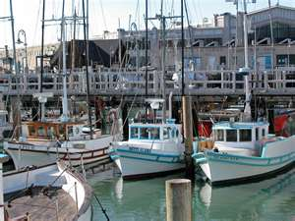
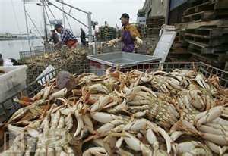
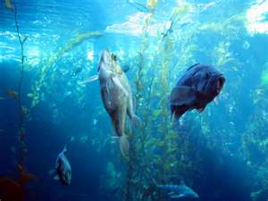
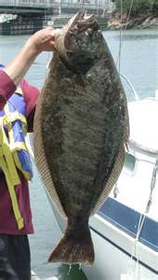
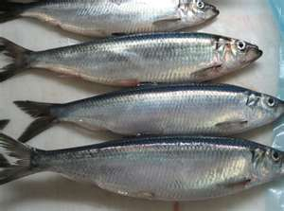
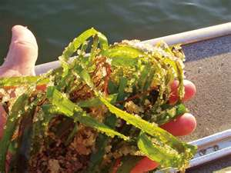
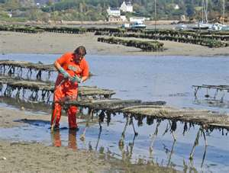
Examples of fisheries and fishing activities that could be affected
Commercial and Mariculture/Aquaculture
Crab
Rockfish
Halibut
Herring
Herring roe
Oyster

Slide 8
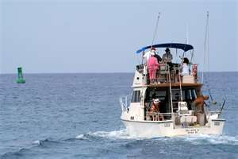
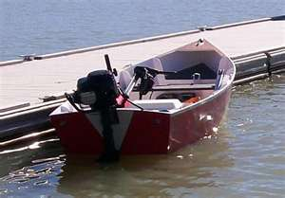
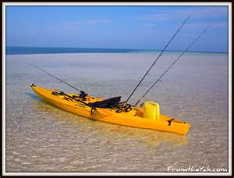
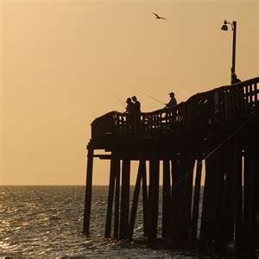

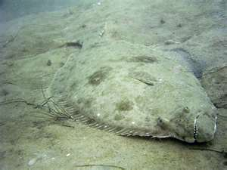
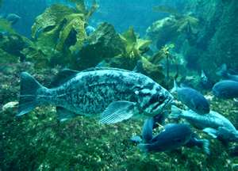
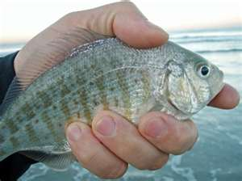
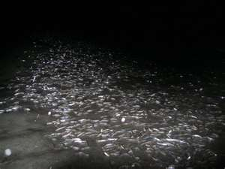
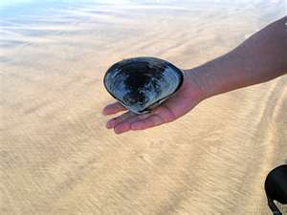
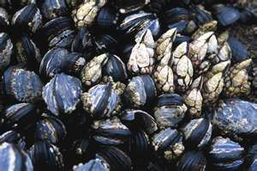
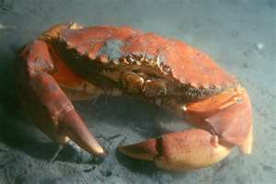
Examples, continued
Recreational and subsistence
Party boat
Kayak
Pier
Shoreline
Skiff
Halibut
Rockfish
Grunion
Surfperch
Mussels
Clams
Rock crab

Slide 9
The first 24 hours, continued:
OSPR SSTS notifies NOAA SSC
OSPR SSTS and OEHHA TS may report to EU at Command Post
OEHHA determines whether public health threat exists (or whether they cannot yet determine threat)
OEHHA notifies DFW Director (in writing) of their recommendation
  Review any prospective closure boundaries with NOAA SSC and SOSC; work with GIS to develop map of prospective closure boundaries

Slide 10
The first 24 hours, continued:
Closure not required if, within 24 hrs of notification, OEHHA finds public health threat does not, or is unlikely, to exist:
(e.g., spill has been contained, no regular public access to fishing area, or CG safety zone in place).

Slide 11
The first 24 hours, continued:
  If there is a closure recommendation, DFW Director will issue a Closure Declaration
    OSPR SSTS notifies SOSC
    OSPR and OEHHA work with PIOs on press releases
    OSPR SSTS communicates closure information to Unified Command
    OSPR SSTS coordinates sign posting
    OSPR SSTS coordinates announcement to fishermen via NOAA Weather Forecasting Office (WFO) if closure includes open water fishing areas
    All flowcharts are in Fishery Closure Protocols, as well as appendices with all relevant contacts, fishing season info, public access points, announcement templates, etc.

Slide 12
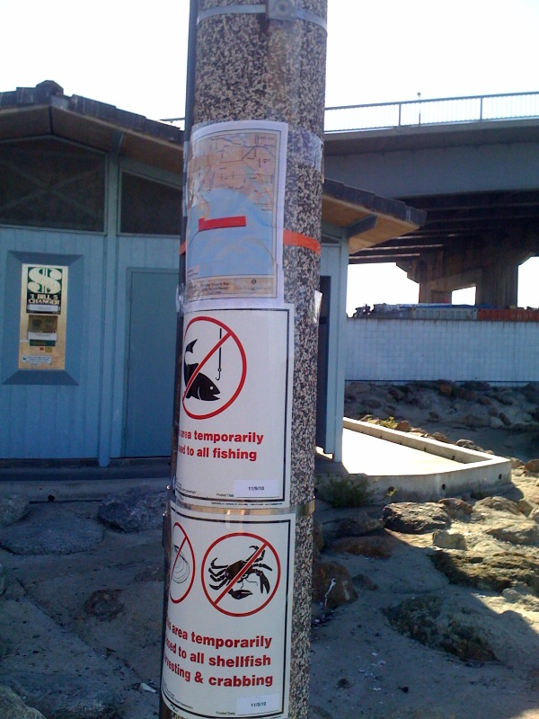
Signs

Slide 13
If there is a closure, then in the next 24 hours:
Determination of consumption threat
  OSPR SSTS continues to gather fisheries information and relay to OEHHA TS and OSPR management
  OEHHA TS evaluates updated spill information to determine whether public health threats still likely to exist (or still cannot be determined), and whether they would recommend changes in closure boundaries
  OEHHA TS reports to OSPR SSTS and/or OSPR Administrator or designee confirming presence/absence of significant human health risk

Slide 14
Modifications, Notifications, Sampling and Analysis, Re-Opening
OSPR SSTS and OEHHA TS review spill trajectory and surface/shoreline oiling information and determine any necessary new closure boundaries
OSPR SSTS and OEHHA TS consult on likely closure period; this information communicated to DFG Director and the public
Planning begins for expedited seafood monitoring

Slide 15
Sampling and Analysis
If closure in effect after 48 hours:
  DFW Director orders expedited testing of fish and/or shellfish
  OEHHA convenes a Seafood Safety Technical Advisory Group (SSTAG)
  OEHHA TS prepares sampling plan on behalf of and with advice from SSTAG
  SSTAG helps OSPR SSTS identify field sampling teams and leads

Slide 16
Sampling and Analysis, continued
Field sampling leads implement sampling plan
OSPR SSTS relays status of field sampling to labs and UC
Labs do analyses; DFW Water Pollution Control Lab validates results, provides data quality report to OEHHA TS
SSTAG incorporates seafood tainting data needs into sampling and analysis plan
Sensory analysis conducted, if necessary
OEHHA evaluates data, makes recommendations to DFW, and may consult with CDPH

Slide 17
Sampling and Analysis, continued
After receiving tissue sampling data, OEHHA conducts expedited human health risk assessment
If threat continues, OEHHA determines:
  1) Any changes to boundaries
  2) Whether some fisheries can be excluded,
  3) Additional sampling needs
  Using above findings, OEHHA issues memo to DFW summarizing recommendations regarding health risk
    4) As soon as practicable, OEHHA issues report

Slide 18
Re-Opening or Maintaining Closures
If fisheries to reopen:
DFW reopens closed areas within 24 hours of receiving OEHHA memo if memo states there is no continued threat to human health
Posted signs are removed
Public advised (via PIOs) of reopened fishing
Any WFO announcements suspended
If fishery closures to be maintained:
DFW Director may issue modified closure declaration
Information communicated to public

Slide 19
State fishery closure relationship to ICS and UC
State fishery closure operates under its separate authority
Is not run by UC; runs parallel to other UC activities
UC advised of state fishery closure activities
OSPR SSTS and OEHHA TS may report to ICP in order to have good access to information and advisors (e.g., NOAA SSC for trajectories, GIS for maps, SCAT for shoreline impacts, SOSC for advice on closure boundaries)

Slide 20
What About Federal Waters?
NOAAs National Marine Fisheries Service (NMFS) has jurisdiction over fisheries in federal waters and operated the Seafood Inspection Program and National Seafood Inspection Laboratory (NSIL)
The U.S. Food and Drug Administration (FDA) has jurisdiction over all fish and fishery products entering interstate commerce and operates a mandatory seafood safety program
For spills in federal waters, the EUL will typically be responsible for notifying NOAA/NMFS and FDA regarding potential seafood safety issues

Slide 21
Federal Waters, continued
NOAA/NMFS and FDA follow general procedures in:
“The Protocol for Interpretation and Use of Sensory Testing and Analytical Chemistry Results for Re-Opening Oil-Impacted Areas Closed to Seafood Harvesting Due to the Deepwater Horizon Oil Spill”
If fisheries closed, NOAA/NMFS and FDA develop sampling and analysis plan
Sensory analysis will likely be conducted by a U.S. DOC Seafood Inspection Program Laboratory
FDA does the human health risk assessment
NOAA and FDA review the data and determine whether closed areas should be maintained, modified, or re-opened

Slide 22
Also:
The U.S Food and Drug Administration (FDA) has jurisdictional authority over the safety of all food entering interstate commerce, and
The California Department of Public Health (CDPH) has jurisdictional authority over certain commercial seafood operations in California, then
In the event of a spill in California state waters where the FDA and/or CDPH also have jurisdiction over commercial products, all responsible agencies will coordinate to facilitate a unified seafood safety plan and re-opening protocol.

Slide 23
How Many State Fishery Closures So Far?
2009 2010 2011 20122013
Notice w/phone & email
tracking only and/or OEHHA 12 16 13
no closure recommendation
Closure with shoreline posting 2 1³
Closure with shoreline posting 1¹ 1²
and WFO alert
Closure with tissue sampling 1¹
¹ Dubai Star
² Da Tang
³ 24-hr closure w/no posting

Slide 24
How Many State Fishery Closures So Far?
 | 2009 | 2010 | 2011 | 2012 | 2013 | 2014
Notice w/phone & email tracking only and/or OEHHA no closure recommendation |  | 12 | 16 | 13 | 17 | 6
Closure with shoreline posting |  | 2 | 1⁴
Closure with shoreline posting and WFO alert | 1¹ | 1² |  |  | 1³
Closure with tissue sampling | 1¹ |  |  |  | 1³
¹ Dubai Star
² Da Tang
³ Ventura Harbor Spill
⁴24-hr closure w/no posting

Slide 25
Questions?
Ms. Lori Chumney
lori.chumney@wildlife.ca.gov
(916) 327-3195 (office)
(916) 356-8175 (cell)

