Slide 1
Applied Response Technologies (ART)
Ellen Faurot-Daniels
Department of Fish and Wildlife
Office of Spill Prevention and Response

Slide 2
Objectives for Presentation
Use of ART in spill response
ART background and legislation
Oil Spill Cleanup Agents (OSCAs)
California Dispersant Plan
California In-Situ Burning Policy
Questions and Discussion

Slide 3
Definition of ART:
“Response technologies, other than mechanical cleanup, that can be employed to address an oil spill.”
Includes:
Oil Spill Cleanup Agents (OSCAs)
  Examples: Dispersants, other chemical countermeasures (including bioremediants), non-chemical sorbents
  In-situ burning (ISB)

Slide 4
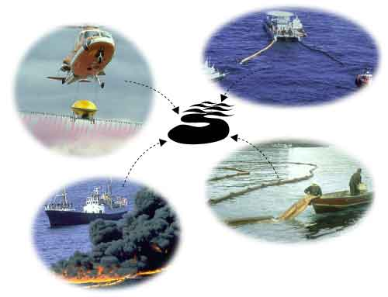
Oil Spill Response Options
Our goal is to have all available tools ready to use in an emergency situation.
Can include:
- Dispersants and other OSCAs
- Skimmers
- Containment and sorbent boom
- In-Situ burning
Can sometimes use more than one at a time.

Slide 5
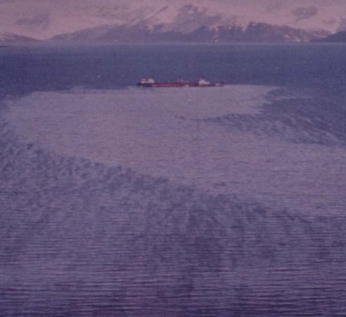
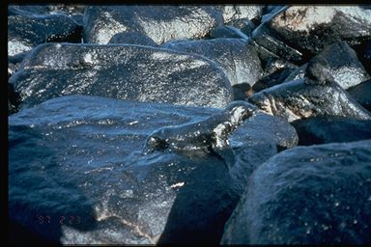
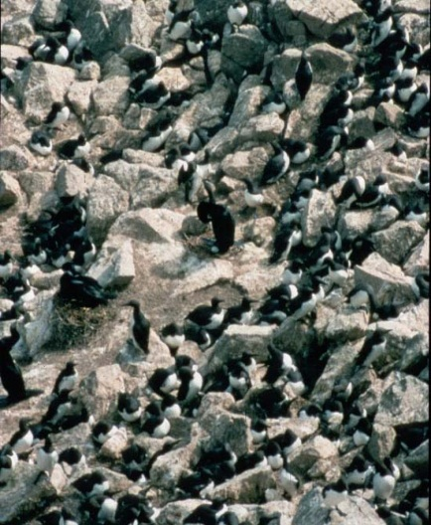
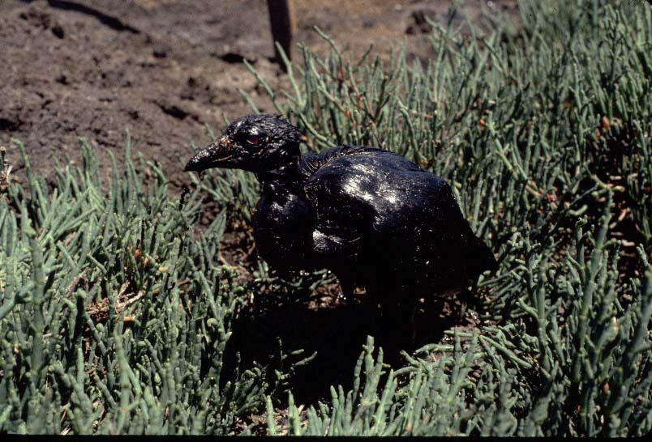
Realities of Spill Response
Why Consider ARTs?
Once oil is spilled, there will be injury to the environment
No amount of cleanup will remove all oil from the environment.

Slide 6
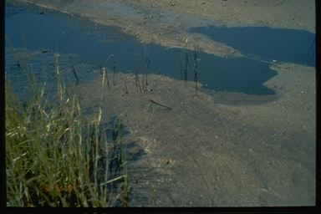
Realities, continued
If environmental injury cannot be avoided, response efforts must shift to minimizing the injury.
We evaluate short-term vs. long-term impacts to habitats and species at risk, and shape response priorities accordingly.

Slide 7
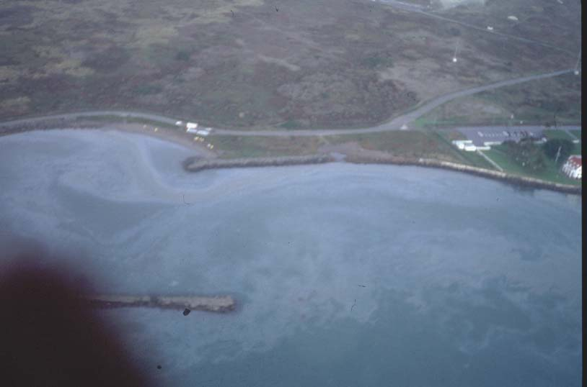
Realities, continued
All decisions associated with spill response have inherent trade-offs.
  - Mechanical
  - Dispersants
  - In-Situ Burning
  - No Response

Slide 8
ART Use in California
The OSPR Administrator has the State’s authority over all response technologies to address an on-water oil spill.
The federal Regional Response Team (RRT) must approve the use of all ARTs to address an oil spill within Federal jurisdiction.

Slide 9
Definition of an OSCA:
“A chemical, or any other substance, used for removing, dispersing, or otherwise clean-up oil or any residual products of petroleum in, or on, any waters of the State.”
An exemption can be approved if the manufacturer can demonstrate that the OSCA is not toxic and does not pose a hazard to the aquatic environment.

Slide 10
State Licensing of OSCAs
The OSPR Administrator has authority over the licensing and use of all OSCAs in state waters (marine and fresh)
All OSCAs must be licensed by the Administrator before use (or reviewed and given an exemption).
    Except: Experimental use of unlicensed products allowed in some limited circumstances.

Slide 11
Federal Listing of OSCAs
Address only oil spill chemical and biological countermeasures.
Product must be listed on the US EPA Product Schedule, or granted an EPA exemption (sorbents always given exemption).
Product Schedule OSCAs are registered, not licensed.
Any OSCA on the federal Product Schedule can be used by the FOSC for spills on federal waters, but need RRT approval
Recommend use of CA licensed products and/or ones that
have had received further study and review)
Other tools: Selection Guide and ARTES

Slide 12
Federal Planning and Response
National Response Team:
  National planning & coordination (products: NCP and NCP Product Schedule)
  Policy and program guidance
Regional Response Team (RRT IX):
  Regional planning, coordination of preparedness and response actions, including use of applied response technologies (products: RCP and ACPs).
  Membership: Federal agencies and State representatives.
  Standing RRT and Incident-Specific RRT.

Slide 13
Chemical Countermeasures
Emulsion-treating agents
Vaso-elasticizers (e.g., elasticity modifying agents, gelling agents, solidifiers)
Shoreline cleaners
Herding agents
Dispersants
Bioremediants

Slide 14
Emulsion Treating Agents
Emulsions are formed when energy is applied to oil and water.
It is difficult to disperse, burn or mechanically recover oil once stable emulsions have formed.
The oil industry uses emulsion breakers in field production, but these products not generally available off-the-shelf.
Some studies by Alaska Clean Seas indicated emulsion treatment could work on up to 70% emulsified oil and still burn.
More research needed into emulsion formation at sea.
No emulsion breakers currently licensed for use in California.

Slide 15
Elasticity Modifiers
Products bond with oil to form a semi-solid or solid mass; oil will not re-sheen; spilled oil more cohesive, easier to pick up
Available in either liquid or dry, granular form; some dry forms packaged in self-contained boom, socks or pillows
State and RRT policies allow use of only self-contained forms on open water (not same as loose within otherwise contained area)
  State pre-approval for some elasticity modifiers/solidifiers in self-contained form (boom, sock, pillow), but no RRT pre-approval yet
Liquid/loose forms can be hard to dose properly for large spills
Liquid/loose forms good for ship grounding to control loss of fuel in a tank, but can ruin the vessel

Slide 16
Shoreline Cleaning Agents
Usually have a surfactant base similar to dispersants.
Optimally, will lift and float oil, not disperse it into water column.
Can be used alone but typically used in combination with warm-water wash.
Present studies suggest that shoreline cleaning agents may be used to clean marsh plants.
Presently, two shoreline cleaners licensed in California:
Cytosol and Accell.
Method of use & type of cleaner is substrate-dependent.

Slide 17
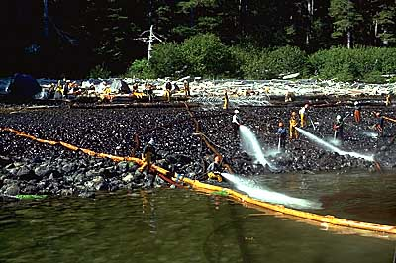
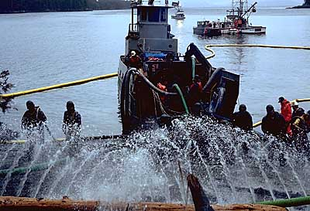
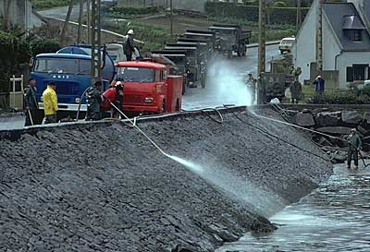
Ways to Enhance the Action of
Shoreline Cleaning Agents
Low-Pressure
Washing
High-Pressure Washing
Passive flooding

Slide 18
Bioremediants
Use of microbes (native or added), nutrient supplementation, and/or oxygen supplementation to enhance natural biodegradation of oil
Slow action time, so typically considered as final step to remove residual oil in sensitive or inaccessible areas, and after danger of re-oiling has passed
Often not necessary if native microbes, nutrients and oxygen are available (Kathleen will give a presentation on natural biodegradation study following a CA spill)
Extensively planned for, but not used, during DWH

Slide 19
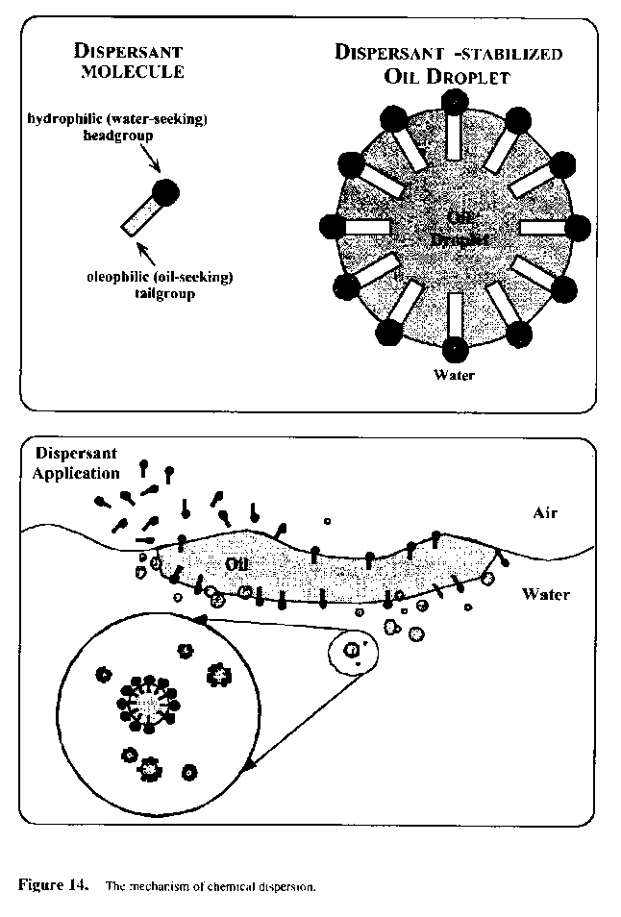
Dispersants
Surface active agents (surfactants) with hydrophilic and hydrophobic components
Used to reduce oil-water interfacial
tension
Effectiveness varies with weathering, salinity and emulsification
Requires addition of energy

Slide 20
Dispersants, continued
Present formulations of dispersants less toxic than spilled crude oil
Present toxicity concerns are with dispersed oil (dispersant + oil), not dispersants alone
A dispersant use decision is a determination of response and environmental trade-offs
In general, the lighter the crude, the easier it is to disperse. However, no benefit to use of dispersants on spills of gasoline, diesel, or jet fuel

Slide 21
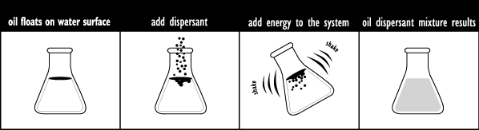
How Dispersants Work -- A Pictorial
The dispersant is applied to the water surface.
Molecules of the dispersant attach to the oil, causing it to break into droplets.
Wave action and turbulence move the oil-dispersant mixture from the water surface into the water column

Slide 22
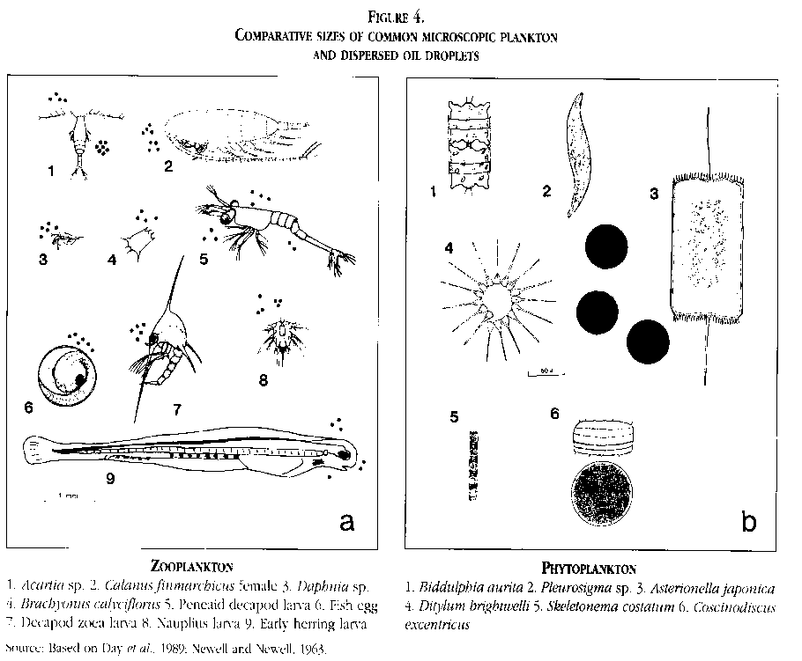
Dispersant-enhanced Bioremediation
Breaking surface oil slicks into small droplets greatly increases the surface area of the oil, and makes the droplets more available to bacteria and other micro-organisms that use it as food source
However, dissolved components of oil (PAHs) can cross cell membranes, fish gills, etc. , and may create new routes of exposure and toxicity
Other contaminants in the oil (e.g., metals) must be broken down as well
Ultimate break-down of hydrocarbons is into CO₂ and H₂O

Slide 23
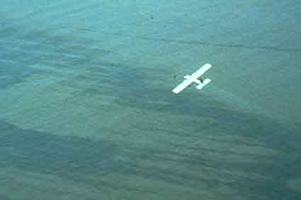
California Dispersant Plan

Slide 24
Policy Development
RRT IX tasked each of the 6 area committees to recommend a policy for dispersant use in federal waters (3 – 200 nm from shore), within each Area Committee’s zone of operation.
Zone recommendations from each Area Committee forwarded to USCG and RRT for their approval.
With modifications as necessary, RRT approved all the dispersant-use plans and they became a part of the RCP and NCP.

Slide 25
Dispersant Use Zones
Pre-Approval Zones
  Federal marine waters 3-200 nm from the coastline or island shoreline
  except:
    Waters part of a National Marine Sanctuary, or within three miles of
    the CA/Mexico border(
    (These may change pending results of ESA Section 7 consultations
    for use of dispersants in offshore pre-approval zones).
RRT Incident-Specific Approval Required Zones and Uses
  State marine waters (0 – 3 nm miles from shore)
  Waters part of a National Marine Sanctuary
  Waters within three miles of the CA/Mexico border
  Marine waters one mile from anadromous fish streams during times of emigration and immigration.
  Subsea use or use at surface for more than 5 days

Slide 26
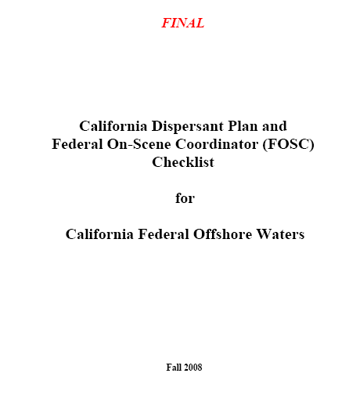
California Dispersant Plan
              Single document for the evaluation of dispersant use in California
FOSC checklists and flow charts for both zone and use types
Appendices for ease of referencing

Slide 27
Embedded Plans and Protocols
Special Monitoring of Applied Response Technologies (SMART)
  Conducted in real time, generally by Pacific Strike Team
  Looks for presence of dispersed oil; does not give oil concentrations.
Wildlife Spotting Protocols
Seafood Safety
Public Communications
Short and Long-Term Monitoring for Environmental Concentrations: Dispersed Oil Monitoring Plan (DOMP)
  Goal: Determine where and when monitoring should take place.
  Data can be used for fishery closures, for NRDA and for validating assumptions made during the NEBA process for dispersant pre-approval

Slide 28
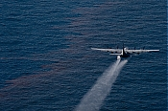
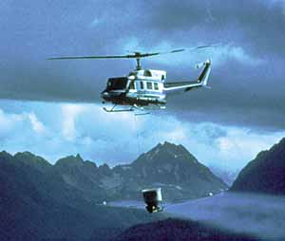
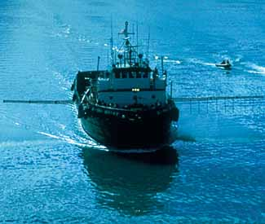
Dispersant Delivery Platforms
Information regarding all dispersant resources available in or to California (dispersant stockpiles, application platforms) is in the California Dispersant Plan

Slide 29
Dispersants: During and After DWH
Both aerial spraying and subsea injection used
  Aerial spraying on surface waters
    April 22 - May 26: About 682,808 gallons Corexit 9527A and 9500A
    May 27 - July 19: About 293,436 gallons Corexit 9500A
    Sub-Total: 976,244
    Subsea injection at the source
    May 9 - May 15: About 15,151 gallons of Corexit 9500A (2 tests)
    May 15 - July 19: About 771,000 gallons of Corexit 9500A
          Sub-Total: 786,151
    Grand Total: 1,762,395

Slide 30
DWH Dispersant Use: Fate and Effects
Oil Budget (August 4, 2010 numbers):
  Directly recovered from wellhead: 17%
  Mechanically skimmed: 3%
  Evaporated or dissolved: 25%
  Naturally dispersed: 16%
  Chemically dispersed: 8%
  In-situ burn: 5%
  Residual: 26%

Slide 31
DWH Dispersant Fate and Effects, continued
Dispersants were applied consistent with all policies
FOSC directed the response and use of dispersants, not the RP
Extensive monitoring for dispersant effectiveness, impacts on human health, and impacts on water and wildlife were employed
Additional EPA dispersant components analysis validated initial toxicity effects data; FDA analysis indicated components commonly used in foods, cosmetics and OTC medications, and many are GRAS
Dispersant use (surface and subsea) greatly reduced shoreline and wildlife impacts
Seafood safely samples indicated uptake of oil by organisms did not reach levels of concern for human consumption
Even with the extensive “loading” of dispersants in this response, the dispersants behaved as expected and there was a determination of net environmental benefit for their use

Slide 32
What Did California Learn from DWH Dispersant Use?
Subsea use, and surface use of dispersants for more than 5 days, had not been previously evaluated as part of NEBA
Subsea use and use of surface for >5 days will need RRT incident-specific approval
Rest of NEBA assumptions still seem to apply
Biological Assessment for ESA Section 7 submitted to NMFS and USFWS, currently under review
Once ESA consultations complete, will update CDP

Slide 33
Other ARTs –
In Situ Burning

Slide 34
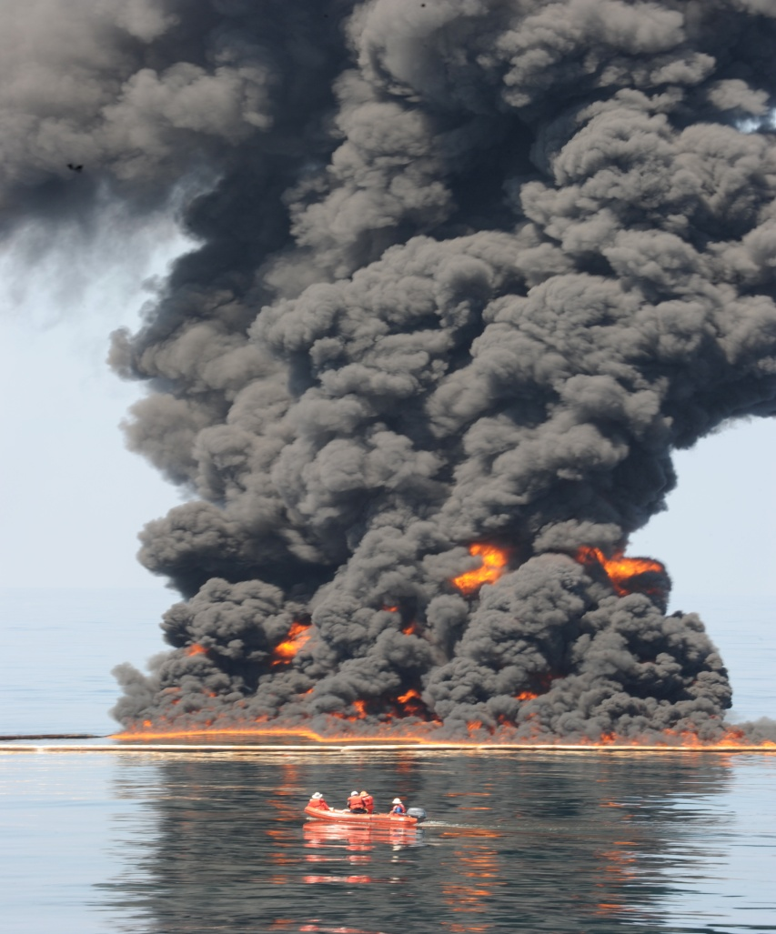
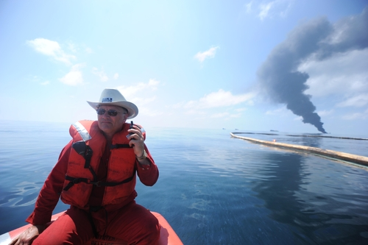
In-Situ Burning

Slide 35
IN-SITU BURNING
Removal of oil from the environment by burning it in-place.
Advantages over other response methods:
  - Quickly removes large quantities of spilled oil
  - Only small amounts of residue are left to clean up
  - Volatile organics are destroyed
  - Combustion products readily dispersed within 500 meters of burn (for burns over water)

Slide 36
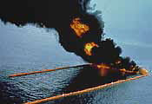
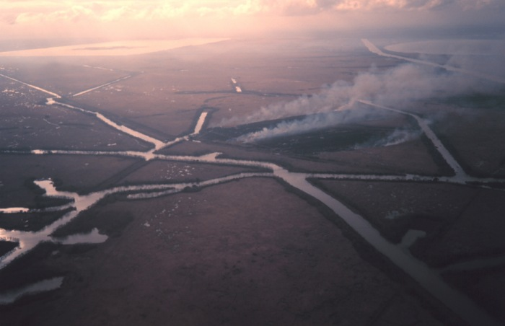
Land vs. On-Water Burn

Slide 37
In-Situ Burning, continued
Major health concern of burning is the particulate matter concentration in soot plume.
  - Can cause significant health risk if inhaled
  - PM10 (particulate matter of 10 micrometer diameter) levels may exceed state standards in soot plume for several miles beyond the burn site.
If oil not burned, it still presents health risk from volatile light-ends.
  - BTEX components (benzene, toluene, ethylbenzene, xylene), known carcinogens & teratogens

Slide 38
In-Situ Burning, continued
In-situ burning is limited by:
  - oil thickness
  - weathering of oil
  - emulsion formation
  - oceanographic conditions
  - availability of specialized fire-retardant containment
  boom (none currently available in CA; closest is in
  WA state, about 24 hrs away)

Slide 39
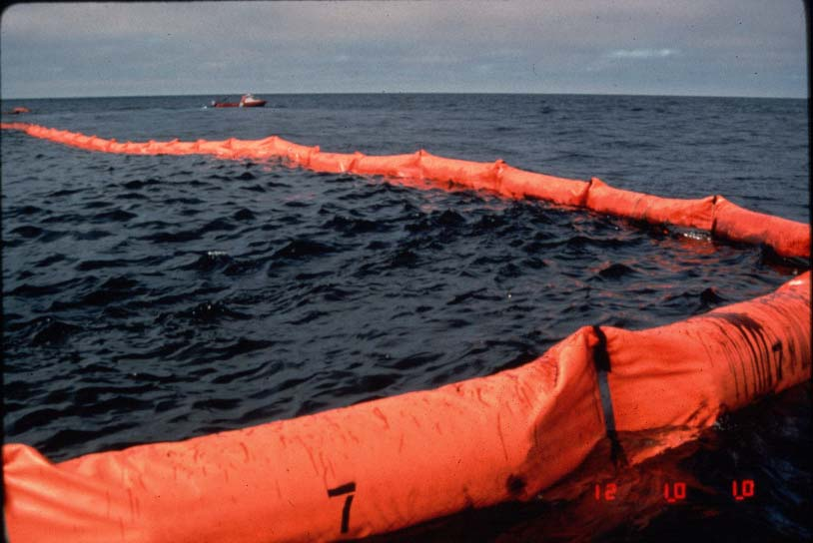
Mechanics of In-Situ Burning
  Need to first boom the oil to maintain a minimum burn thickness

Slide 40
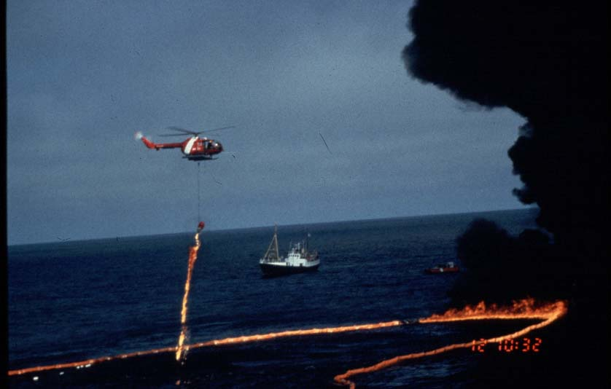
Mechanics of Burning, continued
Need to be able to ignite
the oil once boomed.
Helitorch shown here

Slide 41
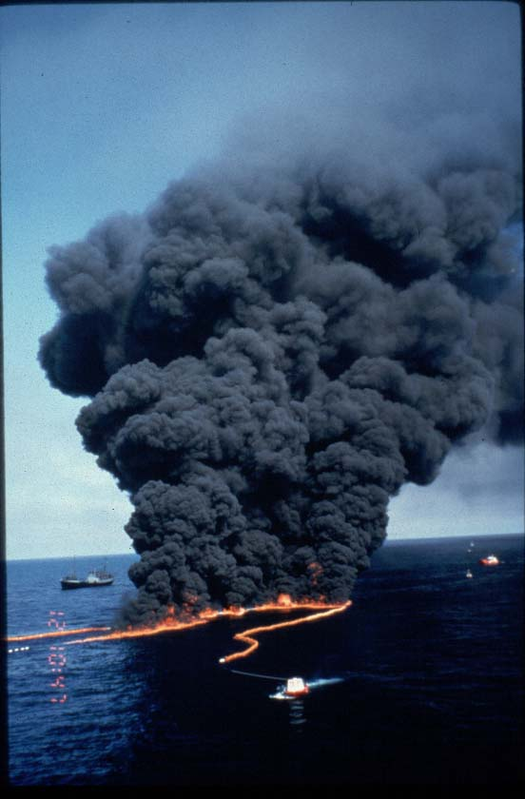
Mechanics of Burning, continued
  Need to be able to control the burn and stop it if necessary.
  Can do this by having the boom boats pull forward faster on the boom, which “drowns” the fire).

Slide 42
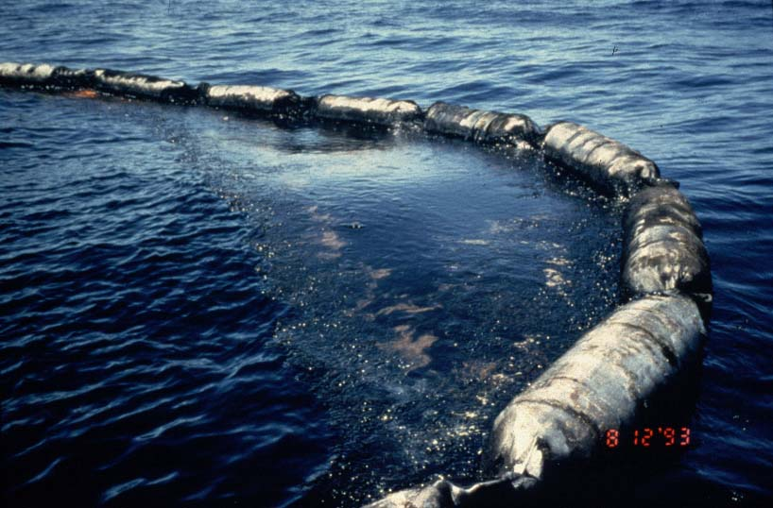
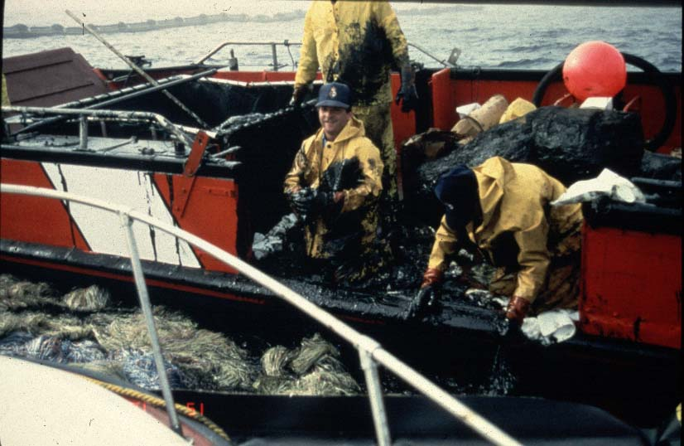
Mechanics of Burning, continued
When burn is done, need to clean-up oil residue.

Slide 43
California In-situ Burn Policy
General Scope
Coast is divided into designated zones:
- Offshore waters 35 nm or more from coastline
    Pre-Approval to FOSC
    FOSC discretion to determine whether use is appropriate.
    - Offshore waters 0-35 nm from coastline
    Quick Approval
    Specific distances from shore with off-shore or parallel-to-shore
    winds.
Case-by-Case
All other areas and wind conditions.
  There are no designated prohibition zones.

Slide 44
Quick Approval Zones
If prevailing winds off-shore/parallel to shore
North Coast AQMD ≥ .5 miles from shore
Mendocino AQMD ≥ .5 miles from shore
Bay Area AQMD ≥ 5 miles from shore
N. Sonoma AQMD ≥ .5 miles from shore
Monterey Bay Unified No QA zones
San Luis Obispo County ≥ 3 miles from shore
Santa Barbara County ≥ 3 miles from shore
Ventura County APCD ≥ .5 miles from shore
South Coast AQMD ≥ 8 miles from shore
San Diego AQMD ≥ .5 miles from shore

Slide 45
Summary of Main Points
It is important that all tools be in the tool box at the time of an oil spill incident.
All response options have inherent trade-offs associated with their use.
All OSCAs must be federal listed and state licensed to gain approval for use during spill response.
OSCA approval is gained by request of the Unified Command, and through approval of the Administrator of the OSPR and the RRT.

Slide 46
Summary of Main Points, continued
Dispersant use can be approved through the Pre-approval or Incident-Specific RRT Approval Processes; the process used depends on the location of spill.
In-Situ burning can be authorized through Pre-approval (≥35 nmi from shore) or through the Quick Approval or Case-by-Case processes for waters <35 nm from shore, or for inland areas.

Slide 47
Questions?
Ellen Faurot-Daniels
ellen.faurot-daniels@wildlife.ca.gov
(831)649-2888 (office)
831-233-0723 (cell)
www.dfg.ca.gov/ospr

