Slide 1

Logistics and Finance/Administration Overview
Notes:
Introduction…..Logistics and Finance Section work closely together during an incident. Logistics orders and procures resources needed then passes along the information to Finance for itemization and documentation of costs.

Slide 2

Incident Command System
LOGISTICS
Logistics Section (LS) is responsible for:
Providing facilities, equipment, resources and ALL other services needed to meet the operational objectives of the incident.
The LS is divided into two branches:
Service Branch
Support Branch
Notes:
The LS is responsible for providing necessary facilities, services, and support to an incident.
It is divided into 2 branches- service and support

Slide 3
LOGISTICS
Services
Support
Notes:
This is a simplified example of the LS org chart.
As I mentioned before the LS is divided into 2 branches-service and support.
Service Branch (food, medical & communication units)
Support Branch (supply, facility, ground support units and technical support Specialist such as IT support

Slide 4
Incident Command System
Service Branch
Service Branch is responsible for:
Management of all service activities at the incident.
Service Branch is divided into 3 units:
Communications Unit
Food Unit
Medical Unit
Notes:
Communications Unit: responsible for maintaining all types of communication. This unit develops the ICS 205 commonly known as the Comms Plan. The plan lists all types of communications used for the incident- radio frequencies, cell phones nos. land lines….
Food Unit: responsible for supplying the food/water needs for the entire incident, including remote locations and personnel that are unable to leave the field.
Medical Unit: responsible for providing on site medical services, and medical aid and transportation for injured and ill responders. The Medical Plan (ICS 206) is created and maintained by the Medical Unit.

Slide 5
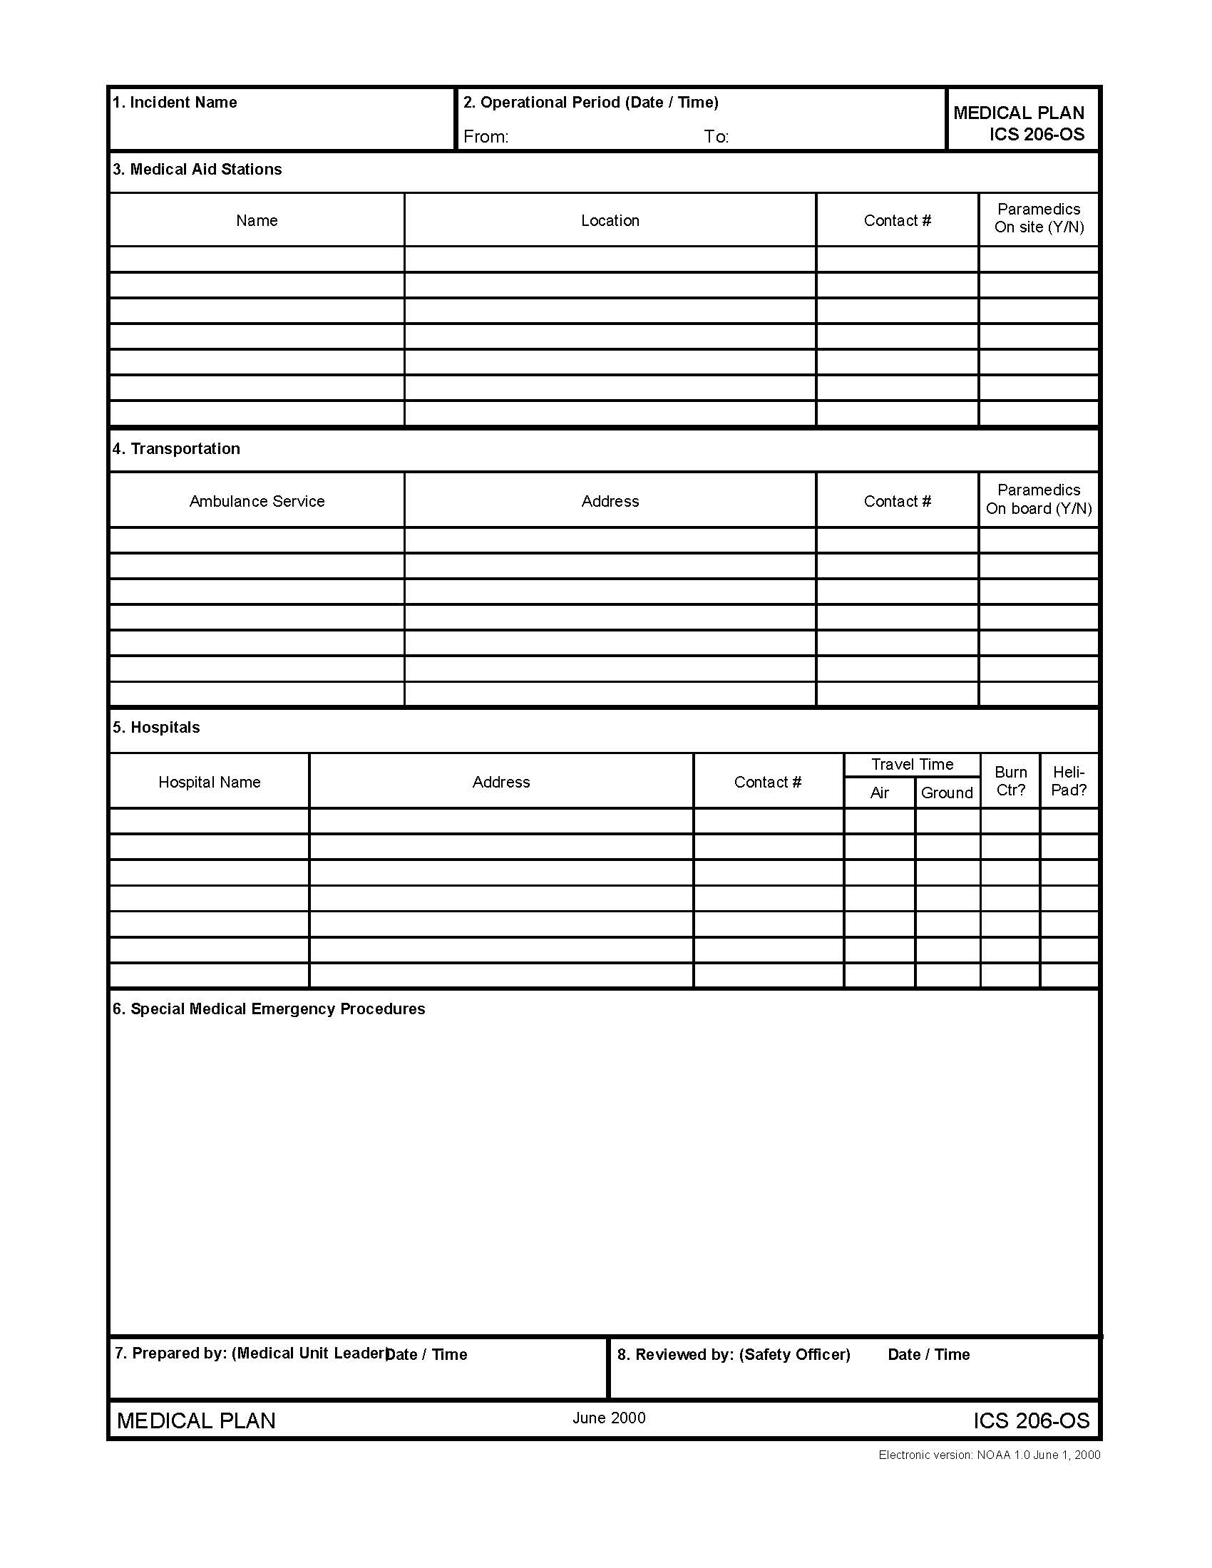
Notes:
I’ve attached an ICS 206 Medical Plan. Even though the ACP may contain this information, we look to locals for guidance on completing these documents with current updated information available.

Slide 6
Incident Command System
Support Branch
Support Branch is responsible for:
Development and implementation of logistics plans in support of the Incident Action Plan (IAP).
Support Branch is divided into 3 units:
Supply Unit
Facilities Unit
Ground/Vessel Support Unit
Notes:
Supply Unit: receives requests for all necessary resources, personnel & equipment using the requisition process. This unit orders, receives, distributes, and stores supplies and equipment as well as maintaining an inventory of everything.
Facilities Unit: responsible for the set up & maintenance of the entire incident. ICP, staging areas, lodging for responders, sanitation services, and most importantly security for the various locations.
Ground/Vessel Support Unit: responsible for transportation of personnel, tactical equipment, fueling of vehicles & will also develop and implement a traffic or vessel routing plan.

Slide 7
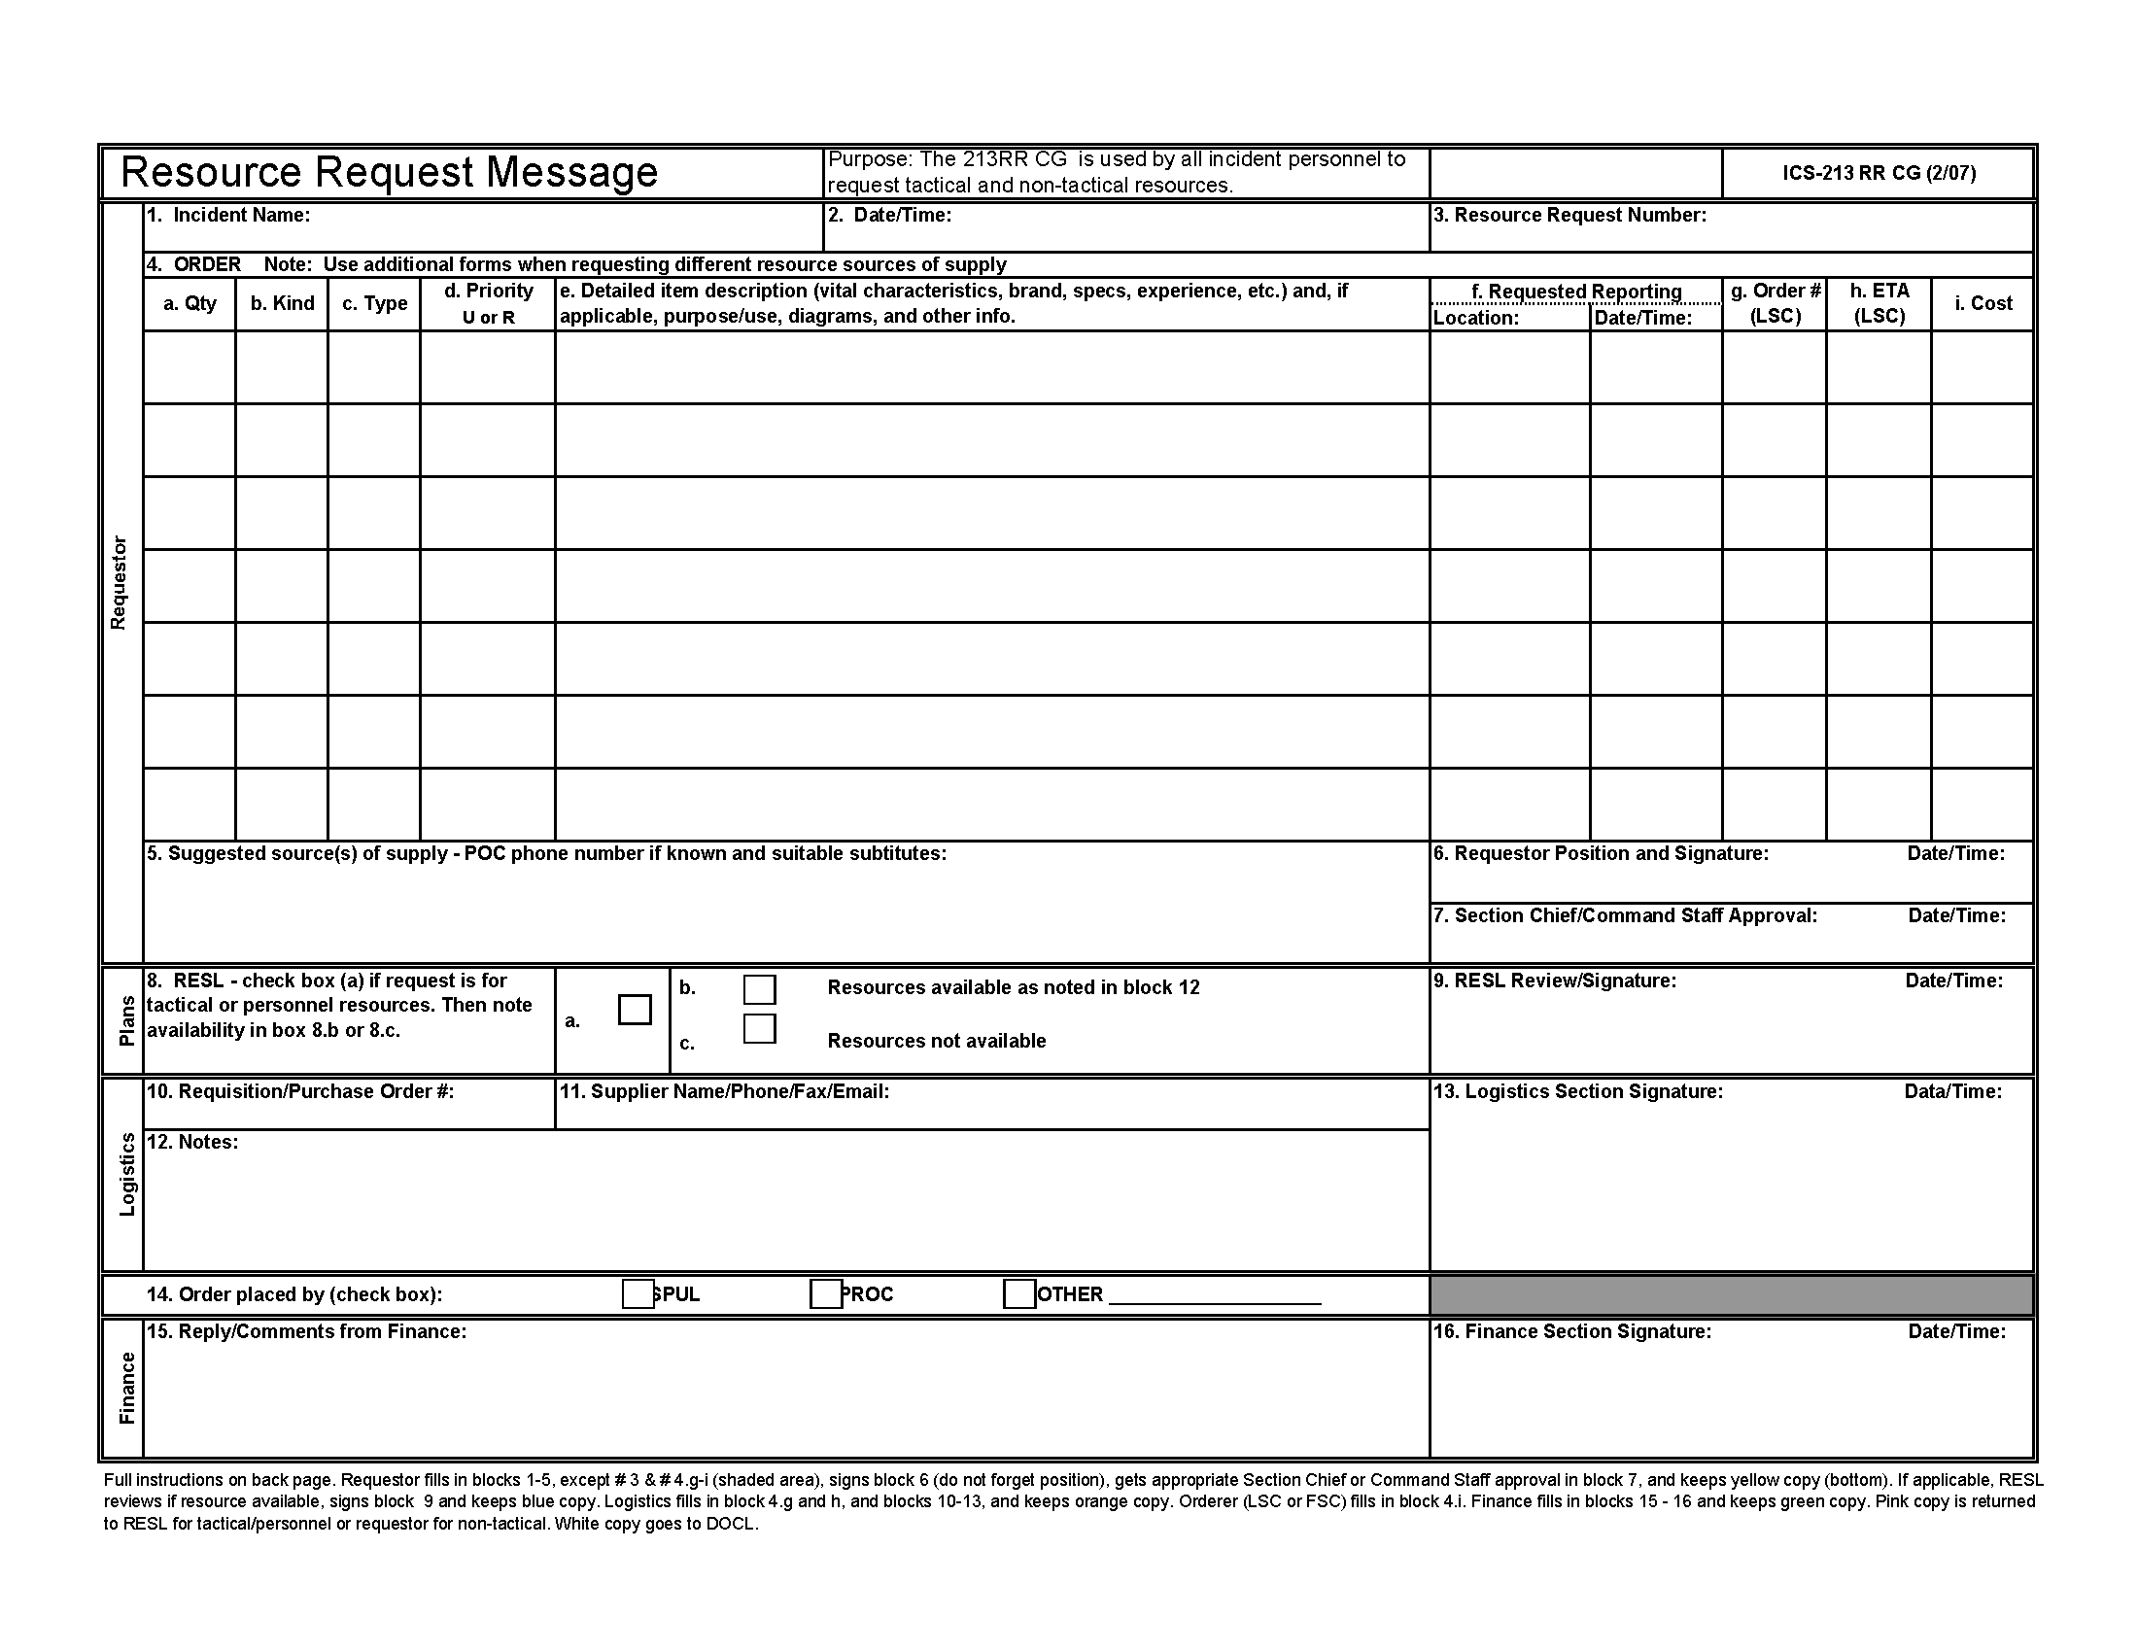
Notes:
The requisition form (213RR) is a means of tracking resources and supplies that have been ordered and delivered to the incident. This form is used to order aircraft, boats, ATV’s, wildlife trailers, personnel, wildlife contractors, printers, GIS plotters, lodging, transportation, copier paper, & pens and pencils. EVERYTHING needs to be on a requisition….so when Logistics completes the order, the requisition goes to Finance for cost tracking……
Requisitions provide a “snap shot” (from Logistics perspective) of what happened at an event.

Slide 8
Finance
Time Unit
Claims Unit
Procurement
Cost
Notes:
Finance section org chart looks like this…Time Unit is responsible for tracking personnel hours, procurement unit might prepare contracts for specialized response needs, claims unit establishes a mechanism for affected parties to identify and report their loss to the RP. The cost unit tracks every cost of every resource for the incident.

Slide 9
FINANCE / ADMINISTRATION
Participating state and local agencies submit costs directly to the Responsible Party
If the Responsible Party refuses to pay agencies submit costs through CDFW-OSPR Cost Recovery Unit
National Pollution Fund Center has forms, sample claims, and guidelines
  http://www.uscg.mil/npfc/claims
Notes:
The FS is responsible for tracking the states costs as well as assisting other state and local agencies track their costs. It’s imperative that the agency or entity is identified in the IAP and working within the UC. If there is no documented coordination there may be no reimbursement. The RP will usually have a Finance Officer on site to coordinate with. If there is no RP or they refuse to accept responsibility, any local agency can submit their costs to the NPFC which is managed by the USCG & EPA. The NPFC website is very user friendly with sample claims and guidelines. For optimal cost recovery it is necessary to back up all costs with supporting documentation….time sheets, hotel receipts, mileage logs, contractor invoices, etc.

Slide 10
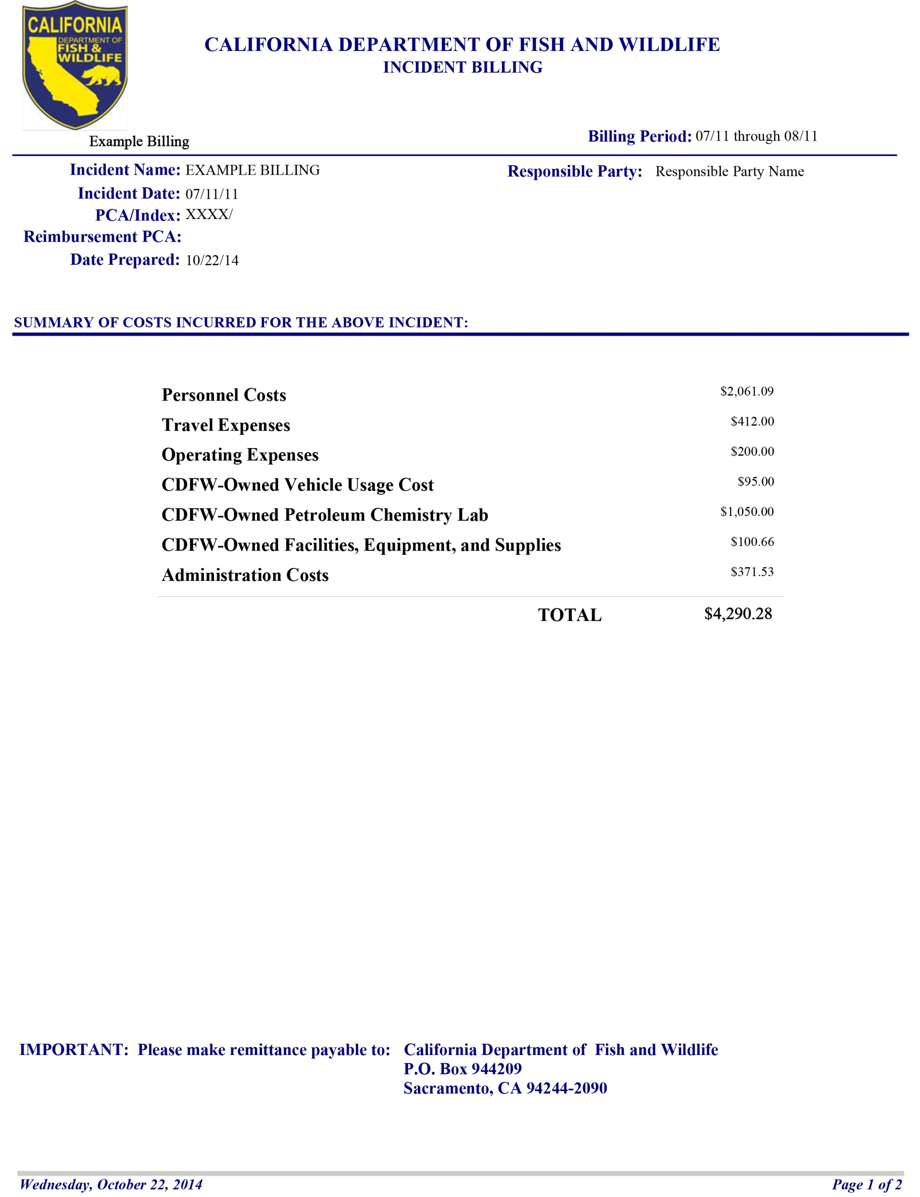
Notes:
An example of what our billing document looks like. We have a face sheet with all the costs broken out by category….

Slide 11
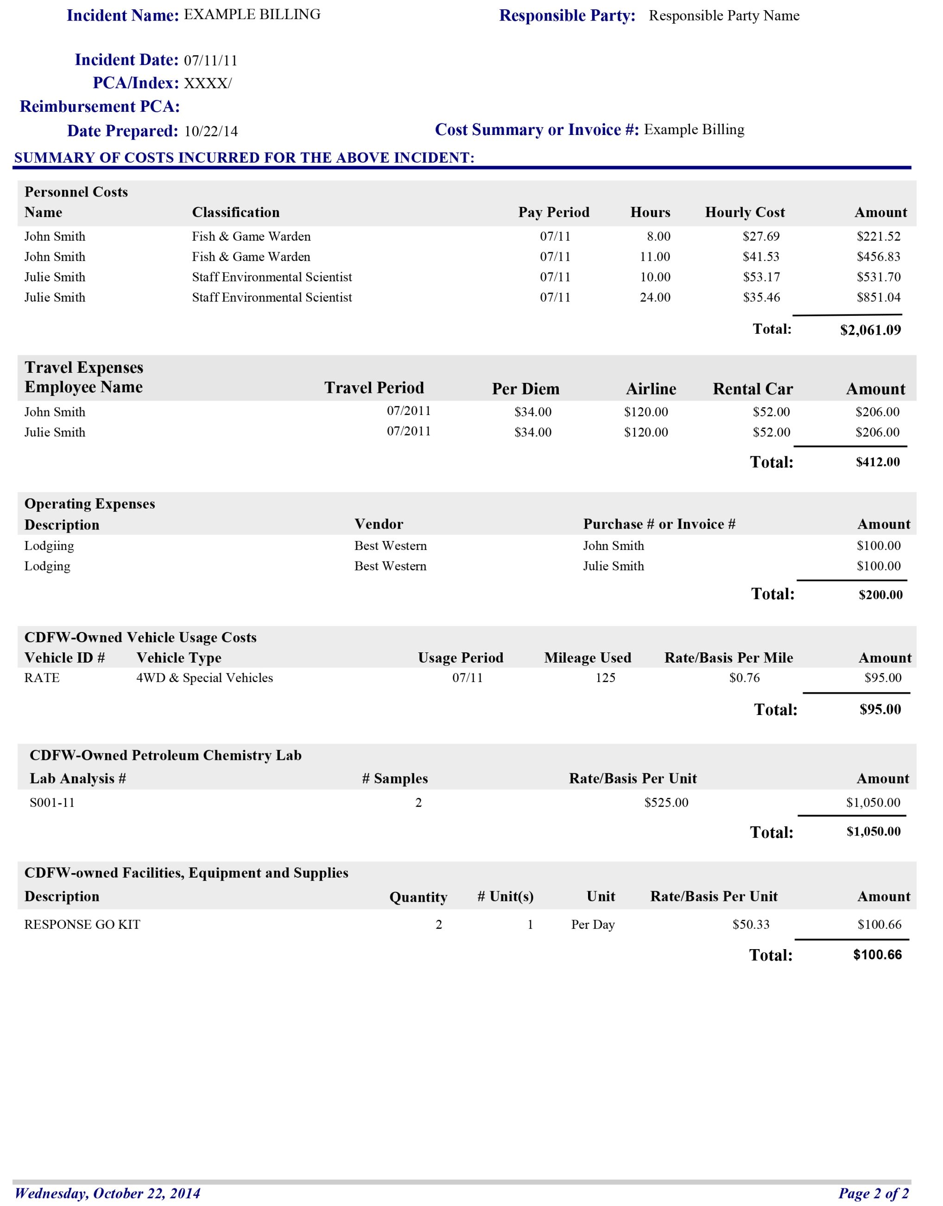
Notes:
Page 2 of the billing document has the detail of each expense.

Slide 13
Supporting Documentation
Air Travel Receipt
Lodging Receipt
Mileage Log
Rental Car Receipt
Employee Salary
Rate Sheet
Equipment Rate Sheet
Copy of Incident Sign in Sheet
Notes:
To back up the billing document it’s necessary to provide supporting documentation of each expense. We’ll need…..

Slide 14
Claims Process
Claims for economic losses associated with an oil spill are referred directly to Responsible Party (RP)
If no RP is identified claims may be submitted
  OSPR Administrator if < $50K
  National Pollution Fund Center
Notes:
Lastly, the FS is responsible for establishing a claims no. for parties or entities that have been damaged as a result of the incident. Usually the RP will post the no. and handle the claims. If not, claims may be sent to NPFC, or to the OSPR administrator if the claim is less than $50K.

Slide 15

Questions

