Slide 1
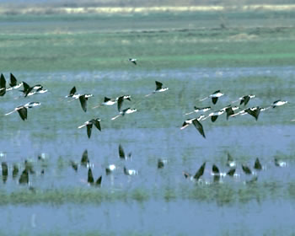
OSPR OVERVIEW
LIAISON
Joy Lavin-Jones
Liaison Officer
Office of Spill Prevention and Response
Notes:
Black-necked stilts.

Slide 2
What We Can Do For You
The Liaison Officer (LO) will coordinate the involvement of Agency Representatives (Agency Reps) in an oil spill response
The LO is the advocate for Agency Reps within the Unified Command

Slide 3
LO’s Initial Tasks
Find a suitable work/meeting space
Check-in Agency Rep and maintain a complete Agency Rep contact list
Point of contact for Agency Reps and their advocate
Facilitate information exchange within and outside the oil spill response (ICS) organization

Slide 4
Coordinating Agency Involvement in the Spill Response
Listen to, and understand, Agency Rep concerns
Prioritize concerns, in consultation with Agency Reps
Relay Agency Rep concerns to the Unified Command
Keep Agency Reps informed

Slide 5
Coordinating Agency Involvement
Where appropriate, plug Agency Reps with specialized knowledge, skills or trustee authority into specific ICS positions
  Health & Safety
  Environmental Unit (EU)
  Logistics
  Public Information
  Cultural/Historic Property
  Technical Specialist

Slide 6
Coordinating Agency Involvement
Establish contact with public health officer
Facilitate Agency Rep reimbursement for the spill response
Collect information on:
  Boom deployed, or intended to be deployed, by local government to protect economic sites
  Cultural Historic Properties
  Local Resources/Contacts

Slide 8
Coordinating Agency Involvement
    Other local resources which may be of use to the Unified Command:
      Helicopters
      Trucks, cranes, front-end loader, other heavy equipment
      Barricades/traffic diverters
      Temporary fencing
      Security personnel
      Site access

Slide 9
Coordinating Tribal Involvement
If Tribal lands are impacted, Tribal involvement needs to be secured
Initial contact is done by LO; typically the Tribal representative is located in the Environmental Unit (EU)
A historic properties specialist at the State Office of Historic Preservation can help with archeological site issues
Notes:
Tribal Reps are coordinated into the spill response just like Agency Reps. The Environmental Unit normally takes the lead.

Slide 10
Keeping Agency Reps Informed
ICS 201 – Incident Briefing
ICS 202 - Incident Objectives
ICS 207 – ICP Org Chart
ICS 208 – Site Safety Plan
ICS 209 – Incident Status Summary
Incident Action Plan (IAP)
Notes:
Agency Rep involvement is facilitated by keeping Agency Reps informed. The next 3 slides discuss how this is done.

Slide 11
Keeping Agency Reps Informed
Presentations by the:
  Situation Unit Leader
  Environmental Unit Leader
  NOAA Scientific Support Coordinator
Briefings by the LO summarizing:
  Command and General Staff meeting
  Planning meeting
Press releases
Community Open House

Slide 12
Keeping Agency Reps Informed
Phone numbers for volunteers, 3rd party claims and reporting oiled wildlife
Incident updates from OSPR Operations Center
Fact sheets, e.g. “Tarballs,” “How Clean is Clean,” etc.
Other spill-specific information put out by the Unified Command
One-on-one responses to inquires from Agency Reps
Cal Spill Watch website: www.CalSpillWatch.ca.gov
ERMA
Notes:
Trajectories, FAQs, factsheets, press releases, incident updates, volunteer information, photos, etc. can all be found on the CalSpillWatch website.

Slide 13
Expectations for Agency Reps
How Agency Reps Can Help

Slide 14
Expectations for Agency Reps
Be knowledgeable of your agency’s:
  Regulatory authority
  Key agency managers and staff
  Geographical area of responsibility
  Agency resources
Be knowledgeable of your local community:
  Good locations for town hall meetings during response
  ID key community leaders to invite to a meeting

Slide 15
Expectations for Agency Reps
Have a good working knowledge of:
  Incident Command System
  The Local Oil Spill Contingency Plan and/or GRP (if available)
Be a conduit for information to your Emergency Operations Center (EOC)
Be able to acquire and commit your agencies resources, or be able to get it done expeditiously

Slide 16
Expectations for Agency Reps
Commit to working for at least one full operational period, preferably more
Keep the LO informed of your schedule
Cooperation between Agency Reps and the LO is very important – we are a team

Slide 17
Expectations for Agency Reps
Remember, the LO may need information from the Agency Rep, e.g., road closures, locations of deployed boom, water intake locations, etc.
Time permitting, be open to taking on special assignments from the LO or even serving as an assistant LO

Slide 18
Expectations for Agency Reps
OSPR needs the Agency Rep to assist in on-going response planning efforts through:
  GRP Development
  Preparing/updating their local oil spill contingency plan
  Participation in Drills and Exercises

Slide 19
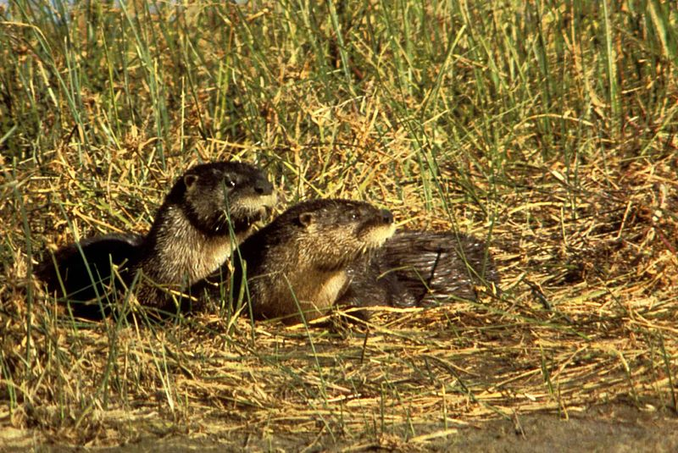
Joy Lavin-Jones
Oil Spill Prevention Specialist
Sacramento
(916) 327-0910
Joy.Lavin-Jones@Wildlife.ca.gov

