Slide 1
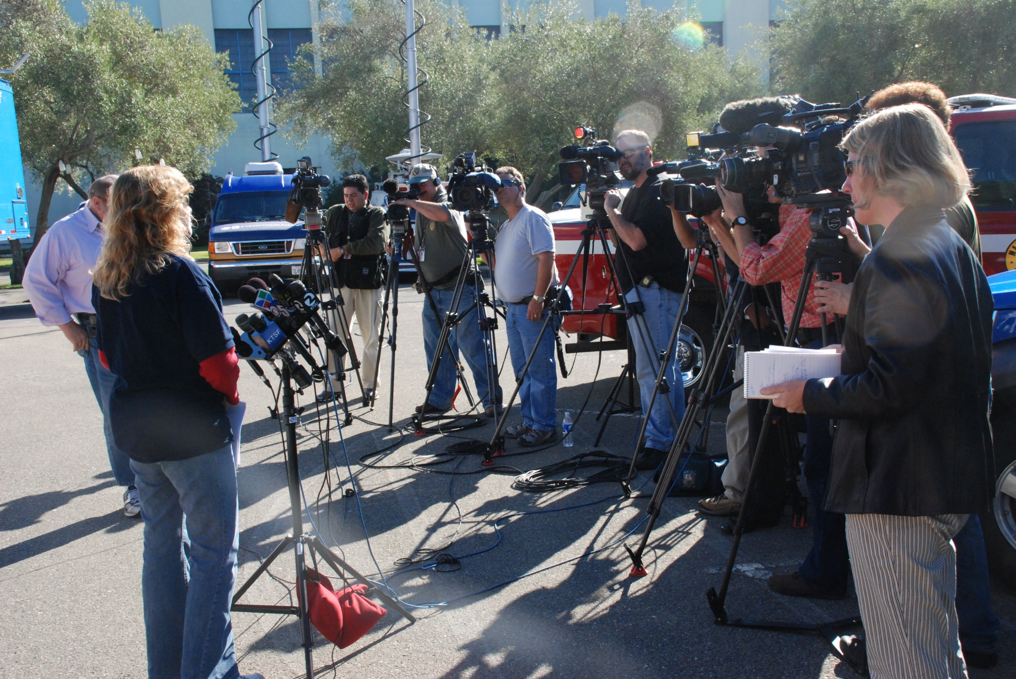

Crisis communication during an oil spill

Slide 2







A Joint PIO Response=
A Uniform Message
-Joint Information Center consists of multi-agency PIO team with unique responsibilities
-One PIO, one JIC manager and multiple Assistant PIOs.
-News releases, social media, and other published messages are uniform/UC-approved

Slide 3

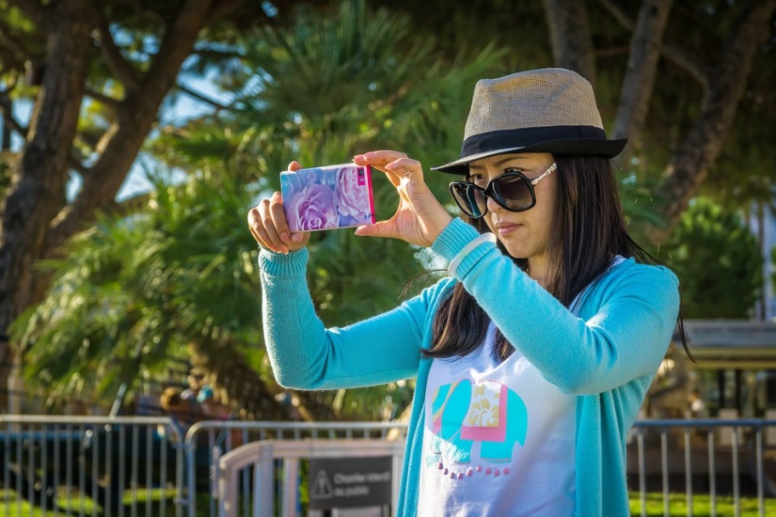
Rule #1:
Be Proactive
-Social media has transformed the way people get news. Tweet response underway & tweet/FB UC-approved messages
-Put out an initial news release ASAP & hold regular news conferences
-Create website, or at least email for the incident.

Slide 4
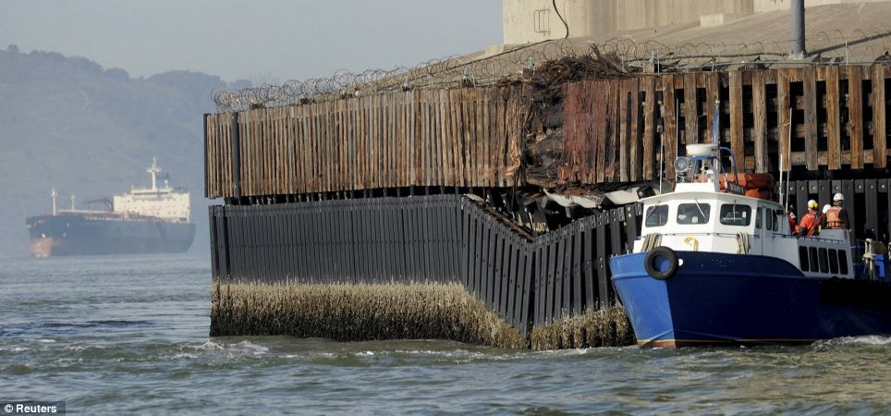
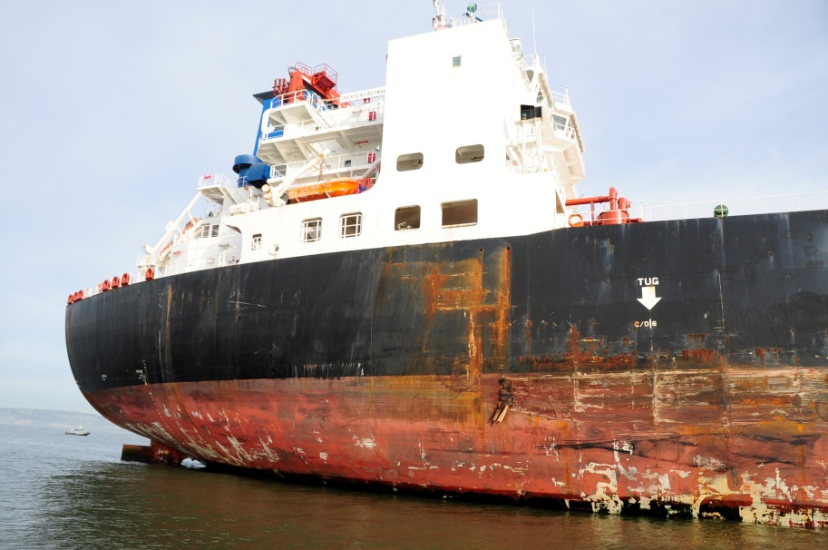
Case Study: SF Bay Bridge incident
Tanker Overseas Reymar strikes bridge; nearby boater tweets within minutes.
Single tweet starts trending; media calls OSPR within 15 min. of incident.

Slide 5
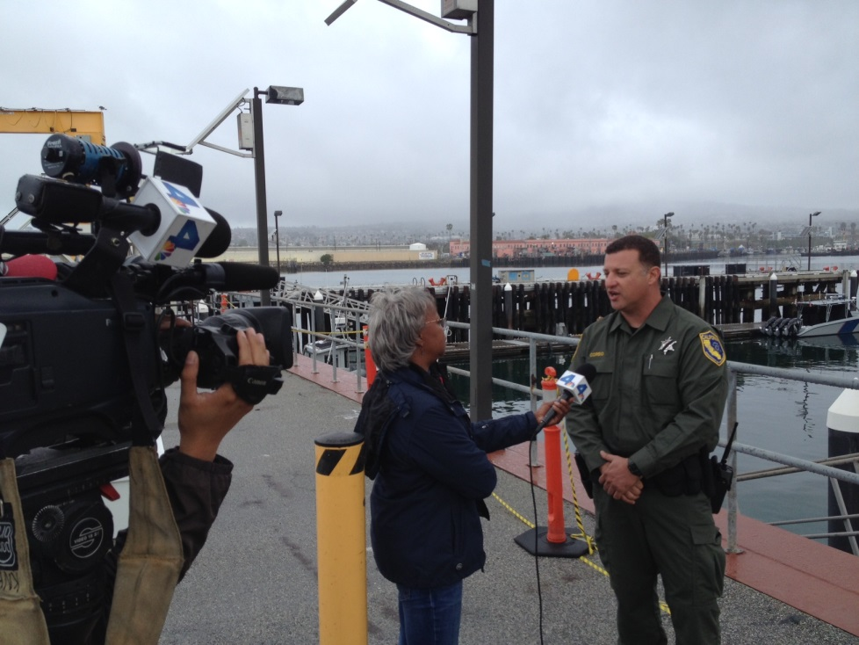
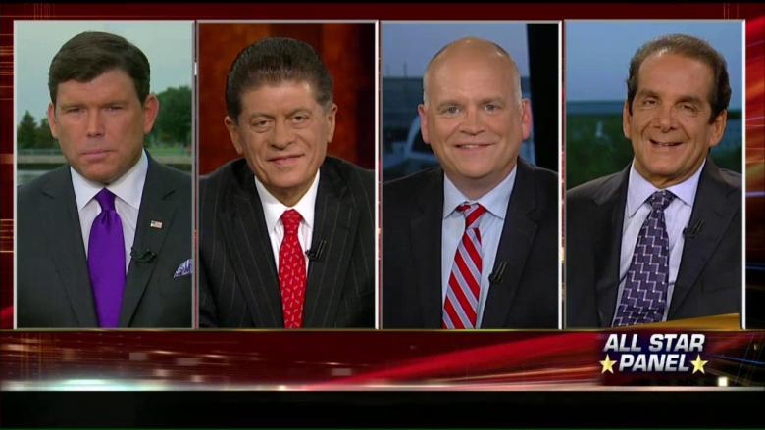
-Be transparent; stick to the facts
Rule #2:
Set the tone
-Use key, uniform messages approved by UC
-Make yourself available to media; correct inaccuracies
-Don’t forget to stay unified

Slide 6
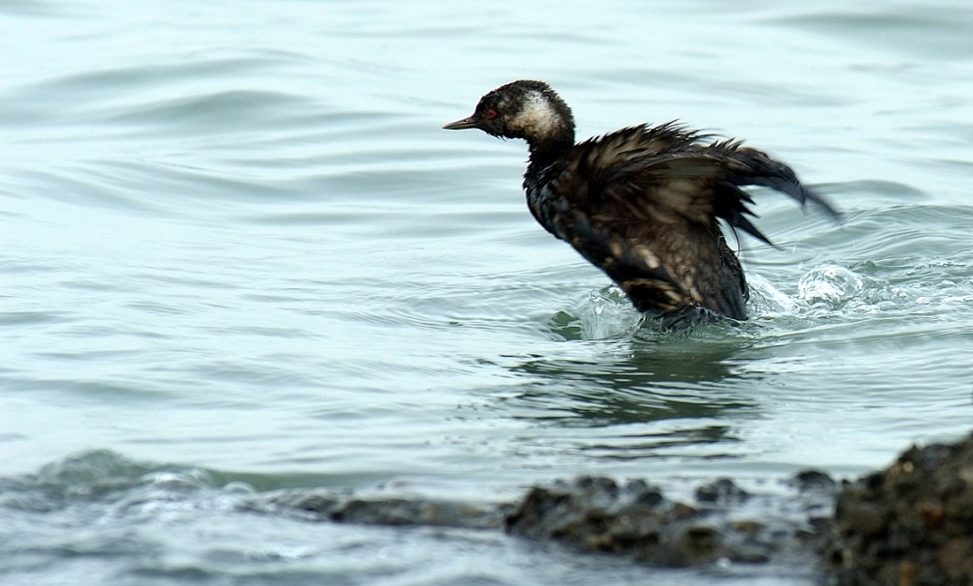
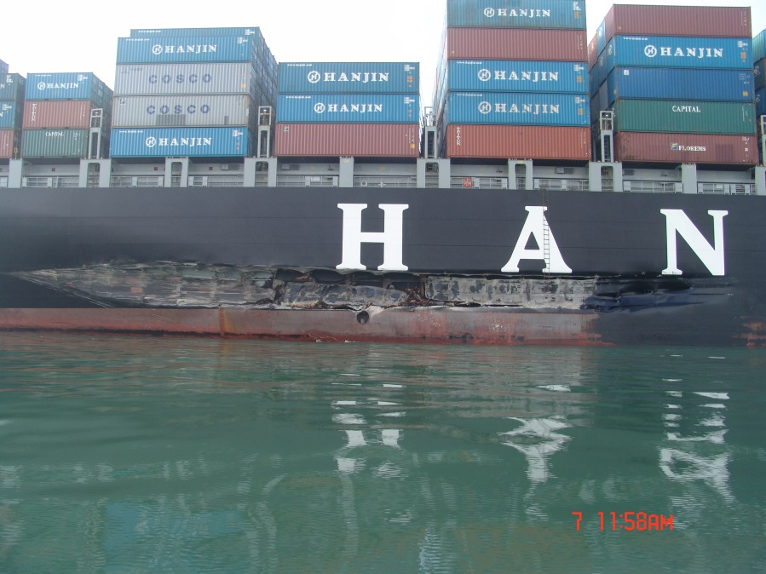
Case Study: Cosco Busan Incident
Cargo ship strikes bridge; spills 53,569 gallons intermediate fuel oil.
Early reports to media/public were only 100 to 400 gallons. Public trust immediately and permanently lost.

Slide 7
Rule #3:
Be Prepared
-Designate a spokesperson/JIC representative(s)
-Drill with agency partners; meet the press
-Create a general media & social media plan
-Mock media interviews

Slide 8

Case Study: Newsom CBS interview

