Slide 1

California Department of Fish & Wildlife: Office of Spill Prevention and Response
Lieutenant Specialist Michael Horn
SoCal Interior
January 20, 2015

Slide 2


California Fish & Wildlife’s Role in Pollution Response
Responsibilities and Mandates
Notification
Roles and Responsibilities
Unified Command
Response, Cleanup, and Restoration
Investigations
Notes:
This talk will focus on our history of response, our responsibilities / Mandates, and on how we respond to pollution events as emergency responders.
Wildlife Officer role only
Focus is on OIL with Statwide Oil Program

Slide 3
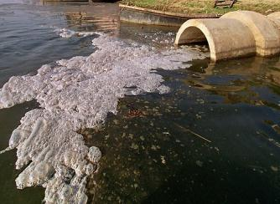
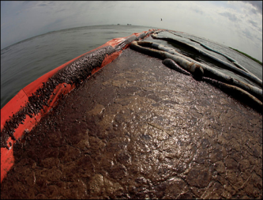
California Fish & Wildlife’s Role in Pollution Response
Protecting Water Quality is our Top Priority
Second Only to the Protection of Human Life
Trustee responsibility
Has evolved into multi-faceted mandate…
1. Pollution Response Role
2. Incident Command
3. Investigation

Slide 4
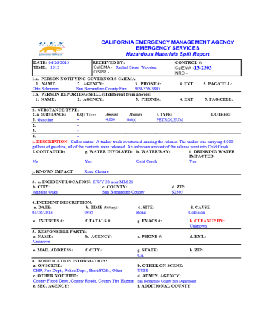
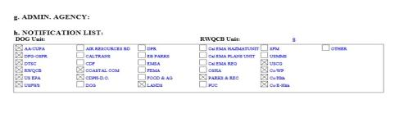
CDFW/OSPR Notification Process
Notification must also be made to the California Governor’s Office of Emergency Services, California State Warning Center for the following:
Discharges or threatened discharges of oil in marine waters
Any spill or other release of one barrel (42 gallons) or more of petroleum products at a tank facility
Discharges of any hazardous substances or sewage, into or on any waters of the state
Discharges that may threaten or impact water quality
Discharges of oil or petroleum products, into or on any waters of the state
Hazardous Liquid Pipeline releases and every rupture, explosion or fire involving a pipeline
CDFW is notified on every Cal OES report made in the State!

Slide 5
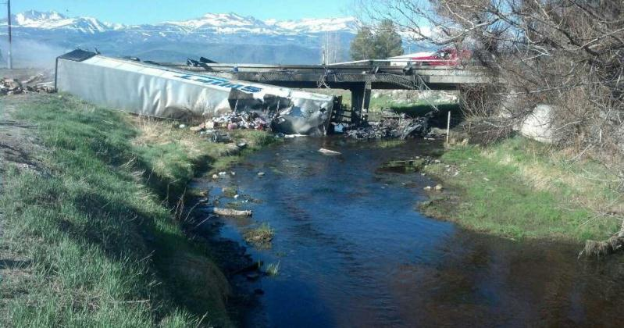
CDFW/OSPR Notification Process
24/7 CDFW/OSPR dispatch receives all Cal OES reports as well as direct reports from the public and other agencies
Dispatch reviews reports for state water nexus and makes notifications to Field Response Team (FRT) or local warden for non-oil

Slide 6
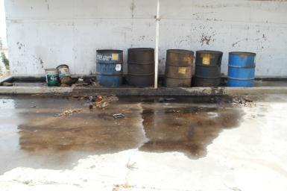
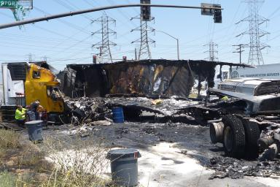
CDFW/OSPR Notification Process
2014 – 7470 statewide Cal OES reports
Approximately half were inland
1148 of these involved petroleum

Slide 7
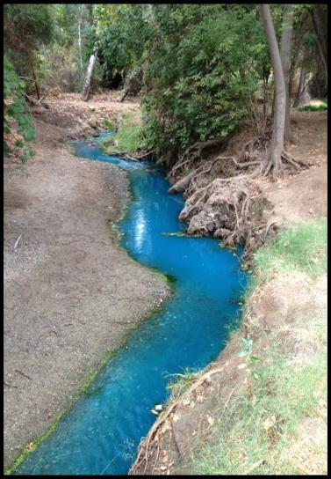
CDFW/OSPR Notification Process
Responsible Party is required to make OES notification…but this doesn’t always happen!
If a report hasn’t been made…make it!
And don’t forget non- hazardous deleterious substances such as:
milk
potable water
corn syrup
sediment

Slide 8
Roles and Responsibilities
Field Response Teams (24/7 On-call)
Wildlife Officers
F
T
R
Oil Spill Prevention
Specialists (OSPS)
Environmental
Scientists (ES)
Notes:
Three disciplines within the field response team (FRT) : Wardens, Oil Spill Prevention Specialists (OSPSs), Environmental Scientists (ESs).
FRT members are those you are most likely to encounter during a spill response.

Slide 9
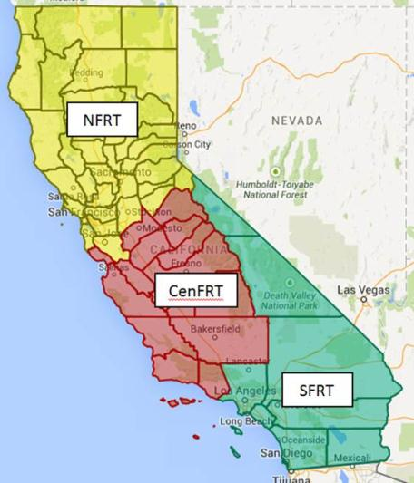
Roles and Responsibilities
Southern FRT Counties
Imperial
Inyo
Los Angeles
Mono
Orange
Riverside
San Bernardino
San Diego

Slide 10
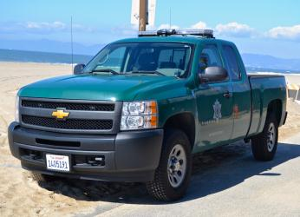
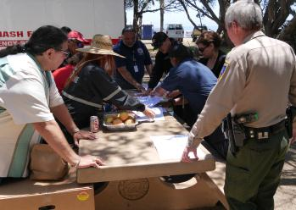
Roles and Responsibilities
Wildlife Officers
State Peace Officers
Roles and Responsibilities:
State On-Scene Coordinator (SOSC)
Public safety and site control
Public Information Officer (PIO)
Investigator
Case officer
Notes:
Background, SOSC, and discuss role as investigator through prosecution… We Have 15 OSPR Officers in the Northern FRT

Slide 11
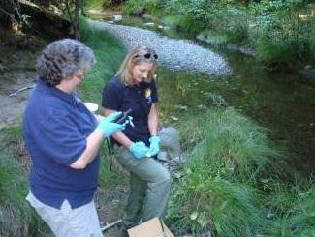
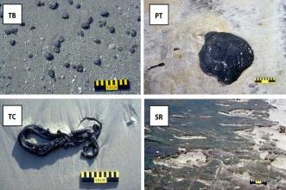
Roles and Responsibilities
Environmental Scientists (ES)
Roles and Responsibilities:
Environmental unit leader
Wildlife Branch Director
Resources at Risk – Protection Priorities
Shoreline Clean-up and Assessment (SCAT)
Clean-up Monitoring and Assessment
Determine Clean-up Endpoints
Resource Injury Assessment
Notes:
Background, SOSC, and discuss role as investigator through prosecution… We Have 15 OSPR Officers in the Northern FRT

Slide 12
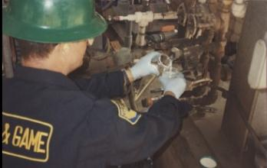
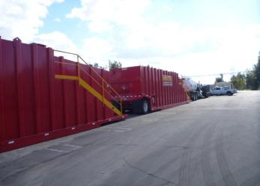
Roles and Responsibilities
Oils Spill Prevention Specialists (OSPS)
Roles and Responsibilities:
Initial Site Safety Officer
Liaison with operations staff
Air monitoring
Release quantification
Human / mechanical failure causal analysis
Salvage operations
Maritime / pipeline / Hazmat expertise
Notes:
Background, SOSC, and discuss role as investigator through prosecution… We Have 15 OSPR Officers in the Northern FRT

Slide 13
Incident Command
Plans
CA State Oil Spill Contingency Plan
CA OES Hazardous Materials Tool Kit
National Contingency Plan
US Region IX Contingency Plan
LEPC Emergency Plans
Local Plans
Area Contingency Plans (ACP) and Geographic Response Plans (GRP)

Slide 14
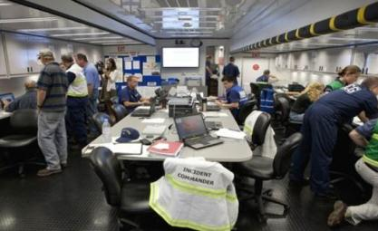
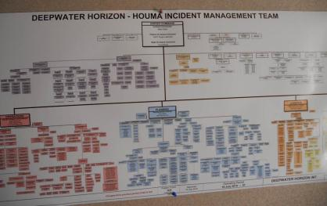
Incident Command
The Plans and Mandated Unified Command Positions
CDFW/OSPR shall serve as the State On-Scene Coordinator (SOSC) for oil spills in all State Waters
CHP shall serve as SOSC for On-Highway oil spills.
USCG shall serve as Federal On-Scene Coordinator (FOSC) for Marine oil spills
USEPA shall serve as FOSC for inland waters oil spills
Un-Mandated
CDFW will generally serve as SOSC for hazardous and deleterious material spills to State Waters

Slide 15
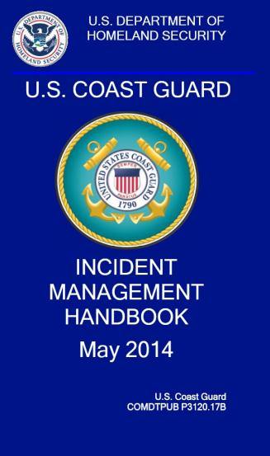
Incident Command
Incident will operate under the National Incident Management System (NIMS)
Enforcement will typically fill the SOSC position
Specialized training in ICS and pollution response
Fire suppression and human health and safety are not our expertise
OSPR personnel have the ability to fully staff most ICS positions

Slide 16
Incident Command
FRT in Oil Spill Unified Command
Warden OSPS ES
Notes:
FRT roles in unified command

Slide 17
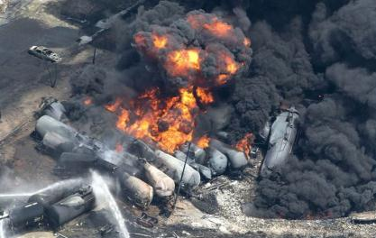
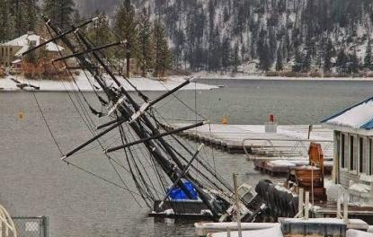
Initial Response
Multi-disciplined Approach to Response (FRT)
Ensure public and responder safety
Control and containment
Establish/ Join Unified Command
Support local response
Evaluate scope of incident and determine resource needs
Make additional notifications

Slide 18
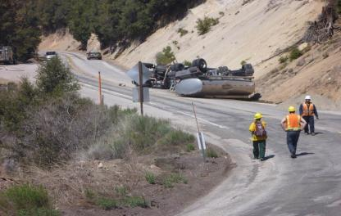
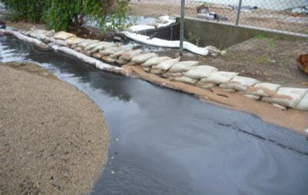
Initial Response
Work with RP to secure contractor services
Identify natural resources at risk
Determine roles
Observe for wildlife impacts
Public information

Slide 19
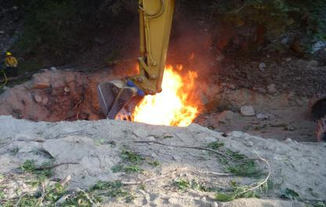
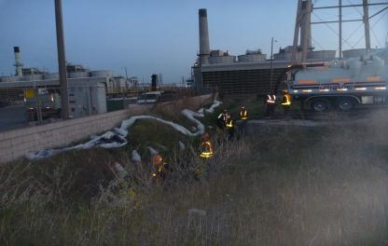
Pollution Response and Cleanup
Transition UC from initial to pollution response
Continued coordination with allied agencies
Site safety
Sampling
SCAT
Contractor coordination
Wildlife collection and hazing

Slide 20
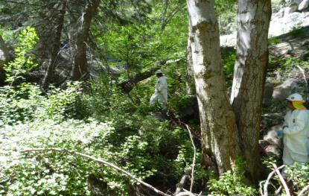
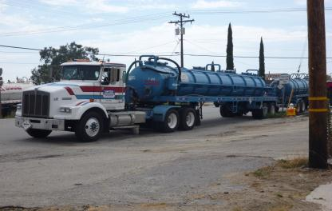
Pollution Response and Cleanup
Cultural and Historic resource protection
Determine cleanup endpoints: “How clean is clean?”
OSPS quantification
Begin demobilization
Public information
Volunteer coordination
Document!!!!

Slide 21
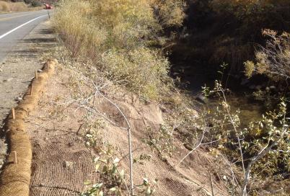
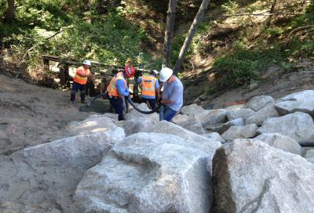
Response Conclusion
Coordinate end points with allied agencies
Confirmation sampling
Visual walkthrough by Sign Off Field Team (SOFT)
Site Restoration

Slide 22
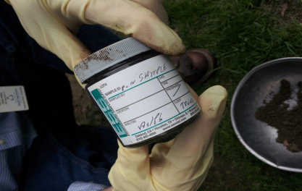
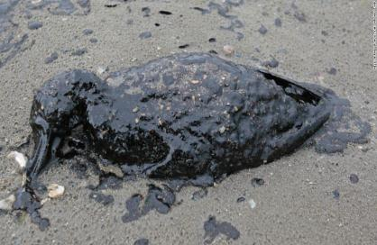
After the Response
Natural Resource Damage Assessment (NRDA)
Long term monitoring
Cost recovery

Slide 23

Investigation
Water Pollution is a Significant Environmental Crime
Penal Code, Fish & Game Code, Gov’t Code…
Evidence Collection & Control
Criminal Prosecution and Civil Considerations

Slide 24
Investigation
Fish & Game Code §5650
Unlawful to deposit or place where it can pass into state waters:
Any petroleum, acid, coal or oil tar, lampblack, aniline, asphalt, bitumen, or residuary product of petroleum, or carbonaceous material or substance.
Any refuse, liquid or solid, from any refinery, gas house, tannery, distillery, chemical works, mill, or factory of any kind.
Any sawdust, shavings, slabs, or edgings.
Any factory refuse, lime, or slag.
Any cocculus indicus.
Any substance or material deleterious to fish, plant life, mammals, or bird life.

Slide 25
Resources
Lt. Michael Horn– SoCal Interior michael.horn@wildlife.ca.gov
California Department of Fish and Wildlife www.wildlife.ca.gov/
CDFW – Office of Spill Prevention and Response www.dfg.ca.gov/ospr/
CDFW-OSPR Cal Spill Watch https://calspillwatch.dfg.ca.gov/

Slide 26
Questions?

