Slide 1
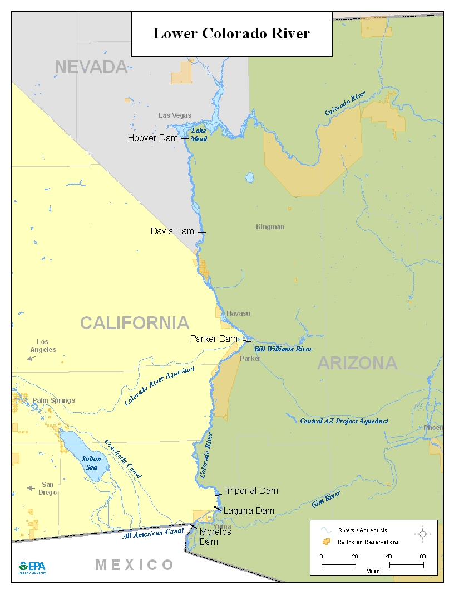

Slide 2
LOWER COLORADO RIVER GEOGRAPHIC RESPONSE PLAN
GOALS
  Improve multi-agency coordination and effectiveness of spill response operations
  Identify agency roles & responsibilities, capabilities and limitations
  Pre-plan key elements of a response prior to the emergency
  Develop good working relationships among participating agencies
Notes:
The benefits of pre-planning:
1) A more rapid response - rapid response will mitigate the amount of damage done
2) Less indecision – decisive steps taken quickly will reduce downtime
3) Directly address other agencies concerns

Slide 3
SCOPE
Hoover Dam to Morales Dam (320 river miles)
3 States: AZ, NV, CA
7 Counties: Clark Co., Mohave Co., Yuma Co., La Paz Co., San Bernardino Co, Riverside Co., Imperial Co.
5 Tribes: Colorado River Indian Tribe, Cocopah Indian Tribe, Fort Mohave Indian Tribe, Quechan Indian Tribe, Chemehuevi Indian Tribe

Slide 4
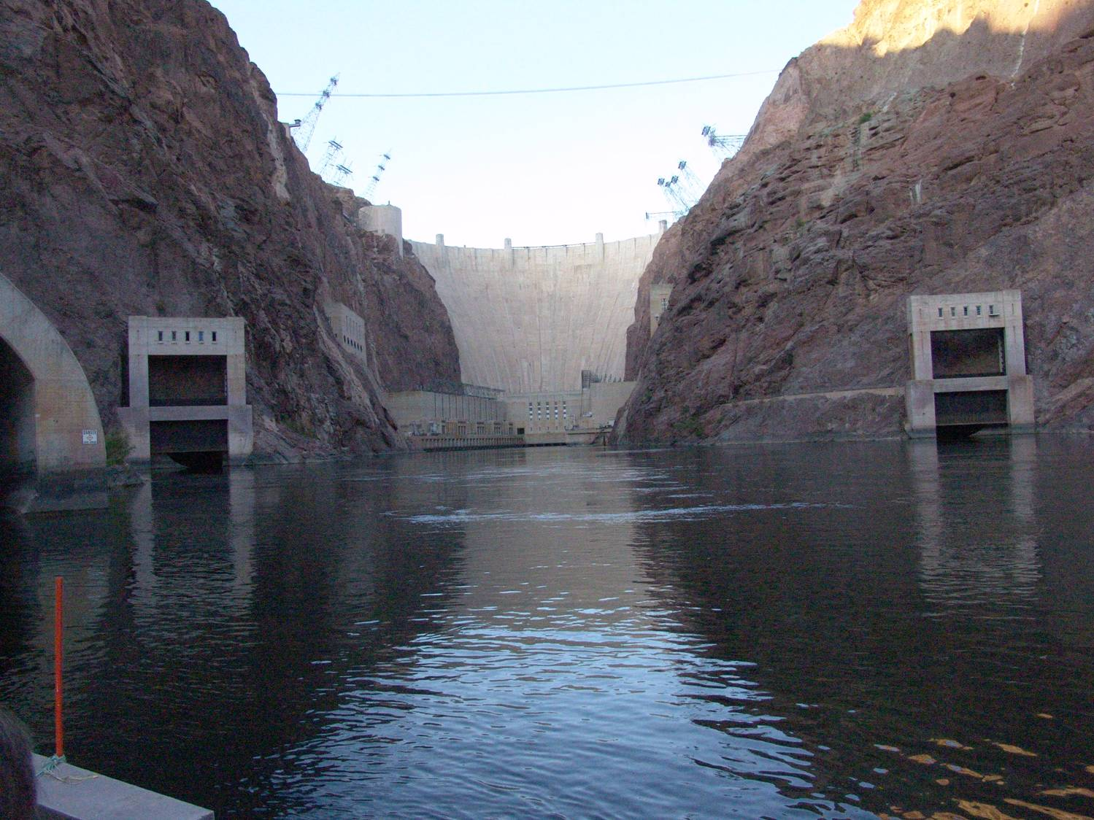
HOOVER DAM

Slide 5
ORGANIZATION
STEERING COMMITTEE
  Federal
    EPA, START, ERT, DOI, USBR, NPS, USGS, USFWS, BLM
  State
    AZDEQ, AZDEMA, NDEP, CAF&G OSPR, AZG&F
  Local
    Clark County Fire, Mohave County Emergency Management, Yuma County Emergency Management

Slide 6
STEERING COMMITTEE MEMBERS
EPA – Dan Shane, Jason Musante, Bill Robberson, Barbara Lee, Tom Dunkelman
START – Robin Clemens, Ecology & Environment
ERT – Fred Stroud
USBR – Jeff Smith
DOI – Pat Port
NPS – Chris Raynolds
USGS – Drew Decker
USFWS – Carrie Marr
BLM – Michael Moran

Slide 7
STEERING COMMITTEE, CON’T
ADEQ – Mike Malone
AZDEMA – Mark Howard
NDEP – Rob Palmer
CAF&G – Jana Rinderneck
Clark County Fire – Richard Brenner
Mohave County EM – Byron Steward
Yuma County EM – Gretchen Robbinson
ITERC of Nevada – Terry Bohl

Slide 8
ORGANIZATION, CON’T
PLANNING ZONES
  Zone 1: Hoover Dam to Davis Dam
  Zone 2: Davis Dam to Parker Dam
  Zone 3: Parker Dam to Morales Dam
AREA COMMITTEES
  Area Committee for each zone
  Area Committee meetings held in all 3 zones

Slide 10
Pre-Planning Objectives
Better understand hazards & vulnerabilities and be prepared to protect and respond
Identify and geo-locate natural and cultural resources
What do you want to protect and how do you want to protect it (site strategies)
Locate spill response resources
Who needs to be notified and who notifies

Slide 11
Workgroups
WORKGROUPS
  Notification & Dispatch
  Hazard & Vulnerability Analysis
  Natural Resources & Cultural Inventory
  River Assessment & Response Strategies
  Spill Response Resources
  Mapping
  Spill Response Training

Slide 12
Notification & Dispatch
Emergency Notification Guide
  Mandatory Notifications
  Emergency 24-hr Agency Contact Lists
  Downstream Notifications
Immediate Action Guide and Checklists
  Incident Information Checklist
  Immediate Action Checklist for Incident Command
  General Information Regarding HazMat Response
  Public Information/Press Release
Dispatch Center Meetings (Zones 1/2 & 3)
  List of all Dispatch Centers
  Dispatcher and IC Responsibilities

Slide 13
Hazards & Vulnerabilities
Questionnaires Sent to Stakeholders
High Risk Facilities
  BNSF Railroad Crossing and I-40 (Topock/Needles)
  Union Pacific Railroad Crossing and I-8 (Yuma/Winterhaven)
  Kinder Morgan Liquid Hazardous Materials Pipeline Crossing (E-NE of Downtown Yuma)
  I-95 Bridge over Bill Williams River
  Marinas

Slide 14
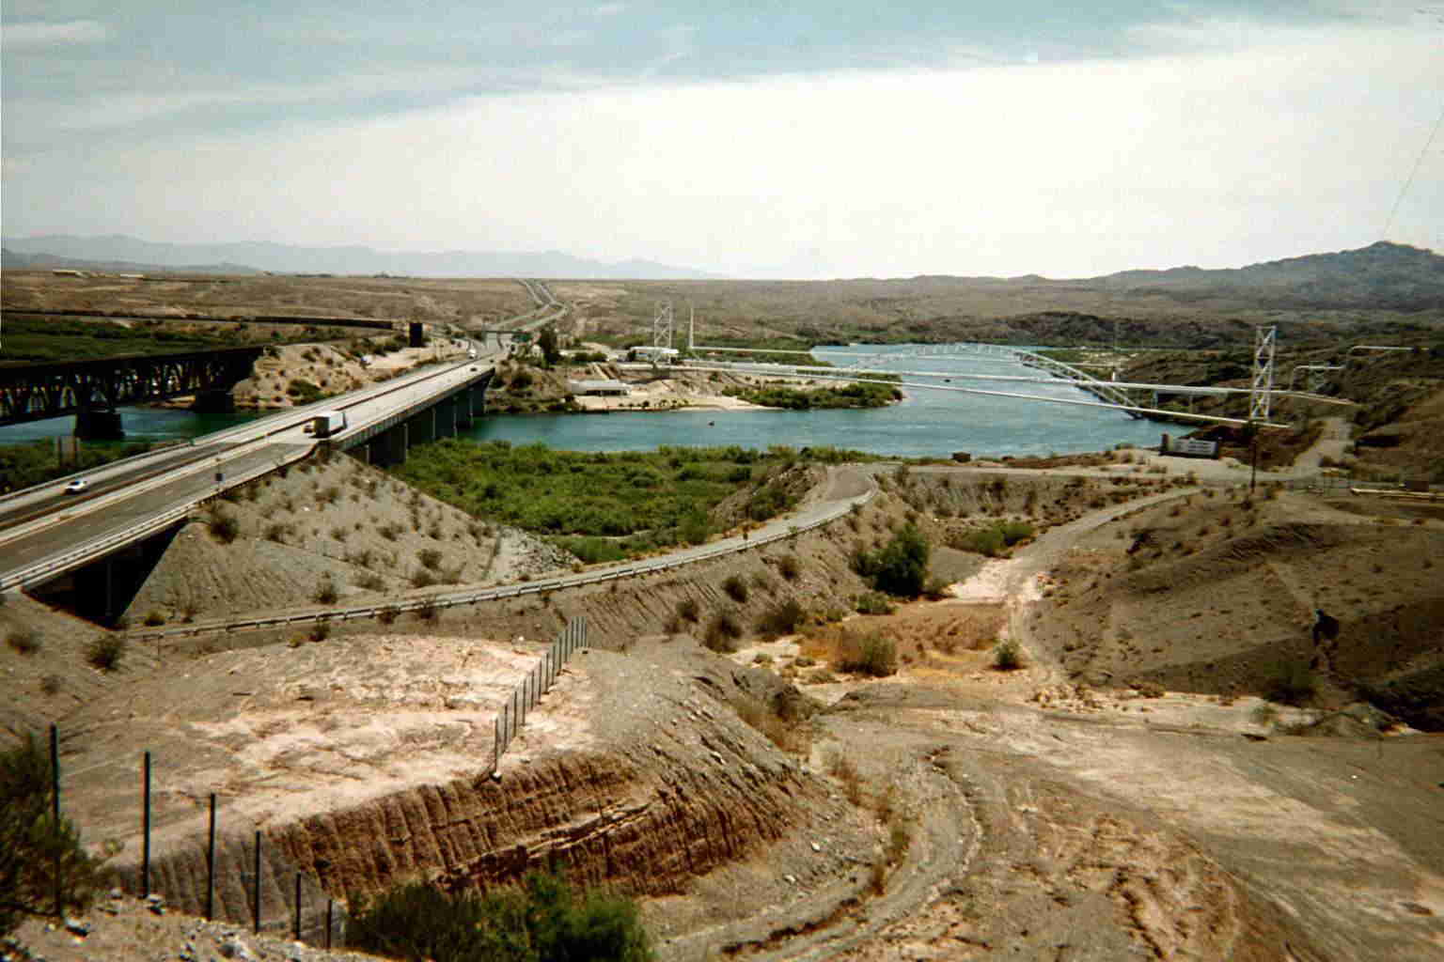
TOPOCK I-40

Slide 15
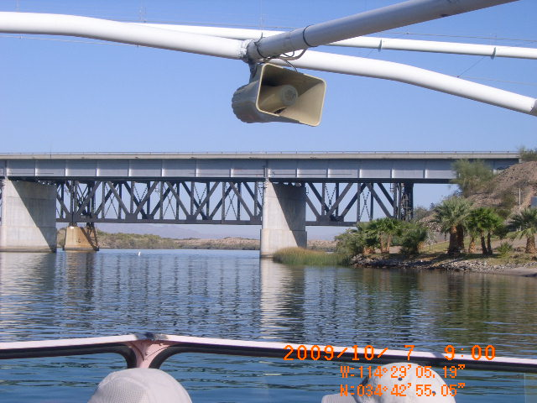
I-40 Highway and BNSF Railroad Crossings

Slide 16
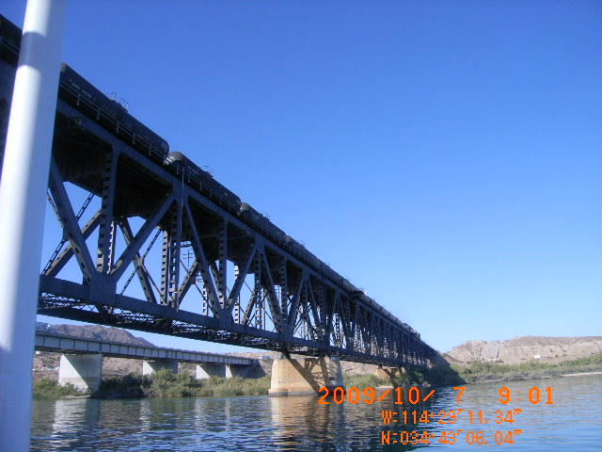
RAILROAD TANK CARS

Slide 17
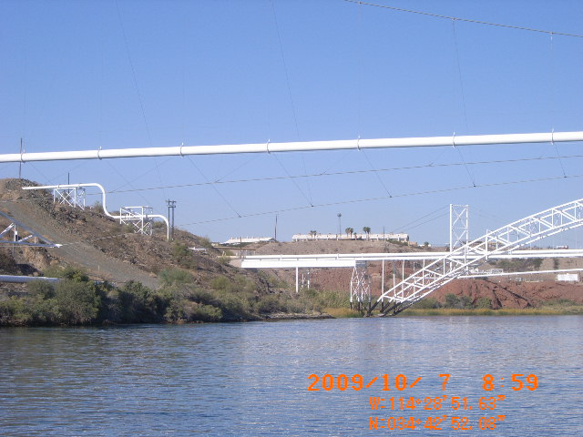
PIPELINE CROSSINGS

Slide 18
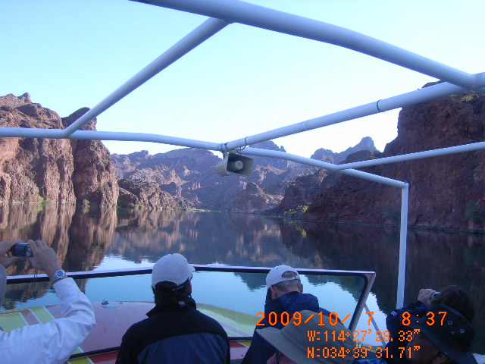
TOPOCK GORGE

Slide 19
PAST SPILLS
Reviewed NRC incident reports for past 20 yrs
In 2006, Overturn Tank Truck on I-95, Bill Williams Bridge, Spilled 7600 Gallons Diesel. Diesel Ignited and Spilled into Bill Williams River, Bill Williams NWR
In 2008, Overturn Tank Truck on I-40 Spilled 7300 Gallons Diesel into a Drainage near Topock, Havasu NWR

Slide 20
NATURAL RESOURCES & CULTURAL INVENTORY
Sensitive Ecological Populations or Habitat
  Wetland areas, wildlife refuges, fish hatcheries
Threatened and Endangered Species Habitat
Recreational and Scenic Resources
Water Intakes
Cultural Resources (historic, archaeological or tribal cultural significance)
Sensitive Human Populations (Schools, hospitals)

Slide 21
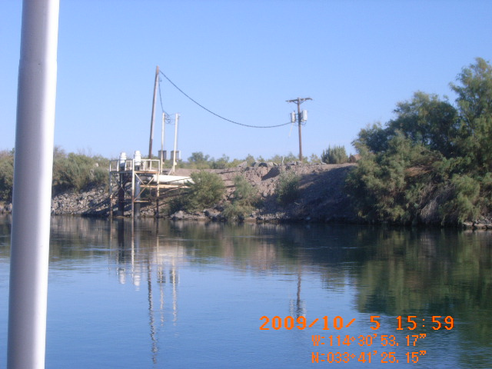
WATER INTAKES FOR CRIT

Slide 22
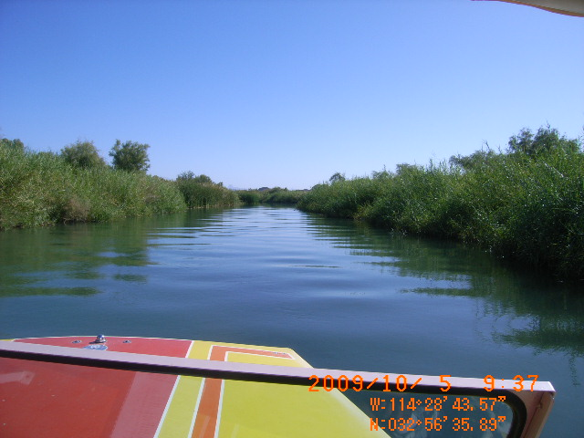
USBR BACKWATER RECLAMATION PROJECT

Slide 23
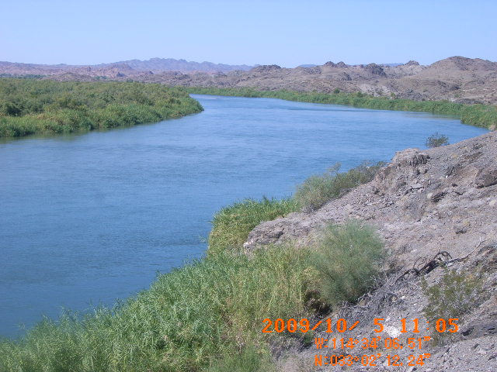
RIVER/RIPARIAN HABITAT

Slide 24
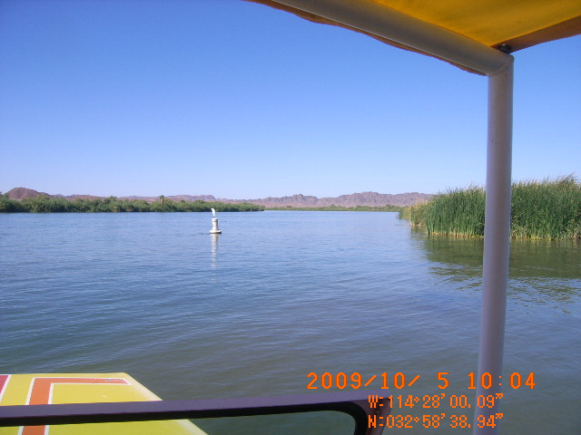
SNOWY EGRET

Slide 25
RIVER ASSESSMENT & RESPONSE STRATEGIES
Dow Car Oil Containment and Recovery Sites
Oil Recovery and Protection Booming Strategies
Field Data Collection
  Directions and Access
  Equipment Staging Area
  Booming Equipment/Deployment Strategies
  Boom Anchoring Points
  Geo-Tagged Photos

Slide 26
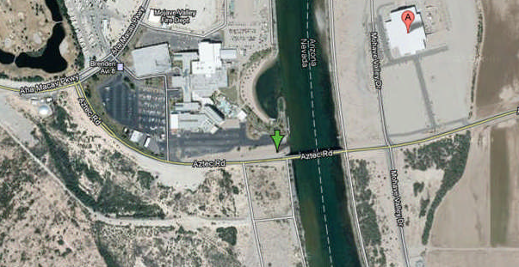
Veteran’s Memorial Bridge
Booming Site

Slide 27
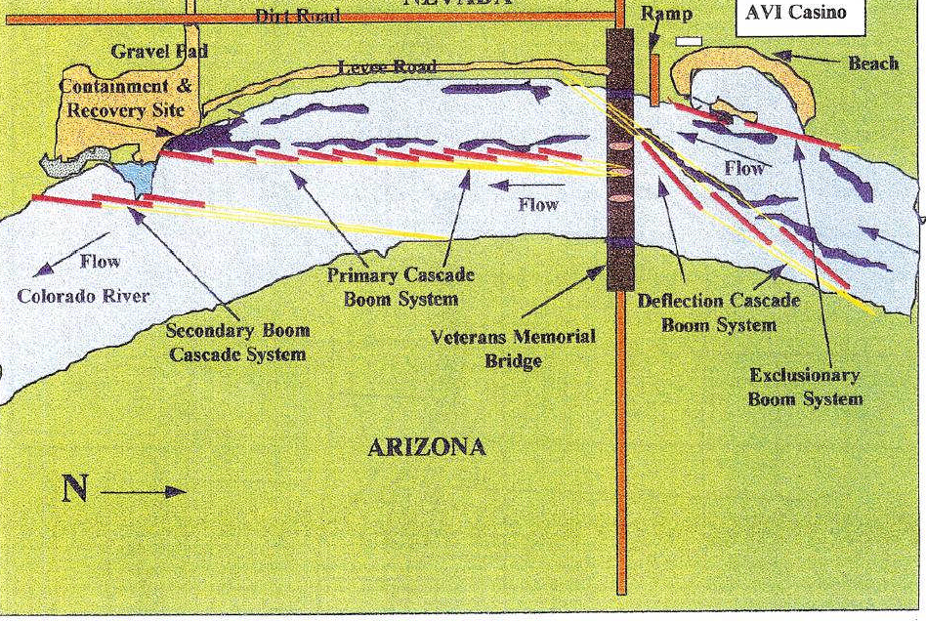
Veterans Memorial Bridge

Slide 28
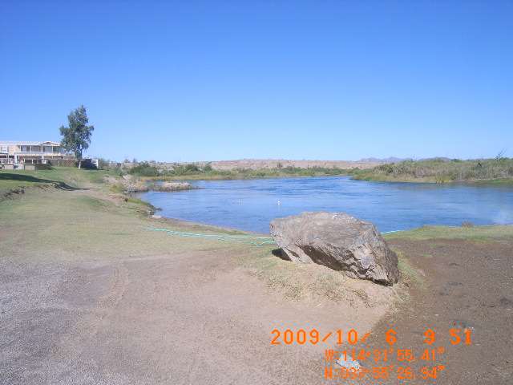
AHA QUINN RESORT BOOMING SITE BELOW PARKER and I-95

Slide 29
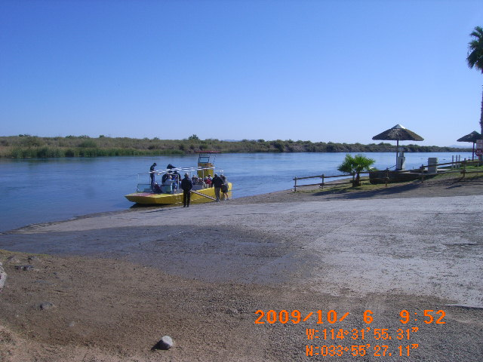
WATER WHEEL RESORT BOOMING SITE

Slide 30
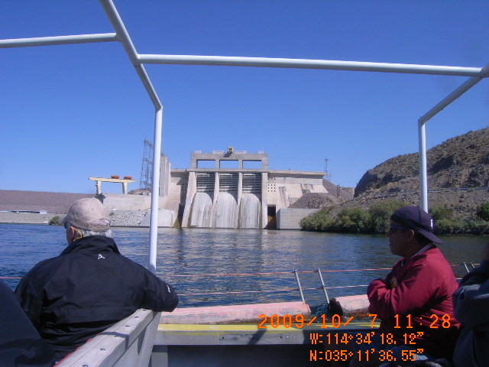
DAVIS DAM

Slide 31
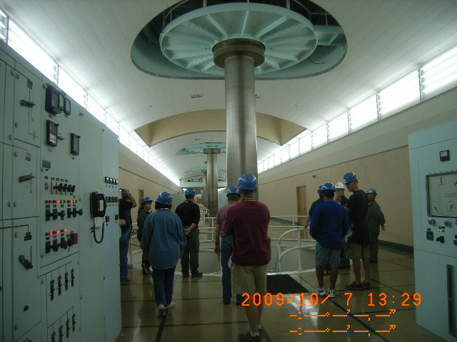
LARGE TURBINE SHAFTS

Slide 32
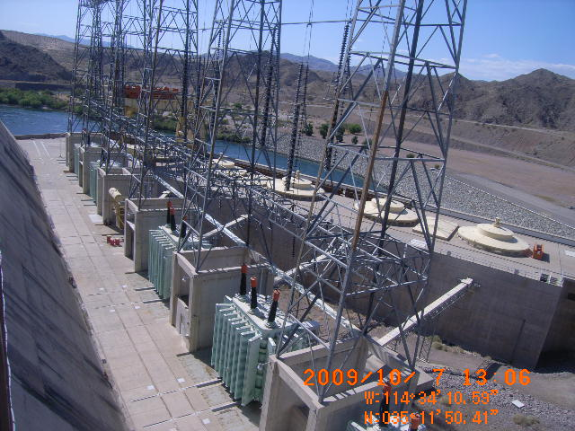
LARGE BANK OF TRANSFORMERS

Slide 33
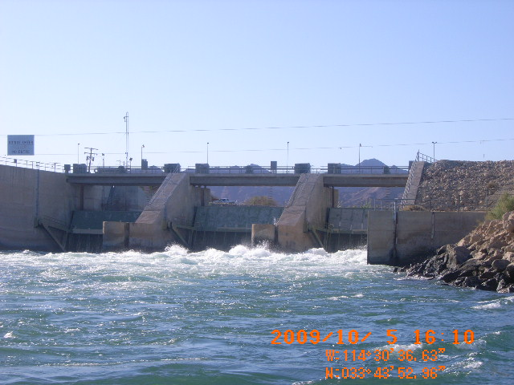
PALO VERDE DIVERSION DAM

Slide 34
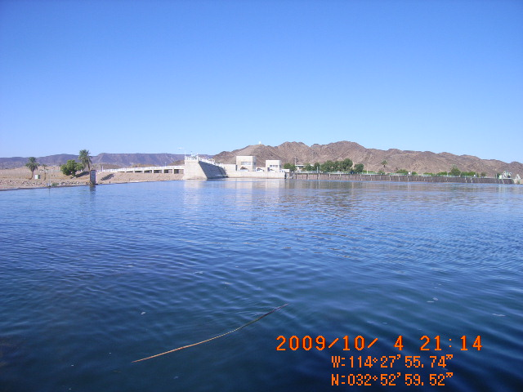
IMPERIAL DIVERSION DAM

Slide 35
SPILL RESPONSE RESOURCES
Significant Resources of Equipment and Personnel Information from Questionnaires
Hazardous Materials Teams
  Bullhead City FD and Lake Havasu City FD
Other Specialized Teams
  EPA, USBR, BLM, USFWS, NPS
  ADEQ, AG&F, ASP, CF&G OSPR, NDEP, NDW
  Local and Tribal Fire and Police Departments

Slide 36
SPILL RESPONSE RESOURCES, CON’T
Private and Commercial
  BNSF & UP Railroads and Kinder Morgan Pipeline have in-house emergency teams
  Resorts and Marinas
Spill Response and Vessel Salvage Contractors
  H2O Environmental, Inc, Las Vegas
    USCG OSRO Rated for Oil Spills
  Metropolitan Marine Solutions, Vessel Assist, Lake Mohave

Slide 37
SPILL RESPONSE RESOURCES, CON’T
USBR
  Boats (Boulder City and Yuma)
  Two trailers with boom and spill response equip.
  600 feet soft boom at Hoover Dam
  1,000 feet hard boom at Hoover Dam
  1,700 feet hard boom at Willow Beach
  Aircraft 6-seater at Boulder City Airport

Slide 38
SPILL RESPONSE RESOURCES, CON’T
USFWS (Parker Dam)
  Two 18-foot pontoon boats, 18-foot whaler, 17-foot SeaArk
La Paz County Sheriff’s Office (Parker)
  Two 20 foot water jet powered utility/patrol boats
  Two 21 foot outboard utility/patrol boat
  One 27 foot pontoon boat
  Two 16 foot shallow water response boats
  One mobile command post

Slide 39
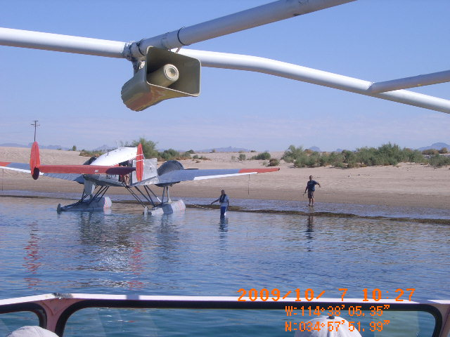
FLOAT PLANE

Slide 40
MAPPING
EPA is building a Geoviewer which is a web-based mapping application
Numerous EPA map data layers display important information for responders
The user can view area plans, maps and data, zoom to areas of interest and generate custom maps
Mobile devices can be used to collect field data (i.e., notes, observations, photos, video)

Slide 41
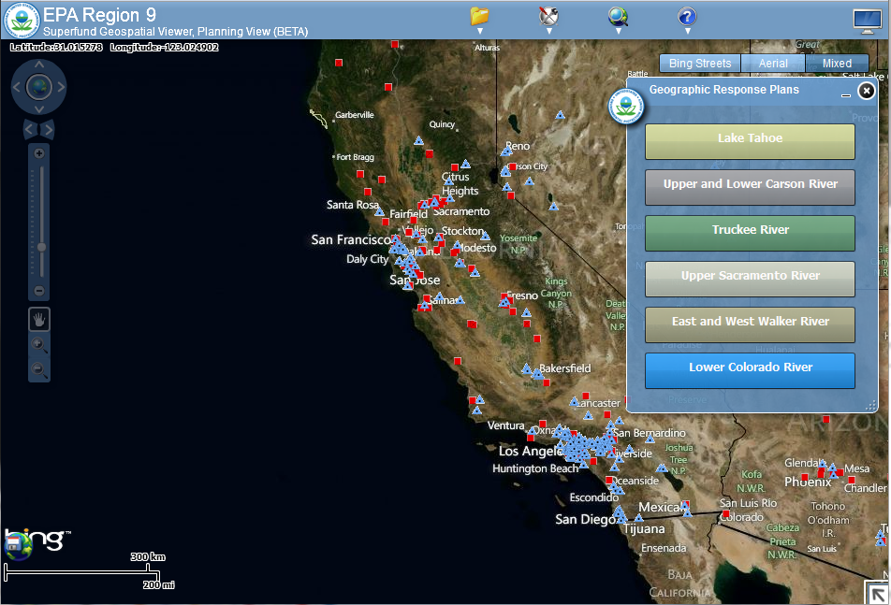
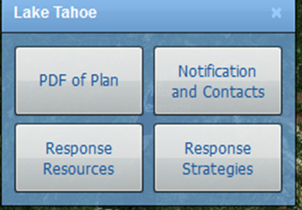
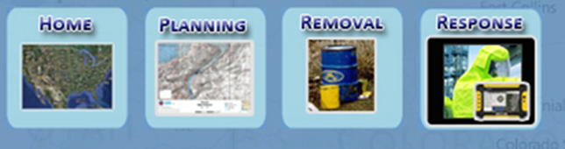
Region 9 Geoviewer (Planning)
Notes:
Provide a quick summary on the Flexviewer (Planning & Response) per user interface environment for Responders and/or GRP Field Data Collection. Also, request comments and feedback for follow-up demo on the GeoViewer by Innovate!.
Planning View: Allows user to view area plans, access maps and data, zoom to areas of interest and generate custom maps.
1. Click on the Planning View icon
2. Once you are in the Planning View, you can select a specific GRP (Geographic Resource Plan) area.
3. For example Lower Colorado River.
Also, other GRPs you can choose from within the Planning View :
Truckee River, Upper Sac River, East and West Walker River, etc.
4. You can view a PDF of the GRP and other related GRP contacts/notifications.

Slide 42
SPILL RESPONSE TRAINING
ERT’s Fast Water Booming Class held at Willow Beach for USBR and NPS in 2010
ERT’s Fast Water Booming Classes held in Mohave Valley (Zone 2) and Yuma (Zone 3) in 2011

Slide 43
SPILL RESPONSE TRAINING, CON’T
Mohave Valley Class
  16-Mohave Valley Fire Department
  4-Lake Havasu Fire Department
  2-Fort Mohave Indian Tribe
  Arizona Central Arizona Project
  U.S. Fish & Wildlife Service
  Bureau of Land Management

Slide 44
SPILL RESPONSE TRAINING, CON’T
Yuma Class
  23 – U.S. Bureau of Reclamation
  7 - Fire Departments (Ehrenberg Fire District, Rural Metro Fire Department)
  Yuma County Sheriff’s Office
  Arizona Game & Fish Department
  California Department of Fish & Game
  Quechan Indian Tribe
  Coachella Valley Water District

Slide 45
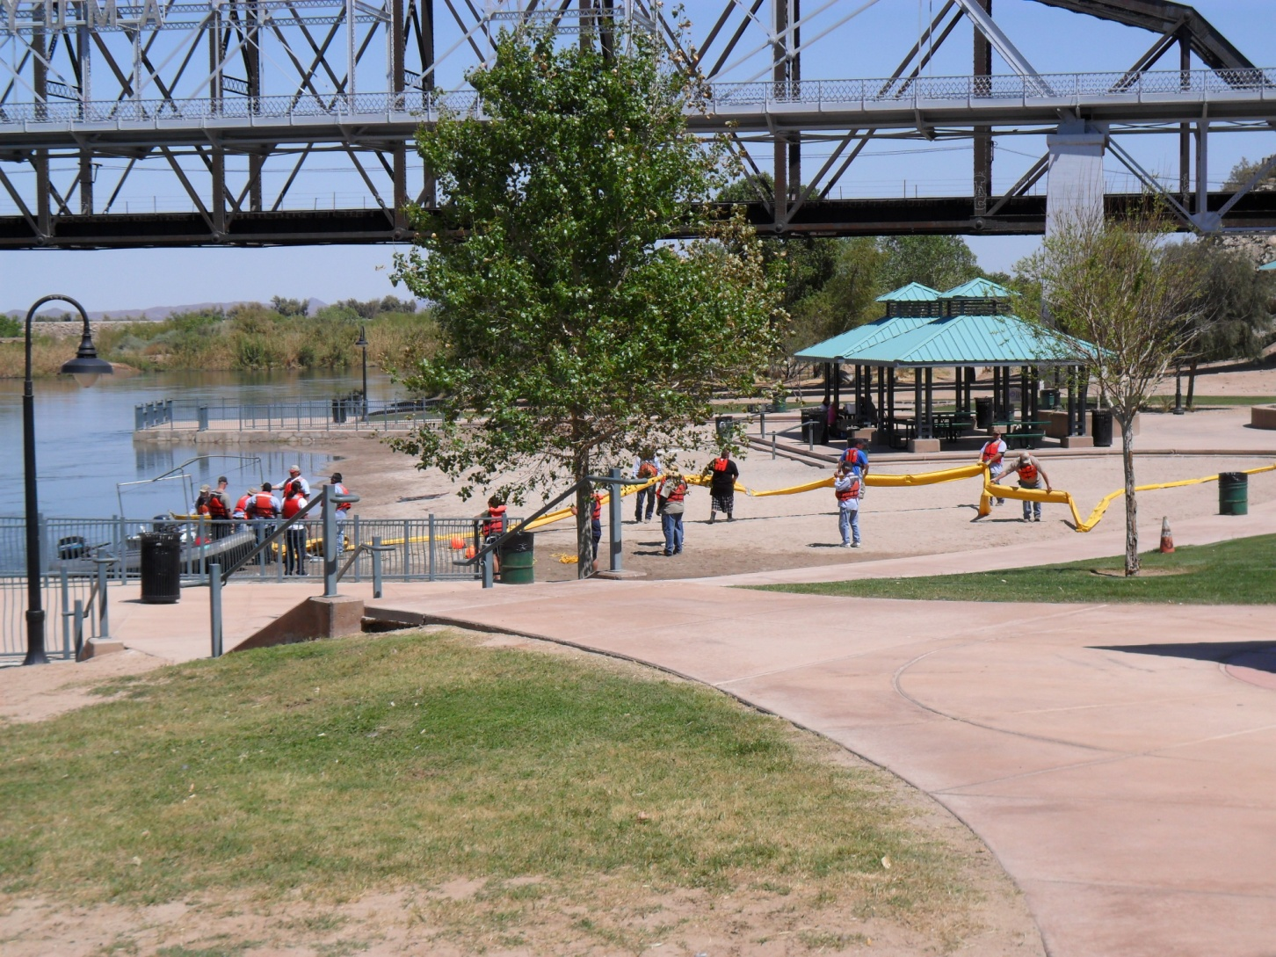
Yuma Training Class

Slide 46
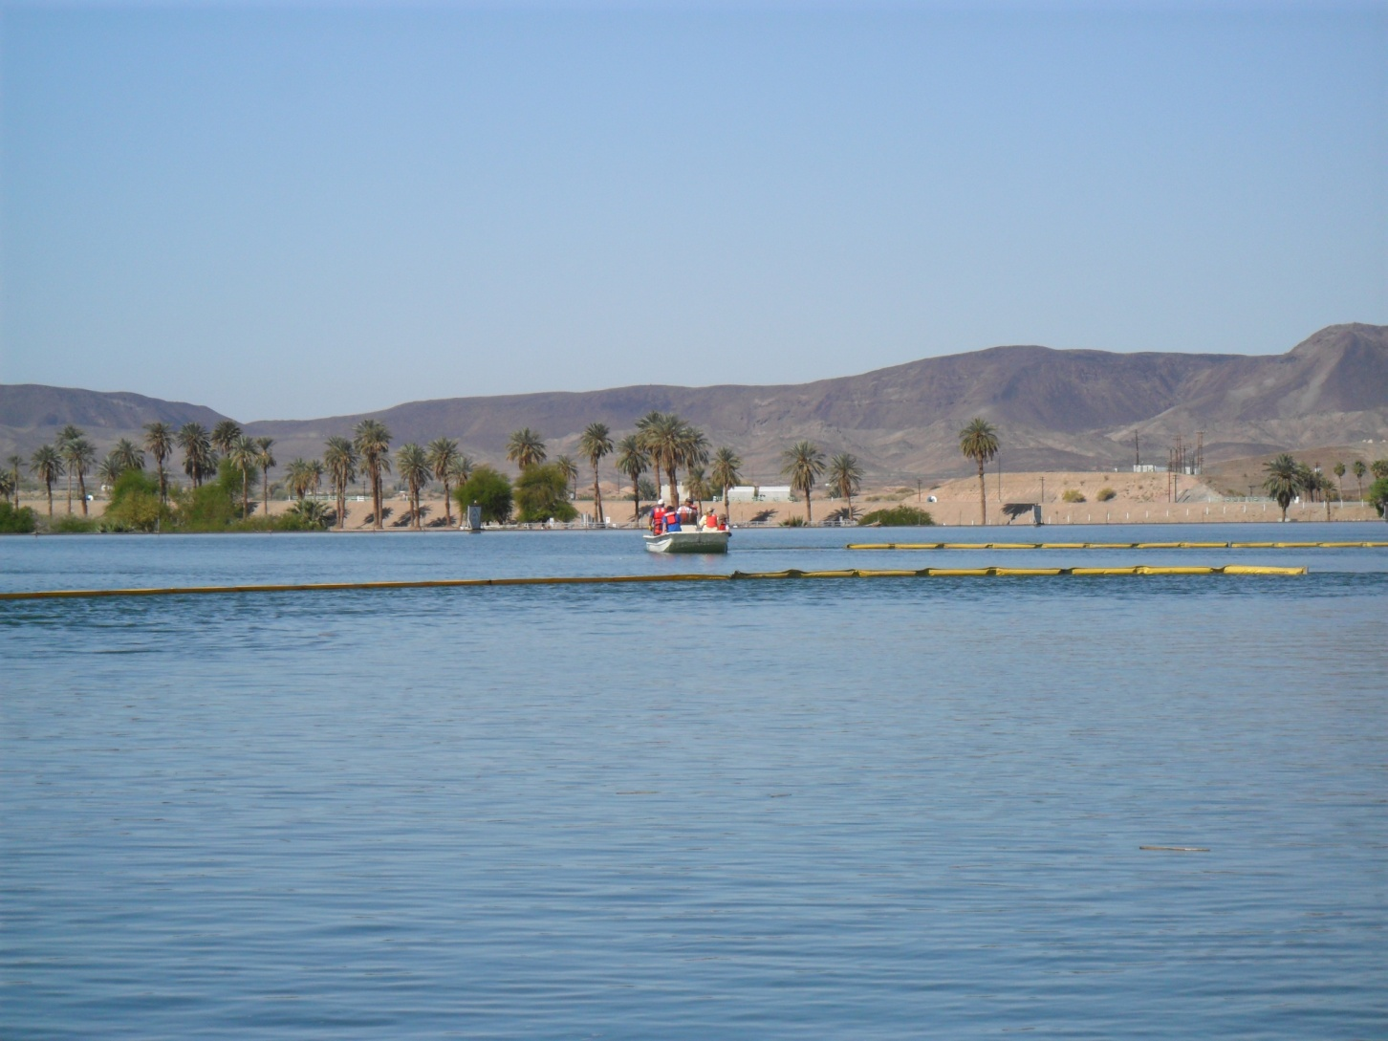
Boom Deployment Exercise

Slide 47
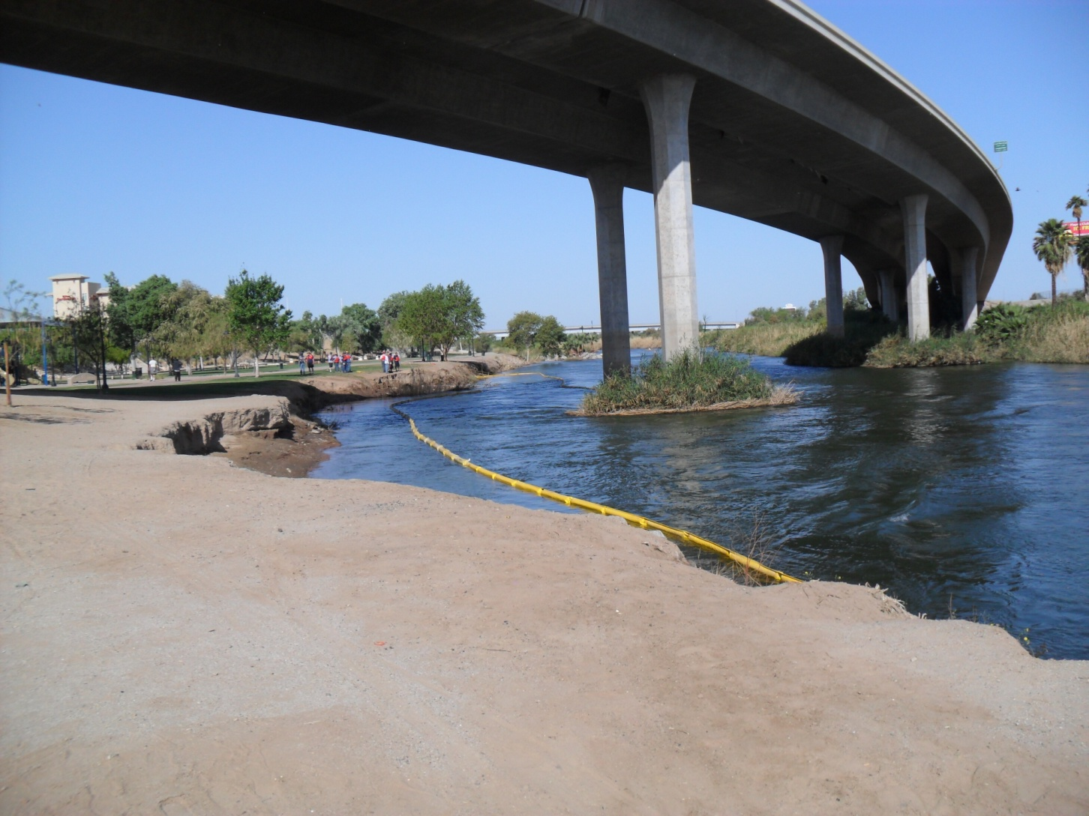
Boom Deployment Exercise

Slide 48
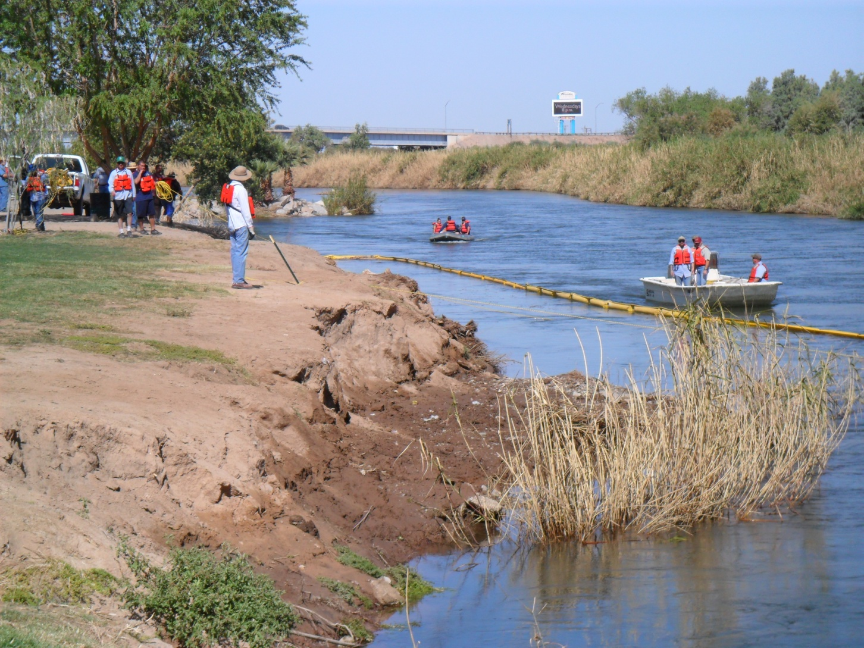
Boom Deployment Exercise

Slide 49
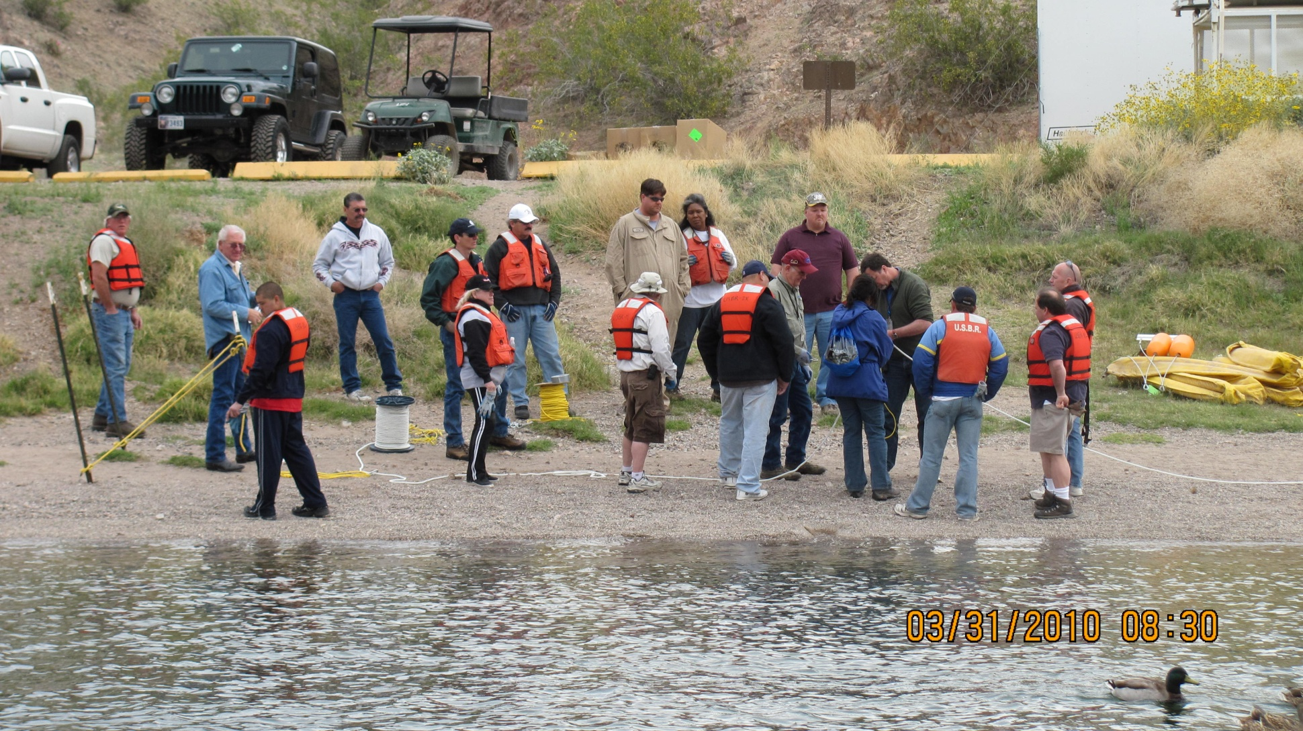
Willow Beach Training Class

Slide 50
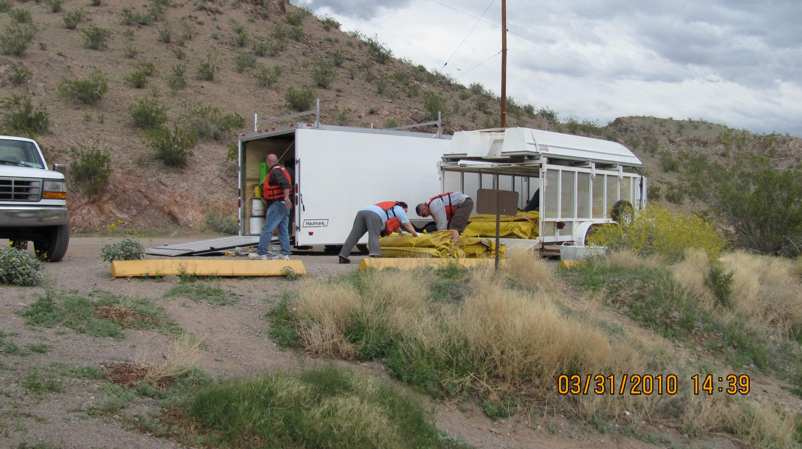
USBR Oil Spill Response Trailers

Slide 51
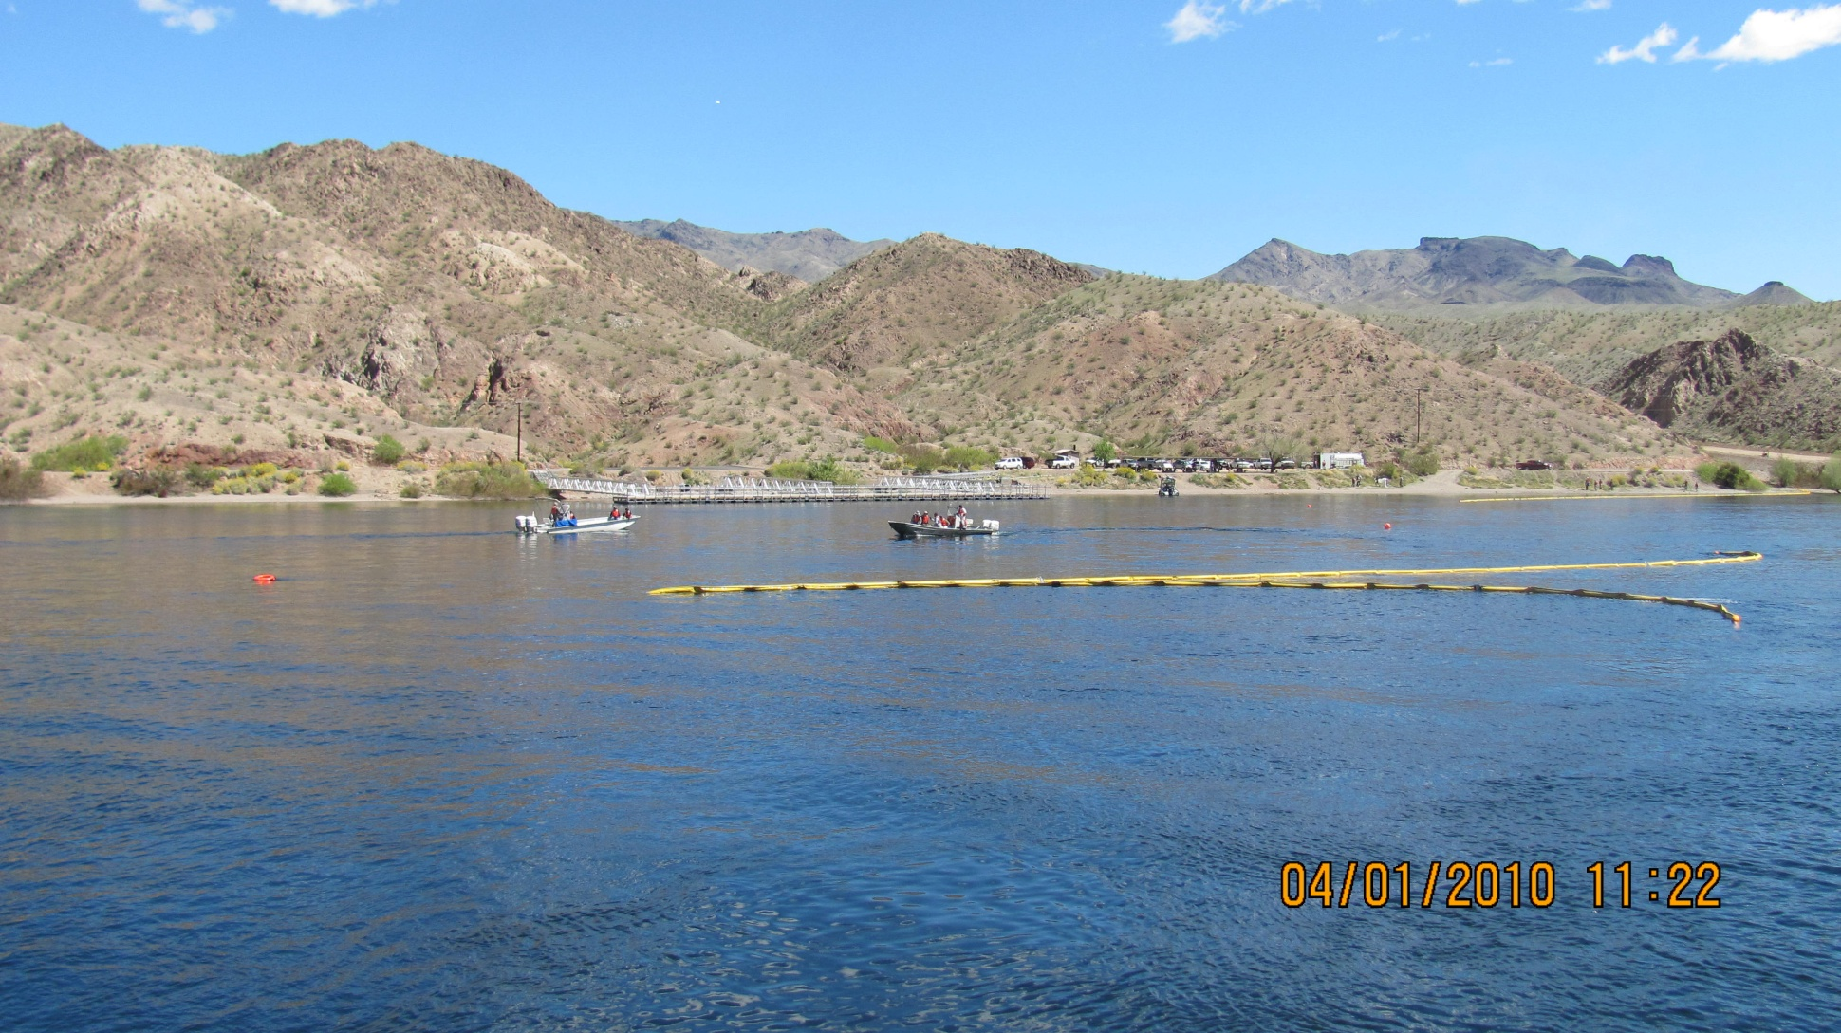
Boom Deployment Exercise

Slide 52
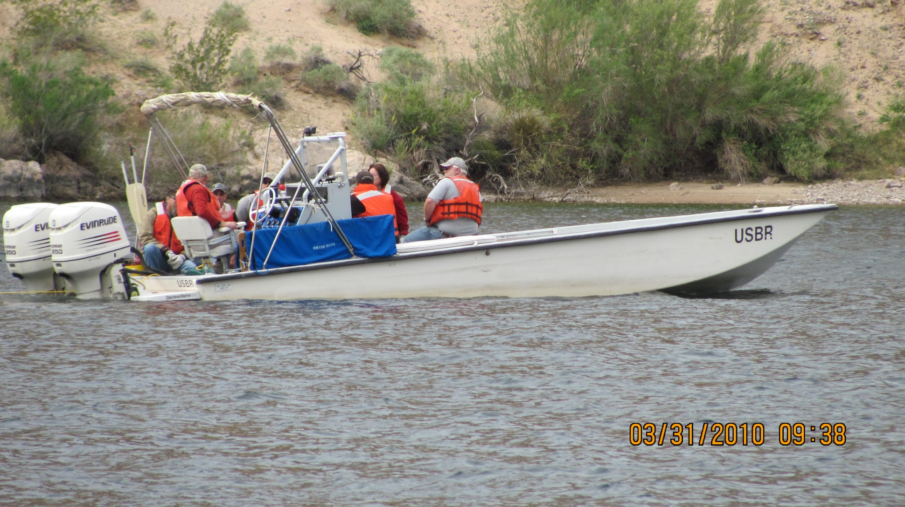
USBR Boat Towing Boom

Slide 53
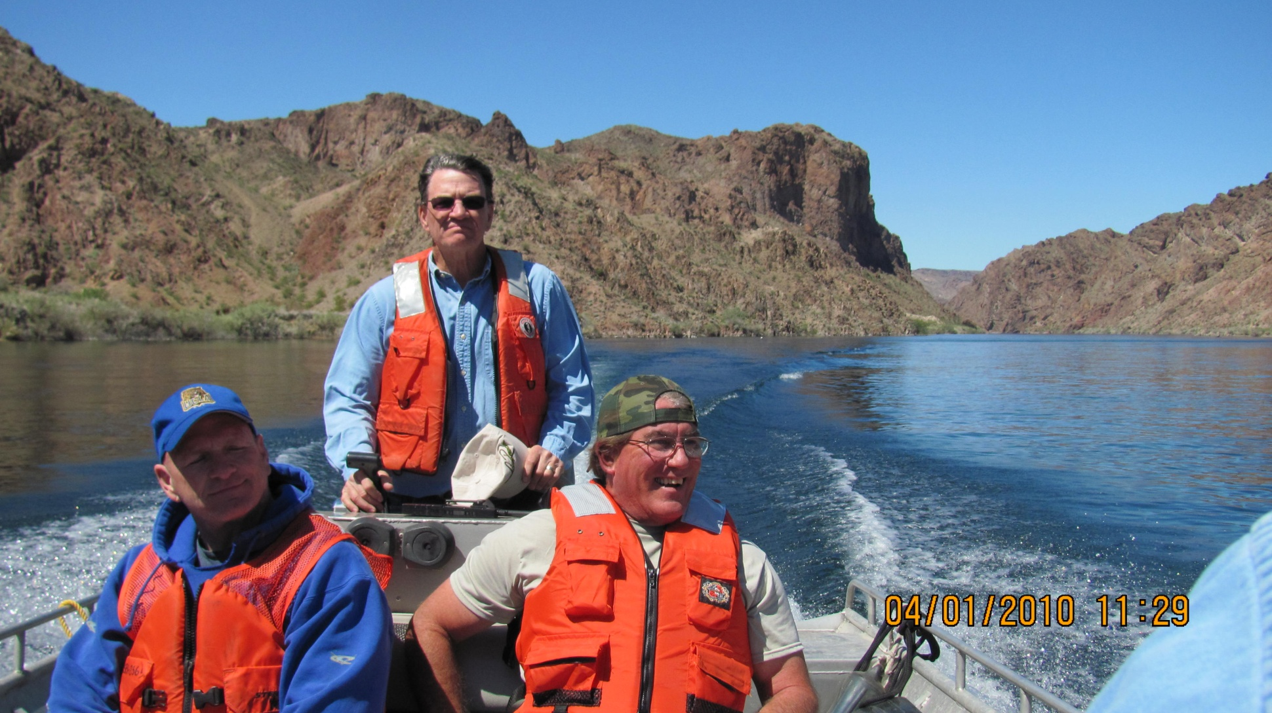
Training Emphasized Teamwork

Slide 54
NEXT STEPS
Finish the plan in FY 13
Complete mapping applications for Geoviewer
Recon Dow Car booming sites and collect photos and site information for maps
Meet with Area Committees to review the plan
Conduct table top exercise to test notification and other emergency response procedures
Improve tribal agency participation

Slide 55
Colorado River Review Boat Trip
USBR Yuma Area Office sponsors a 3-day boat trip (Yuma River Tours) from Imperial Dam to Hoover Dam
The trip provides an overview of the river ecology, environmental issues, backwater restoration, fish habitat and riparian work, wildlife refuges, dam operations, etc.
Ms. Dedina Williams is the River Review Coordinator, 928-343-8139.

Slide 56
