Slide 1
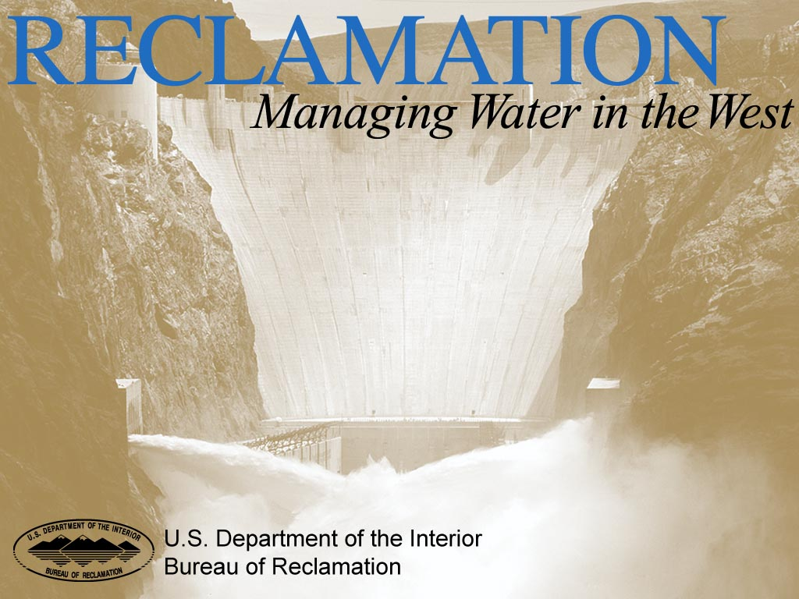
Oil and Hazardous Substance Contingency Planning
Presented By
Jeffery Smith
Regional Hazmat Coordinator
Bureau of Reclamation
Lower Colorado River Region
Notes:
Although the volume of an inland oil spill is usually small compared to that of an ocean oil spill, the frequency of inland oil spills is far greater than that of ocean oil spills, Thus, the cumulative volume of inland oil spills can still cause significant environmental impacts on the receiving waters.
In a report to congress EPA stated that from 1980 to 2003, one study reported more than 280 million gallons of oil (about 12 million gallons/year) were discharged to the inland waters of the U.S. or its adjoining shorelines in about 52,000 spill incidents.

Slide 2
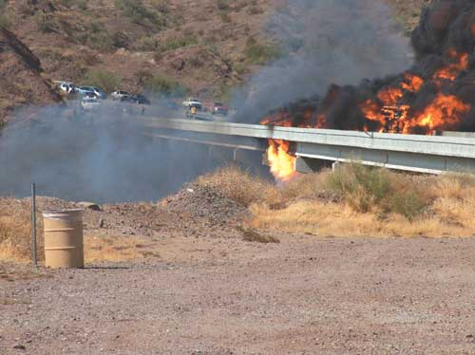
Bill Williams River Bridge Tanker Truck Spill and Fire
Notes:
At approximately 3 pm on Friday, July 28, 2006 a tanker truck over-turned in the middle of the Bill Williams River bridge and spilled its load of diesel fuel, which caught on fire. All that remained of the truck after the fire was extinguished was the steel frame of the cab and the axles. The melted aluminum tank was reduced to a layer about 3 inches thick. The Bill Williams Refuge Manager along with the USBR LC Regional Hazmat Coordinator and an EPA Region 9 FOSC estimated that less than 10% of the 7600 gallon load entered the Bill Williams River. The other 90% of the fuel was burned in the ensuing fire. The fire spread east of the bridge and burned for two and a half weeks, affecting 385 acres of the Bill Williams National Wildlife Refuge
A Consent Decree, United States v. the trucking company on July 20, 2007, was issued for the amount of $1,217,382.91 as settlement for damages to natural resources on the Bill Williams River National Wildlife Refuge. The initial response cost was covered by the Oil Liability Trust fund. The Oil Liability Trust fund is handled by the National Pollution Fund Center who administer the disbursement and ensure proper use of the Emergency Fund, 24 hours a day, every day, so that the FOSC can immediately respond to a discharge or monitor prompt and effective cleanup activities by the responsible party (RP).
The Emergency Fund can be used by FOSCs to cover expenses associated with mitigating the threat of an oil spill, as well as the costs of oil spill containment, countermeasures, cleanup, and disposal activities. While the use of the OSLTF is most closely associated with discharges from ships, it has increasingly been used for discharges at industrial or onshore oil storage and production facilities

Slide 3
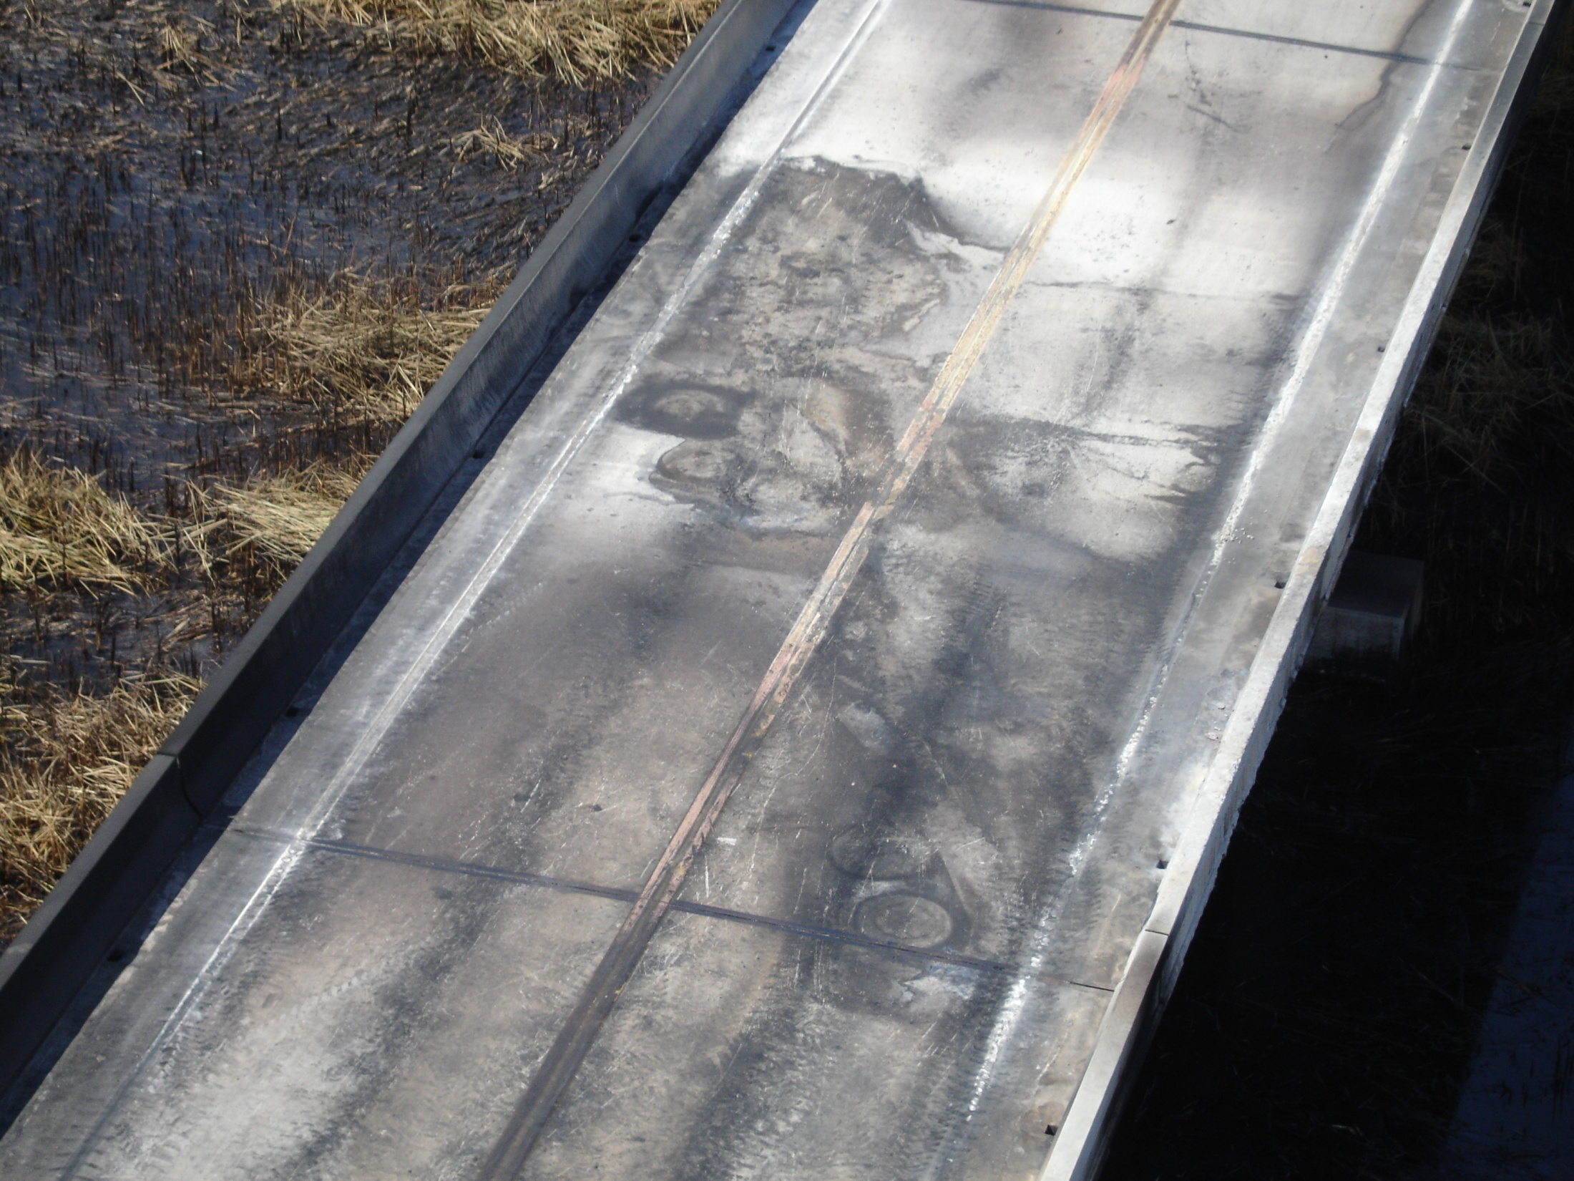
Notes:
The outline of the prime mover and the 7600 gallon fuel tank on the Bill Williams River Bridge

Slide 4
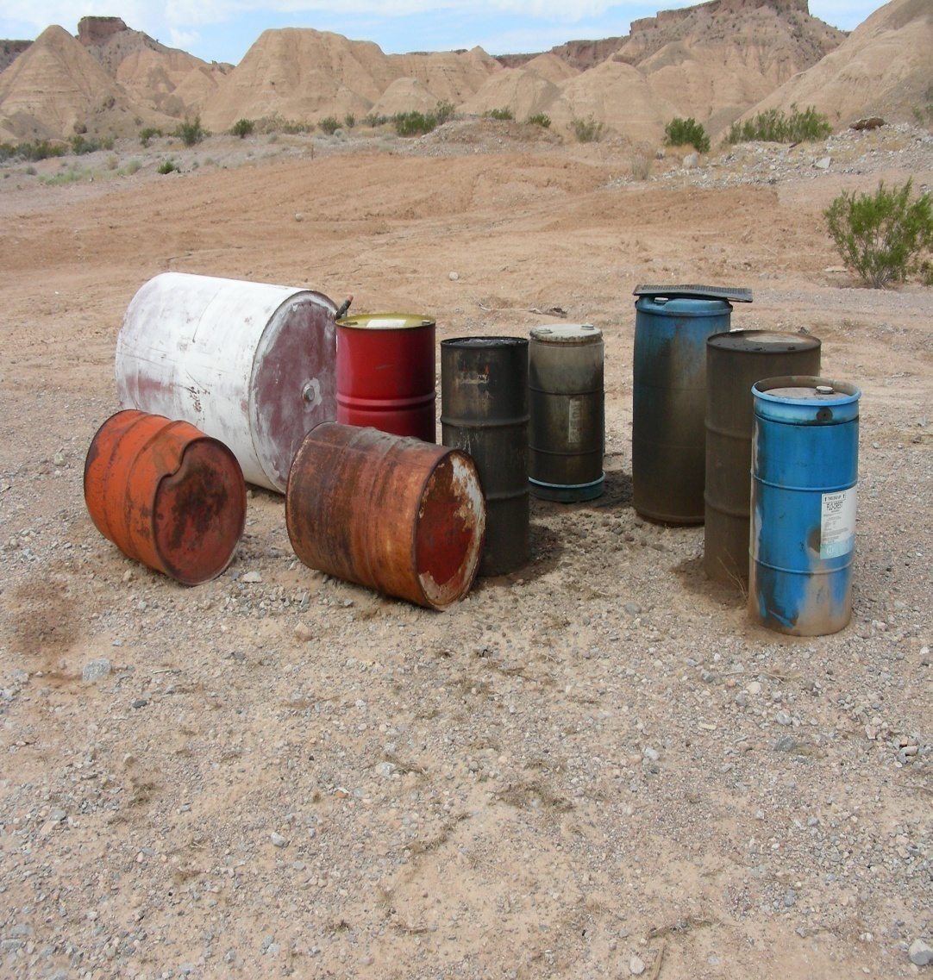
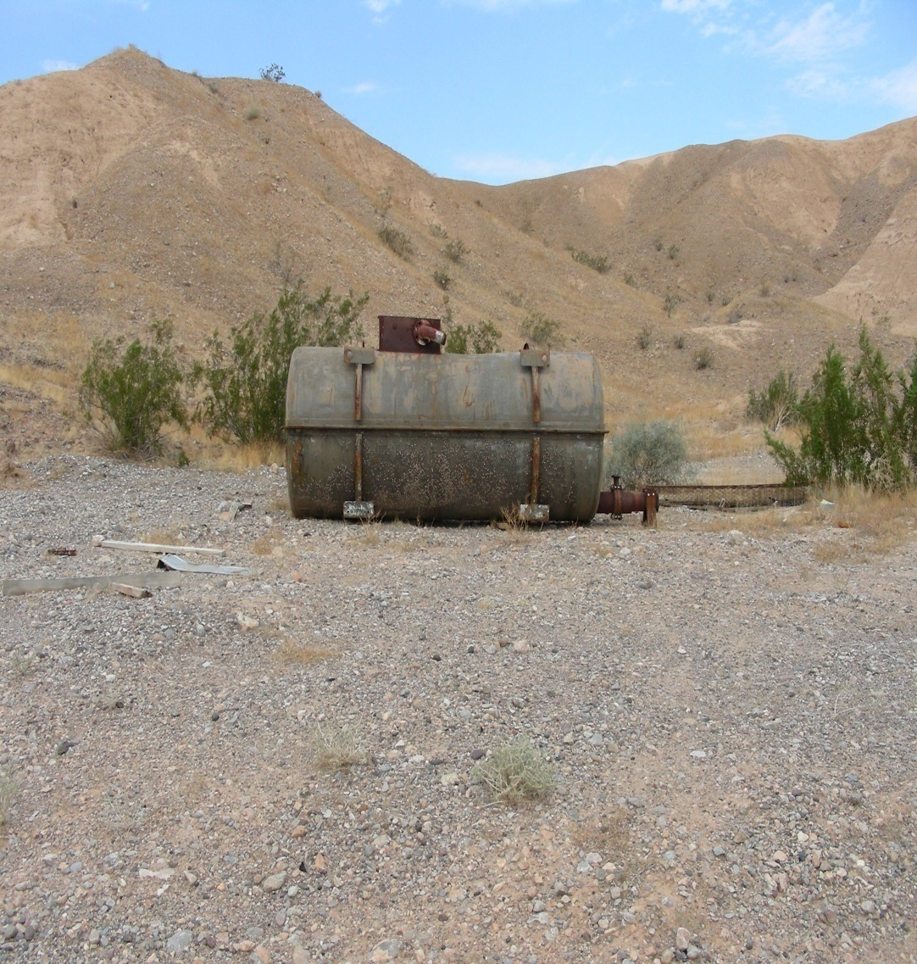
Overton Nevada Abandoned Landfill
Notes:
Congress passed the Comprehensive Environmental Response, Compensation, and Liability Act of 1980 (CERCLA, also known as "Superfund") in response to a growing national concern about the release of hazardous substances from abandoned waste sites. Under CERCLA, Congress gave the federal government broad authority to regulate hazardous substances, to respond to hazardous substance emergencies, and to develop long-term solutions for the Nation's most serious hazardous waste problems. CERCLA also created a $1.6 billion Hazardous Substance Response Trust Fund which is supported by an excise tax on feedstock chemicals and petroleum to pay for cleanup activities at abandoned waste sites.

Slide 5
National Response System and Federal Contingency Plans
There are three levels of contingency planning under the National Response System
1) National Contingency Plan (NCP)
2) Regional Contingency Plans (RCP)
3) Area Contingency Plans (ACP)

Slide 6
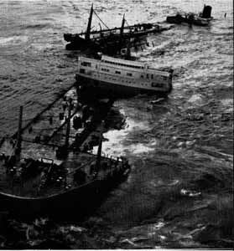
NCP Development
Developed and published in 1968 in response to a massive oil spill from the oil tanker Torrey Canyon off the cost of England
Notes:
On March 18,1967 more then 31 millons gallons of crude oil spilled into the water causing massive environmental damage off the coast of England. To avoid the same problems that faced response officials in England, the U.S. developed a coordinated approach to cope with potential spills in U.S. Waters The 1968 plan provided the first comprehensive system of accident reporting, spill containment and cleanup, and established a response headquarters (National Response Center), a national reaction Team (National Response Team), and regional reaction team (Regional Response Team)
With the passage of the Superfund Legislation in 1980 the NCP was broadened to cover releases at HW Sites requiring emergency removal actions.
Over the years these plans have been updated several times to better protect human health and the environment.

Slide 7

Why We Plan

Slide 8
National Response Team (NRT)
The NRT is co-chaired by the Environmental Protection Agency and the U.S. Coast Guard
The NRT three major activities related to managing a response are:
1) Distributing Information
2) Planning for Emergencies
3) Training for Emergencies
Notes:
NRT is responsible for distributing technical, financial, and operational information about hazardous substance releases and oil spills to all members of the NRT
Three Standing Committee of the NRT are:
1) Response Committee
2) Preparedness Committee
3) Science and Technology Committee
Planning: The NRT ensures that the role of federal agencies in the NRT for emergency response are clearly outlined in the NCP ---- Gather information to form assessments and recommendations to improve the NCP and the National Response System ---- NRT may be asked by the RRT in developing contingency plans ----- NRT reviews plans to determine compliance with federal policy and emergency response
Training is the key to the federal strategy for preparing for oil spills or hazardous substance releases ----- The NRT is responsible for developing training courses and programs, coordinates federal training efforts and provide information to regional, state and local officials about training needs

Slide 9


Why Are There Two Co-Chairs?
The U.S. Coast Guard is responsible for the planning and incident response involving Coastal Zone
EPA is responsible for the planning and incident response involving inland areas
Notes:
Depending on the location of the incident EPA or the Cost Guard will provide a Federal On Scene Coordinator (FOSC) to direct response activities

Slide 10
NRT Members
EPA
U.S. Coast Guard
FEMA
DOD
DOE
NRC
Dept. of State
Treasury
NOAA
ASTDR
DHS
USDA
DOC
DOI
DOJ
DOL
DOT
GSA
HHS
CDC
NIOSH
OSHA

Slide 11
Regional Contingency Plans (RCP)
The Regional Response Team (RRT) will work with federal, states and tribal organizations in developing response strategies
The RCP shall include information on all useful facilities and resources in the region, from government, commercial, academic, and other resources
Notes:
The RCP must follow the same format as the NCP and be coordinated with state emergency response plans
The RCP shall contain lines of demarcation between coastal and inland zones

Slide 12
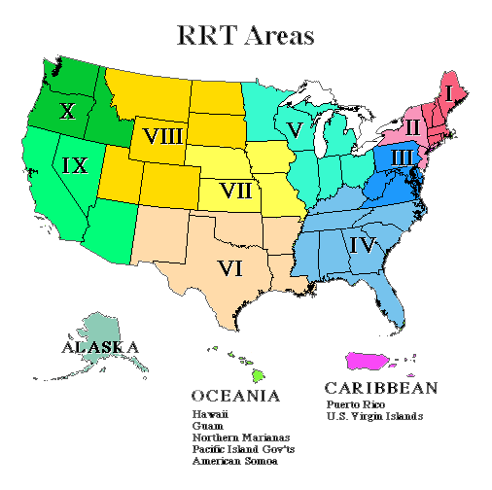
Notes:
There are 13 RRT’s in the U.S. each representing a particular geographic region
RRT’s are composed of representative from regional, area, and field offices of federal and state agencies and representatives
RRT’s are required to hold meetings quarterly

Slide 13
Regional Response Team (RRT)
The RRT is co-chaired by the Environmental Protection Agency and the U.S. Coast Guard
The RRT major rolls are:
1) Regional Planning and Coordination
2) Preparedness
3) Response

Slide 14
RRT Members
EPA
U.S. Coast Guard
DOD
DOE
NRC
Dept. of State
Treasury
NOAA
ASTDR
DHS (Bureaus & Offices)
States and Tribes
USDA
DOC
DOI (Bureaus & Offices)
DOJ
DOL
DOT
GSA
HHS
CDC
OSHA & NIOSH
Notes:
The RRT agency membership parallels the NRT but also includes state and local representatives

Slide 15
Area Contingency Planning (ACP)
ACP’s are developed under the direction of an On Scene Coordinator (OSC) from EPA or the Coast Guard
An Area Committee is formed to plan and address the removal of a worst case discharge of oil or hazardous substances
The OSC shall coordinate with the affected State Emergency Response Commissions (SERC), Local Emergency Planning Committees (LEPC), industries, federal and state agencies, and Tribes

Slide 16


Slide 17
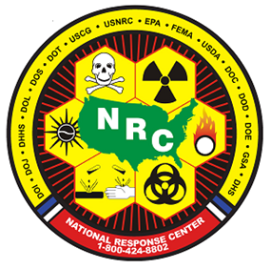
Notification of an Incident
The NCP, RCP and ACP requires that any incident involving a release of oil or hazardous substance above the reportable quantity be reported to the National Response Center (NRC) immediately at 1-800-424-8802
Notes:
The NRC is operated by the U. S. Cost Guard 24 hours a day.
The NRC acts as the single point of contact for all pollution incidents reporting and NRT communication center

Slide 18
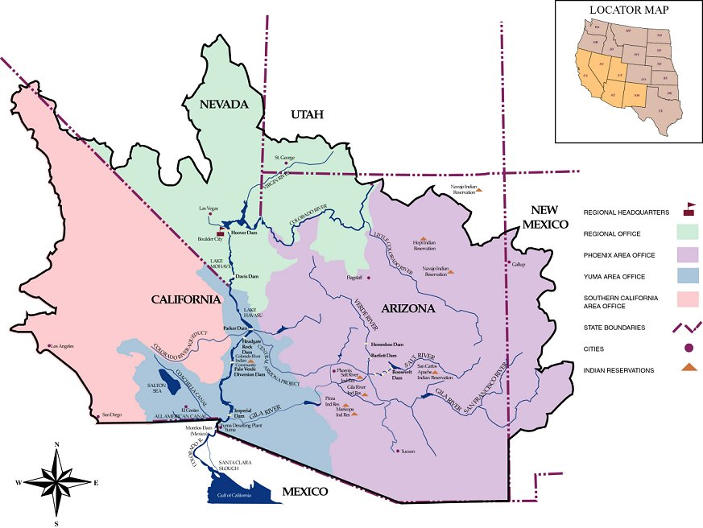
Reclamation Lower Colorado River Region
Covers the Colorado River from Lee’s Ferry to the United States / Mexican Boarder approximately 688 River Miles
Covers five states California, Nevada, Arizona, Utah, & New Mexico
Notes:
The Colorado River rises in the snowcapped mountains of north central Colorado and zigzags southwest for more than 1,400 miles before reaching the Gulf of California. The river and its tributaries - the Green, the Gunnison, the San Juan, the Virgin, the Little Colorado, and the Gila Rivers - are called the "Colorado River Basin." These rivers drain 242,000 square miles in the United States, or one-twelfth of the country's continental land area, and 2,000 square miles in Mexico. Seven western states and Mexico have beneficial interests in the Colorado River Basin.

Slide 19
Lower Colorado River Area Committee Workgroups
Mapping
Notification and Dispatch
Natural and Cultural Resources
Hazard and Vulnerability Analysis
Spill Response Resources
River Assessment and Response Strategies
Oil Spill Response Training
Notes:
Mapping The Oil Pollution Act of 1990 requires the Area Committee identify areas of environmental and economic importance. The Area Committee relies on the Natural Resource Trustees, State Trustees and local officials to designate sensitive areas for inclusion in the ACP. Collection of sensitive areas information falls into two main efforts: first, raw data collection and database development; second, use of existing EPA Geographic Information System (GIS) environmental and economic coverage's (map data layers). The information was gathered and organized into a Sensitive Areas Database that identifies locations of fish, wildlife, their habitats, and other sensitive environments. The database also provides a mechanism to be used during a spill response for timely identification of sensitive areas and prompt implementation of protection measures.
Notification and Dispatch: Due to the remoteness of some of the areas along the Colorado River and due to the fact that when there is an incident that incident will affect multi-states, counties and cities. It is important to notify the appropriate authorities and organizations so that they are aware of the situation and can take the appropriate actions to protect their resources. Dispatch among the response agencies is another area of concern during an incident and will be addresses in the Area Plan.
Hazard and Vulnerability Analysis: Essentially, a hazards analysis provides you with maps that indicate which areas in your community are most susceptible to hazards. To effectively narrow the focus of your vulnerability assessment, you must first identify the risk areas within your community. In order to obtain the most complete and comprehensive results, it is advisable that you consider all hazards facing your community. If there are data limitations, it is possible to focus your analysis on only one hazard of particular concern. Keep in mind, however, that the more risk data included in your analysis, the more opportunity there will be to focus your assessment activities in your highest-risk areas.
Spill Response Resources: Due to the remoteness of the Colorado river it could take a spill contractor anywhere from 3 to 8 hours to respond to a spill. So it is important to locate and map the location of spill equipment and resources so that response times can be greatly reduced.
River Assessment and Response Strategies: The Area Committee has broken the lower Colorado river down into three zones Hoover Dam to Davis Dam, Davis Dam to Parker Dam and Parker Dam to Morelos Dam

Slide 20
Planning for Areas of Special Economic and Environmental Importance
Environmentally Sensitive Areas
Economically Sensitive Areas
Natural Resources
Population Concentrations
Recreational Areas
Cultural Resources
Notes:
In describing areas of special economic and environmental importance, several factors should be considered. The factors include, but are not limited to: the presence and proximity of natural resources, cultural resources, environmentally sensitive areas, endangered species habitats, population concentrations, drainage basins and appropriate geographic and/or topographic features, water supplies intakes, beaches, ports, recreational areas, areas of seasonal significance, and migratory bird flyways.
Environmentally sensitive areas refers to environments that may be considered habitat to fish and wildlife or contain significant biological resources other than fish and wildlife. Environmentally sensitive areas are broken down into three separate categories: wildlife habitat, management areas and biological resource areas.
Economically sensitive areas refers to environments that are susceptible to the direct impacts of oil due to the economic value of the natural resources (e.g., from both a recreational and/or commercial perspective). Economically sensitive areas are broken down into three separate categories: water dependent commercial areas, water dependent recreational areas and anthropological areas.

Slide 21
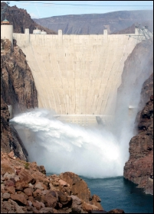
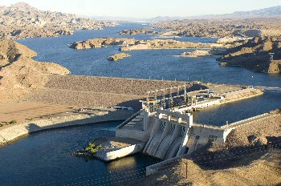
Planning Areas
Area 1 Hoover Dam to Davis Dam 67 river miles
Area 2 Davis Dam to Parker Dam 84 River Miles
Notes:
Hoover Dam's authorized purposes is for: "flood control; improvement of navigation and regulation of the Colorado River; storage and delivery of Colorado River waters for reclamation of public lands and other beneficial uses exclusively within the United States; and hydroelectric power production.
The water storage and river control Hoover and subsequent downstream dams and water delivery projects provide enables modern man to use the waters of the lower Colorado River for many purposes: Irrigation of more than one million acres of land in the United States and nearly half a million acres in Mexico. These croplands, some of America's richest, grow a wide variety of fruits, vegetables, cotton, wheat, and hay throughout the year, generating millions of dollars for local economies. Meeting the domestic water needs of more than 20 million people in homes and businesses in Las Vegas, Los Angeles, San Diego, Phoenix, Tucson, and other southwestern cities, towns and Indian communities in Arizona, Nevada, and California.
The primary purpose of Davis Dam is to re-regulate Hoover Dam releases to meet downstream needs. Behind the dam lies Lake Mohave which is confined for most of its length between the steep walls of Pyramid, Painted, Eldorado and Black Canyons. The lake is comparatively narrow, not more than 4 miles across at its widest point.
Parker Dam's primary purpose is to provide reservoir storage from which water can be pumped into the Colorado River. There are tow major water intakes they are Central Arizona Project Aqueduct which feeds water to cities in Arizona and then there is the Southern California Metropolitan Water District intake that feeds water to Southern California. Lake Havasu, the reservoir behind Parker Dam, is about 45 miles long and covers nearly 20,390 acres. It can store 648,000 acre-feet or nearly 211 billion gallons of water. Parker Dam is the deepest dam in the world; 73 percent of its structural height of 320 feet is below the original riverbed. Men and machines excavated 235 feet into the Colorado riverbed before concrete was placed for the dam's foundation. About 85 feet of the dam are visible. However, the dam's superstructure rises another 62 feet above the roadway across the top of the dam.
The Morelos Dam is the final dam on the Colorado River. It was built in 1950 between the town of Los Algodones, Baja California, in northwestern Mexico and Yuma County, Arizona in the southwestern United States. The 1944 Water Treaty between the US and Mexico relating to the Colorado River provides a guaranteed annual quantity of 1,500,000 acre-feet and any other quantities arriving at the Mexican points of diversion with certain conditions stipulated in the 1944 Treaty.

Slide 22
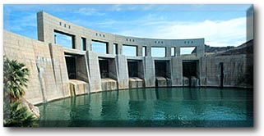
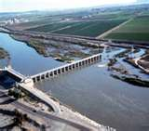
Planning Areas Continued
Area 3 Parker Dam to Morelos Dam 192 River Miles

Slide 23
A QUICK LOOK INTO SOME PLANNING FACTORS

Slide 24
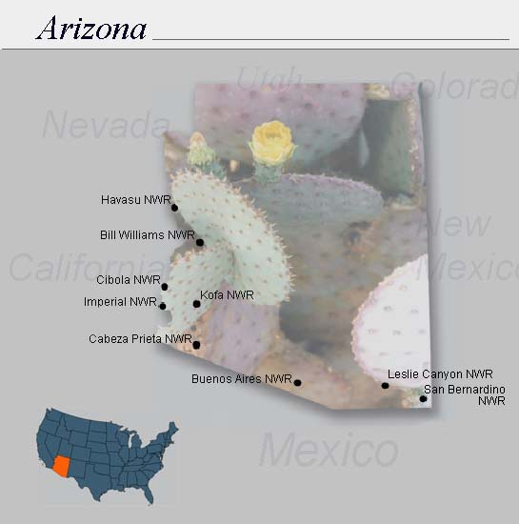
Wildlife Refuges on the Lower Colorado River
Lake Havasu National Wildlife Refuge
Bill Williams National Wildlife Refuge
Cibola National Wildlife Refuge
Imperial National Wildlife Refuge

Slide 25

LCR Multi-Species Conservation Program
Extends to over 400 River Miles
Over 8,100 acres of habitat for fish and wildlife species
Production of over 1.2 million native fish to augment existing populations
The plan will benefit at least 26 species, most of which are state or federally listed endangered, threatened, or sensitive species
MSCP Steering Committee, currently represents 57 entities, including state and Federal agencies, water and power users, municipalities, Native American tribes, conservation organizations, and other interested parties

Slide 26
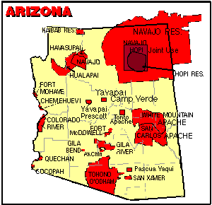
Native American Tribes Arizona

Slide 27
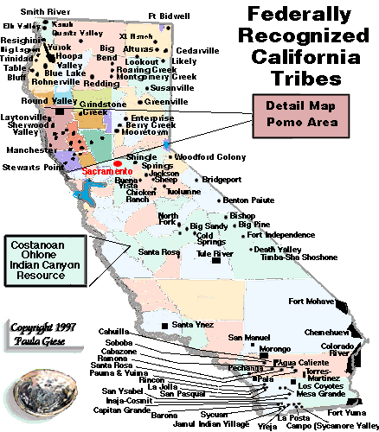
Native American Tribes California

Slide 28
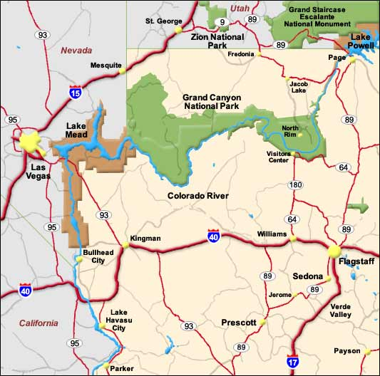
Lake Mead National Recreation Area
Notes:
As the Colorado River exits the Grand Canyon it enters the massive Lake Mead created by the Hoover Dam. Lake Mead is the largest reservoir in the United States The river line through Lake Mead is about 70 miles to the dam.
Once below Hoover Dam, it flows through canyons for some 45 miles before reaching Lake Mohave. The Lake Mead NRA boundary is at the south end of Lake Mohave at Davis Dam, just north of Bullhead City.

Slide 29
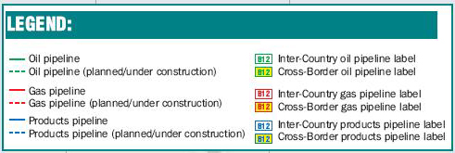
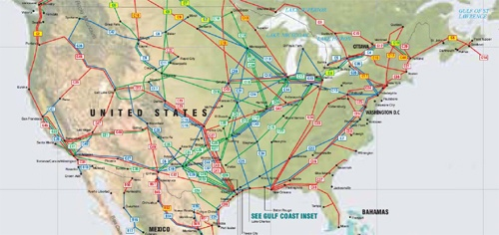
Notes:
Petroleum Pipelines in the US carry 69% of all transported oil in the US
Pipeline label codes are colored green for oil, red for gas and blue for products, such as gasoline, propane and ethylene

Slide 30
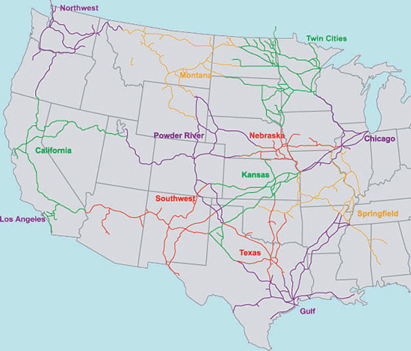
BNSF Railroad Map

Slide 31
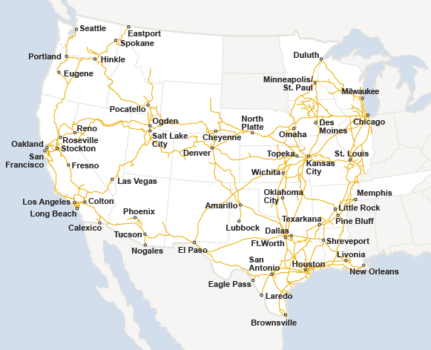
Union Pacific Railroad Map

Slide 32
Notes:
Major Interstate Freeways in the LC Region

Slide 33
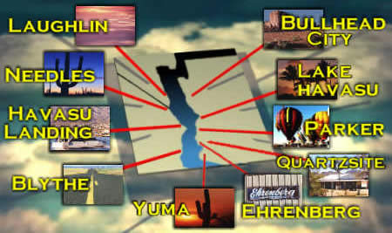
CITIES ON THE COLORADO RIVER

Slide 34
PLANING REFERENCE INFORMATION
The National Contingency plan can be found in
40 CFR 300.1 through 300.3
The National Response Team can be found in
40 CFR 300.110
The Regional Response Team can be found in
40 CFR 300.115
Federal Agency Participation can be found in
40 CFR 300.170
Federal Agencies Additional Responsibilities can be found in 40 CFR 300.175

Slide 35
PLANNING WEB SITE INFORMATION
EPA websites
http://www.epa.gov/oilspill/ncpover.htm
http://www.epa.gov/superfund/
http://www.epa.gov/superfund/cleanup/index.htm
DOI Website
http://www.doi.gov/oepc
Reclamation Website
http://www.usbr.gov/lc/
National Response Team Website
http://www.nrt.org
Notes:
We with in DOI need to help plan and protect our lands, water air and resources. There is help out there all we have to do is ask.
In conclusion I would like to leave you a quote from Robert Redford.

Slide 36
CONCLUSION
I think the environment should be put in the category of our national security. Defense of our resources is just as important as defense abroad. Otherwise what is there to defend?
~Robert Redford,
Yosemite National Park dedication, 1985

Slide 37
Question and Answers

