Slide 1
Key criteria used identify priority GRP’s:
Rail and High Hazard Rail within ¼ mile of a waterway
Pipelines and facilities within ¼ mile of a waterway
Area with historical spills
Presence of terrestrial and aquatic threatened and endangered species and their habitats
Cultural/historical concerns
Political sensitivities
LEPC boundaries – 1 GRP in each LEPC

Slide 2
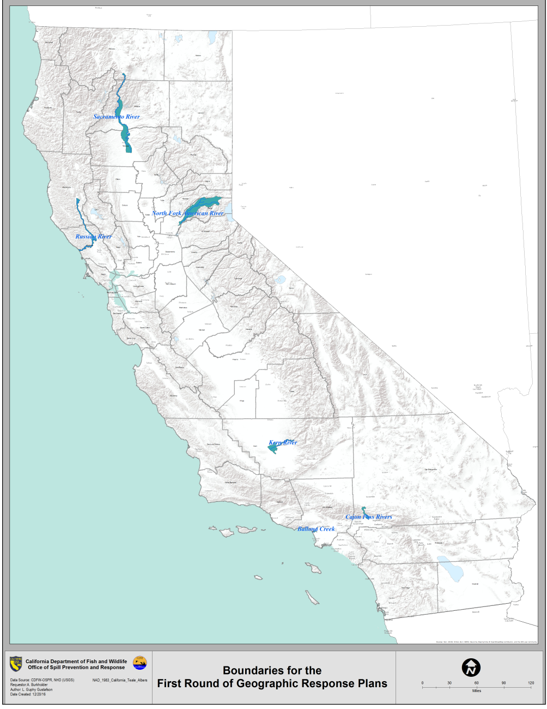
Priority GRP’s Identified by OSPR for First Planning Cycle
Upper Sacramento River
North Fork American River
Russian River
Kern River
Ballona Creek
Cajon Pass

Slide 3
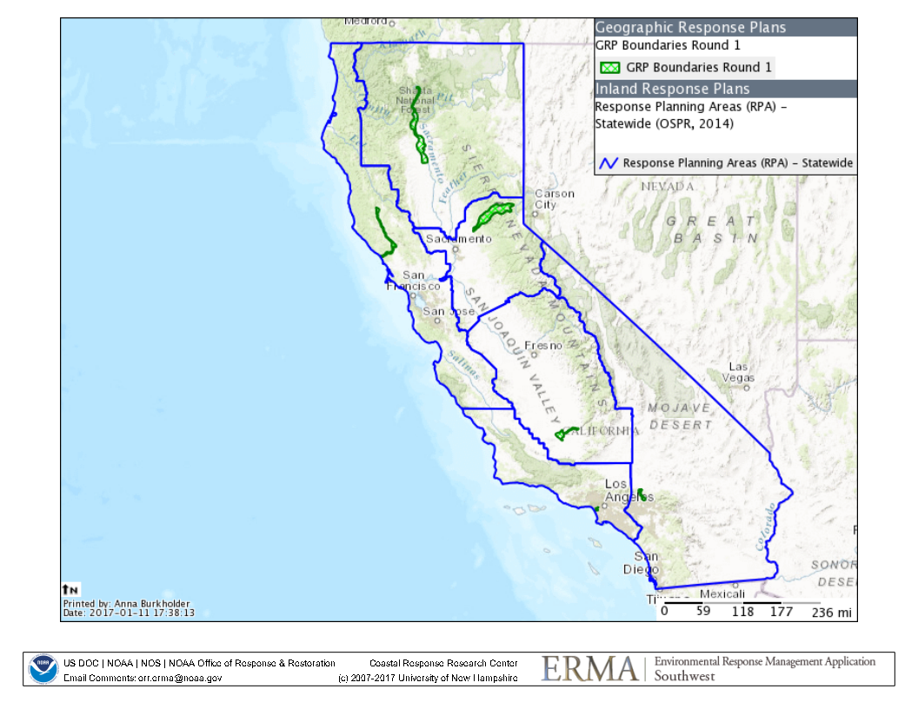
GRP Boundaries with Local Emergency Planning Committee (LEPC) Regions

Slide 4
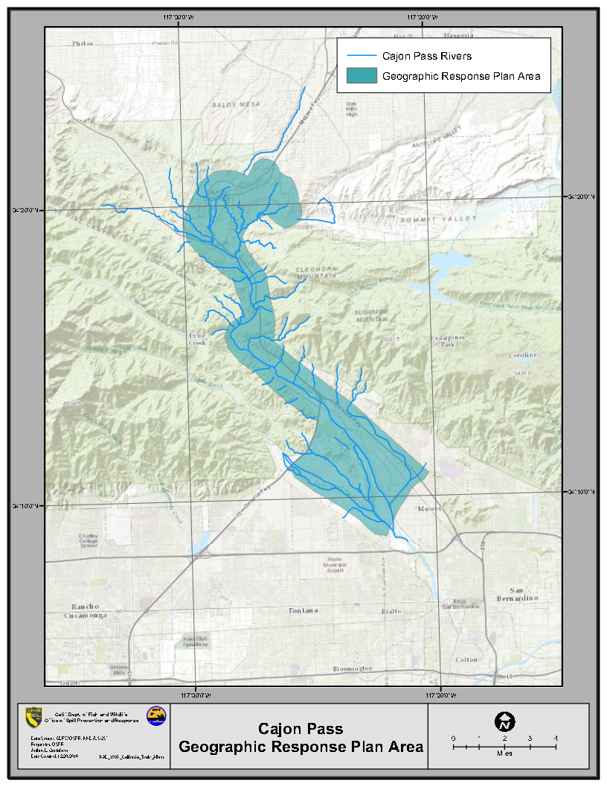

Slide 5
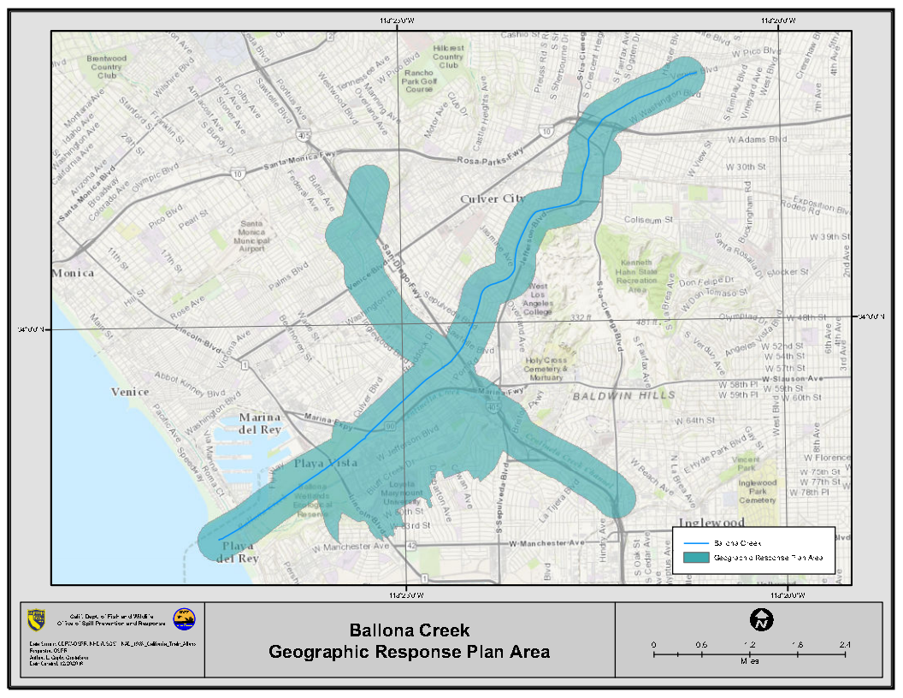

Slide 6
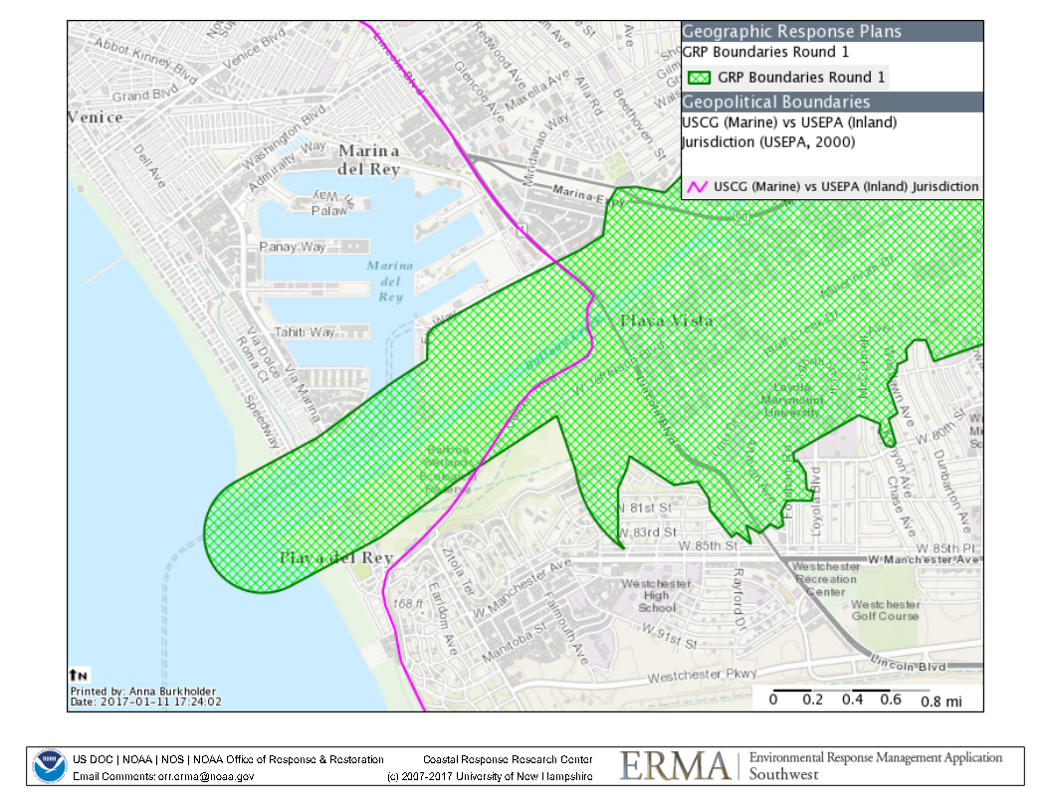
Ballona Creek – USCG/EPA Boundary

Slide 7
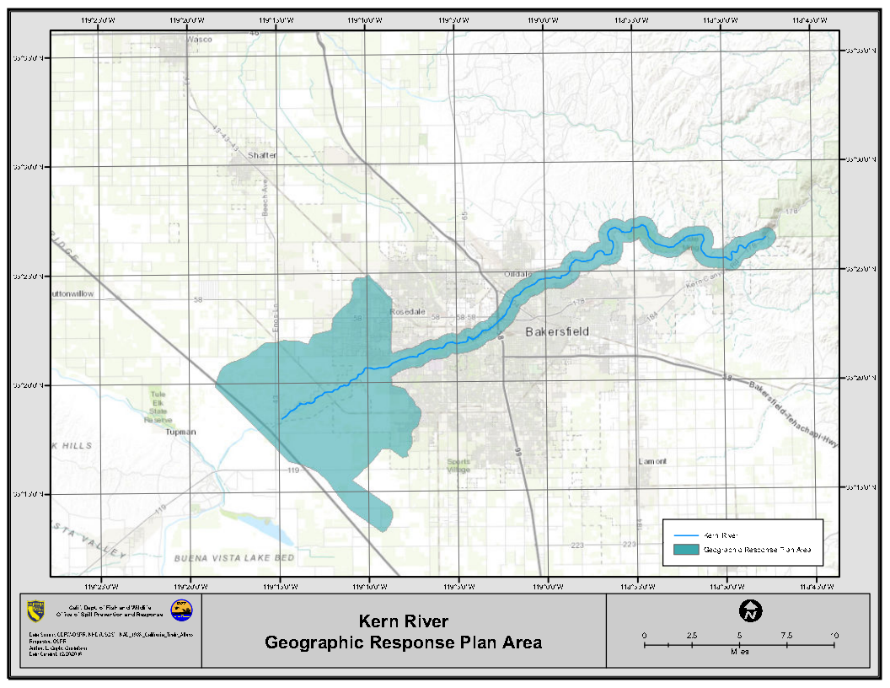

Slide 8
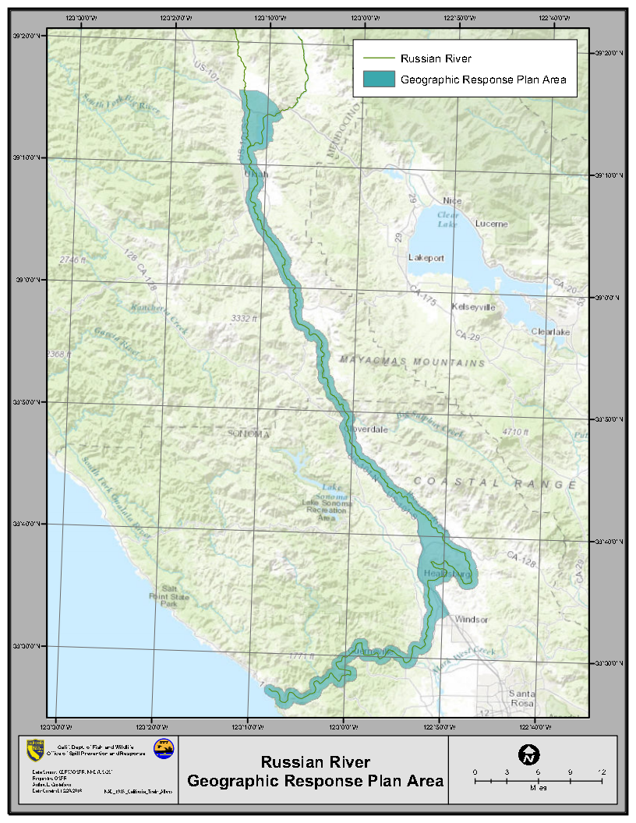

Slide 9
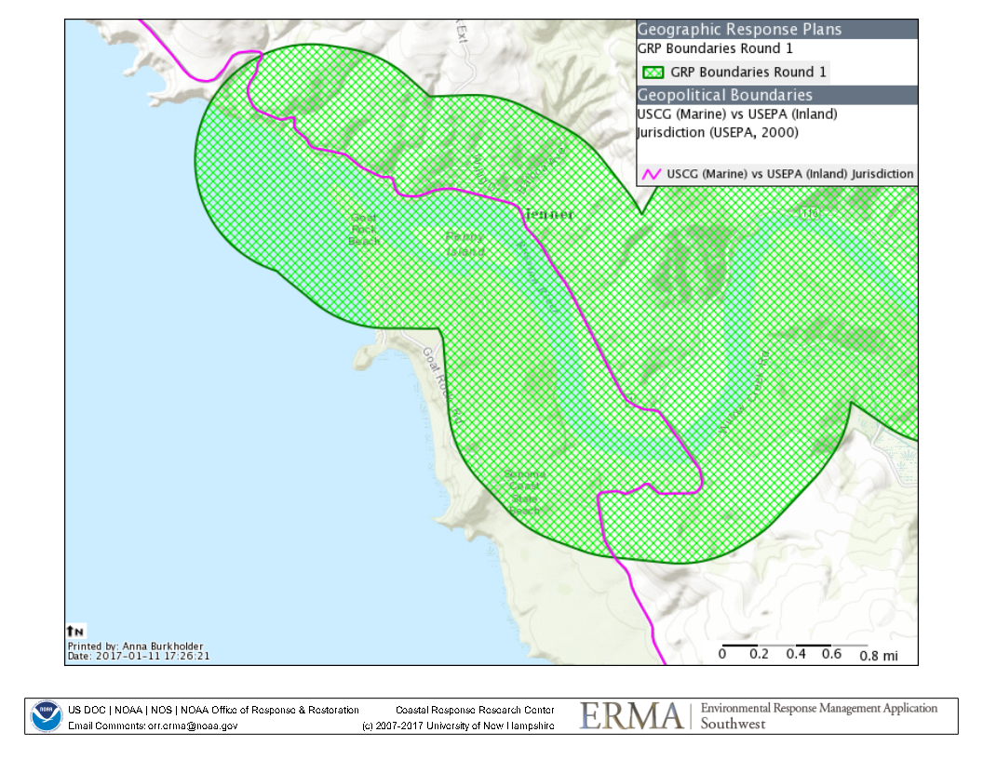
Russian River – USCG/EPA Boundary

Slide 10
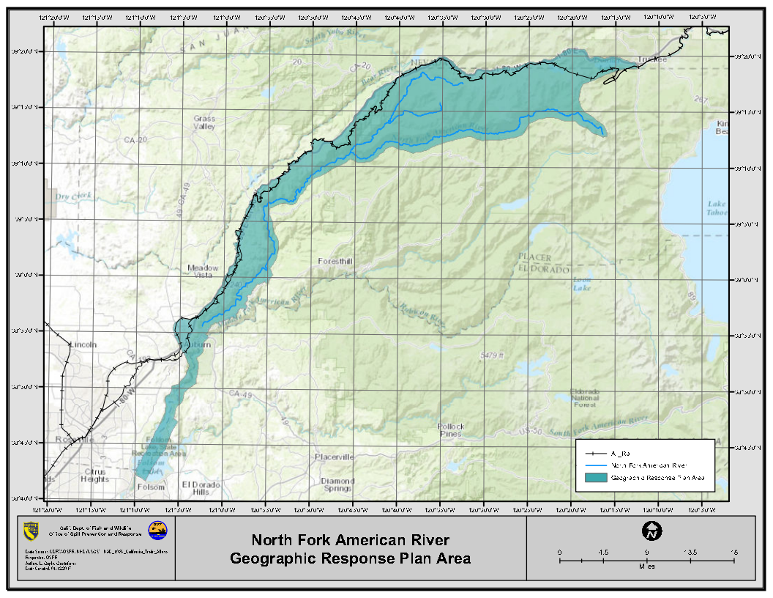

Slide 11
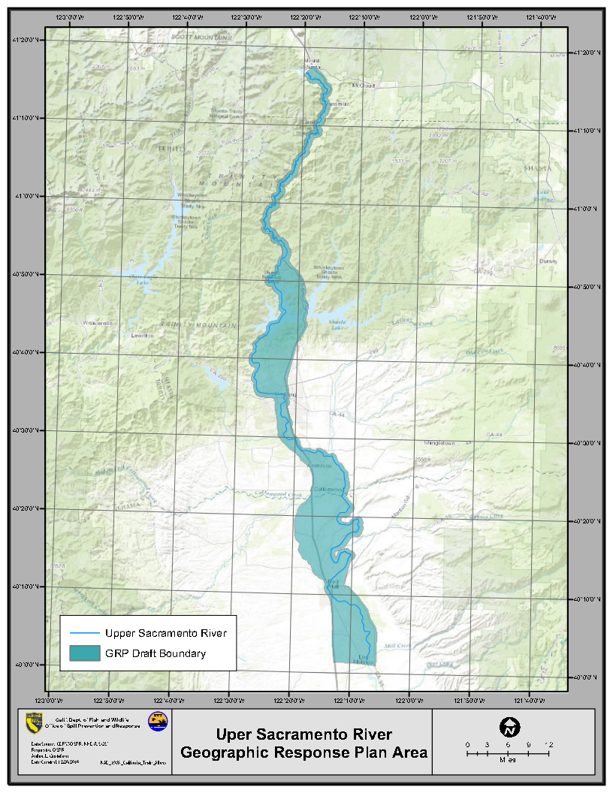
Upper Sacramento River
Geographic Response Plan

Slide 12
Table of Contents (TOC)
Documents Reviewed:
Feather River Draft GRP - March 2016 (foundation of TOC)
LEPC Guidance Document Template
SF/Delta Area Contingency Plan (ACP)
San Diego ACP
EPA Region 7 Regional Integrated Contingency Plan (RICP)
EPA Region 5 Regional Contingency Plan (RCP)
National Contingency Plan (NCP)
EPA ACP Handbook
Existing California/Nevada GRP’s such as the Truckee River and Lake Tahoe
EPA Region 10 GRP’s
Gray’s Harbor
Nansook River
Middle Columbia River/John Day’s Pool
Feather River GRP – August 2016

Slide 13
Proposed Next Steps:
Finalize all guidance documents for GRP development
Establish GRP Subcommittee’s/Workgroups
Start with LEPC’s
Timeframe for completion of GRP’s
Draft GRP’s: 12 to 18 months from first subcommittee meeting
Final GRP’s: 24 months from first subcommittee meeting

