Slide 1
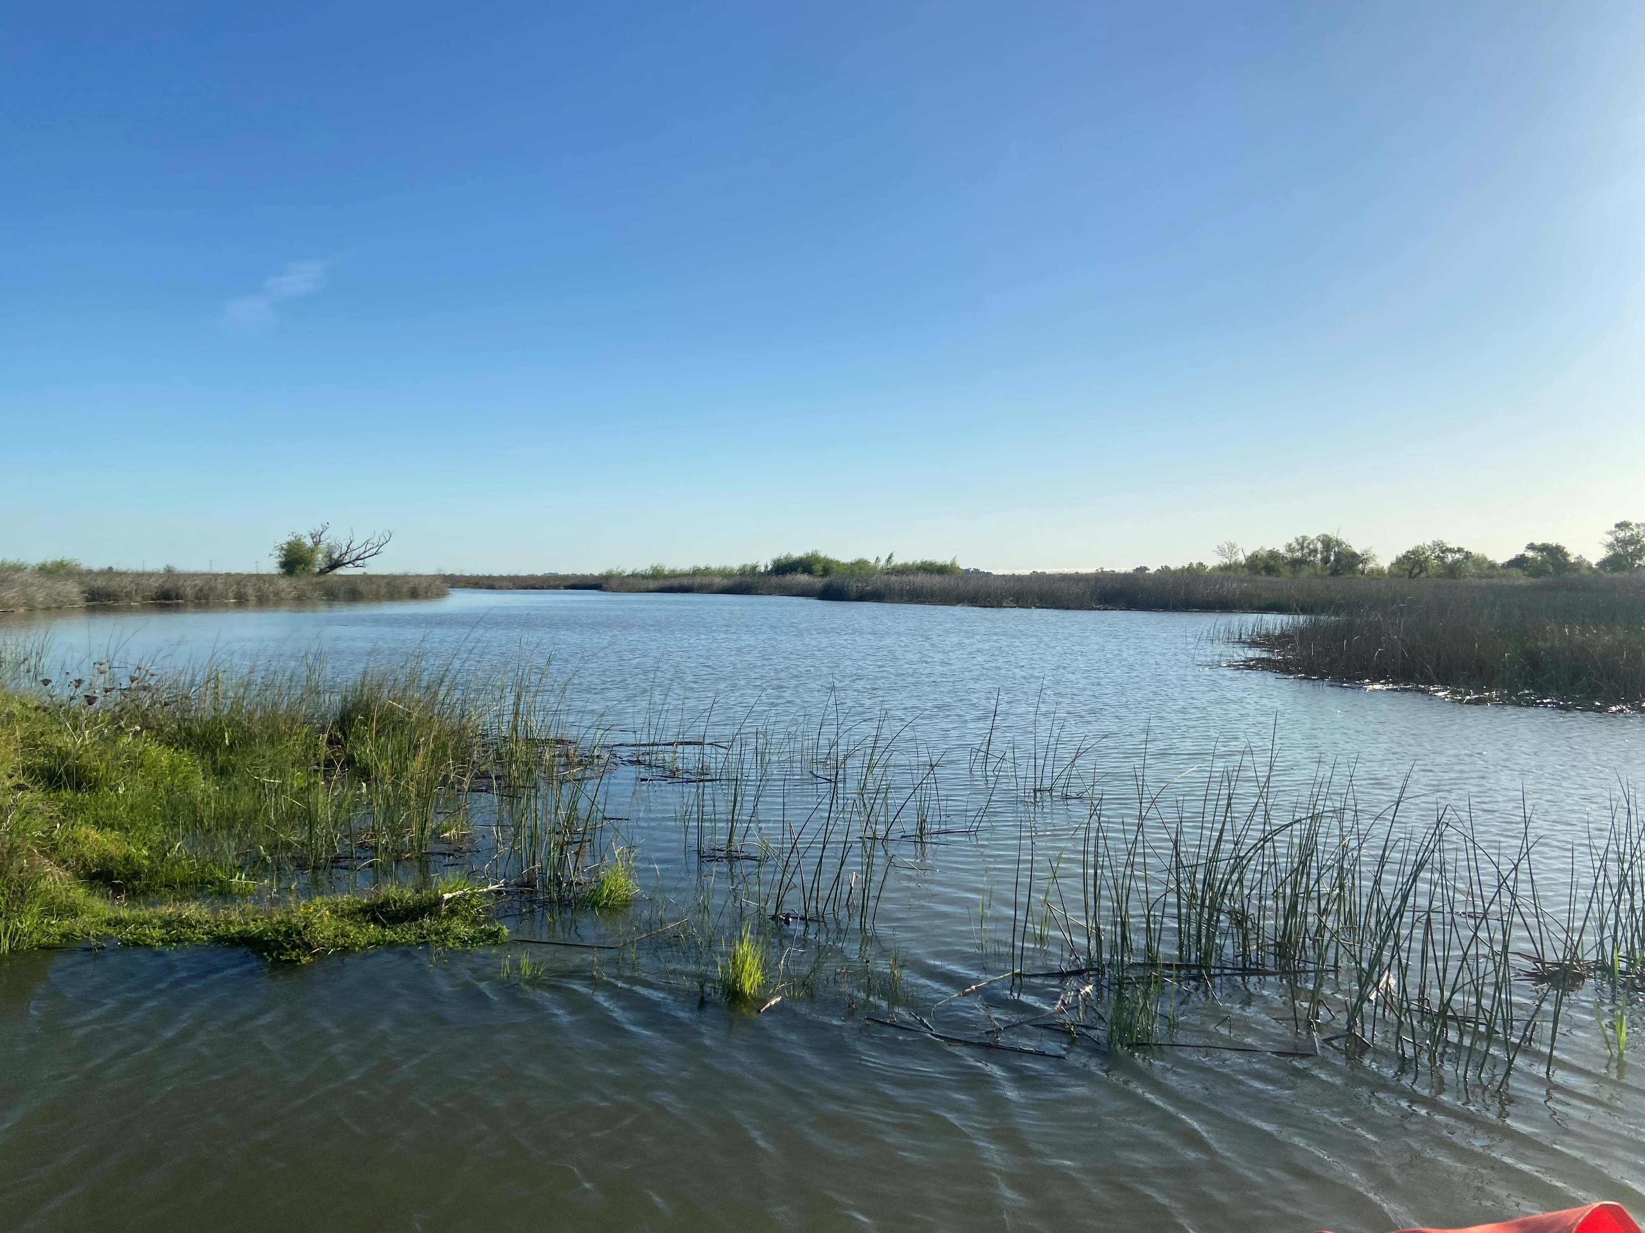

Thermal refugia in restored tidal wetlands
Daniel Cox
Fish Restoration Program Effectiveness Monitoring Team
CA Dept Fish and Wildlife
Notes:
Good morning
Danny cox
Water qual and phyto lead
Cdfw frp effectiveness monitoring team
Today…

Slide 2
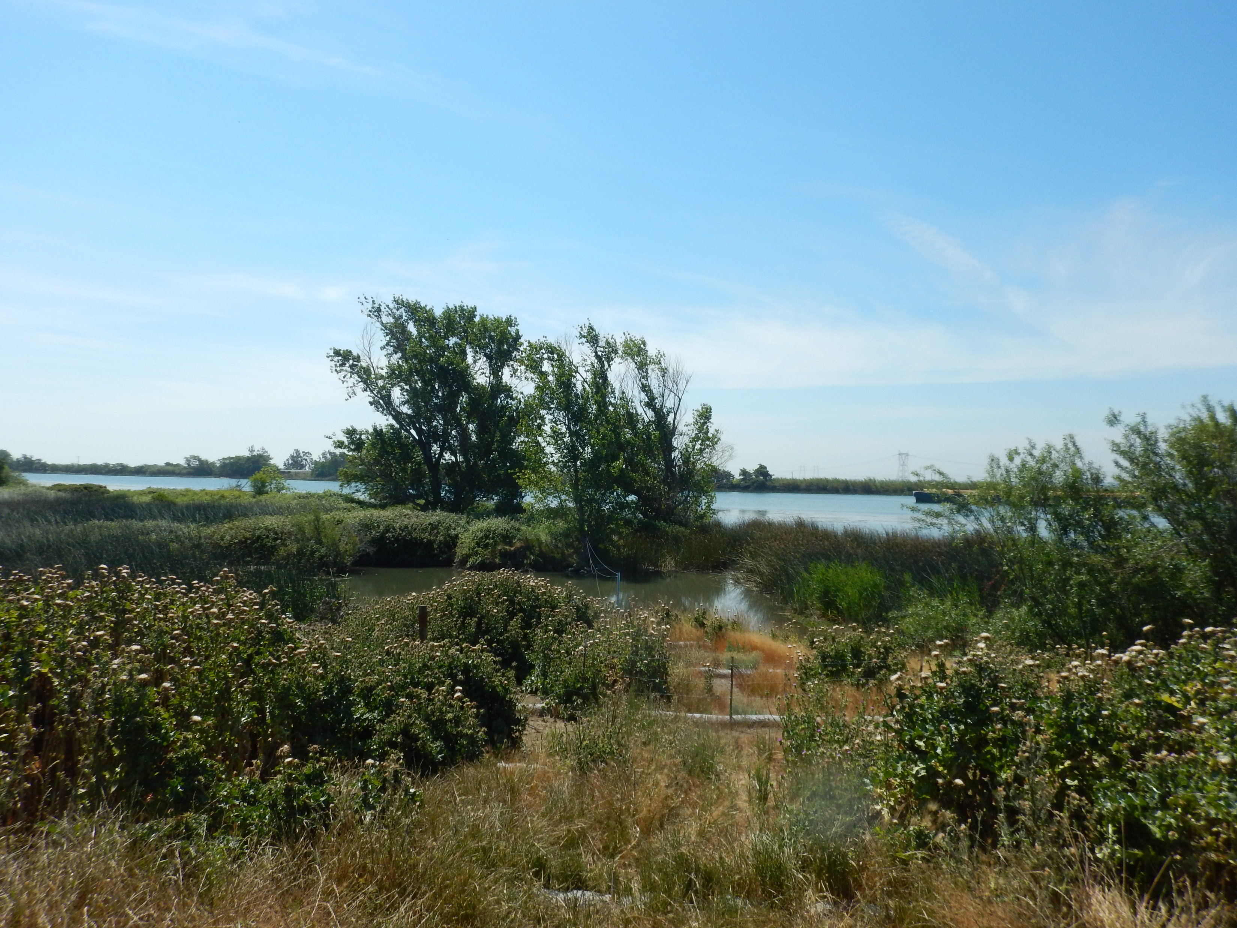
Background
8,000+ acres of tidal wetland restoration required by permits for State Water Project operation
DWR
CDFW Implementation
CDFW Monitoring
Decker Island
Notes:
The Fish Restoration Program is tasked with restoring over 8000 acres of tidal wetland habitat as mandated by the permits for the operation of the State Water Project. The three groups involved in the program include: DWR, CDFW implementation team, and the CDFW effectiveness monitoring team

Slide 3
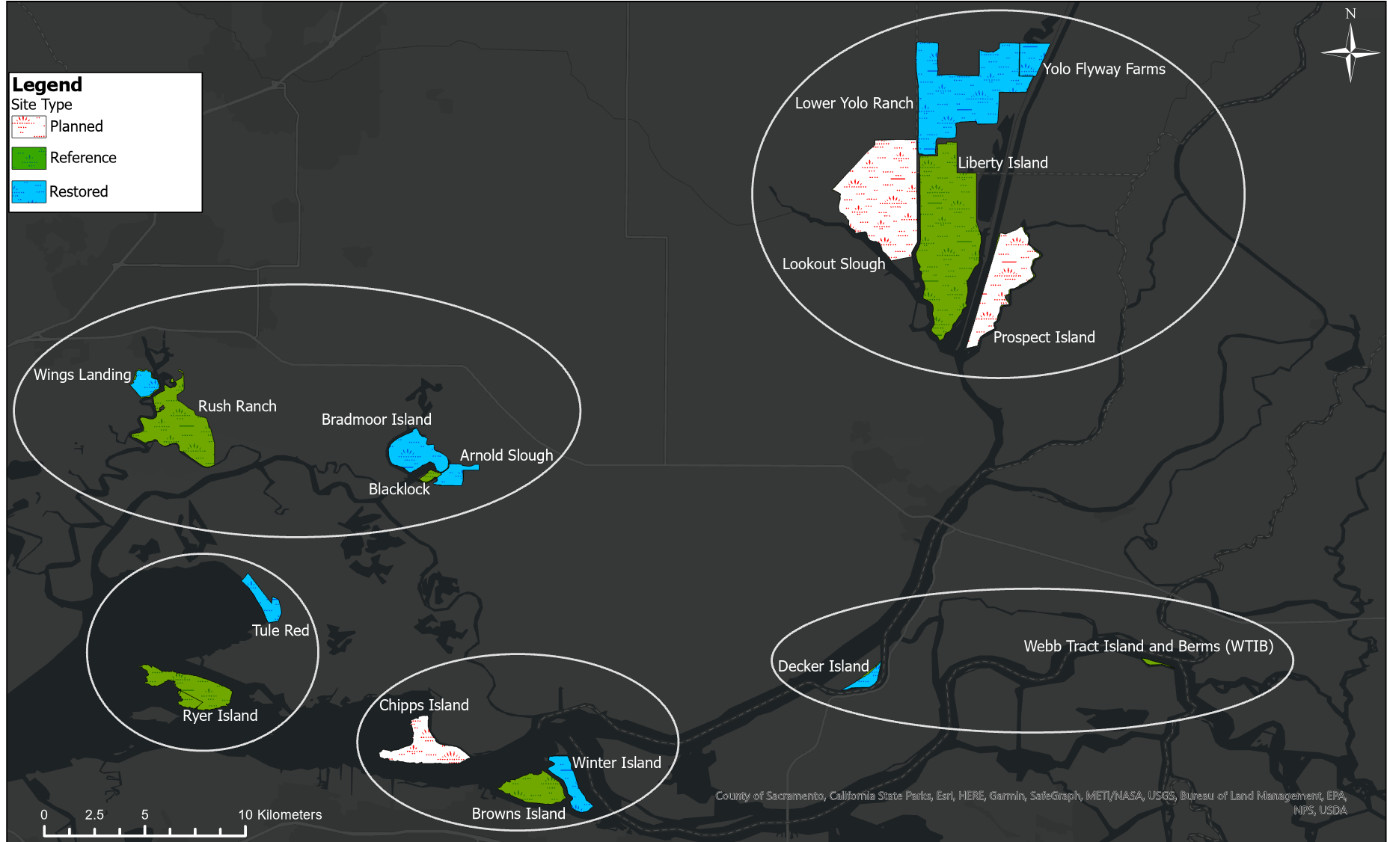
Background
Notes:
The restoration sites are spread across the North Delta Arc which spans from the Cache slough complex down to Grizzly Bay

Slide 4
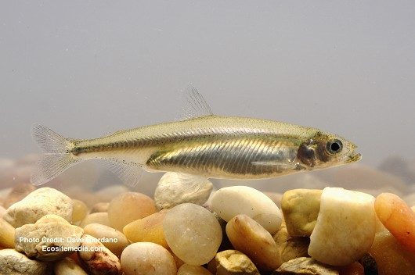
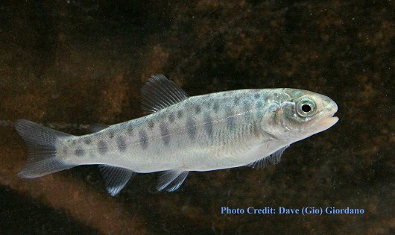
Tidal Wetland Restoration:
Capacity, Opportunity, and Realized Function
Significant effort to restore tidal marshes for Delta Smelt, juvenile Salmonids, and Longfin Smelt
Do restored sites have the capacity to support listed species?
  Abiotic habitat
  Food web
Simenstead and Cordell 2000;
Pictures from Calfish.ucdavis.edu
Notes:
The goal of FRP is to restore tidal wetlands for Delta Smelt, juvenile chinook salmon, and Longfin Smelt
The effectiveness of tidal wetland restoration can be measured by the following metrics: capacity, opportunity, and realized function
At the Effectiveness Monitoring Team, we investigate whether restoration increases the capacity to support listed fish species through improved abiotic habitat and greater availability of food web resources

Slide 5
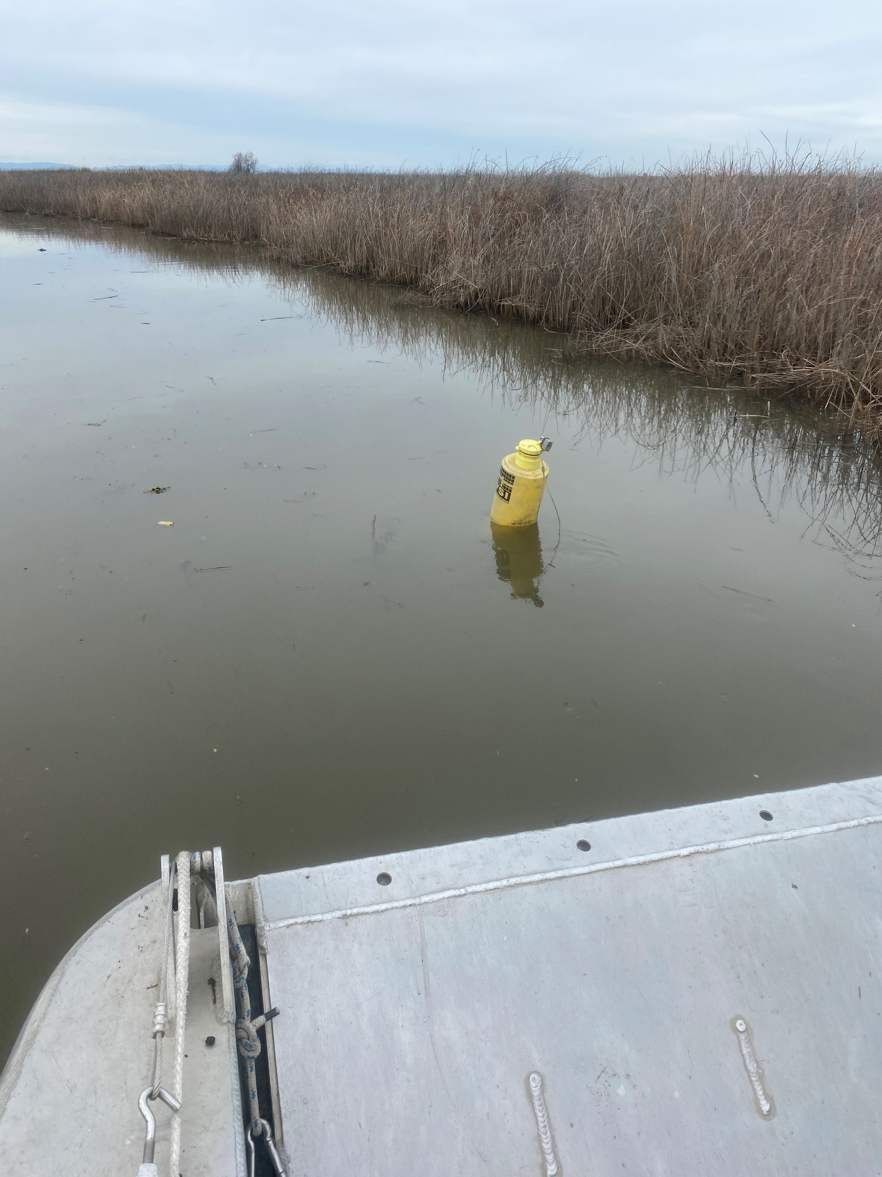
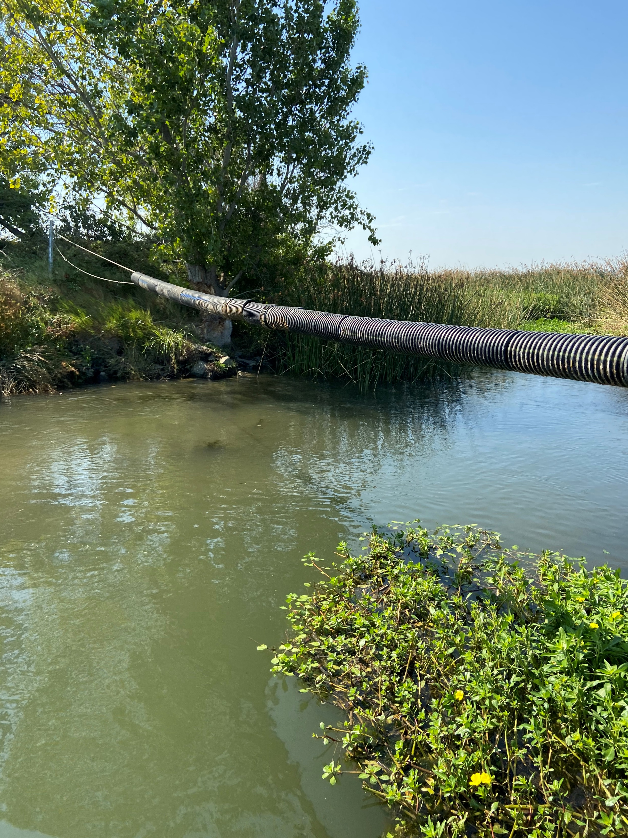
High-frequency, long-term monitoring
2019 – Yolo Flyway Farms & Decker Island
Notes:
2019 began continuous monitoring
Red Circles indicate sites for today’s talk
Stars indicate monitoring stations adjacent water body
Buoy deployment for Flyway
Cable installation for Decker to suspend instrument

Slide 6
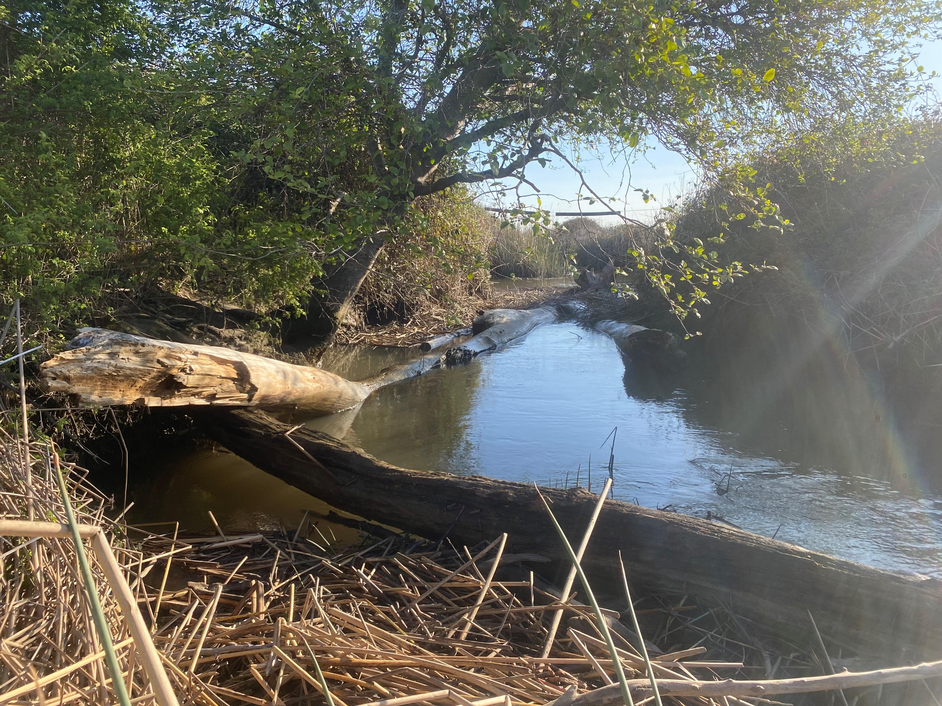
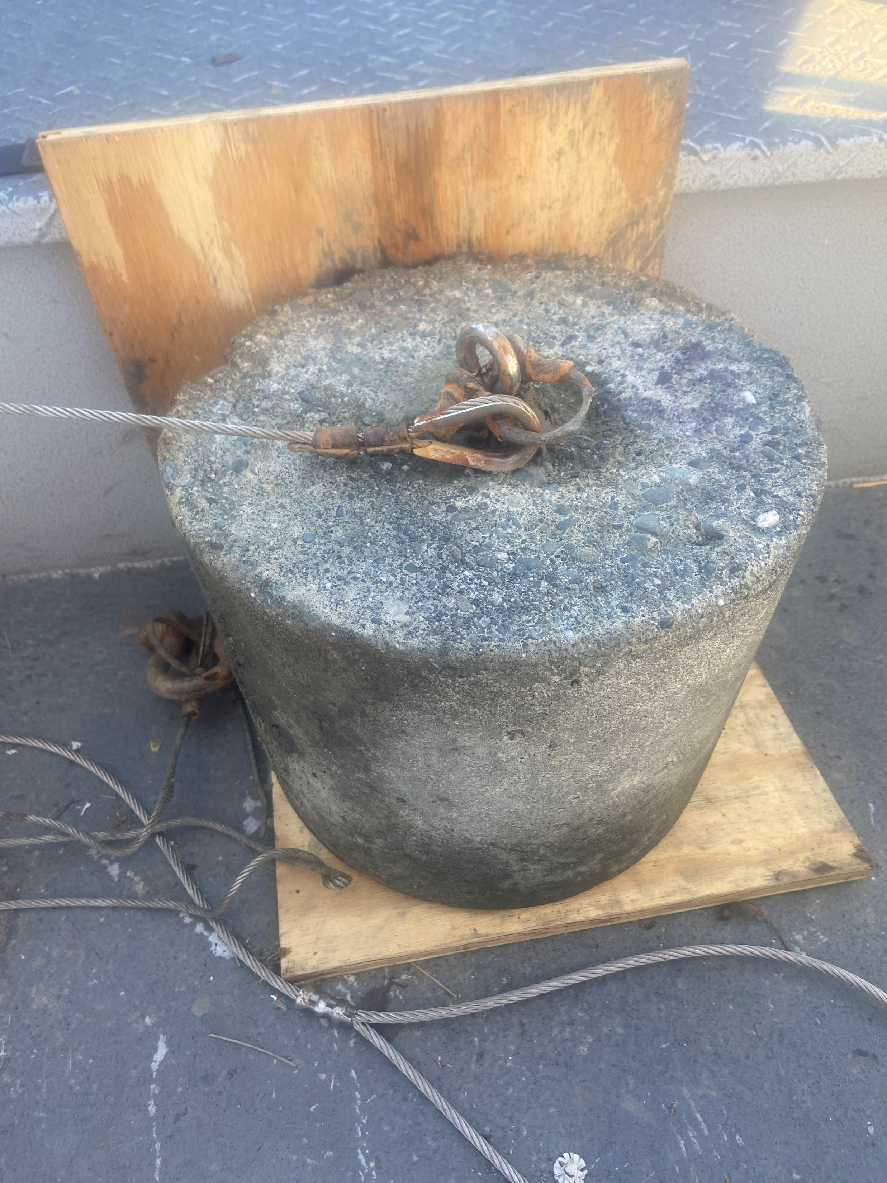
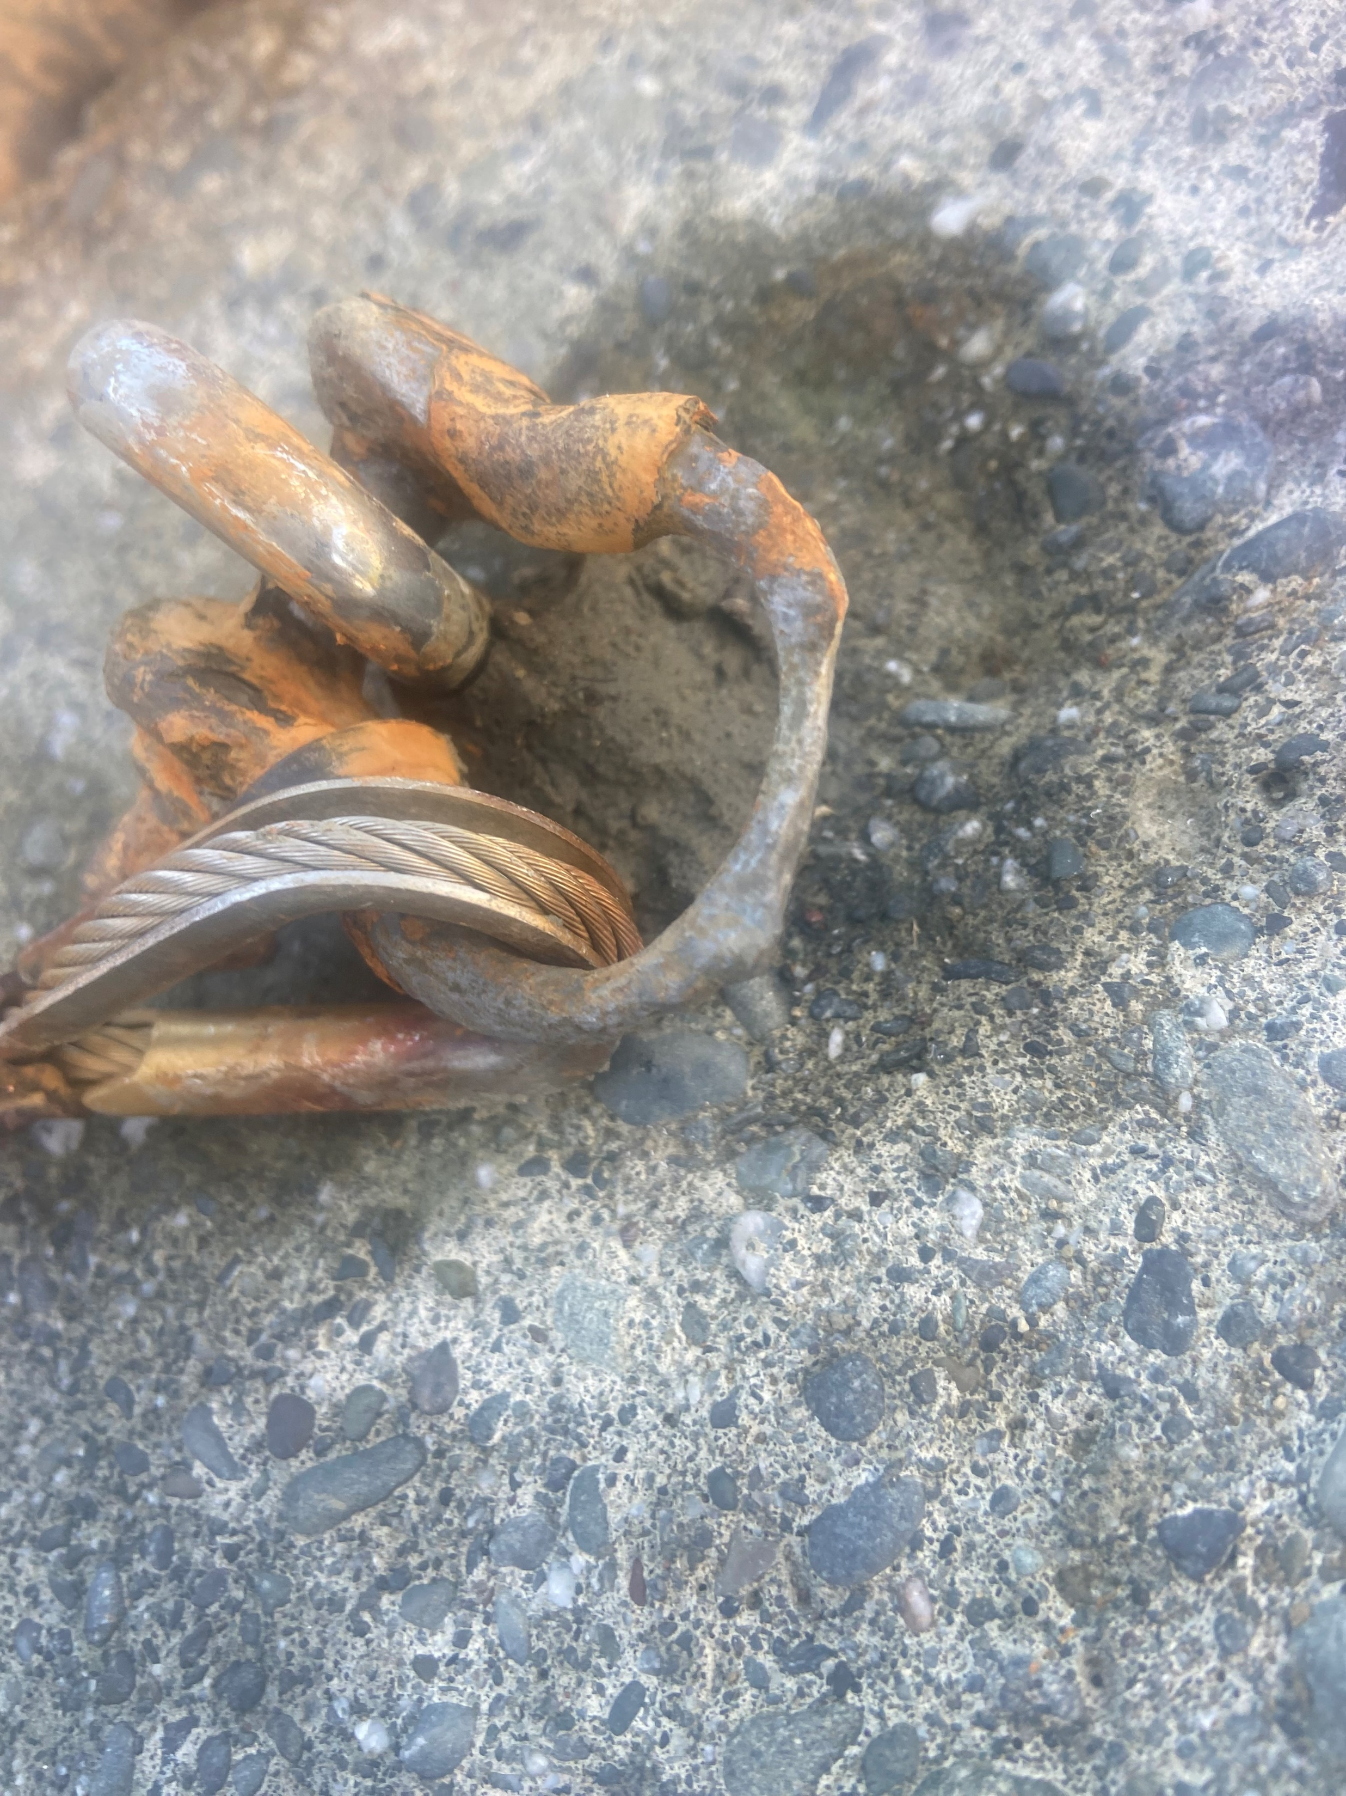
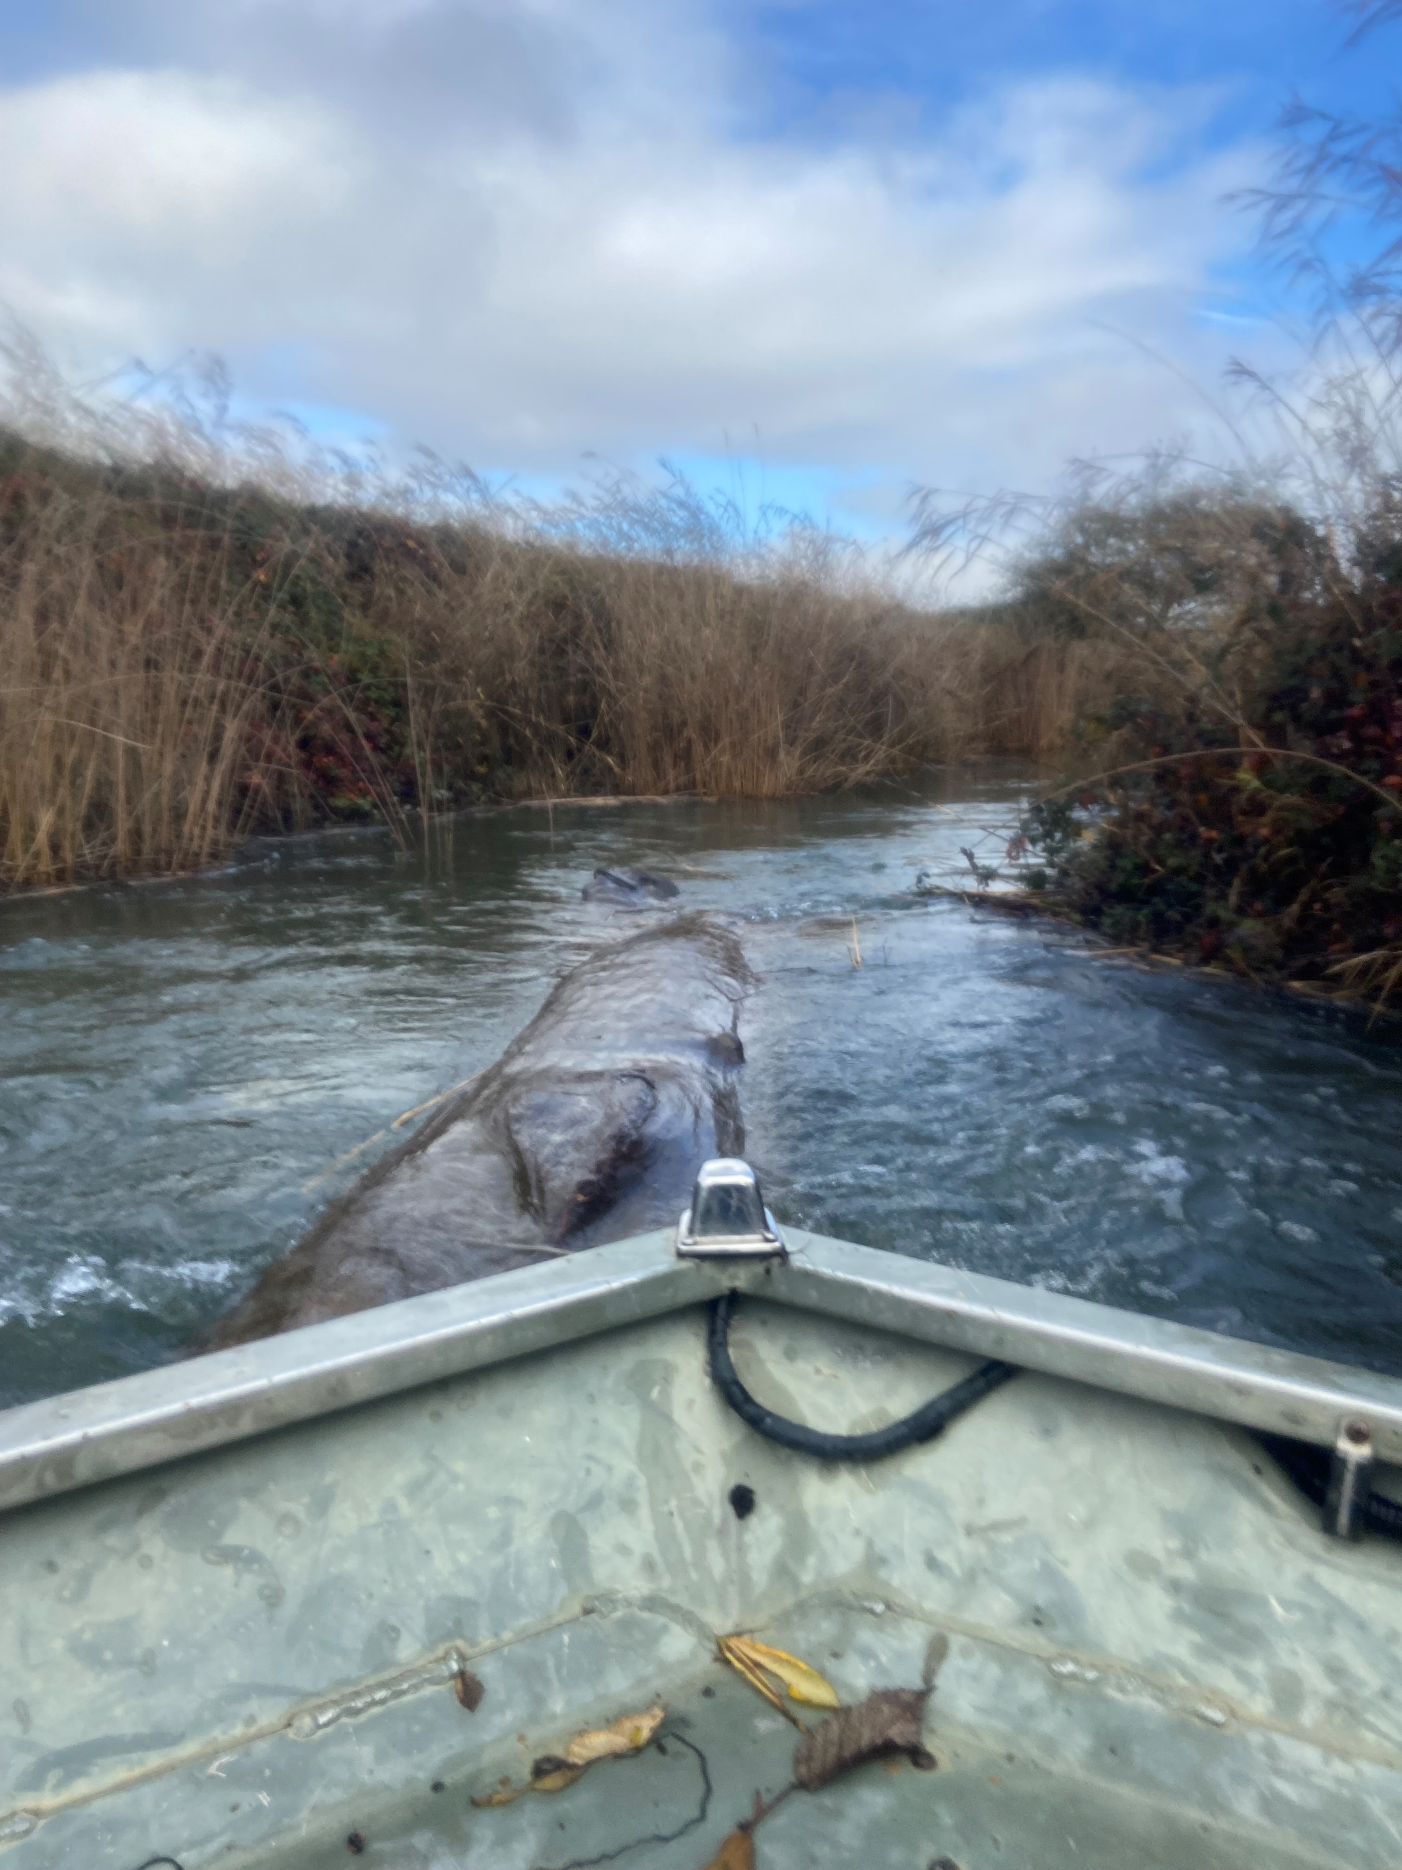
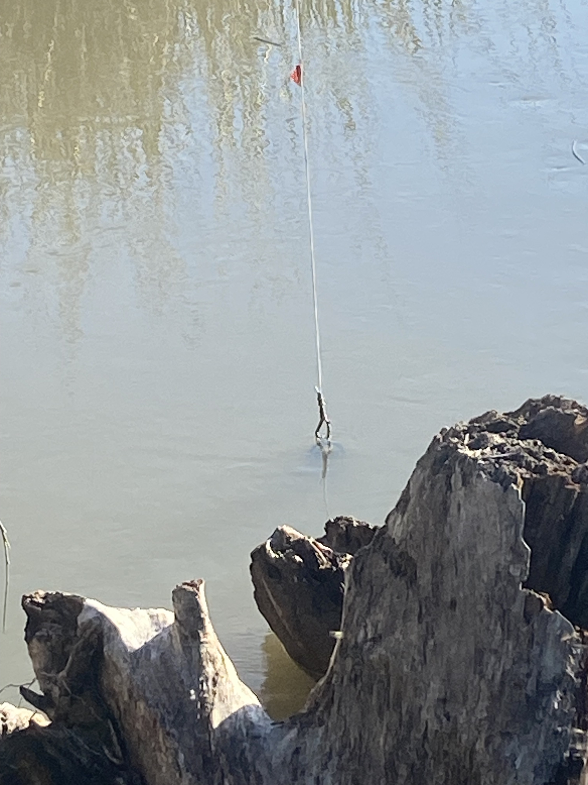
Notes:
Before jumping into data –
Physical barriers
Corrosion and abrasion on hardware used to keep buoy moored to this weight
Trees lodged in Decker

Slide 7
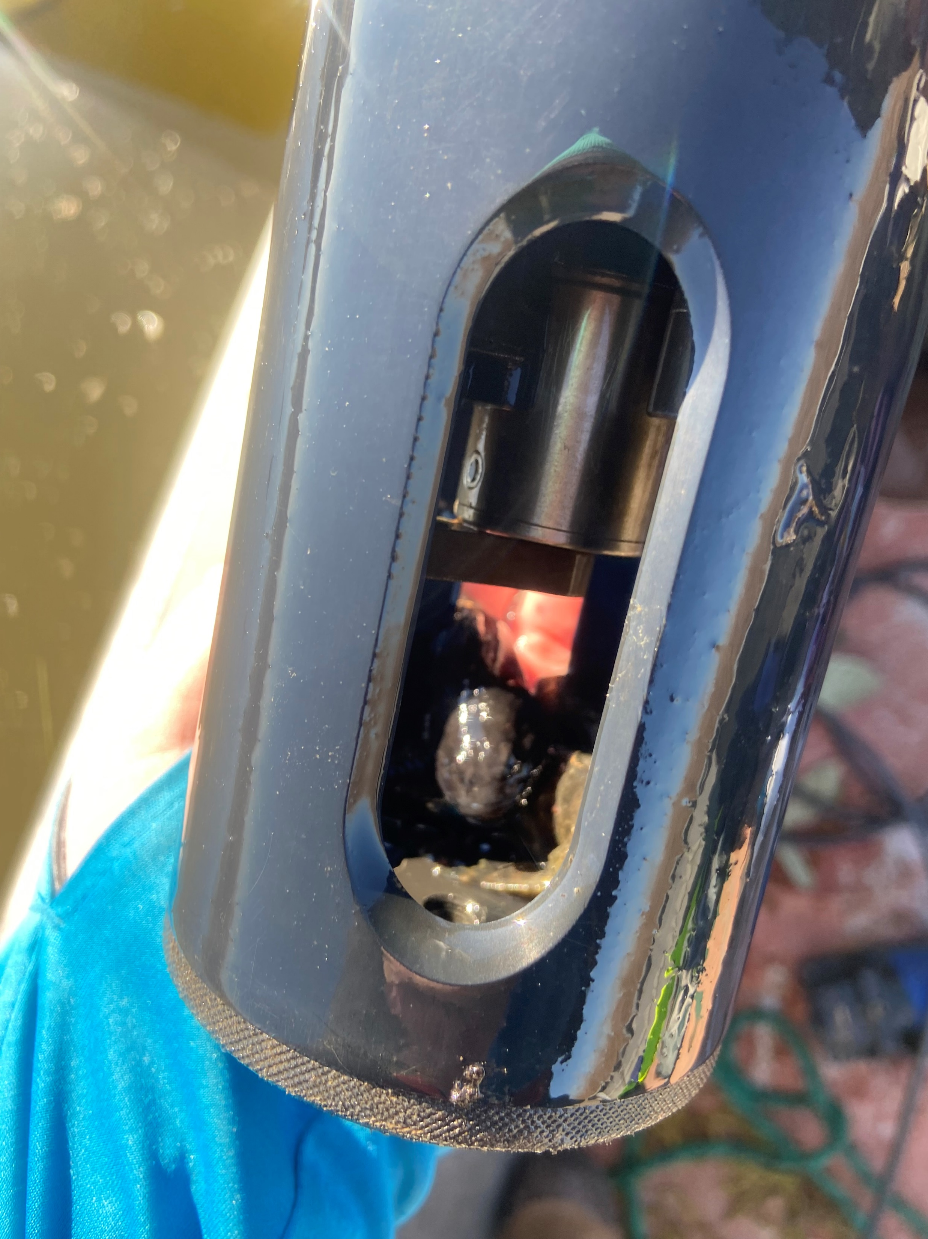
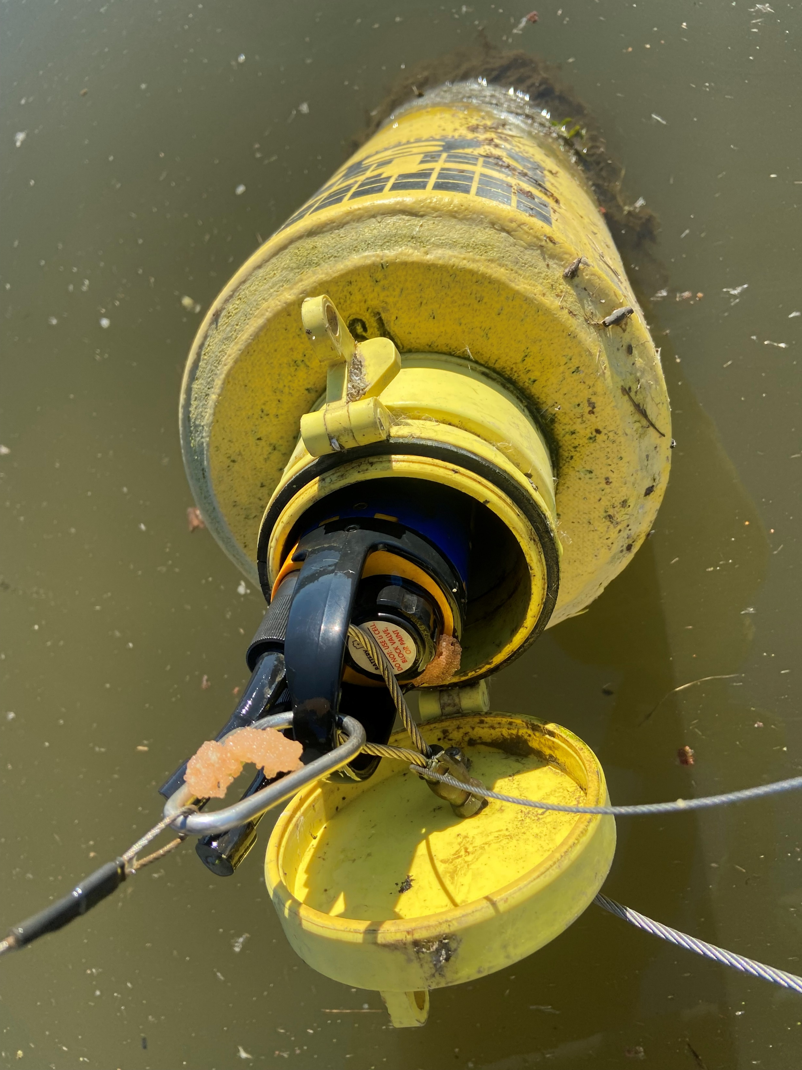
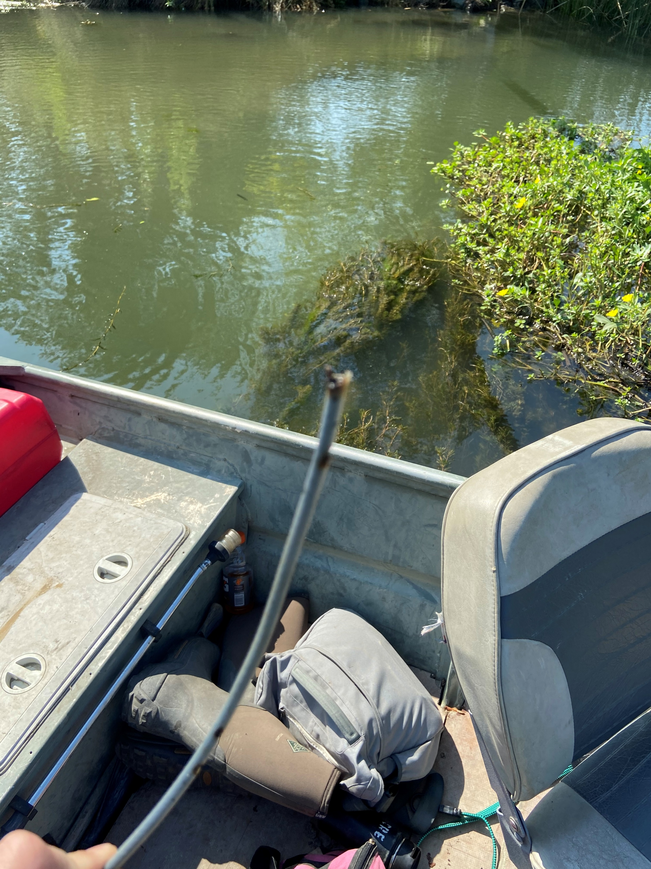
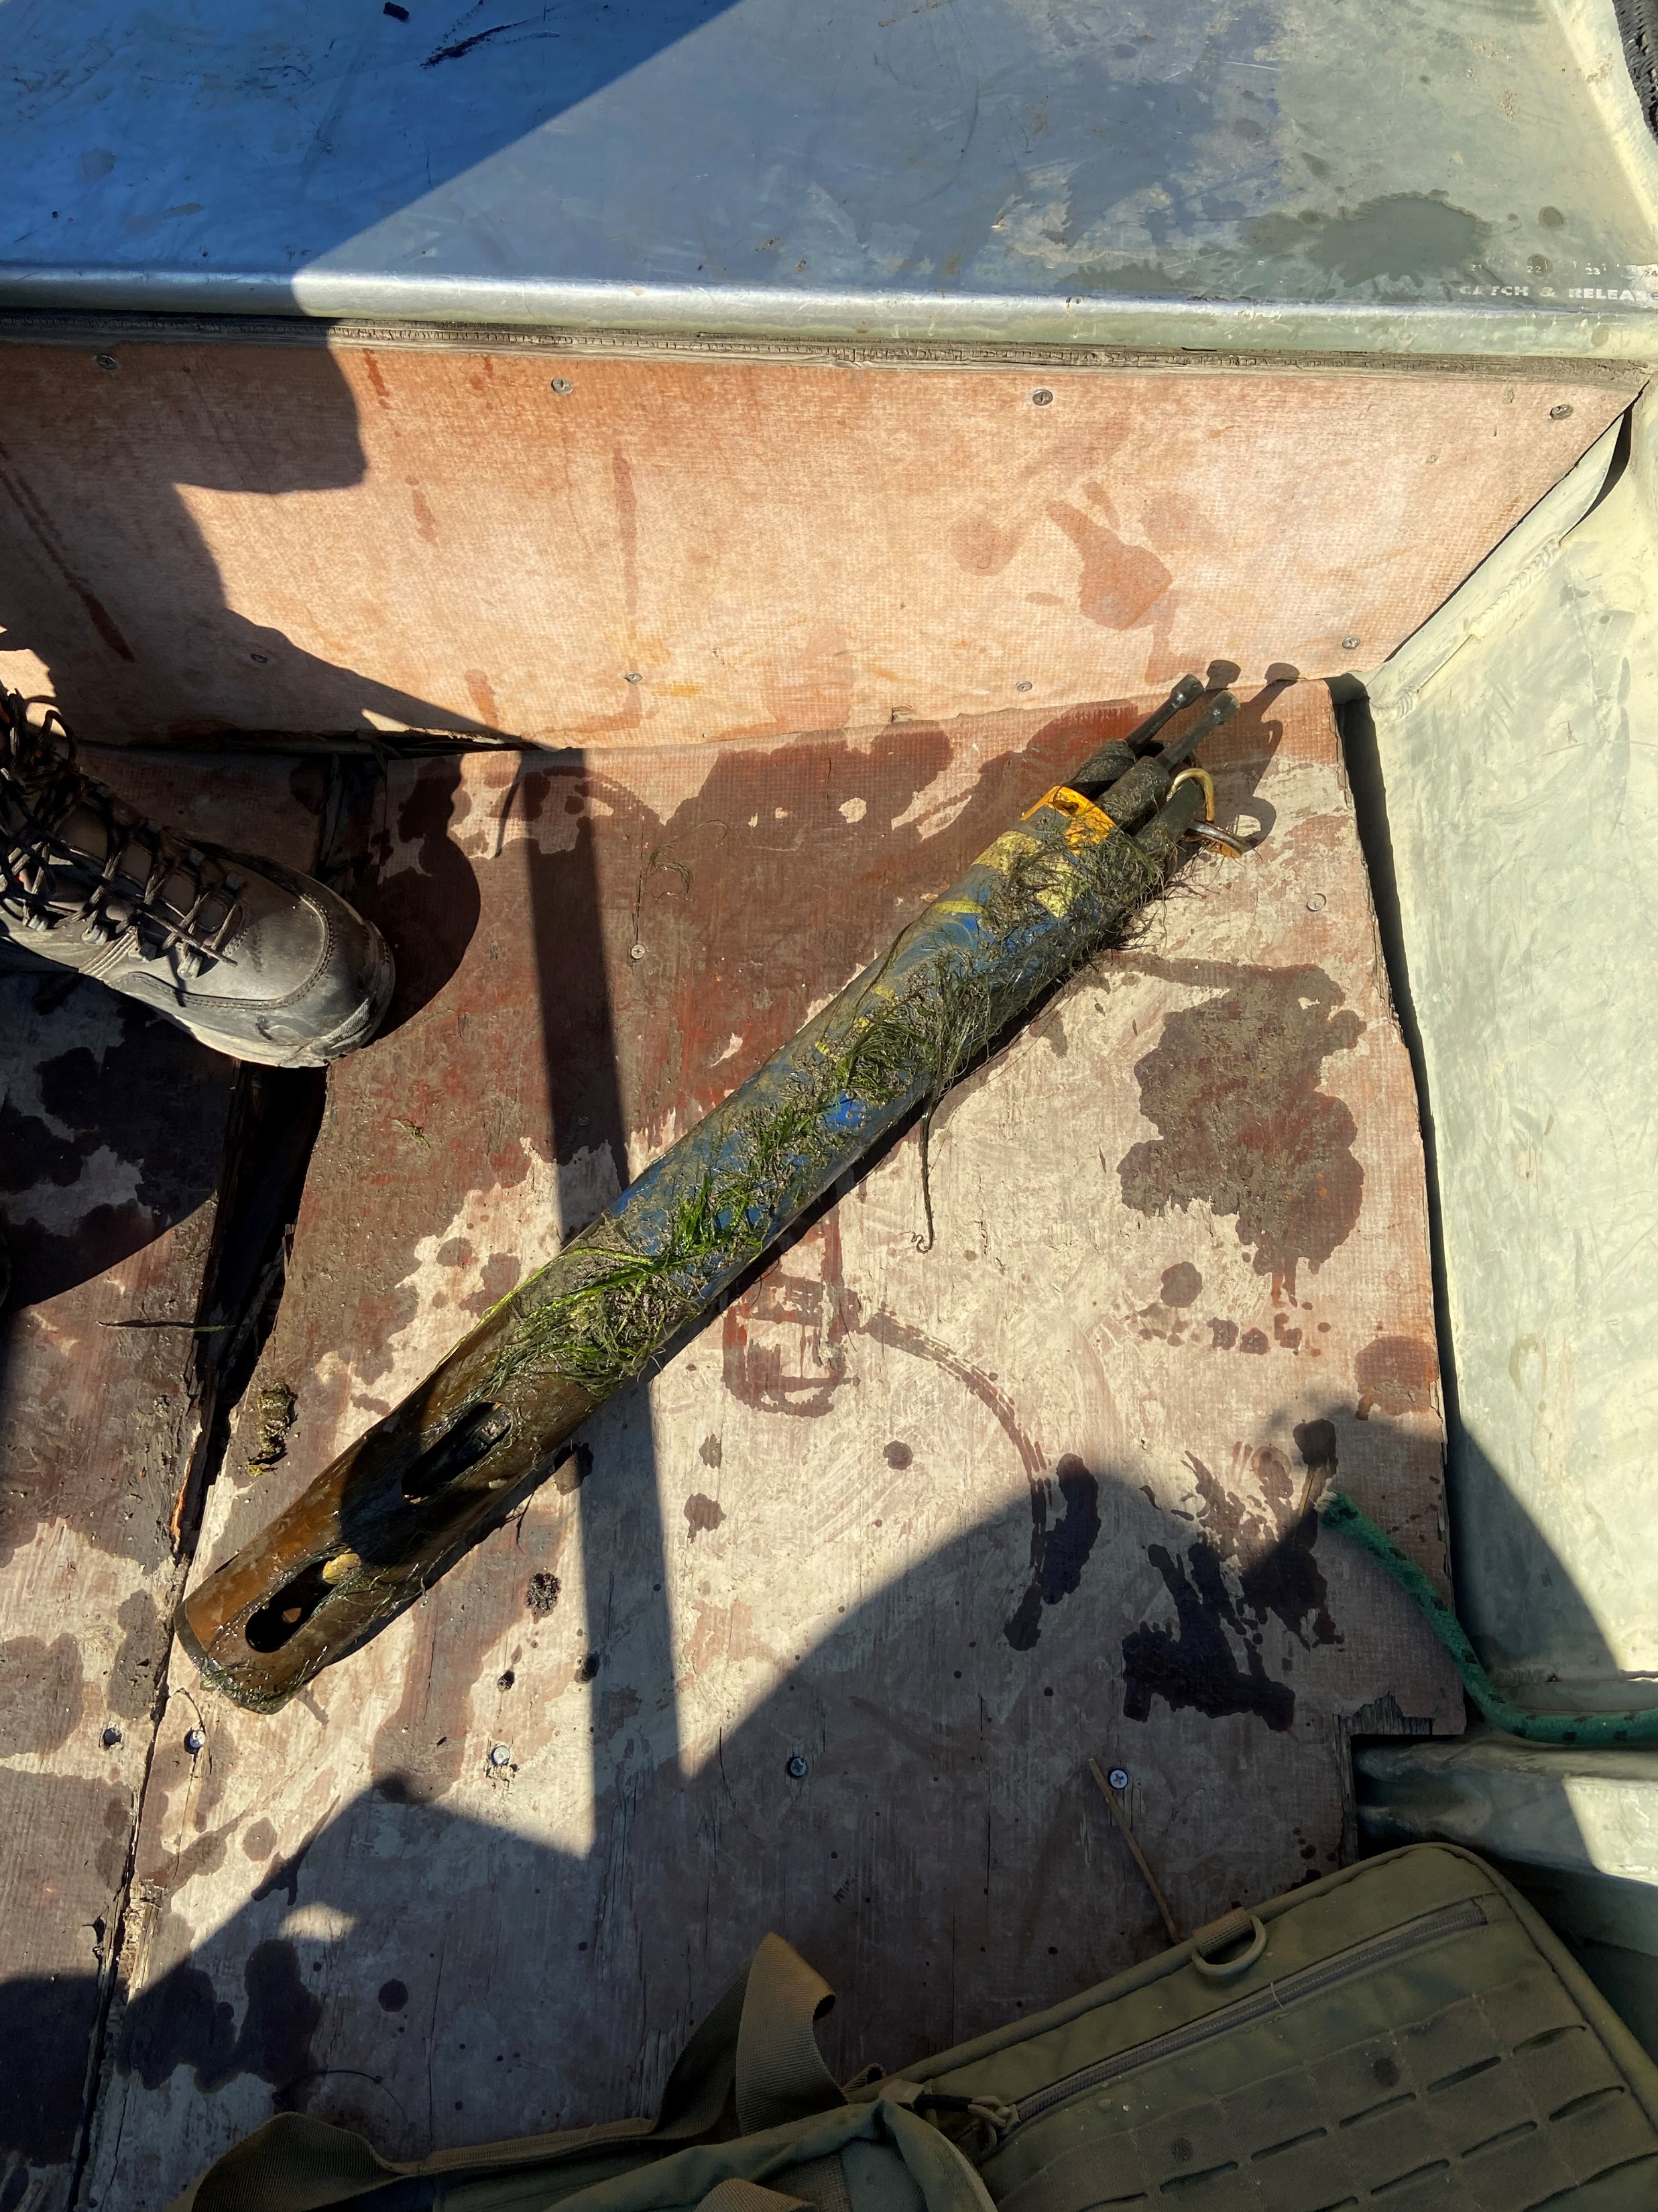
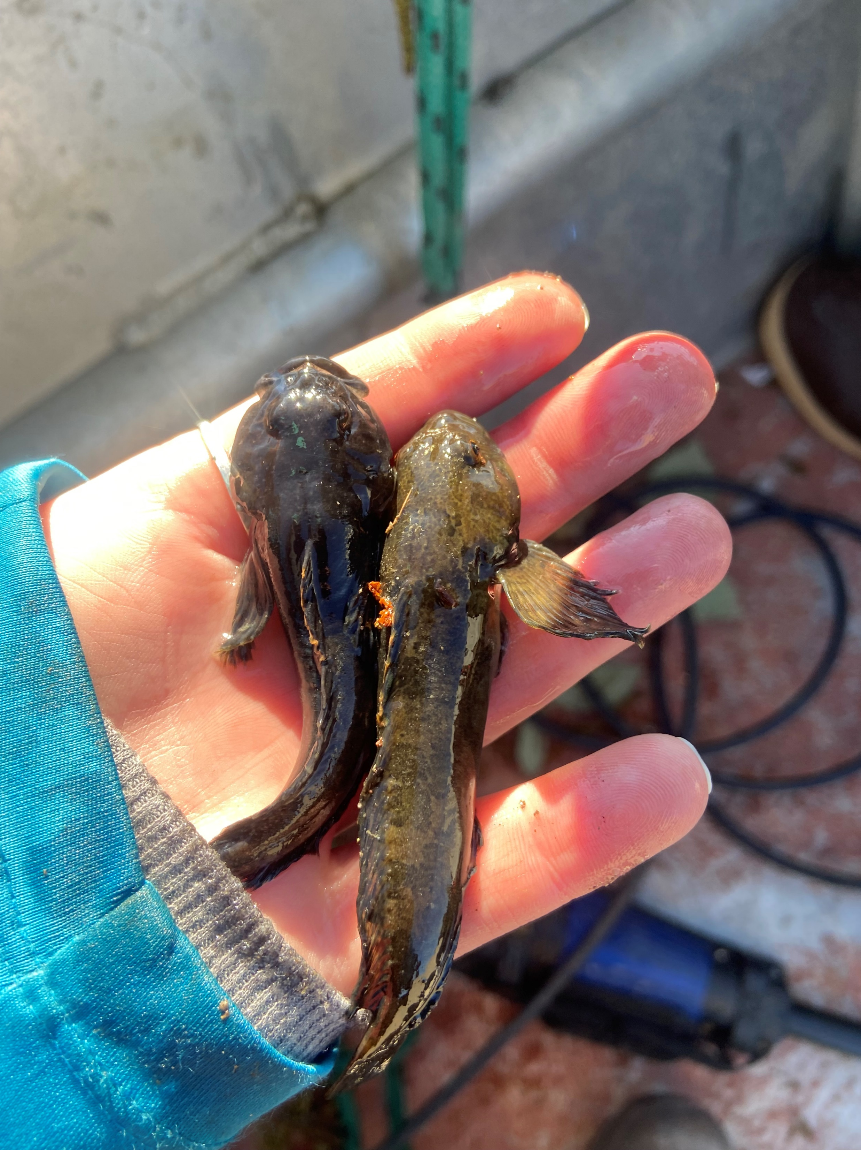
Notes:
Biological hiccups
Sculpin making themselves at home in buoys
Beavers in Decker and shuffling around to find it

Slide 8
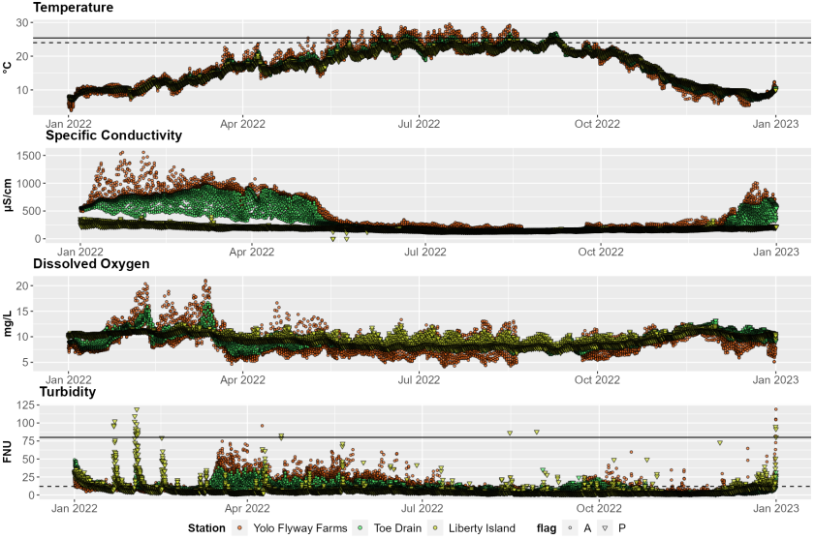
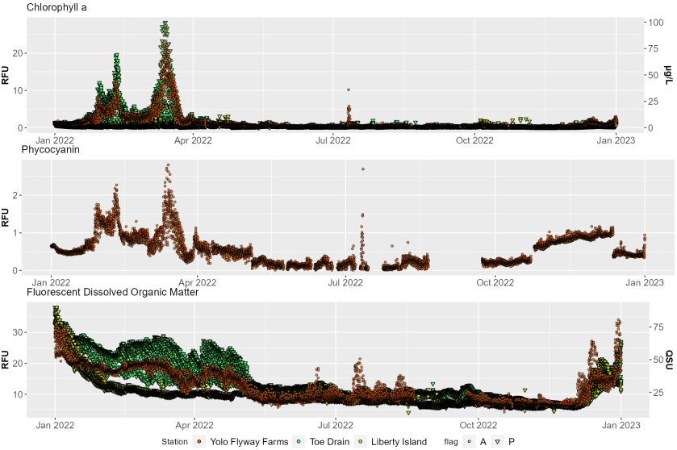
“Slough” of data
Notes:
And now
Illustrate how much data we collect
Characterize abiotic environment using…
Proxies for algal and cyanobacterial biomass
Detrital foodweb
Today focus on temp

Slide 9
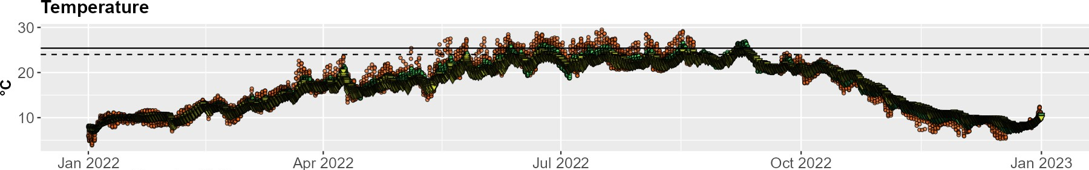
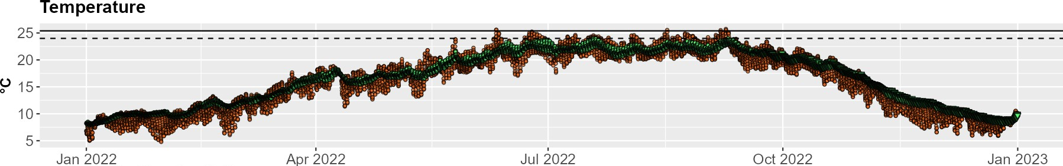
Thermal dynamics in tidal marshes
Yolo Flyway Farms
Decker Island
Restoration site
Adjacent waterbody
Juvenile Chinook salmon CTmax (dashed)
Delta Smelt CTmax (solid)
Reference site

Slide 10
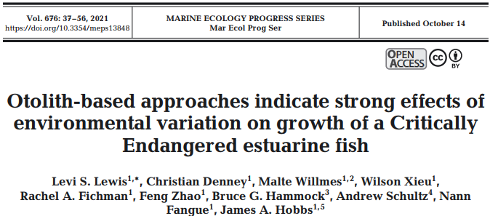
Yolo Flyway Farms
Decker Island
Restoration site
Adjacent waterbody
Reference site

Slide 11

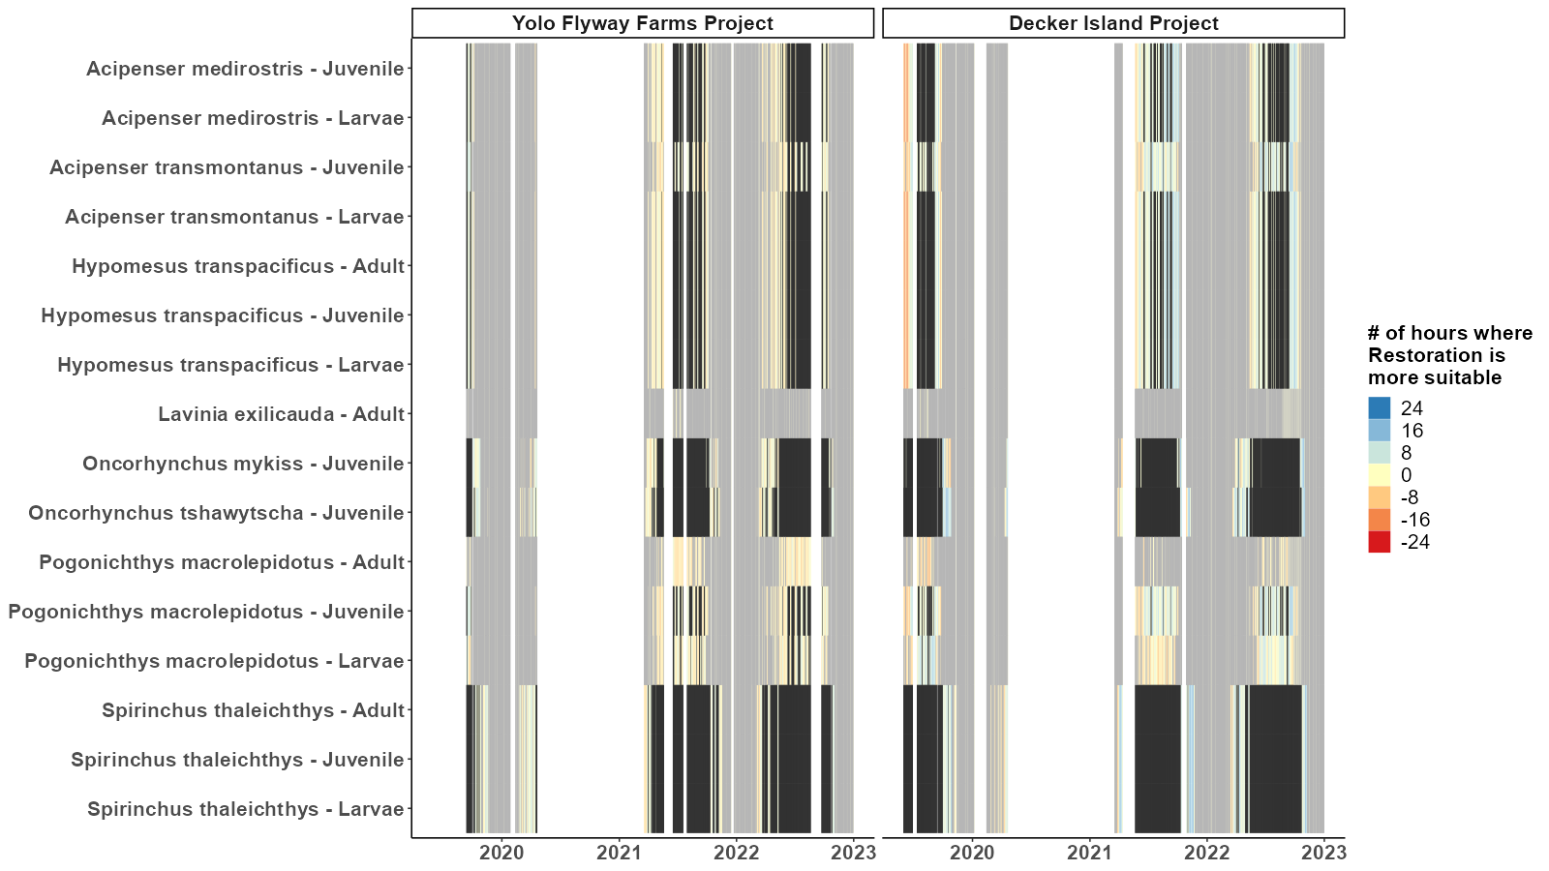
Both are suitable
Neither are suitable
Notes:
To distill the variability in temp with respect to more species
Heat map of daily temperature conditions
Compare site with respective adj waterbody
Use temp thresholds gathered by Bush et al

Slide 12
Both are suitable
Neither are suitable
Notes:
A lot of overlap in terms of both or neither being suitable at the same time
Note that some anadromous fish aren’t in the system at all times of the year

Slide 13
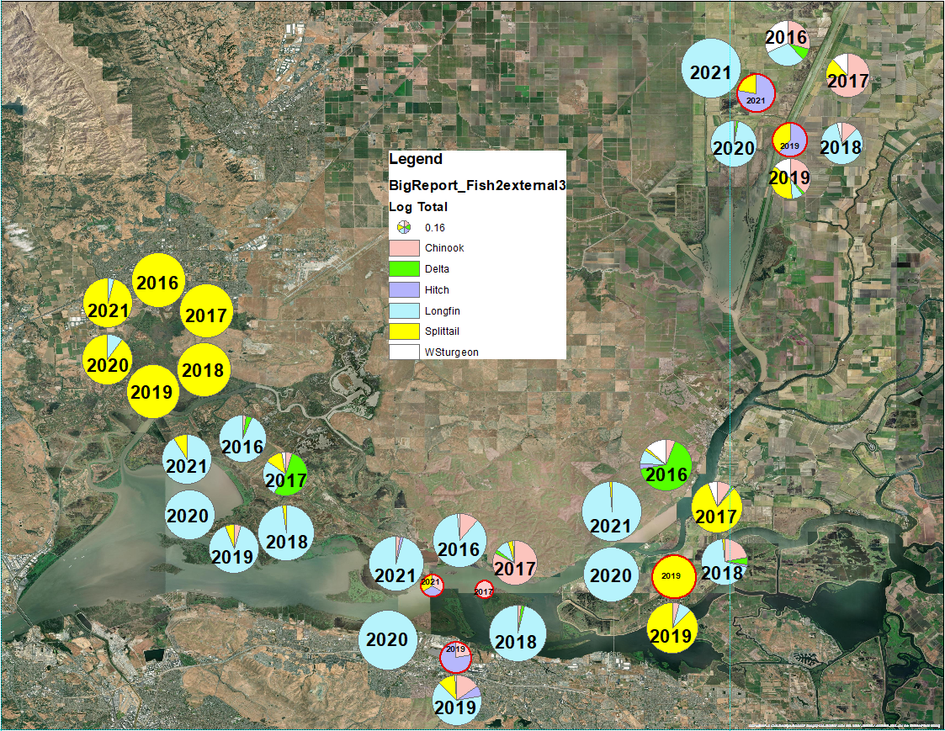
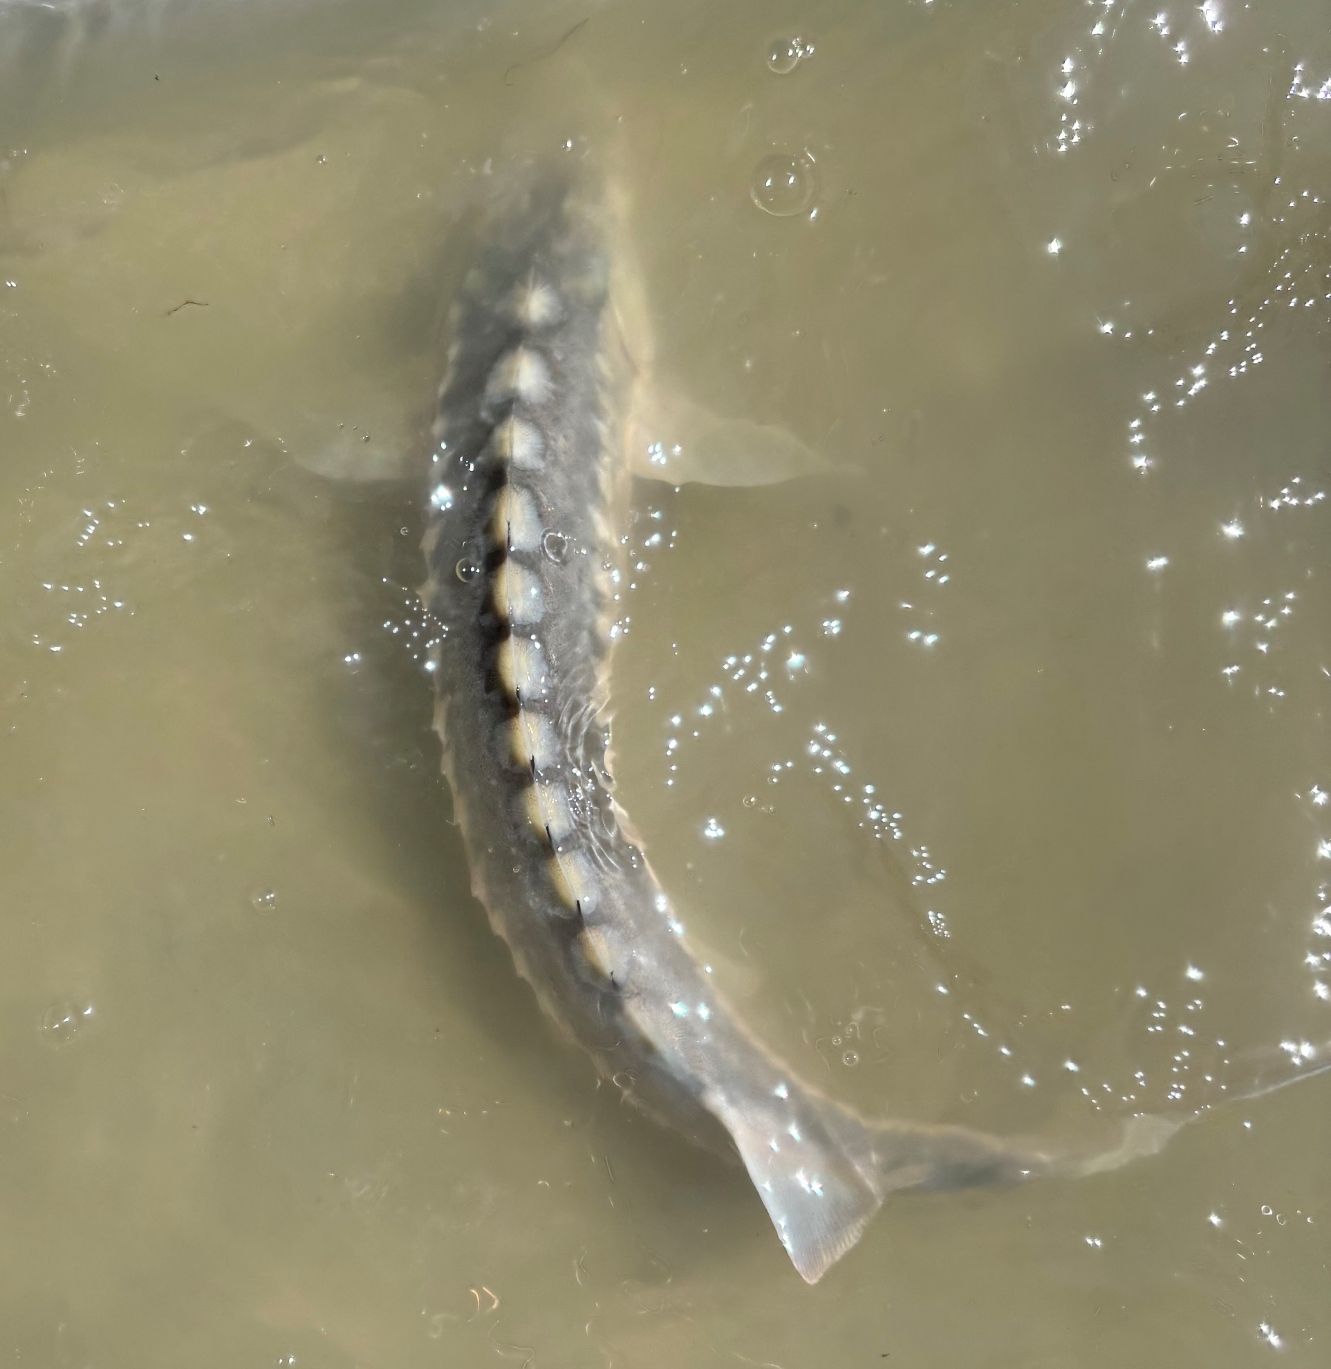
Inside restoration site
Chinook salmon
Delta Smelt
Hitch
Longfin Smelt
Splittail
White Sturgeon
Notes:
Now that you’ve seen the potential thermal habitat available for listed fish species, I’d like to show some fish data for context.
This figure shows the relative proportion of each species caught within and around the restoration sites
Pie charts with red border indicate catches from inside the restoration site
Right shows a white sturgeon caught earlier this month right outside the mouth of one of our sites

Slide 14
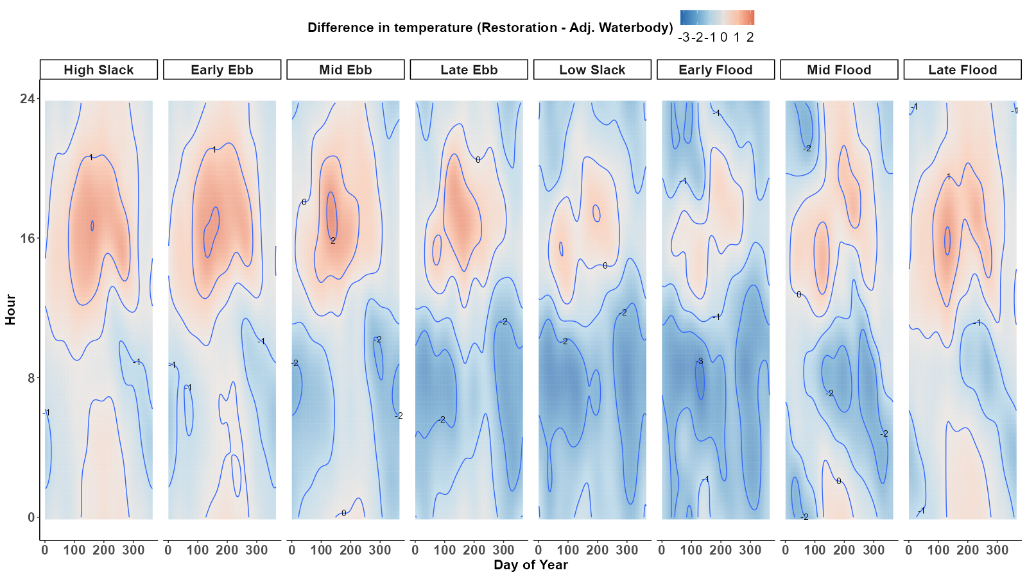
Notes:
Now,
Show results from GAM
Modeled difference in temp
Function of DoY, ToD, depth of water

Slide 15
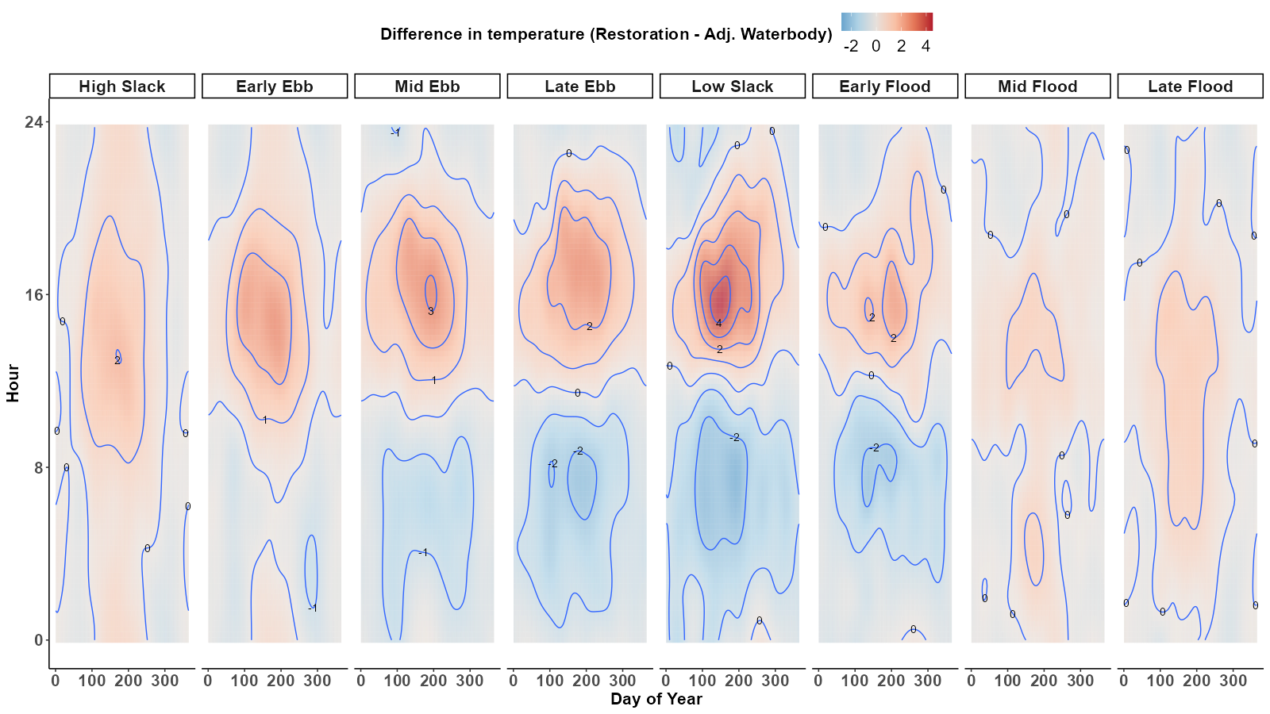
Yolo Flyway Farms
Notes:
First, Yolo Flyway Farms
Temps about the same or warmer at or near high tide

Slide 16
Yolo Flyway Farms
Notes:
Water coming off the wetland was generally warmer in the afternoon during the warm month

Slide 17
Yolo Flyway Farms
Notes:
Much cooler water was available on the wetland at or around low tides occurring in the early morning hours

Slide 18
Decker Island
Notes:
Now, if we look at Decker Island

Slide 19
Decker Island
Notes:
There is a similar trend of cooler water available on-site during the low tides coinciding with early morning hours

Slide 20
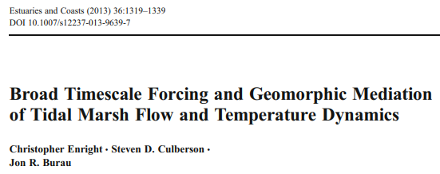
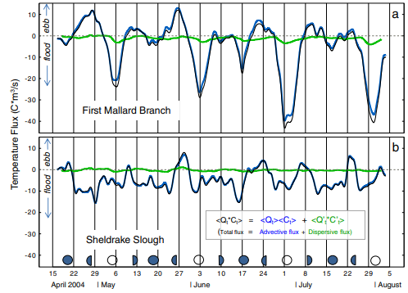
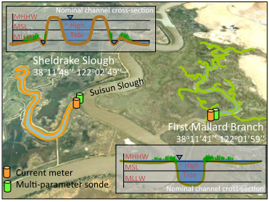
Thermal dynamics in tidal marshes
Notes:
Briefly, some of mechanisms behind this cooling have been described by Enright et al. 2013
They studied two channels – 1 with an adjacent marsh plain that if flooded periodically and 1 channel that has no interaction with the surrounding marsh plain
Found that greater cooling occurs when water overtops the marsh plain at night. This allows for latent, sensible and long-wave heat transfer to the atmosphere.

Slide 21
2023 and beyond…
Notes:
With that,
Discuss progress since 2023 and future directins
Team at DWR deployed at every restoration site

Slide 22
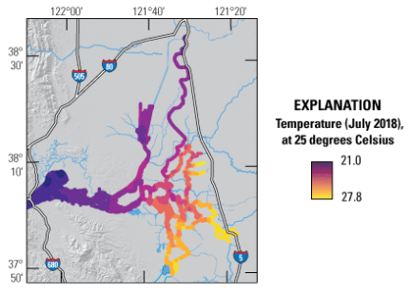
2023 and beyond…
High-resolution mapping
HOBO temperature pendants
Bergamaschi et al. 2023
Notes:
Conduct mapping with a kayak over all the channels across spring-neap tidal cycle
Deploy hobo temperature pendants across restoration sites to add spatial resolution to our already large datasets with high temporal resolution

Slide 23
Acknowledgements
CA Department of Water Resources
State Water Contractors
DWR Real-Time Data Subcommittee
DWR Tidal Habitat Restoration continuous monitoring team
Sam Bashevkin

Slide 24
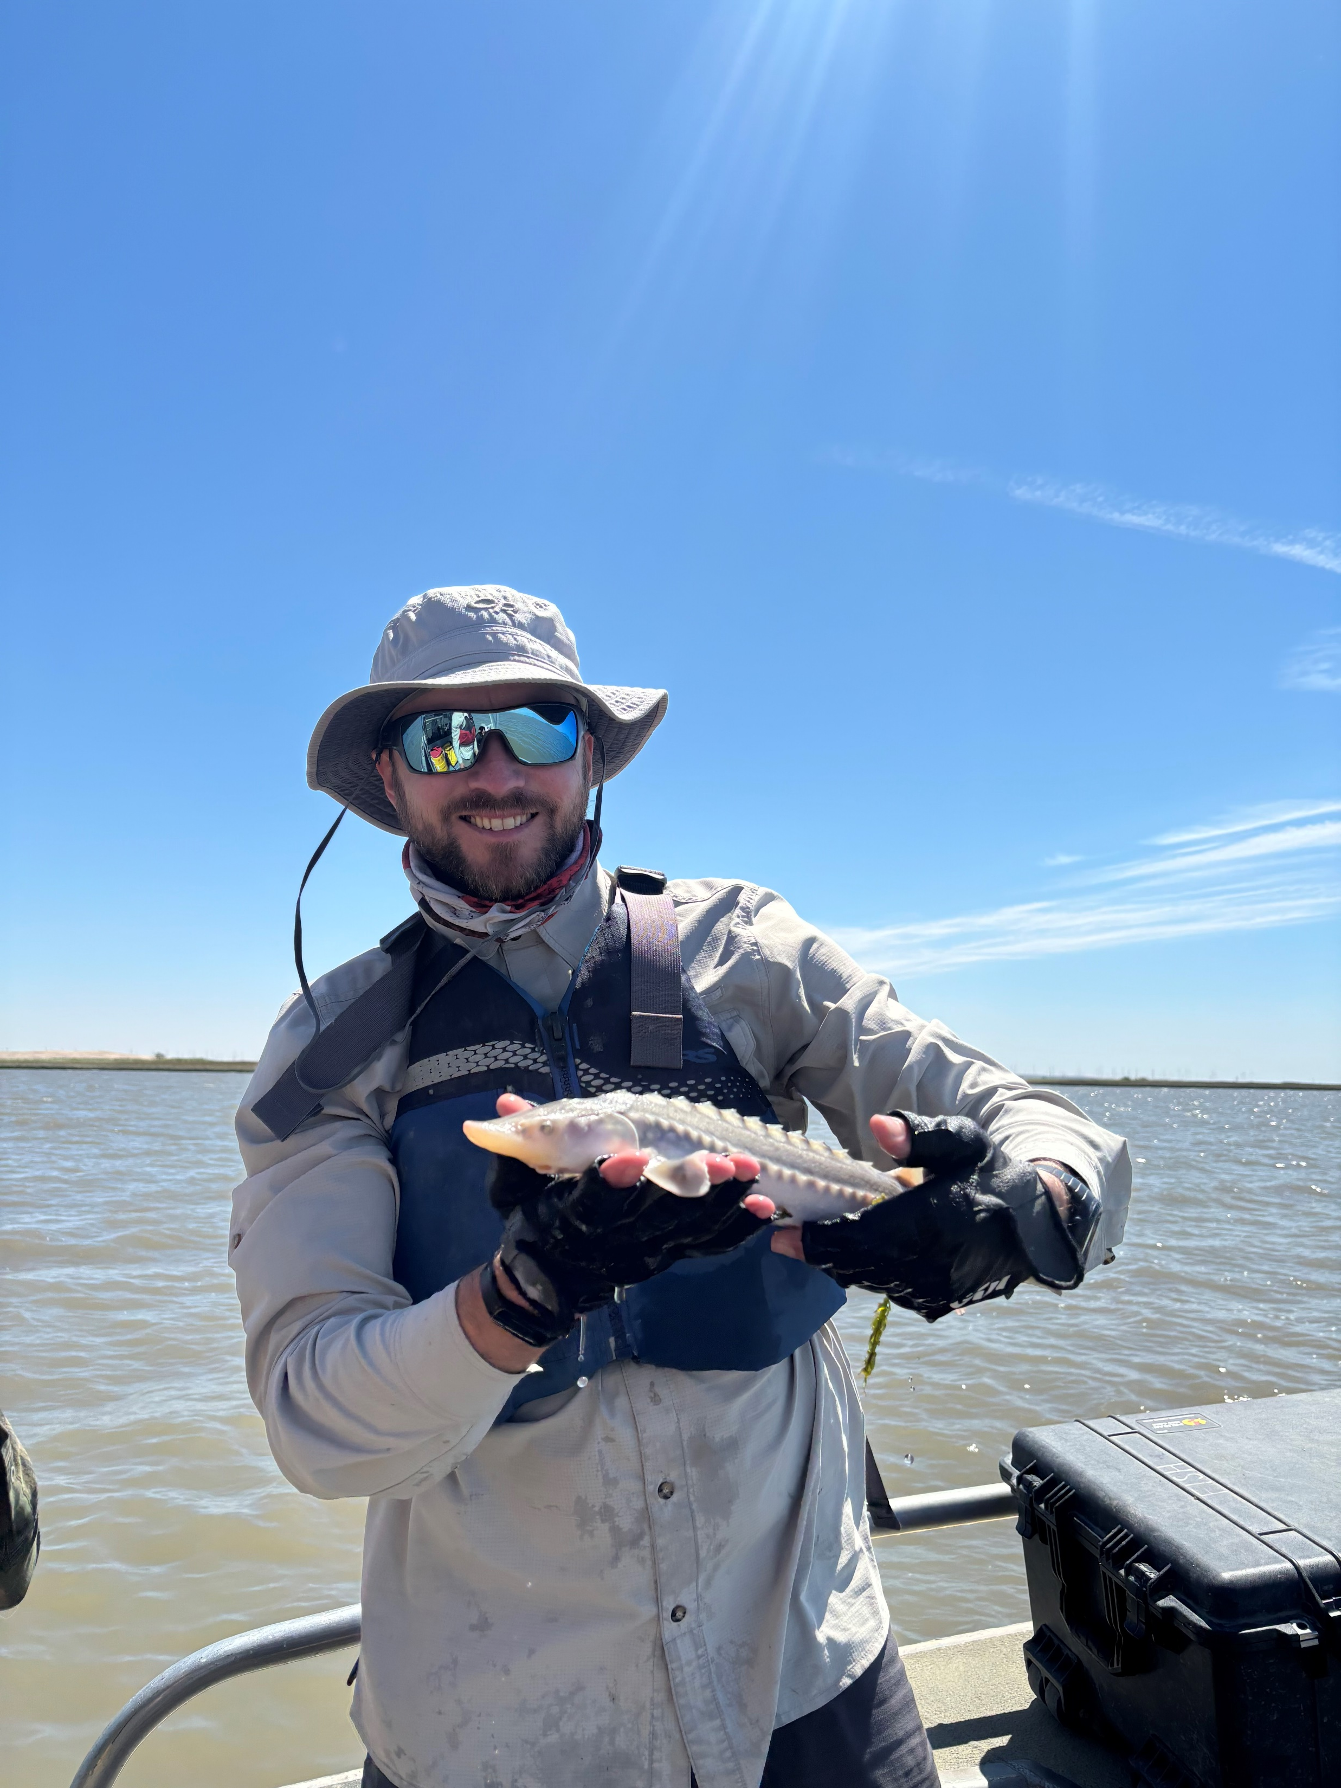
Questions?

